Slide 1

Words & Eloquent Speech
Tucker, GA

Slide 2

https://www.youtube.com/watch?v=JYDe7u6xqi8

Slide 3
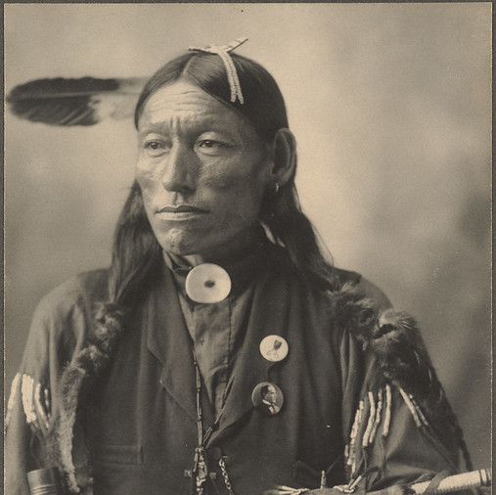
O GREAT SPIRIT
help me always to speak the truth quietly, to listen with an open mind when others speak, and to remember the peace that may be found in silence.
Cherokee Prayer

Slide 4
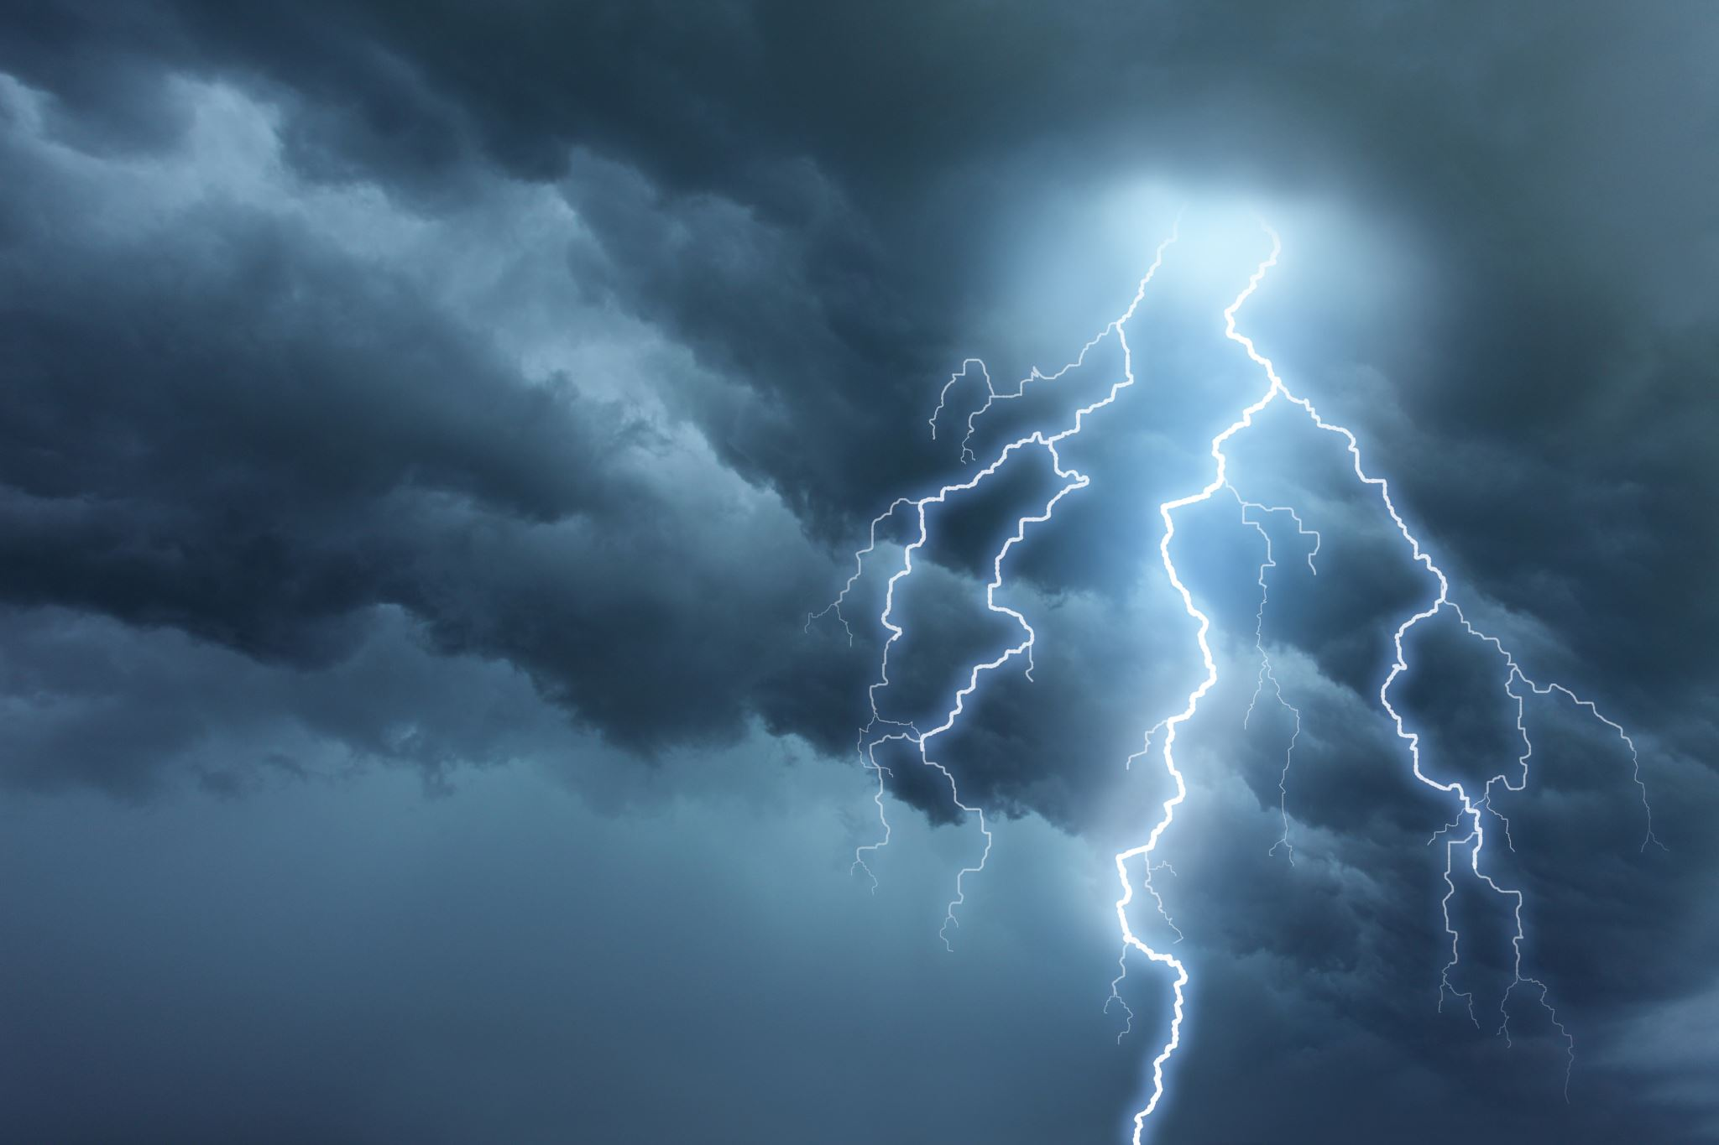
It is better to have less thunder in the mouth and more lightning in the hand.
Apache Proverb

Slide 5

When a man speaks words of truth he speaks words of greatness: know the nature of truth.
When a man knows, he can speak the truth.
He who does not know cannot speak truth; know the nature of knowledge.
Hinduism,
Chandogya Upanishad 7: 16

Slide 6
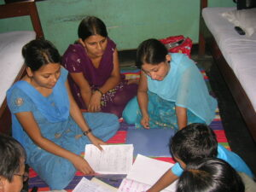
Unoffensive, truthful, agreeable and wholesome speech, and practice of study of the Vedas—these are called austerity of speech.
Hinduism,
Bhagavad Gita 17: 15

Slide 7
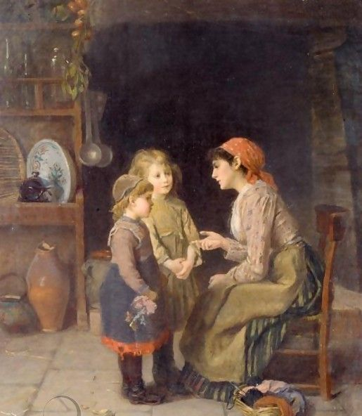
Apply thy heart unto instruction, and thine ears to the words of knowledge.
Judaism,
Misheli (Proverbs) 23: 12

Slide 8

Turn you at my reproof; behold, I will pour out my spirit unto you, I will make known my words unto you.
Judaism,
Misheli (Proverbs) 1: 23

Slide 9

Watching one’s speech, restraining well the mind, let one not commit any wrong with one’s body. Whoever keeps these three roads of action clear, will make progress on the path taught by the wise.
Buddhism,
Dhammapada 196

Slide 10
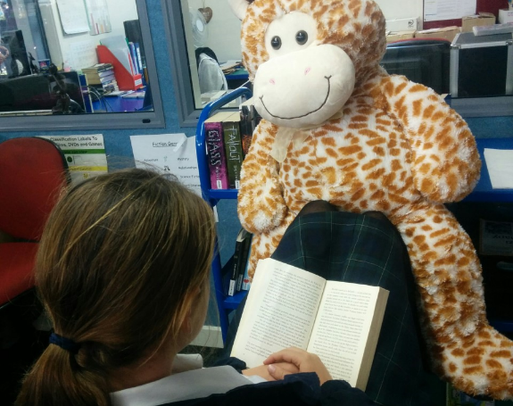
Do not speak anything harsh. Those who are spoken to will answer you. Angry talk is painful, and retaliation will touch you.
Buddhism,
Dhammapada 133

Slide 11

Express yourself completely, then keep quiet.
Be like the forces of nature:
when it blows, there is only wind;
when it rains, there is only rain;
when the clouds pass, the sun shines through.
Taoism,
Tao Te Ching, Chap 23

Slide 12

Therefore, putting away falsehood, let everyone speak the truth with his neighbor, for we are members one of another.
Christianity,
Ephesians 4: 25

Slide 13
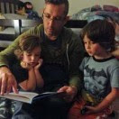
Let your speech be always with grace, seasoned with salt, that ye may know how ye ought to answer every man.
Christianity,
Colossians 4: 6

Slide 14
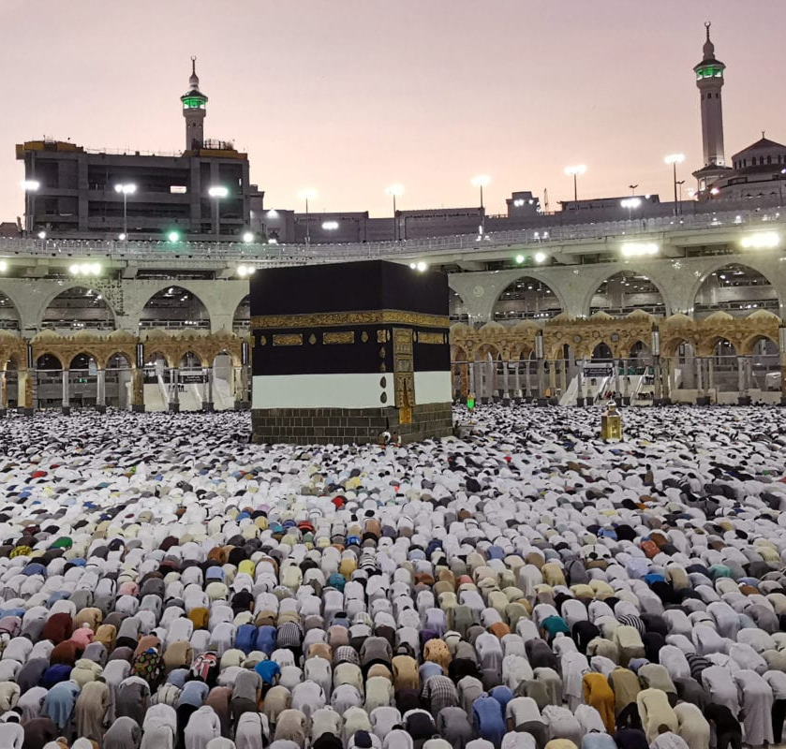
Call to the way of your Lord with wisdom and goodly exhortation, and have disputations with them in the best manner; surely your Lord best knows those who go astray from His path, and He knows best those who follow the right way.
Islam,
Qur’án 16: 125
This Photo by Unknown Author is licensed under CC BY-SA-NC

Slide 15
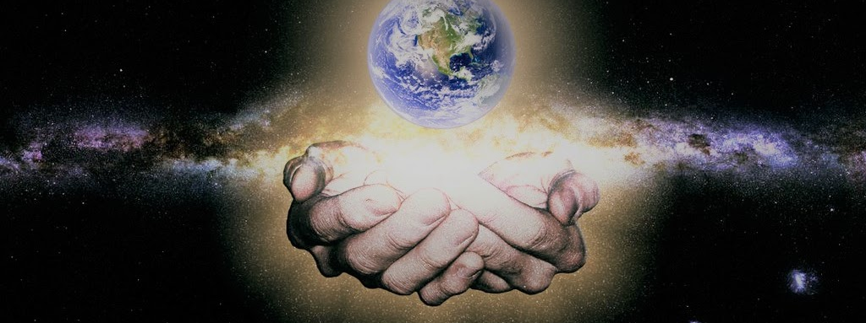
And among His Signs is the creation of the heavens and the earth, and the variations in your languages and your colours: verily in that are Signs for those who know.
Islam, Qur’án 30: 22

Slide 16

Good speech and truthfulness are, in loftiness of position and rank, like unto the sun which hath risen from the horizon of the heaven of knowledge.
Bahá’i, Bahá’u’lláh,
Tablets of Bahá’u’lláh, p. 12

Slide 17
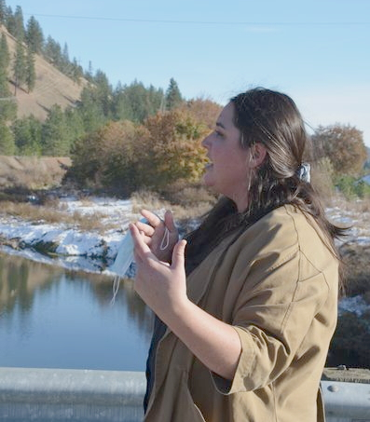
No man of wisdom can demonstrate his knowledge save by means of words. This showeth the significance of the Word as is affirmed in all the Scriptures, whether of former times or more recently. For it is through its potency and animating spirit that the people of the world have attained so eminent a position...
Bahá’i, Bahá’u’lláh,
Tablets of Bahá’u’lláh, p. 172

Slide 18
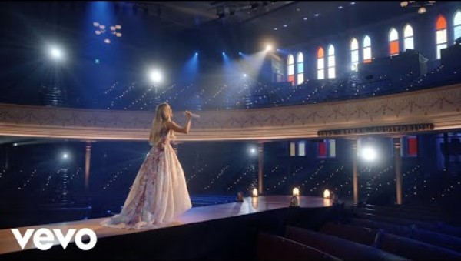
https://www.youtube.com/watch?v=Yf6C0L_7-CA

Slide 19

https://www.youtube.com/watch?v=MwkGWkIPtuQ

