Slide 1

Humility
Tucker, GA

Slide 2

https://www.youtube.com/watch?v=5TXt7E8bhFU&t=1s

Slide 3
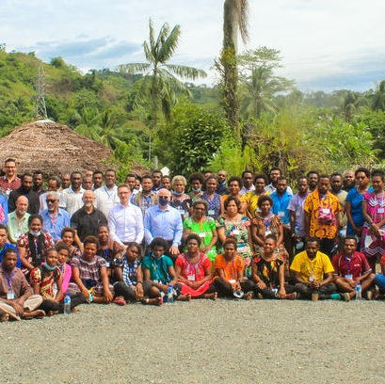
Speak truth in humility to all people.
Only then can you be a true man.
Sioux Proverb

Slide 4
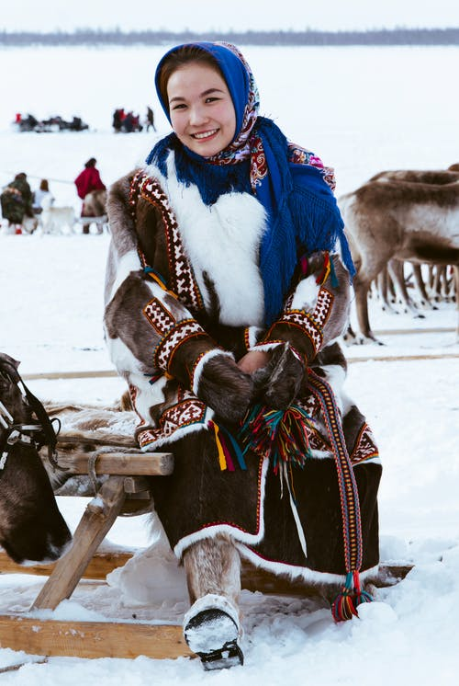
I have seen that in any great undertaking it is not enough for a man to depend simply upon himself.
Lone Man (Isna-la-wica),
Teton Sioux

Slide 5
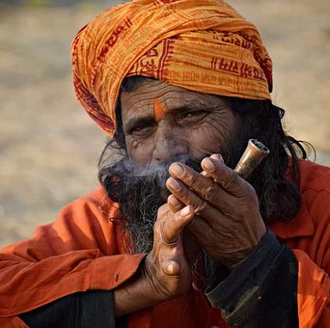
Be humble, be harmless,
Have no pretension,
Be upright, forbearing;
Serve your teacher in true obedience,
Keeping the mind and body in cleanness,
Tranquil, steadfast, master of ego,
Standing apart from the things of the senses,
Free from self;
Aware of the weakness in mortal nature.
Hinduism, Bhagavad Gita 13.7-8

Slide 6
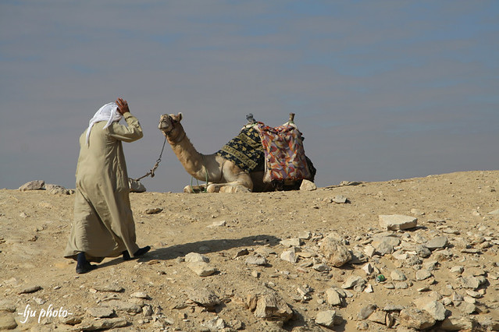
And the man Moses was very humble, more than any other men which were upon the face of the earth.
Judaism, Numbers 12:3

Slide 7
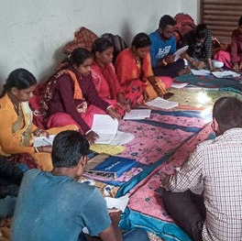
The fear of the Lord is instruction in wisdom; and humility is before honor.
Judaism,
Misheli (Proverbs) 15:33

Slide 8

Before destruction the heart of a man is haughty, and before honour goeth humility.
Judaism,
Misheli (Proverbs) 18: 12
This Photo by Unknown Author is licensed under CC BY-SA

Slide 9
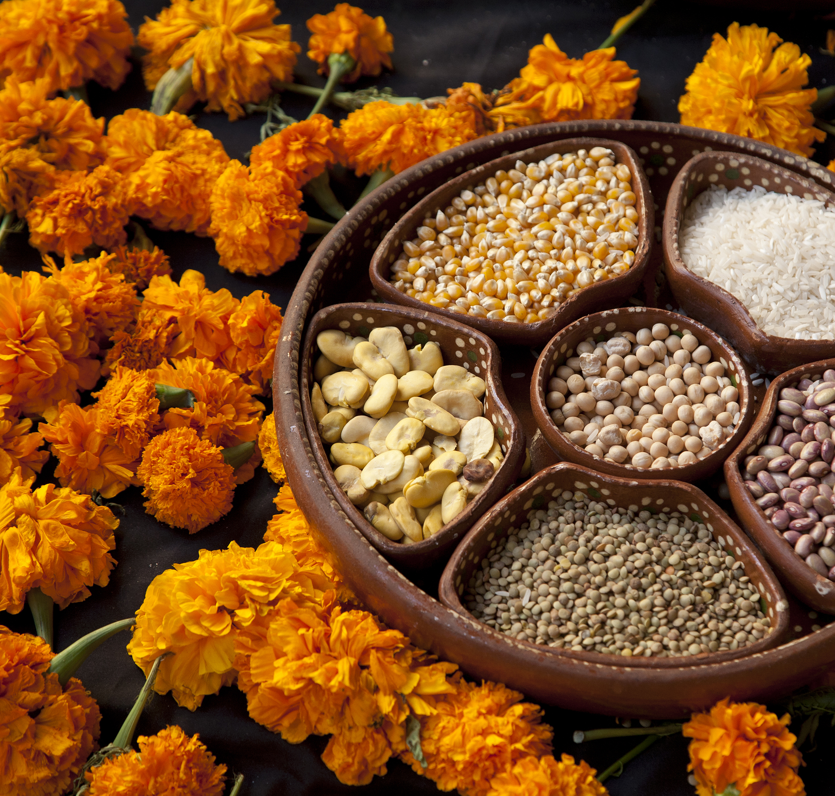
Men are born soft and supple; dead, they are stiff and hard.
Plants are born tender and pliant; dead, they are brittle and dry.
Thus whoever is stiff and inflexible is a disciple of death.
Whoever is soft and yielding is a disciple of life.
Taoism,
Tao Te Ching, Chapter 76

Slide 10

Nothing in the world is as soft and yielding as water. Yet for dissolving the hard and inflexible, nothing can surpass it. The soft overcomes the hard; the gentle overcomes the rigid. Everyone knows this is true, but few can put it into practice.
Taoism,
Tao Te Ching, Chapter 78

Slide 11

Do nothing from selfishness or conceit, but in humility count others better than yourselves. Let each of you look not only to his own interests, but also to the interests of others.
Christianity,
Philippians 2: 3-4

Slide 12

Take care! Don‘t do your good deeds publicly, to be admired, because then you will lose the reward from your Father in heaven.
Christianity,
Matthew 6: 1

Slide 13

Do you enjoined others to do what is good and forget your ownselves, while you read the book? Will you not then understand? And seek help with patience and prayer, and this indeed is hard except for the humble in spirit, Who know for certain that they will meet their Lord, and to HIM will they return.
Islam,
Qur’án 2: 45-47

Slide 14

The servants of the All-beneficent are those who walk humbly on the earth, and when the ignorant address them, say, ‘Peace!’
Islam,
Qur’án 25: 63

Slide 15

O My servants! Be as resigned and submissive as the earth, that from the soil of your being there may blossom the fragrant, the holy and multicolored hyacinths of My knowledge.
Bahá’i, Bahá’u’lláh,
Gleanings, p. 322

Slide 16
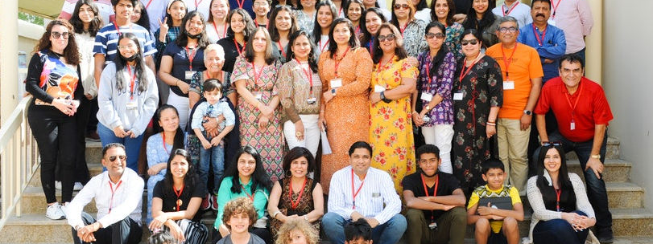
They who are the beloved of God, in whatever place they gather and whomsoever they may meet, must evince, in their attitude towards God, and in the manner of their celebration of His praise and glory, such humility and submissiveness that every atom of the dust beneath their feet may attest the depth of their devotion.
Bahá’i, Bahá’u’lláh, Gleanings, p. 7

Slide 17

https://www.youtube.com/watch?v=awzNHuGqoMc

Slide 18

https://www.youtube.com/watch?v=W-D4PWrRmDg

