Slide 1
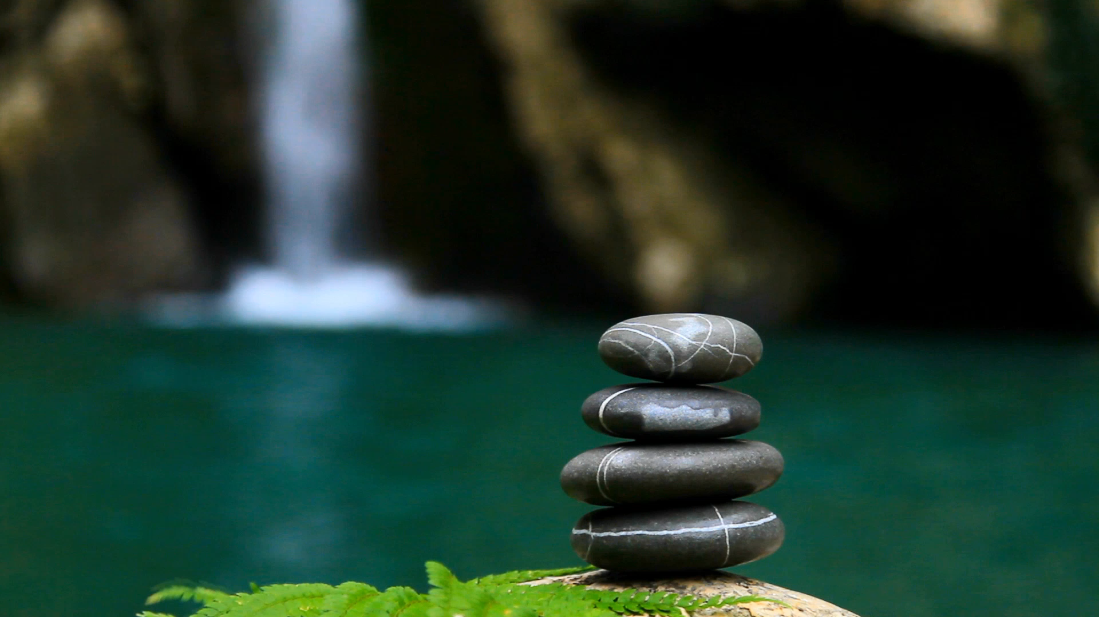
Body & Physical Existence
Tucker, GA

Slide 2
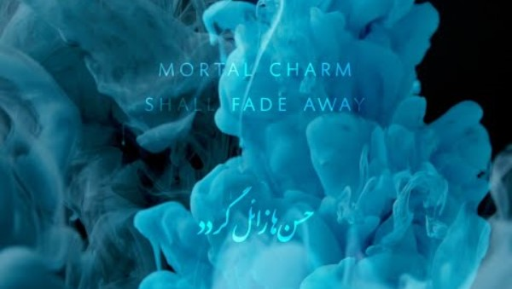
https://www.youtube.com/watch?v=N4K_m02qTRI

Slide 3
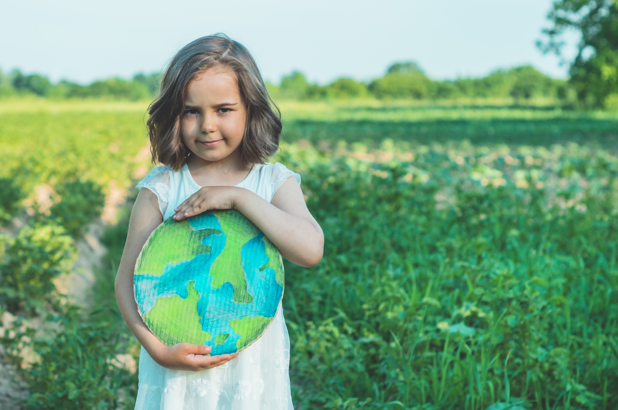
Will you teach your children what we have taught our children? That the earth is our mother? What befalls the earth befalls all the sons of the earth.
American Indigenous Religions, Chief Seattle (Suquamish)

Slide 4
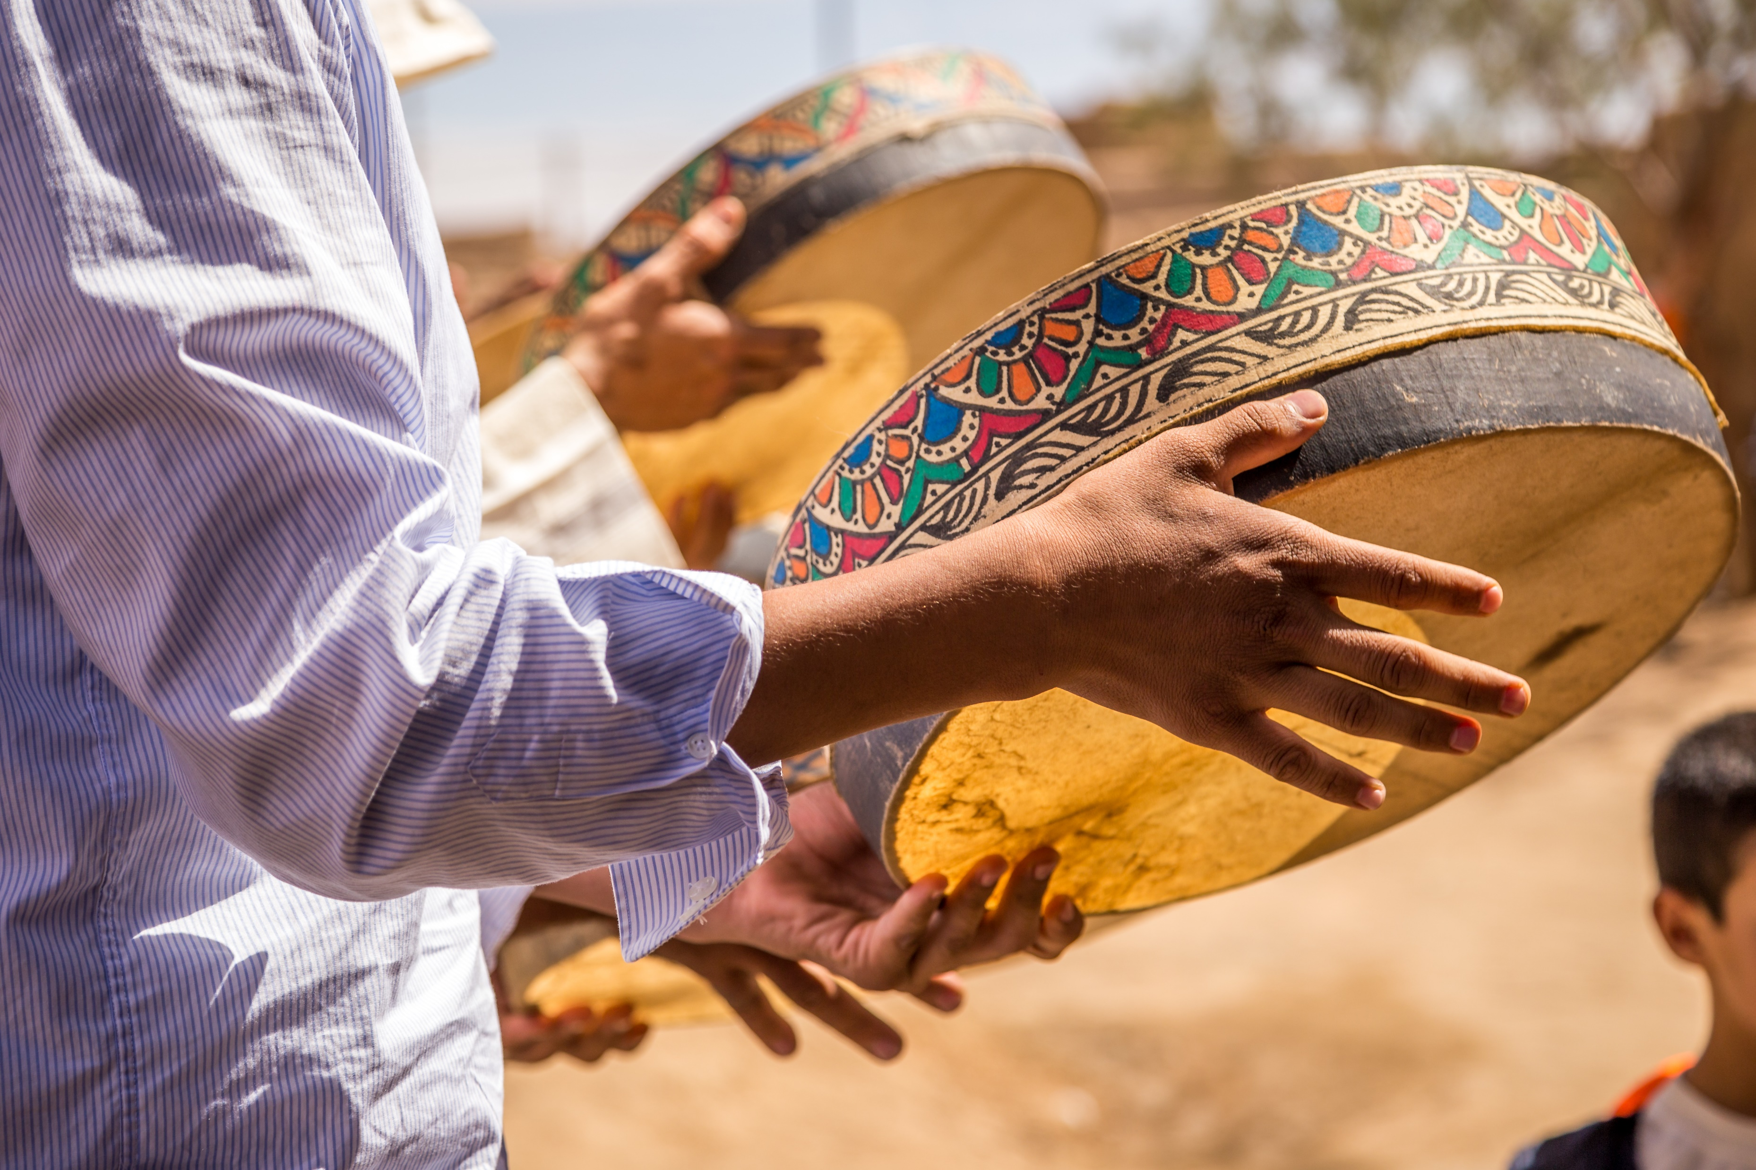
I can lose my hands and still live. I can lose my legs and still live. I can lose my eyes and still live...But if I lose the air I die. If I lose the sun I die. If I lose the earth I die. If I lose the water I die. If I lose the plants and animals I die. All of these things are more a part of me, more essential to my every breath, than is my so-called body. What is my real body?
American Indigenous Religions,
Jack Forbes, A World Ruled by Cannibals, p. 145

Slide 5
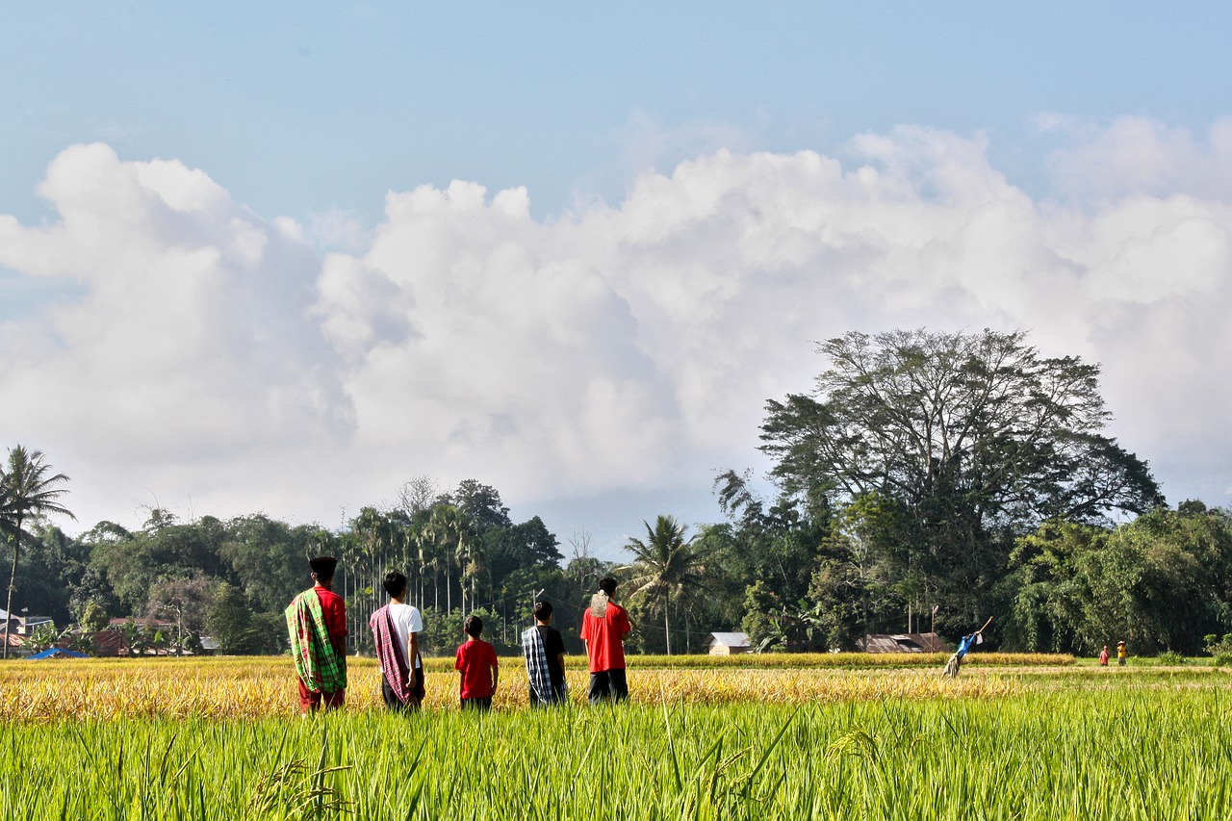
This body is mortal, always gripped by death, but within it dwells the immortal Self. This Self, when associated in our consciousness with the body, is subject to pleasure and pain; and so long as this association continues, freedom from pleasure and pain can no man find.
Hinduism, Chandogya Upanishad 8.12: 1

Slide 6
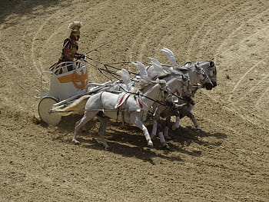
Know that the Self is the rider, and the body the chariot; that the intellect is the charioteer, and the mind the reins. The senses, say the wise, are the horses; the roads they travel are the mazes of desire....
Hinduism,
Katha Upanishad 1.3: 3

Slide 7
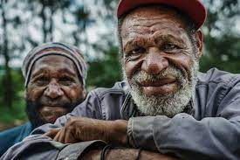
This body is wearing out, a nest of diseases and frail; this heap of corruption falls apart; life ends in death.
Buddhism,
Dhammapada 108

Slide 8
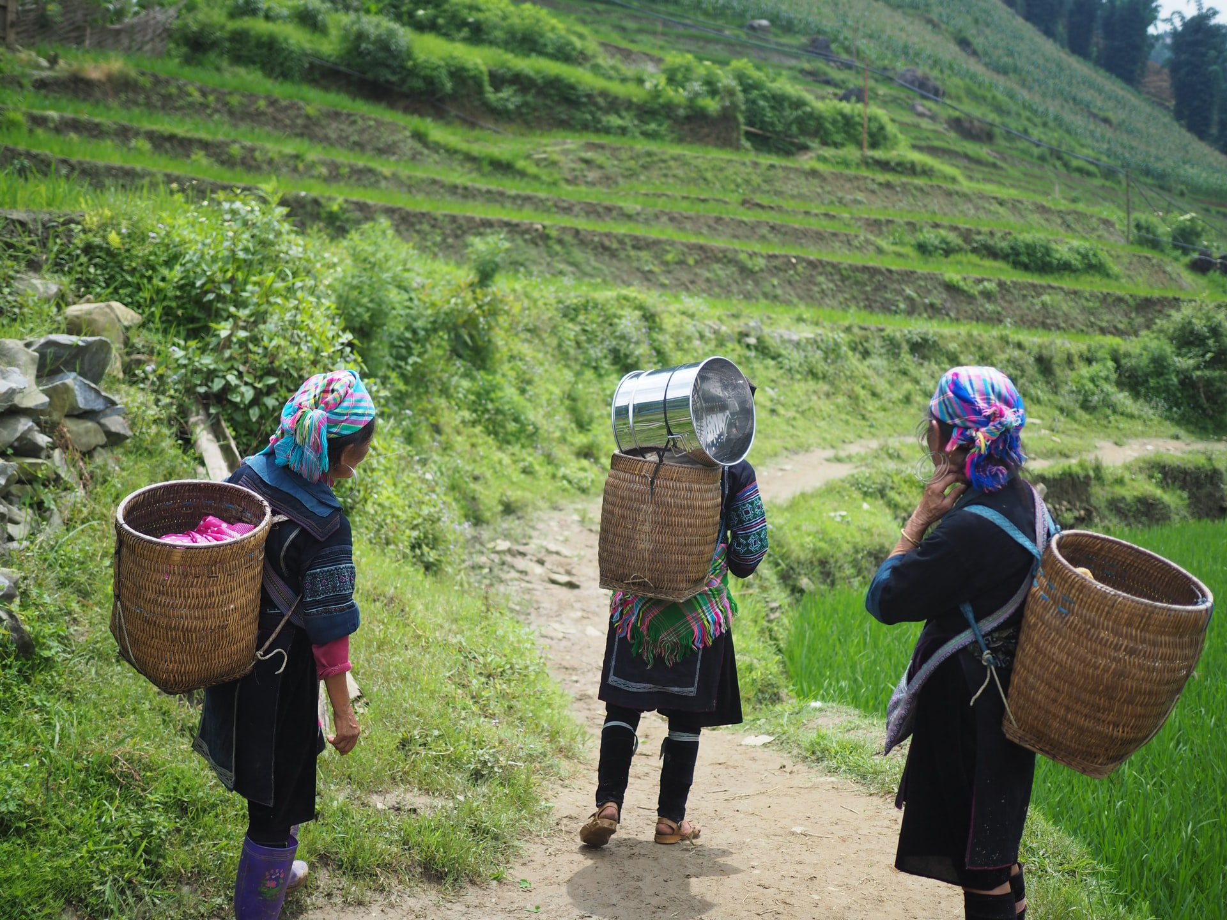
The glorious chariots of the kings wear out; the body also comes to old age; but the virtue of good people never ages; thus the good teach each other.
Buddhism,
Dhammapada 110

Slide 9
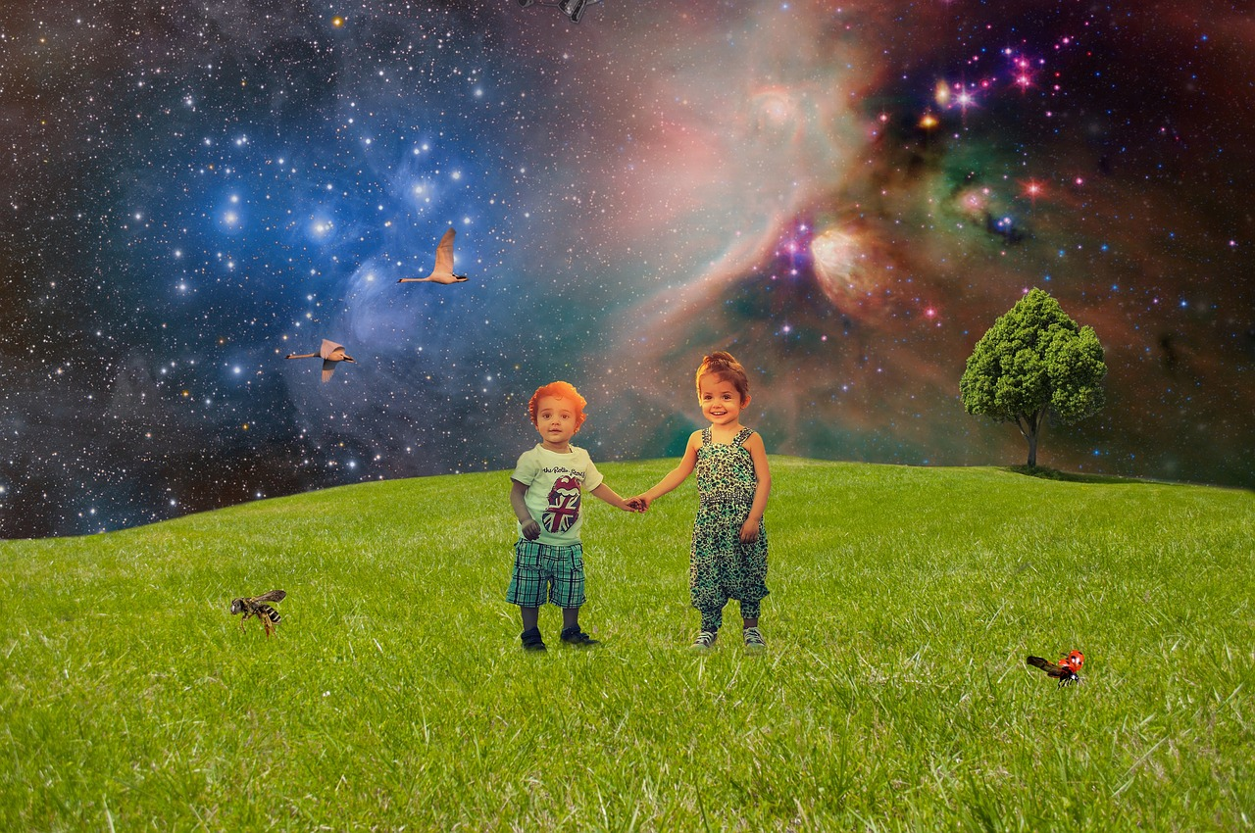
Do you not know that you are God‘s temple and that God‘s Spirit dwells in you?
Christianity,
I Corinthians 3: 16

Slide 10

So, whether you eat or drink, or whatever you do, do all to the glory of God.
Christianity,
I Corinthians 10: 31

Slide 11
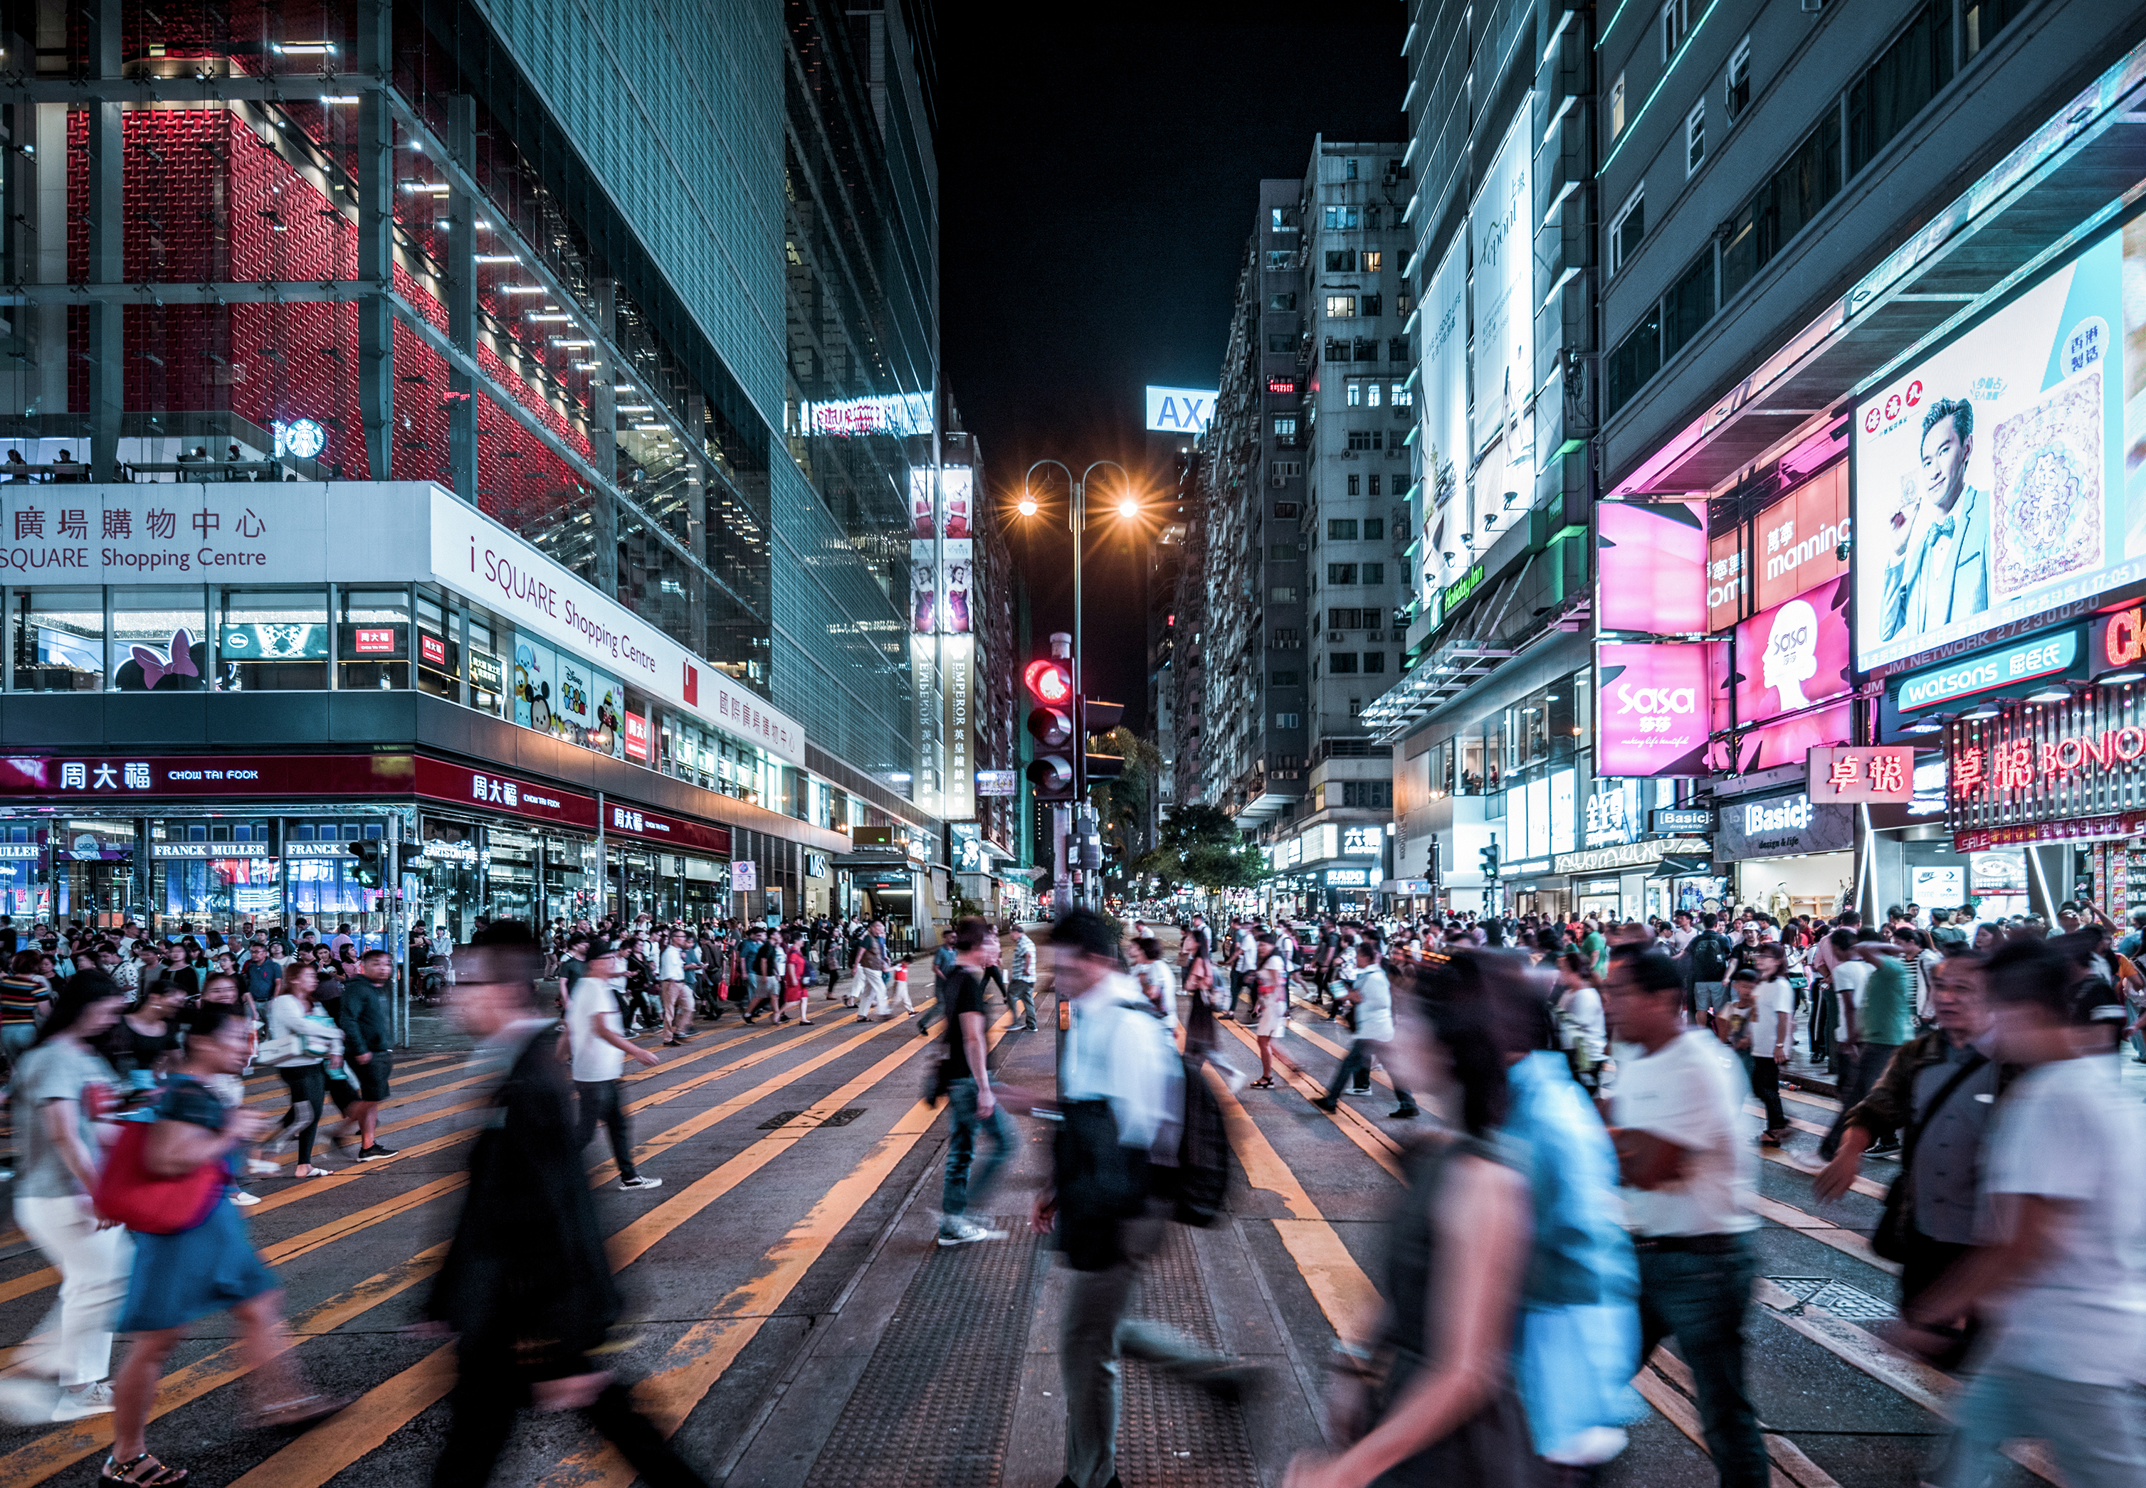
The life of this world is made to appear attractive to those who disbelieve; and they scoff at those who believe. But those who fear God shall be above them on the day of Resurrection; and ALLAH bestows HIS gifts on whomsoever HE pleases without reckoning.
Islam,
Qur’án 2: 213

Slide 12
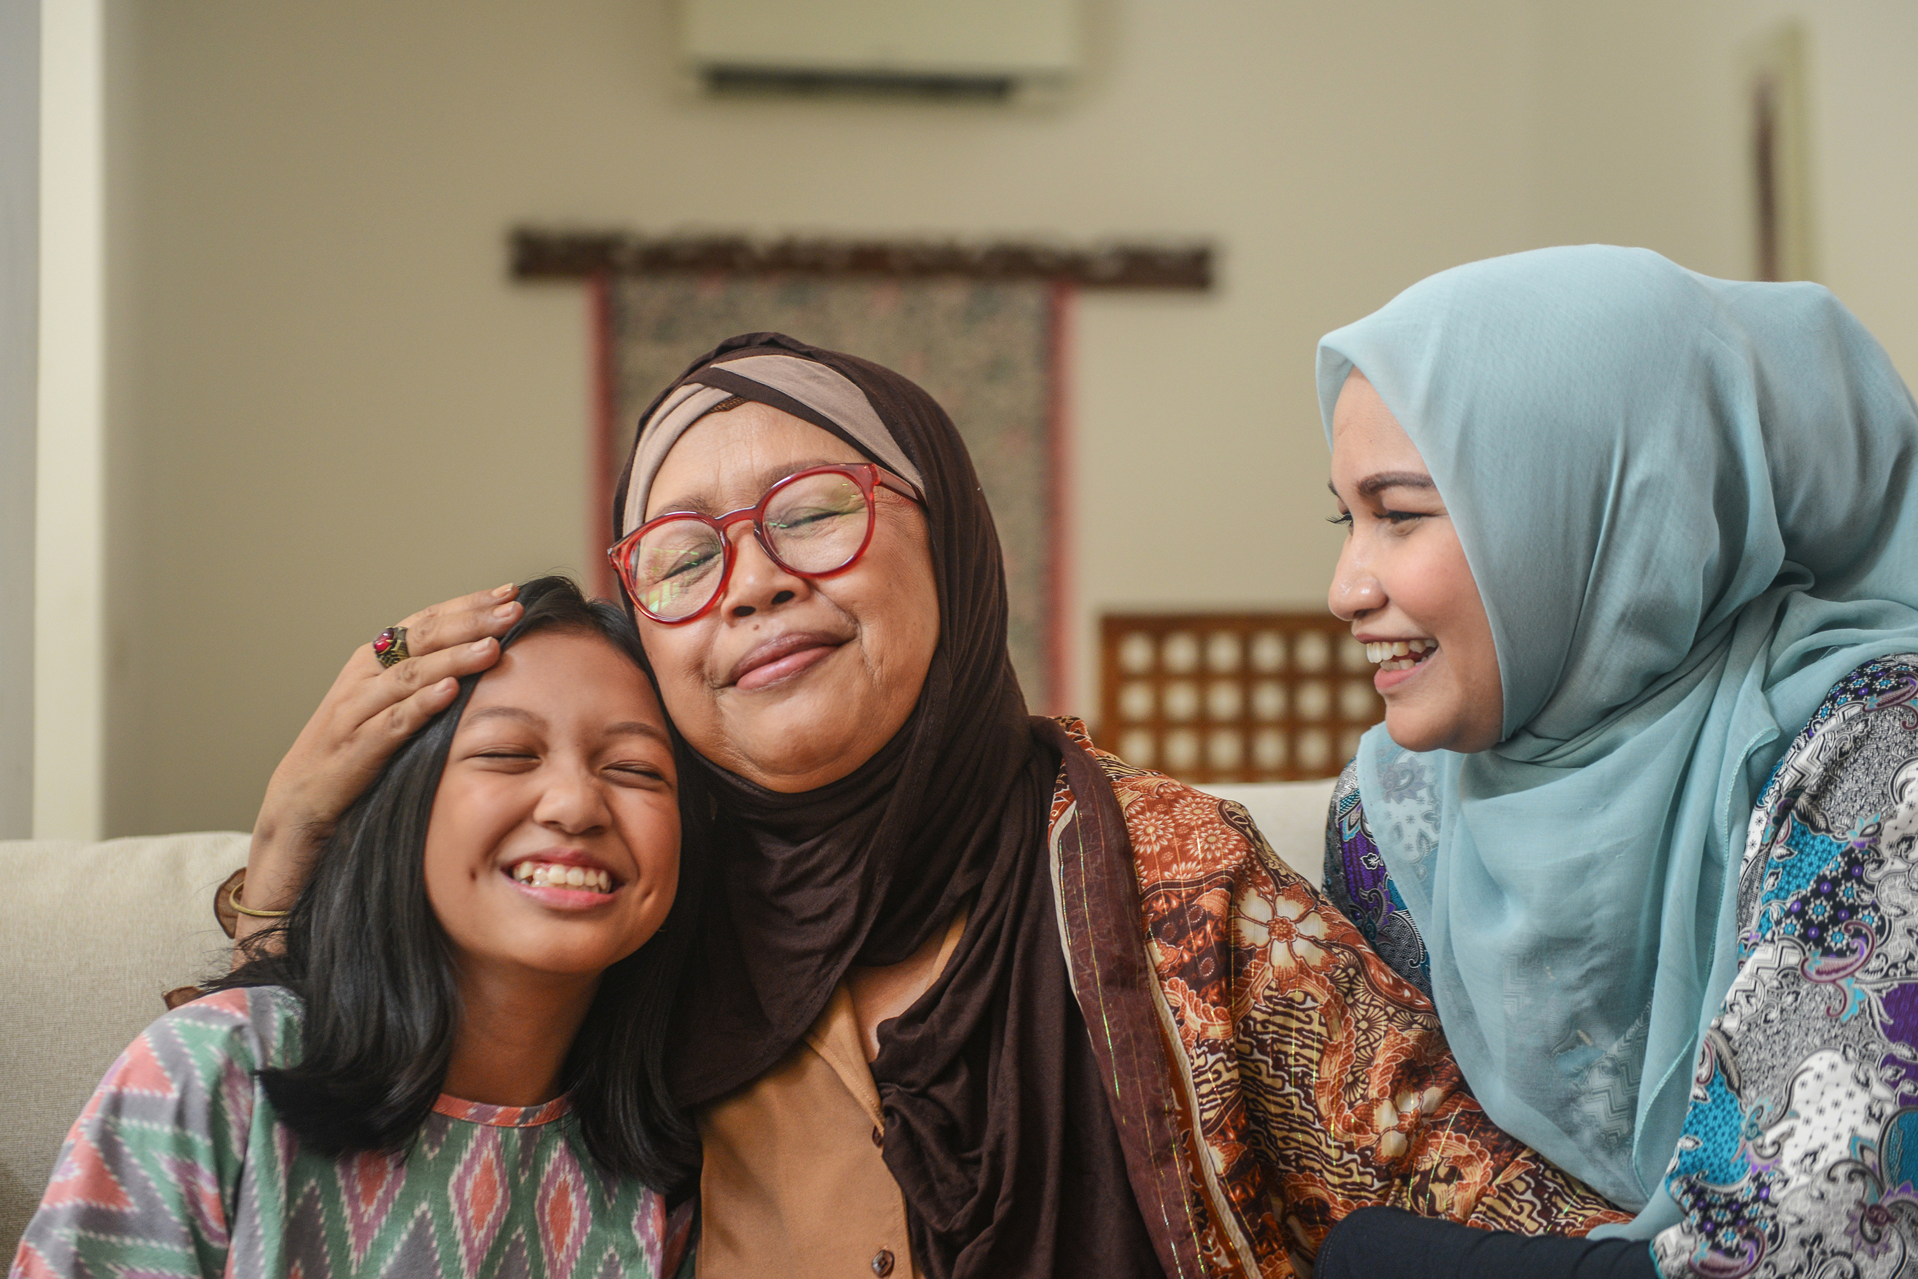
For Allah loves those who turn to Him constantly and He loves those who keep themselves pure and clean.
Islam,
Qur’án 2: 222

Slide 13

If the health and well-being of the body be expended in the path of the Kingdom, this is very acceptable and praiseworthy; and if it is expended to the benefit of the human world in general--even though it be to their material benefit and be a means of doing good--that is also acceptable.
Bahá’i, ‘Abdu’l-Bahá,
Bahá’í World Faith, p. 376

Slide 14
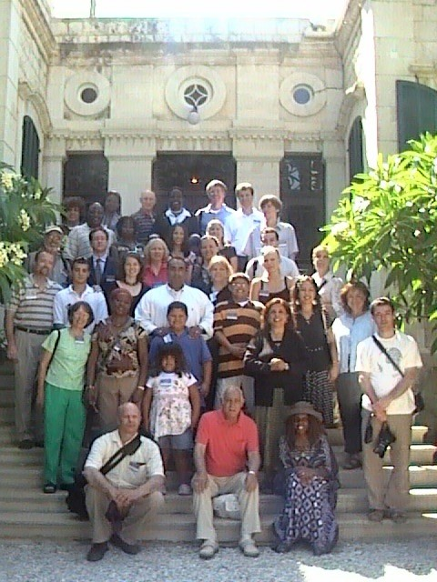
Man is the temple of God. He is not a human temple. If you destroy a house, the owner of that house will be grieved and wrathful. How much greater is the wrong when man destroys a building planned and erected by God!
Undoubtedly, he deserves the judgment and wrath of God.
Bahá’i, ‘Abdu’l-Bahá,
Promulgation of Universal Peace, p. 352

Slide 15
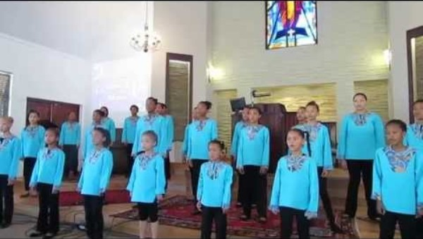
https://www.youtube.com/watch?v=4FuurRAJkZY

Slide 16
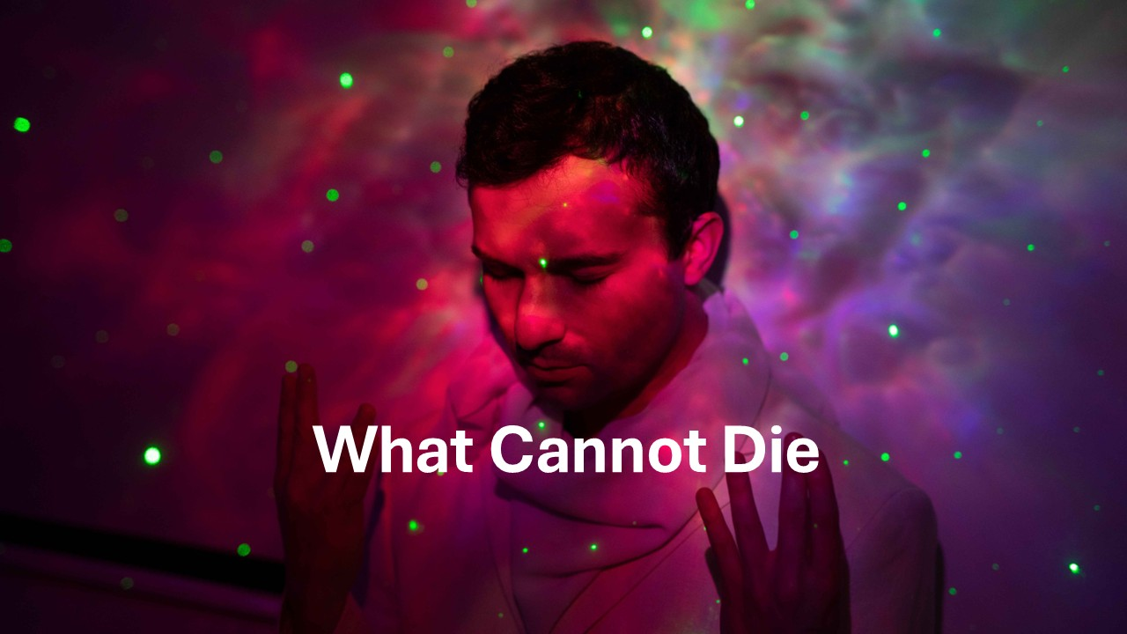
https://www.youtube.com/watch?v=ixS_qWiaZDE

