Slide 1

Patience & Calm
Tucker, GA

Slide 2


Slide 3

You who are the servants of God fight against oppression, hate and discord. .. Only have faith, patience and courage--this is but the beginning, but surely you will succeed, for God is with you!
'Abdu'l-Bahá
Paris Talks, p. 101

Slide 4
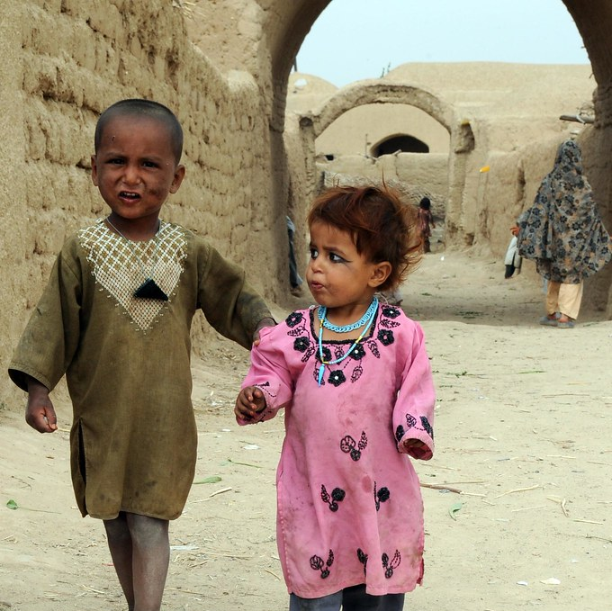
O SON OF MAN!
For everything there is a sign. The sign of love is fortitude under My decree and patience under My trials.
Bahá'u'lláh
Hidden Words, Arabic #48

Slide 5
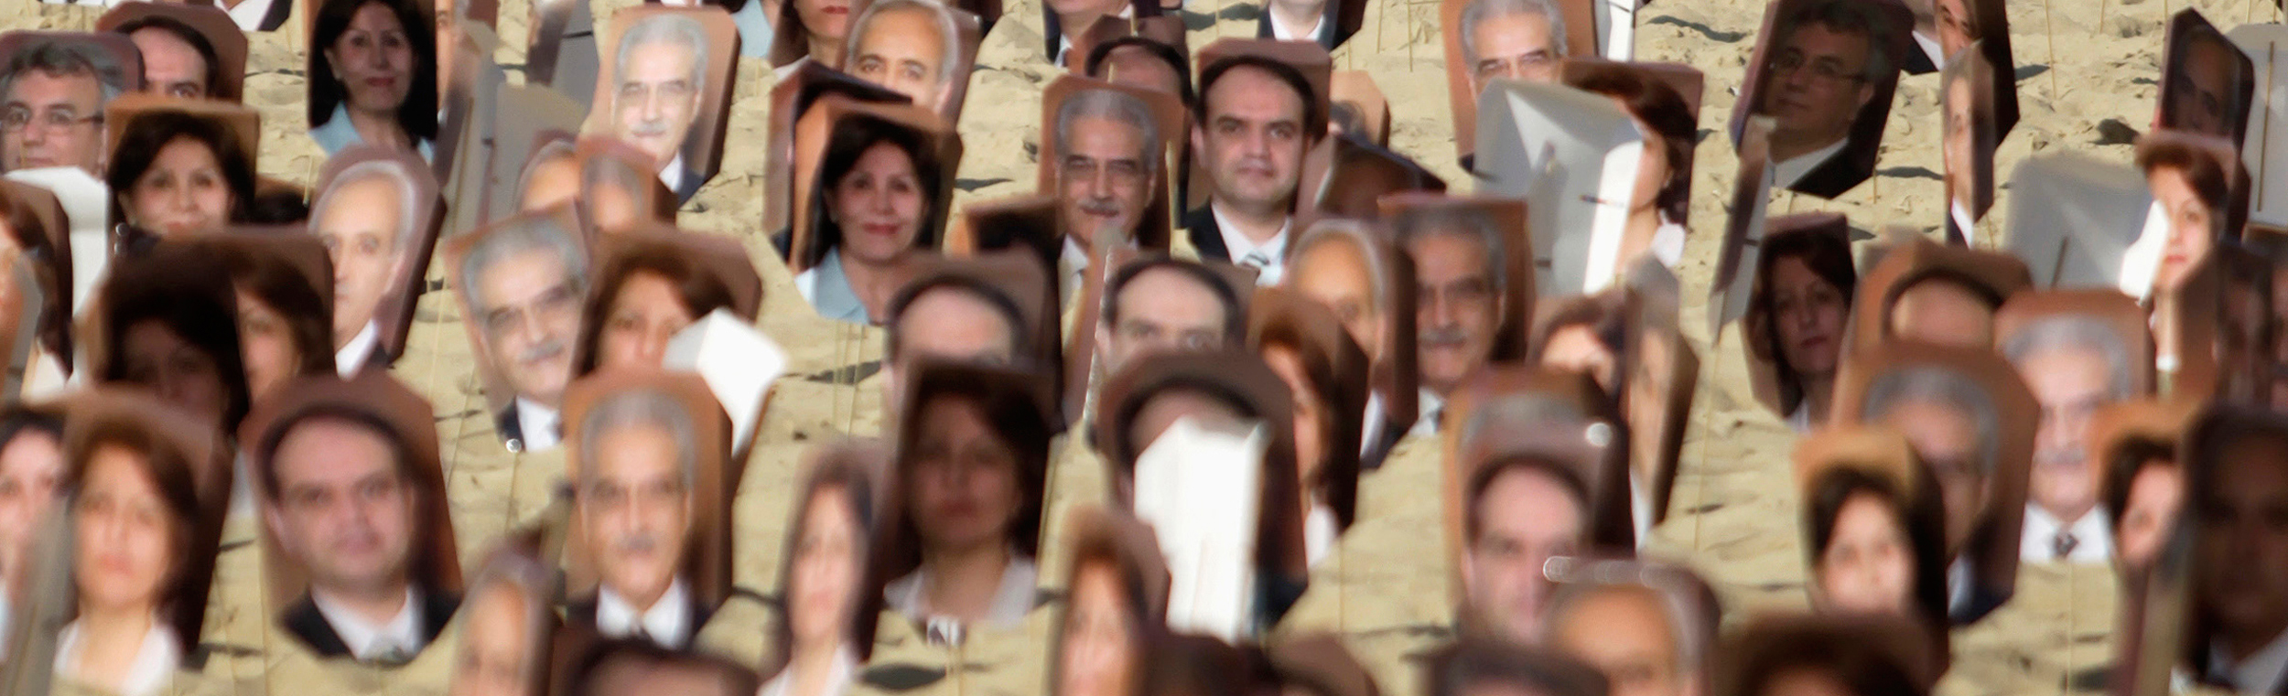
...God, verily, loveth those women and men who show forth patience. Obey ye My commandments, and follow not the ungodly, they who have been reckoned as sinners in God's Holy Tablet.
Bahá'u'lláh
The Kitáb-i-Áqdás, p. 43

Slide 6

It behoveth whosoever hath set his face towards the Most Sublime Horizon to cleave tenaciously unto the cord of patience, and to put his reliance in God, the Help in Peril, the Unconstrained.
Bahá'u'lláh
Tablets of Bahá’u’lláh, p. 212

Slide 7
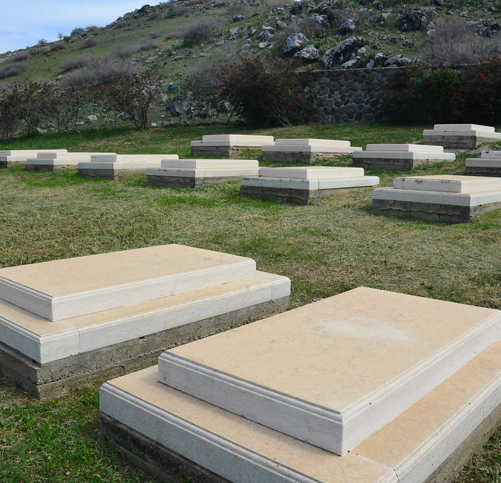
Say, this earthly life shall come to an end, and everyone shall expire and return unto my Lord God Who will reward with the choicest gifts the deeds of those who endure with patience. Verily thy God assigneth the measure of all created things as He willeth, by virtue of His behest; and those who conform to the good-pleasure of your Lord, they are indeed among the blissful.
The Báb
Selections from the Báb, p. 161

Slide 8

Therefore, thou must widen thy heart, dilate thy breast, have patience in plenty, calmness of soul and cut thyself from everything but God!
'Abdu'l-Bahá
Bahá’í World Faith, p. 363

Slide 9

Therefore, we must exercise extreme patience, sympathy and love toward all mankind, considering no soul as rejected. If we look upon a soul as rejected, we have disobeyed the teachings of God. God is loving to all. Shall we be unjust or unkind to anyone? Is this allowable in the sight of God? God provides for all. Is it befitting for us to prevent the flow of His merciful provisions for mankind?
'Abdu'l-Bahá
Promulgation of Universal Peace,
pp. 286-287

Slide 10

You should exhort all the friends to patience, to acquiescence, and to tranquillity, saying: O ye loved ones of God in that land! Ye are glorified in all the worlds of God because of your relationship to Him Who is the Eternal Truth, but in your lives on this earthly plane, which pass away as a fleeting moment, ye are afflicted with abasement…. Whatever hath befallen you, hath been for the sake of God.
Bahá’u’lláh
Compilation of Compilations,
Vol I, p. 171

Slide 11
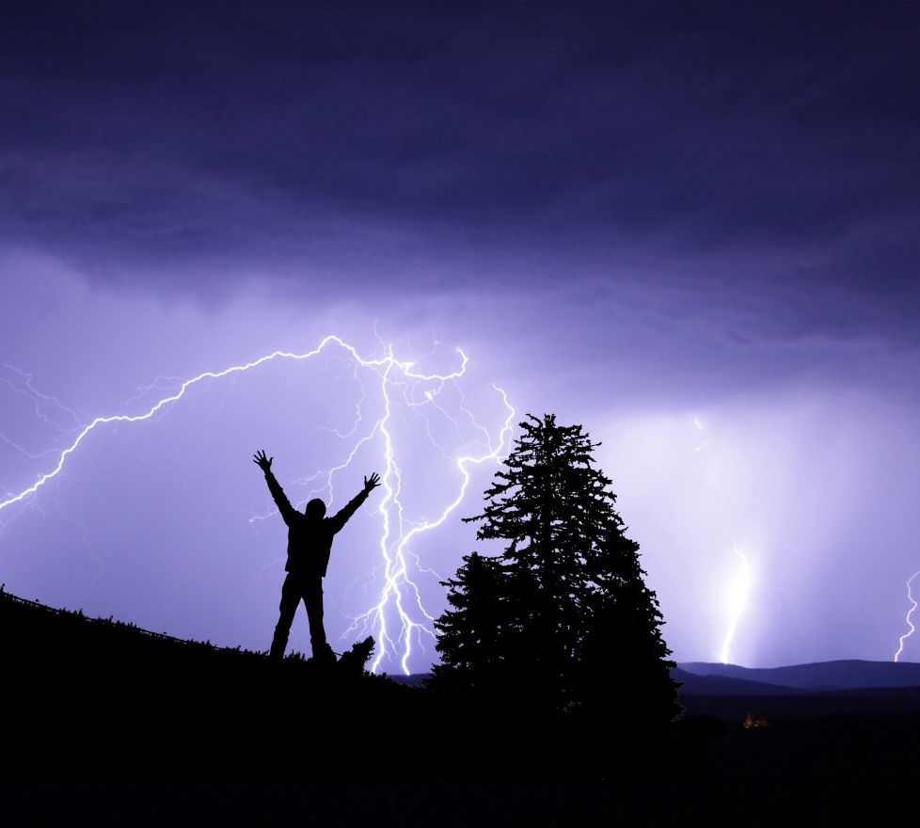
Be patient under all conditions, and place your whole trust and confidence in God.
Bahá’u’lláh
Gleanings, p. 296

Slide 12

...the stages that mark the wayfarers’ journey from their mortal abode to the heavenly homeland are said to be seven.
The first is the Valley of Search. The steed of this valley is patience; without patience the wayfarer on this journey will reach nowhere and attain no goal. Nor should he ever become downhearted: If he strive for a hundred thousand years and yet fail to behold the beauty of the Friend, he should not falter.
Bahá’u’lláh
The Call of the Divine Beloved, 2.6-7

Slide 13

It behoveth whosoever hath set his face towards the Most Sublime Horizon to cleave tenaciously unto the cord of patience, and to put his reliance in God, the Help in Peril, the Unconstrained.
Bahá’u’lláh
Tablets of Bahá’u’lláh, p. 212

Slide 14
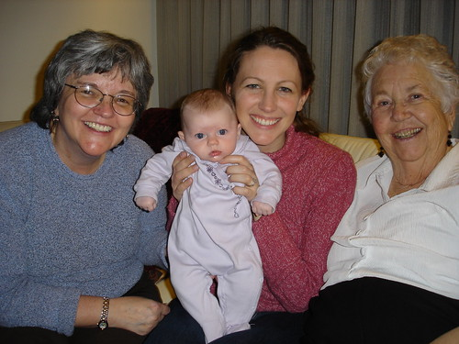
Say, this earthly life shall come to an end, and everyone shall expire and return unto my Lord God Who will reward with the choicest gifts the deeds of those who endure with patience. Verily thy God assigneth the measure of all created things as He willeth, by virtue of His behest; and those who conform to the good-pleasure of your Lord, they are indeed among the blissful.
The Báb
Selections from the Báb, p. 161

Slide 15

O My servants! Be as resigned and submissive as the earth, that from the soil of your being there may blossom the fragrant, the holy and multicolored hyacinths of My knowledge.
Bahá'u'lláh
Gleanings, p. 322

Slide 16

https://www.youtube.com/watch?v=Aq9ZSIIGrr8

Slide 17

https://www.youtube.com/watch?v=_Hiiailn5mc

