Slide 1
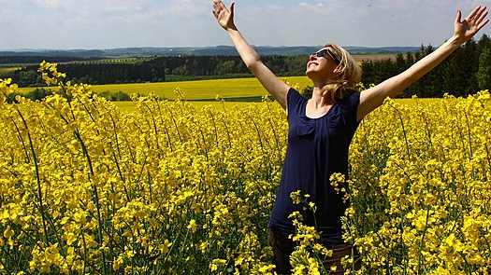
Gratitude & Thankfulness
Tucker, GA

Slide 2

https://www.youtube.com/watch?v=SSWV0Fayqj4

Slide 3

O SON OF HIM THAT STOOD BY HIS OWN ENTITY IN THE KINGDOM OF HIS SELF! Know thou, that I have wafted unto thee all the fragrances of holiness, have fully revealed to thee My word, have perfected through thee My bounty and have desired for thee that which I have desired for My Self. Be then content with My pleasure and thankful unto Me.
Bahá'u'lláh
Hidden Words, Arabic #70

Slide 4

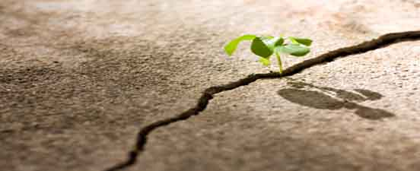
Be generous in prosperity, and thankful in adversity.
Bahá’u’lláh
Epistle to the Son of the Wolf,
pp. 93-94

Slide 5
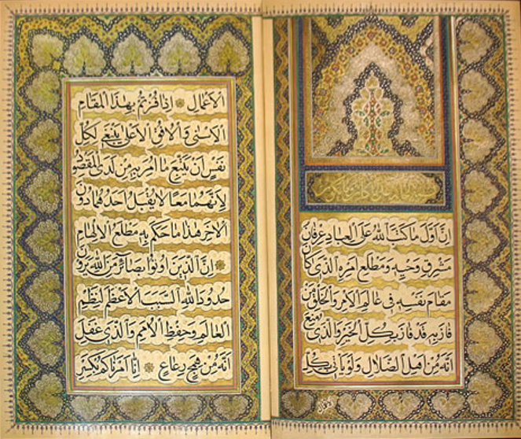
Be thankful unto God that Baha'u'llah has given us a firm and solid foundation. He left no place for sadness in hearts, and the writings of His sacred pen contain consolation for the whole world. He had the words of truth, and anything that is contrary to His teaching is false.
'Abdu'l-Bahá
Paris Talks, p.172

Slide 6
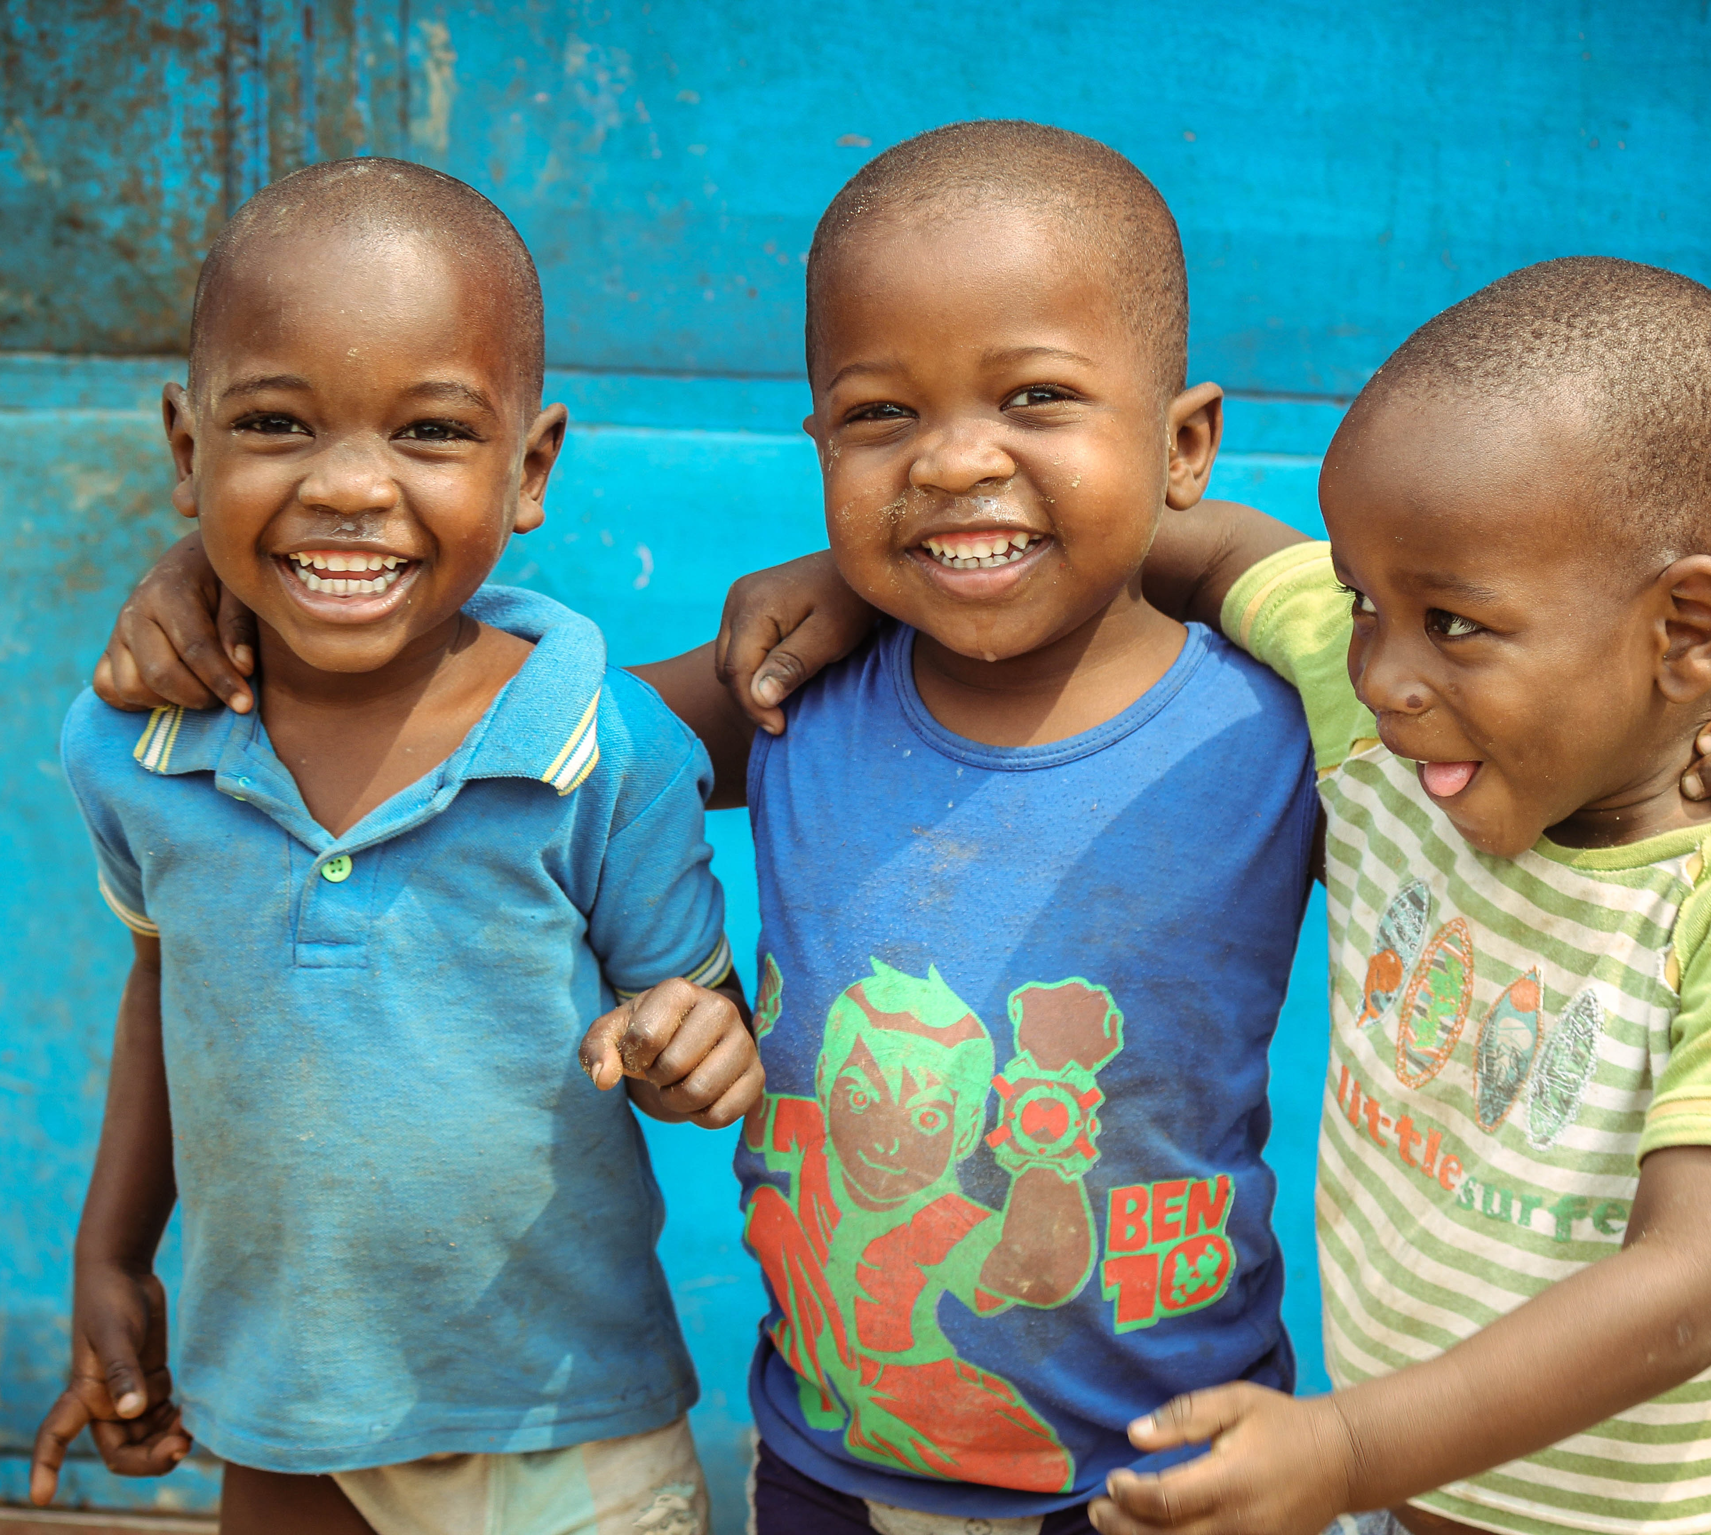
You should all be very happy and thankful to God for the great privilege that is yours.
'Abdu'l-Bahá
Paris Talks, p.112

Slide 7

But real thankfulness is a cordial giving of thanks from the heart. When man in response to the favors of God manifests susceptibilities of conscience, the heart is happy, the spirit is exhilarated. These spiritual susceptibilities are ideal thanksgiving.
‘Abdu’l-Bahá
Promulgation of Universal Peace, p. 236

Slide 8
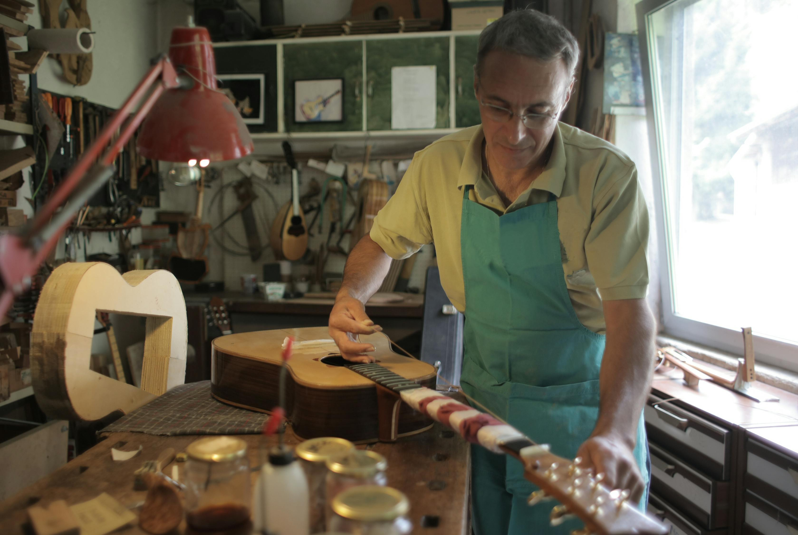
It behooveth the craftsmen of the world at each moment to offer a thousand tokens of gratitude at the Sacred Threshold, and to exert their highest endeavor and diligently pursue their professions so that their efforts may produce that which will manifest the greatest beauty and perfection before the eyes of all men.
‘Abdu’l-Bahá
Selections from the Writings of ‘Abdu’l-Bahá, 127.2

Slide 9
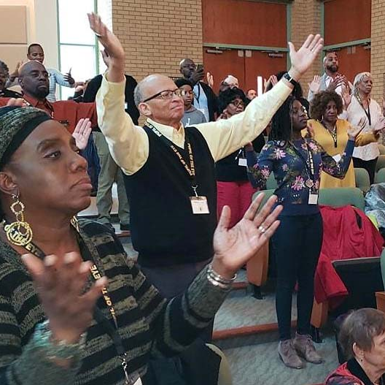
Praise be to God, the hosts of the Supreme Concourse secure the victory and the power of the Kingdom is ready to assist and to support. Should ye at every instant unloosen the tongue in thanksgiving and gratitude, ye would not be able to discharge yourselves of the obligation of gratitude for these bestowals.
‘Abdu’l-Bahá
Selections from the Writings of ‘Abdu’l-Bahá, 68.6

Slide 10
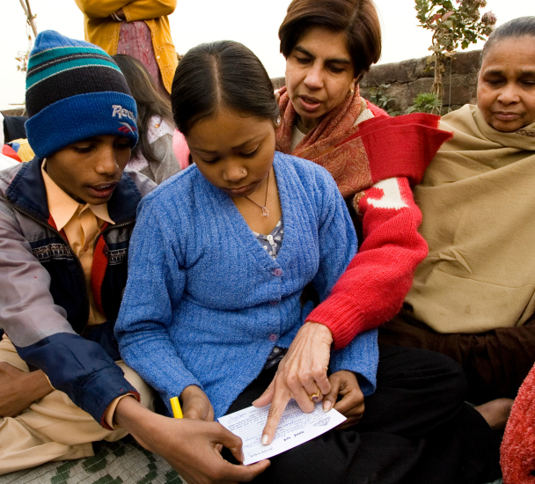
Know verily that the essence of justice and the source thereof are both embodied in the ordinances prescribed by Him Who is the Manifestation of the Self of God amongst men, if ye be of them that recognize this truth...Were men to discover the motivating purpose of God’s Revelation, they would assuredly cast away their fears, and, with hearts filled with gratitude, rejoice with exceeding gladness.
Bahá’u’lláh
Gleanings from the Writings of Bahá’u’lláh, 88

Slide 11

Be not grieved if thou performest it thyself alone. Let God be all-sufficient for thee. Commune intimately with His Spirit, and be thou of the thankful. Proclaim the Cause of thy Lord unto all who are in the heavens and on the earth.
Bahá’u’lláh
Gleanings from the Writings of Bahá’u’lláh, 129.2

Slide 12
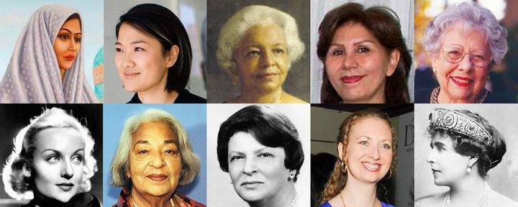
Wherefore, be thankful to God, for having strengthened thee to aid His Cause, for having made the flowers of knowledge and understanding to spring forth in the garden of thine heart. Thus hath His grace encompassed thee, and encompassed the whole of creation. Beware, lest thou allow anything whatsoever to grieve thee.
Bahá'u'lláh
Gleanings, p. 303

Slide 13

Praise be to God, ye are firm and steadfast; be ye thankful that like unto blessed trees ye are firmly planted in the soil of the Covenant. It is sure that every firm one will grow, will yield new fruits and will increase daily in freshness and grace.
'Abdu'l-Bahá
Selections From the Writings of ‘Abdu’l-Bahá, p. 211

Slide 14
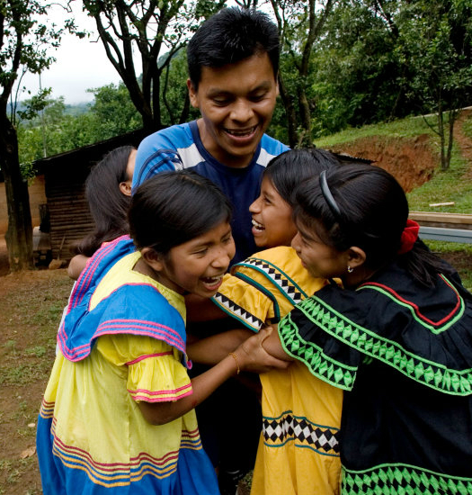
Man must, under all conditions, be thankful to God, the One, for it is said in the blessed text: “If ye be thankful I will increase thee.”
‘Abdu’l-Bahá
Tablets of ‘Abdu’l-Bahá ‘Abbás vol. 1-3, 62.2

Slide 15
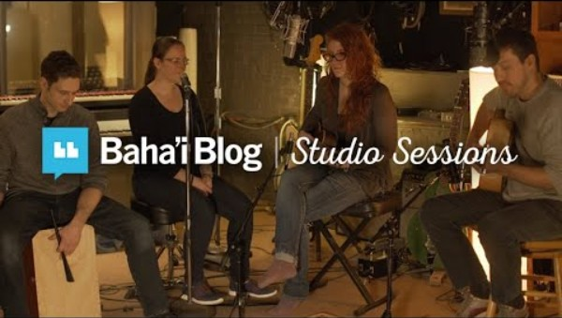
https://www.youtube.com/watch?v=luKgFOhy4tI

Slide 16
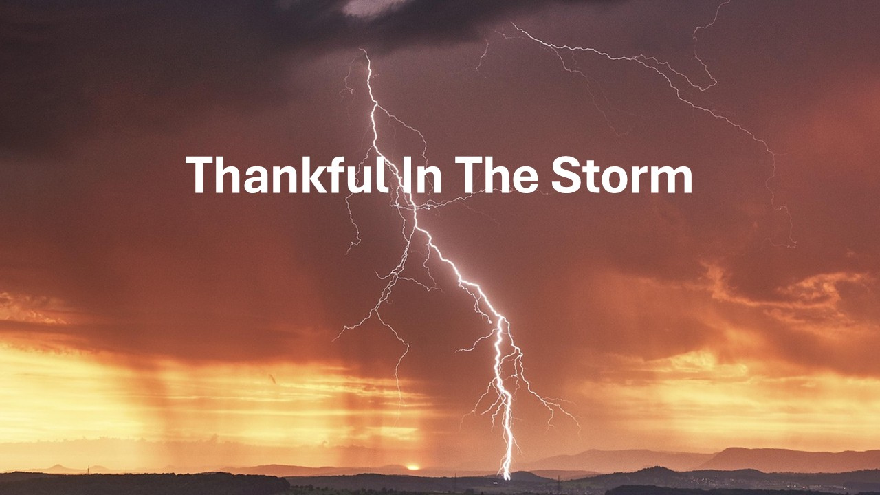
https://www.youtube.com/watch?v=AqdjA8ZO4cU

