Slide 1
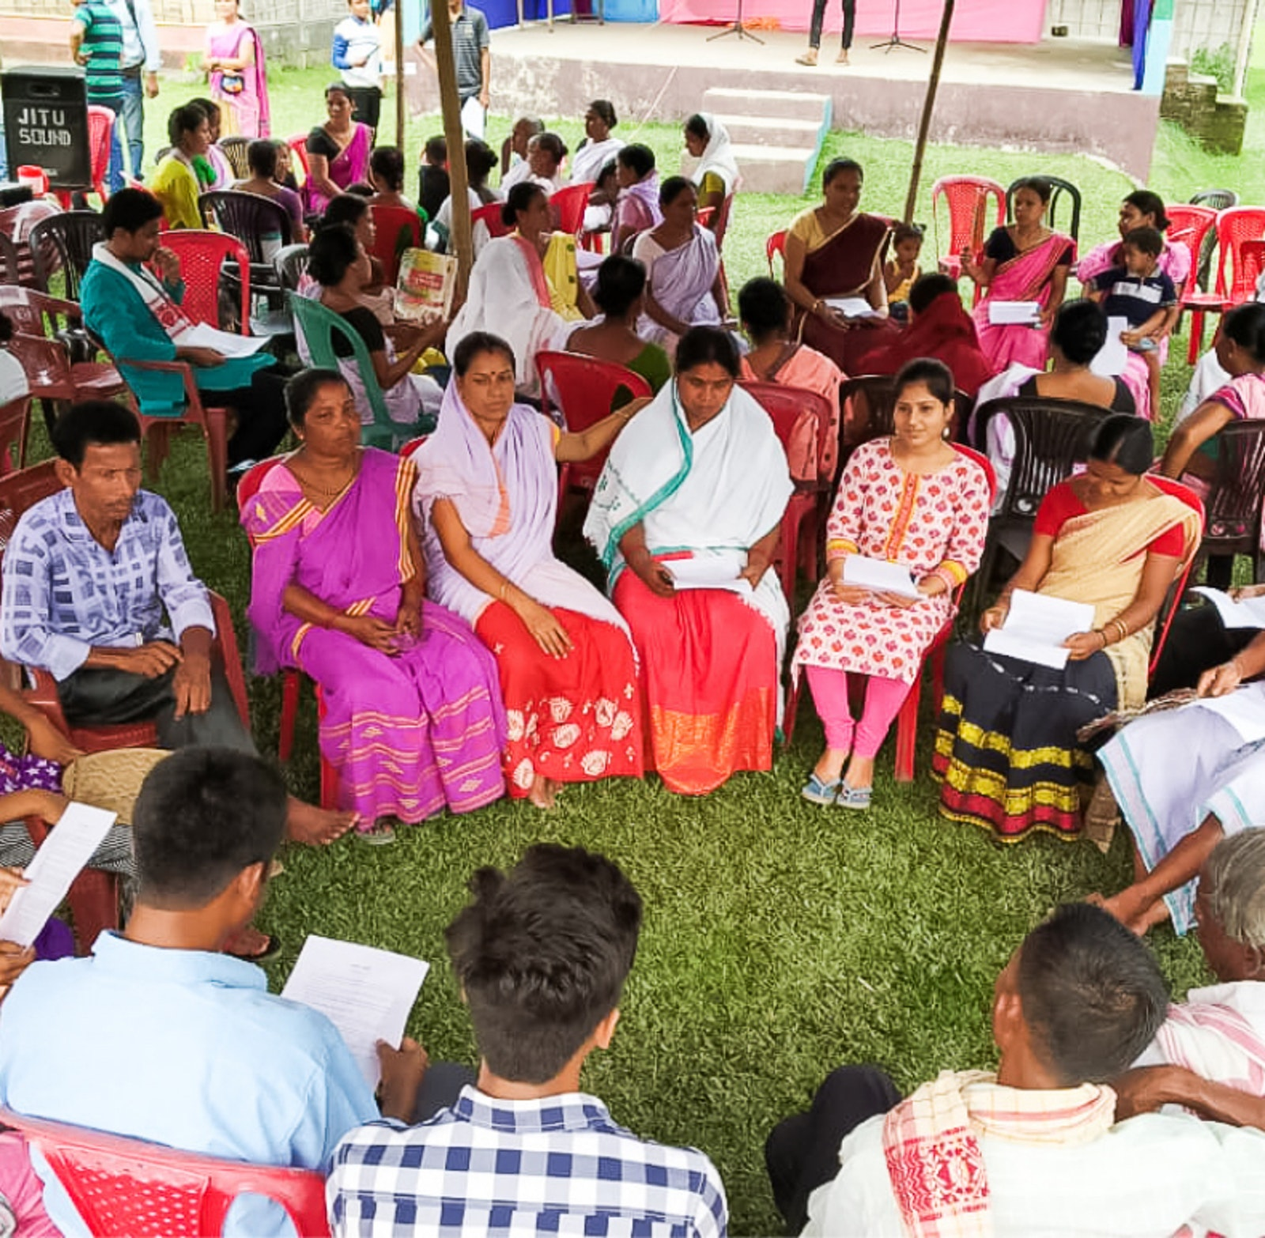
Consultation & Decision Making
Tucker, GA

Slide 2

https://www.youtube.com/watch?v=_OybDX88-XA

Slide 3
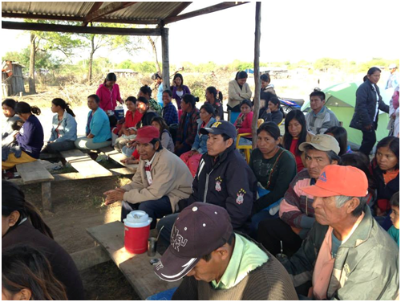
In a society where all are related, simple decisions require the approval of nearly everyone in that society. It is society as a whole, not merely a part of it, that must survive. This is the indigenous understanding. It is the understanding in a global sense. We are all indigenous people on this planet, and we have to reorganize to get along.
American Indigenous,
Rebecca Adamson, Cherokee

Slide 4
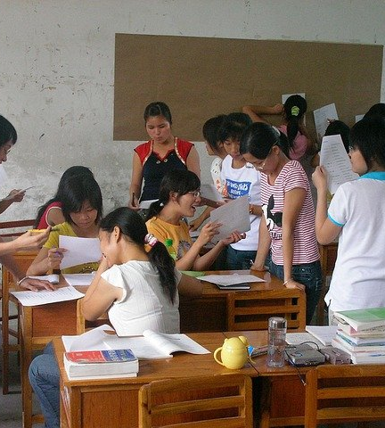
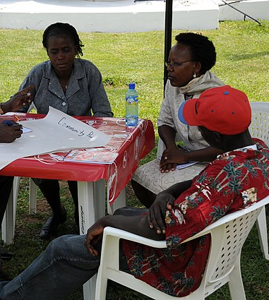
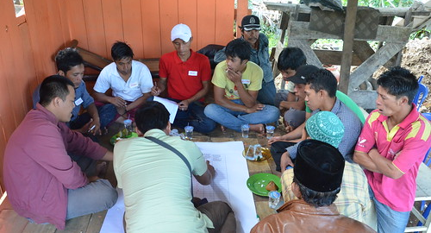
May your counsel be common, your assembly common, common the mind, and the thoughts of these united. A common purpose do I lay before you, and worship with your common oblation.
Hinduism,
Rig Veda 10.191: 3

Slide 5

Sit in the assembly of the honest; join with those that are good and virtuous; nay, seek out a noble enemy where enmity cannot be helped and have nothing to do with the wicked and the unrighteous.
Hinduism, Garuda Purana 112

Slide 6

He that walketh with wise men shall be wise; but the companion of fools shall smart for it.
Judaism,
Misheli (Proverbs) 13: 20

Slide 7

Iron sharpeneth iron; so a man sharpeneth the countenance of his friend.
Judaism,
Misheli (Proverbs) 27: 17

Slide 8

Counsel in the heart of man is like deep water; but a man of understanding will draw it out.
Judaism,
Misheli (Proverbs) 20: 5

Slide 9

Being with the wise, like meeting with family, is joyful. Therefore, one should follow the wise, the intelligent, the learned, the patient, the dutiful, the noble; one should follow the good and wise, as the moon follows the path of the stars.
Buddhism, Dhammapada 208

Slide 10

While speaking with others, do not hope or pray not to be disagreed with. Without disagreement, self-righteousness can flourish.
Buddhism,
Sutra on the Eight Realizations, 1.36

Slide 11
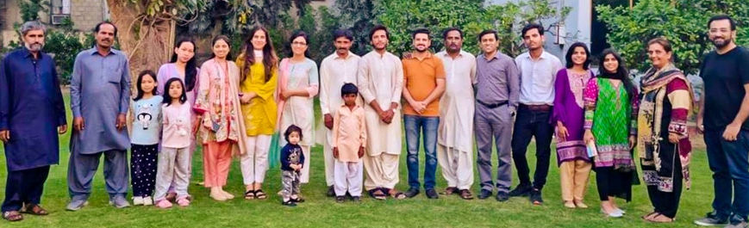
Therefore, putting away falsehood, let every one speak the truth with his neighbor, for we are members one of another.
Christianity,
Ephesians 4: 25

Slide 12

Let no one seek his own good, but the good of his neighbor.
Christianity,
Corinthians I 10: 24

Slide 13

And those who respond to their Lord and keep up prayer, and their rule is to take counsel among themselves, and who spend out of what we have given them.
Islam,
The Qur’an, 42.53

Slide 14

The Prophet said: The consultations of two friends are like trust. It is not lawful to disclose to another what one does not like. One wise man was asked. How can you keep matters secret? He said: I am like a grave for these matters. The heart of a fool is in his tongue and the tongue of a wise man is in his heart. In other words, the fool cannot keep secret what is in his mind and discloses it in such a place which he does not know.
Islam, Imam Ghazzali,
Revival of Religious Learnings Vol-II, 5.2.15

Slide 15
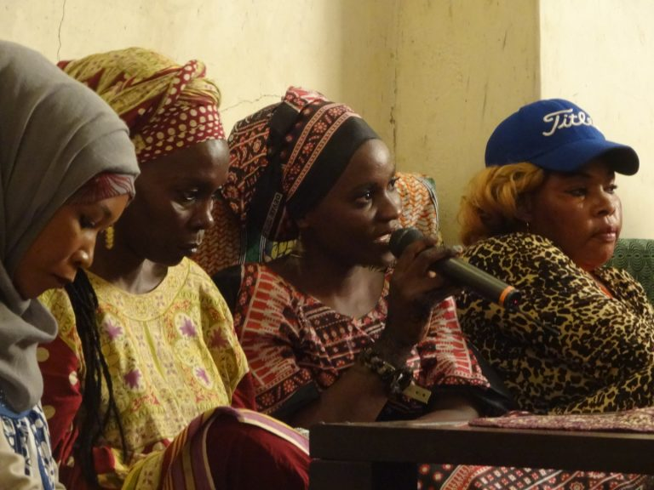
The heaven of divine wisdom is illumined with the two luminaries of consultation and compassion. Take ye counsel together in all matters, inasmuch as consultation is the lamp of guidance which leadeth the way, and is the bestower of understanding.
Bahá’i, Bahá’u’lláh,
Tablets of Bahá’u’lláh Revealed
After the Kitáb-i-Aqdas, p. 168

Slide 16

Regarding thy question about consultation of a father with his son, or a son with his father, in matters of trade and commerce, consultation is one of the fundamental elements of the foundation of the Law of God. Such consultation is assuredly acceptable, whether between father and son, or with others. There is nothing better than this. Man must consult in all things for this will lead him to the depths of each problem and enable him to find the right solution.
Bahá’i, ‘Abdu’l-Bahá,
Compilation of Compilations,
Vol I, p. 98

Slide 17

https://www.youtube.com/watch?v=X3tv3fRQjiM

Slide 18

https://www.youtube.com/watch?v=AsHP1auivaw

