Slide 1
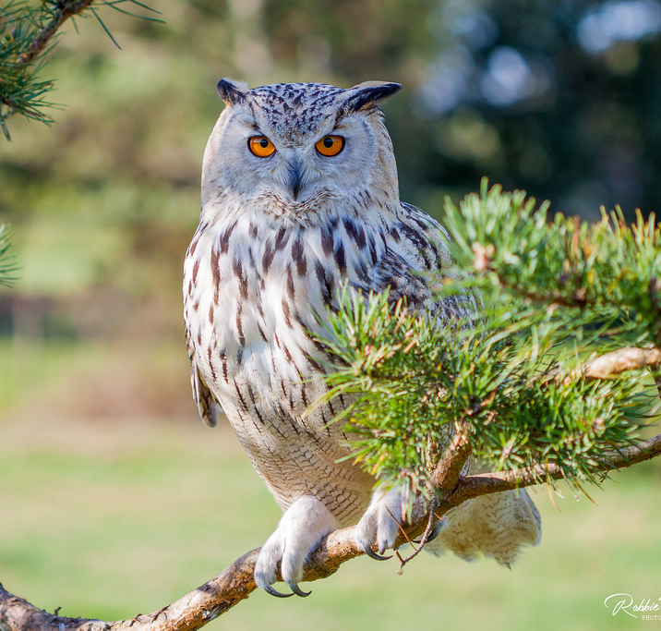
Wisdom
Tucker, GA

Slide 2
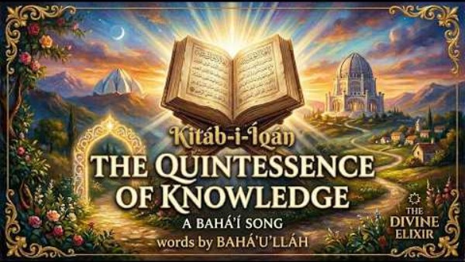
https://www.youtube.com/watch?v=L69BNAg3D9o

Slide 3



Slide 4
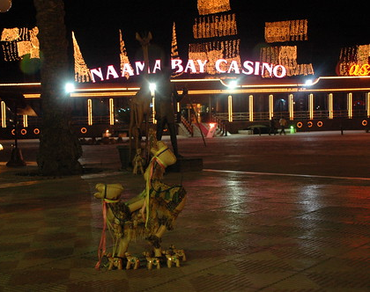
The foolish run after outward pleasures and fall into the snares of vast-embracing death. But the wise have found immortality, and do not seek the Eternal in things that pass away.
Hinduism,
Katha Upanishad 4: 2

Slide 5
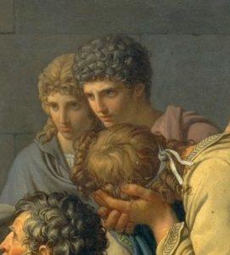
He who is without affection on any side, who does not rejoice or loathe as he obtains good or evil, his intelligence is firmly set (in wisdom).
Hinduism,
Bhagavad Gita 2: 57

Slide 6

My son, attend unto my wisdom; incline thine ear to my understanding; That thou mayest preserve discretion, and that thy lips may keep knowledge.
Judaism, Misheli
(Proverbs) 5: 1-2

Slide 7

He that walketh with wise men shall be wise; but the companion of fools shall smart for it.
Judaism,
Misheli (Proverbs) 13: 20

Slide 8

Knowing others is intelligence;
knowing yourself is true wisdom.
  Taoism,
  Tao Te Ching, Chap 33

Slide 9

If you need wisdom--if you want to know what God wants you to do--ask him, and he will gladly tell you. He will not resent your asking.
Christianity,
James 1: 5

Slide 10
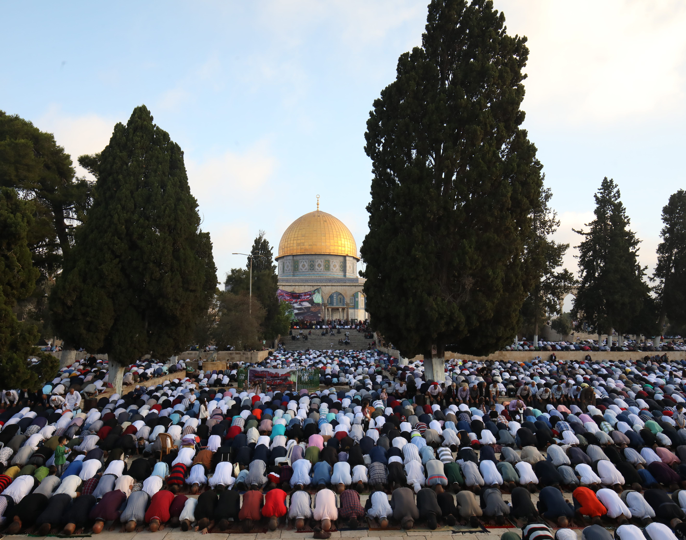
Call unto the way of thy Lord with wisdom and goodly exhortation and argue with them in a way that is best. Surely, thy Lord knows best who has strayed from HIS way; and HE also knows those who are rightly guided.
Islam,
Qur’án 16: 126

Slide 11

My Lord, bestow wisdom on me and join me with the righteous;
And grant me true and lasting reputation among posterity;
And make me one of the heirs of the Garden of Bliss;
And forgive my father, for he is of the erring ones;
And disgrace me not on the day when they will be raised up,
The day when wealth and sons shall not avail;
Save him who comes to ALLAH with a sound heart.
Islam, Qur’án 26: 84-90

Slide 12

Above all else, the greatest gift and the most wondrous blessing hath ever been and will continue to be wisdom. It is man’s unfailing Protector. It aideth him and strengtheneth him. Wisdom is God’s Emissary and the Revealer of His Name the Omniscient. Through it the loftiness of man’s station is made manifest and evident.
Bahá’i, Bahá’u’lláh, Tablets of Bahá’u’lláh, p. 66

Slide 13

The essence of wisdom is the fear of God, the dread of His scourge and punishment, and the apprehension of His justice and decree.
Bahá’i, Bahá’u’lláh,
Tablets of Bahá’u’lláh, p. 155

Slide 14


The heaven of divine wisdom is illumined with the two luminaries of consultation and compassion and the canopy of world order is upraised upon the two pillars of reward and punishment.
Bahá’i, Bahá’u’lláh,
Tablets of Bahá’u’lláh, p.126

Slide 15
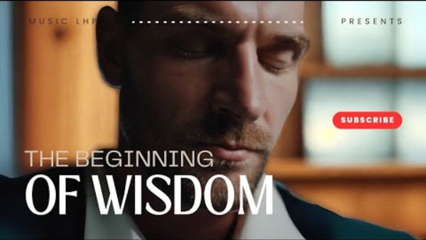
https://www.youtube.com/watch?v=TQ80C7i10EM

Slide 16

https://www.youtube.com/watch?v=uSrfckAQI3M

