Slide 1

Cognitive
Intelligence
Tucker, GA

Slide 2

https://www.youtube.com/watch?v=AGx8f_2t2j4

Slide 3

...the rise of artificial intelligence necessitates that we examine what really makes us uniquely human and what we can learn from indigenous wisdom in a world obsessed with speed, efficiency and automation.
Kyle Pearce

Slide 4

I am going to venture that the man who sat on the ground in his tipi meditating on life and its meaning, accepting the kinship of all creatures, and acknowledging unity with the universe of things, was infusing into his being the true essence of civilization.
Chief Luther Standing Bear
Lakota Sioux

Slide 5
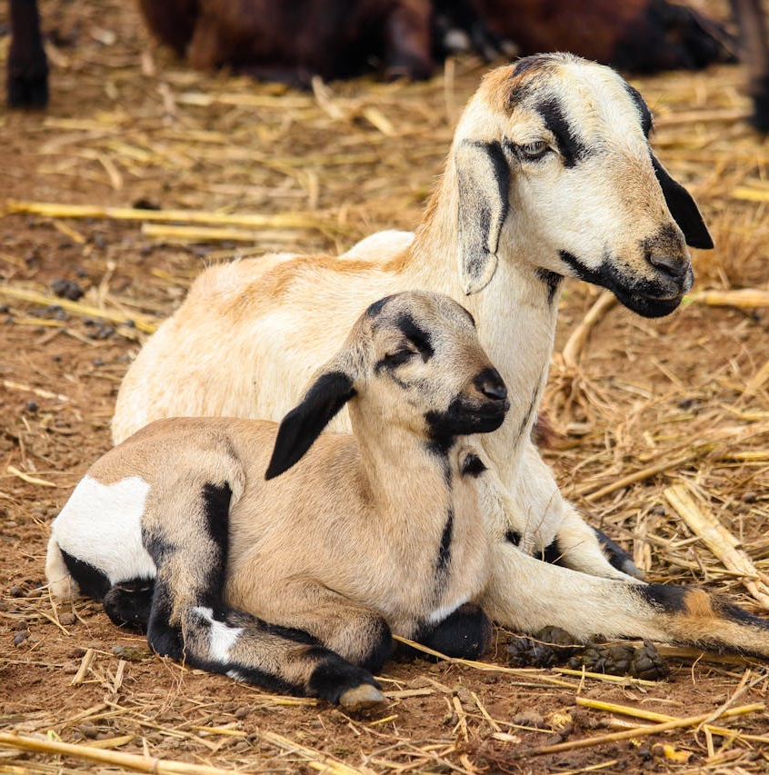
Man, by apprehending with the aid of his intelligence, the manner in which creatures come and leave the world, is sure to gradually attain to steadfast tranquillity.
Hinduism,
The Mahabharata 12, 194.2

Slide 6

By exercising his own intelligence, he should settle what he is to do. By consulting with others he should either abandon or confirm such resolution. Aided by that intelligence which is sharpened by the scriptures, one can settle his courses of action. In this consists the usefulness of the scriptures.
Hinduism,
The Mahabharata 12, 586

Slide 7
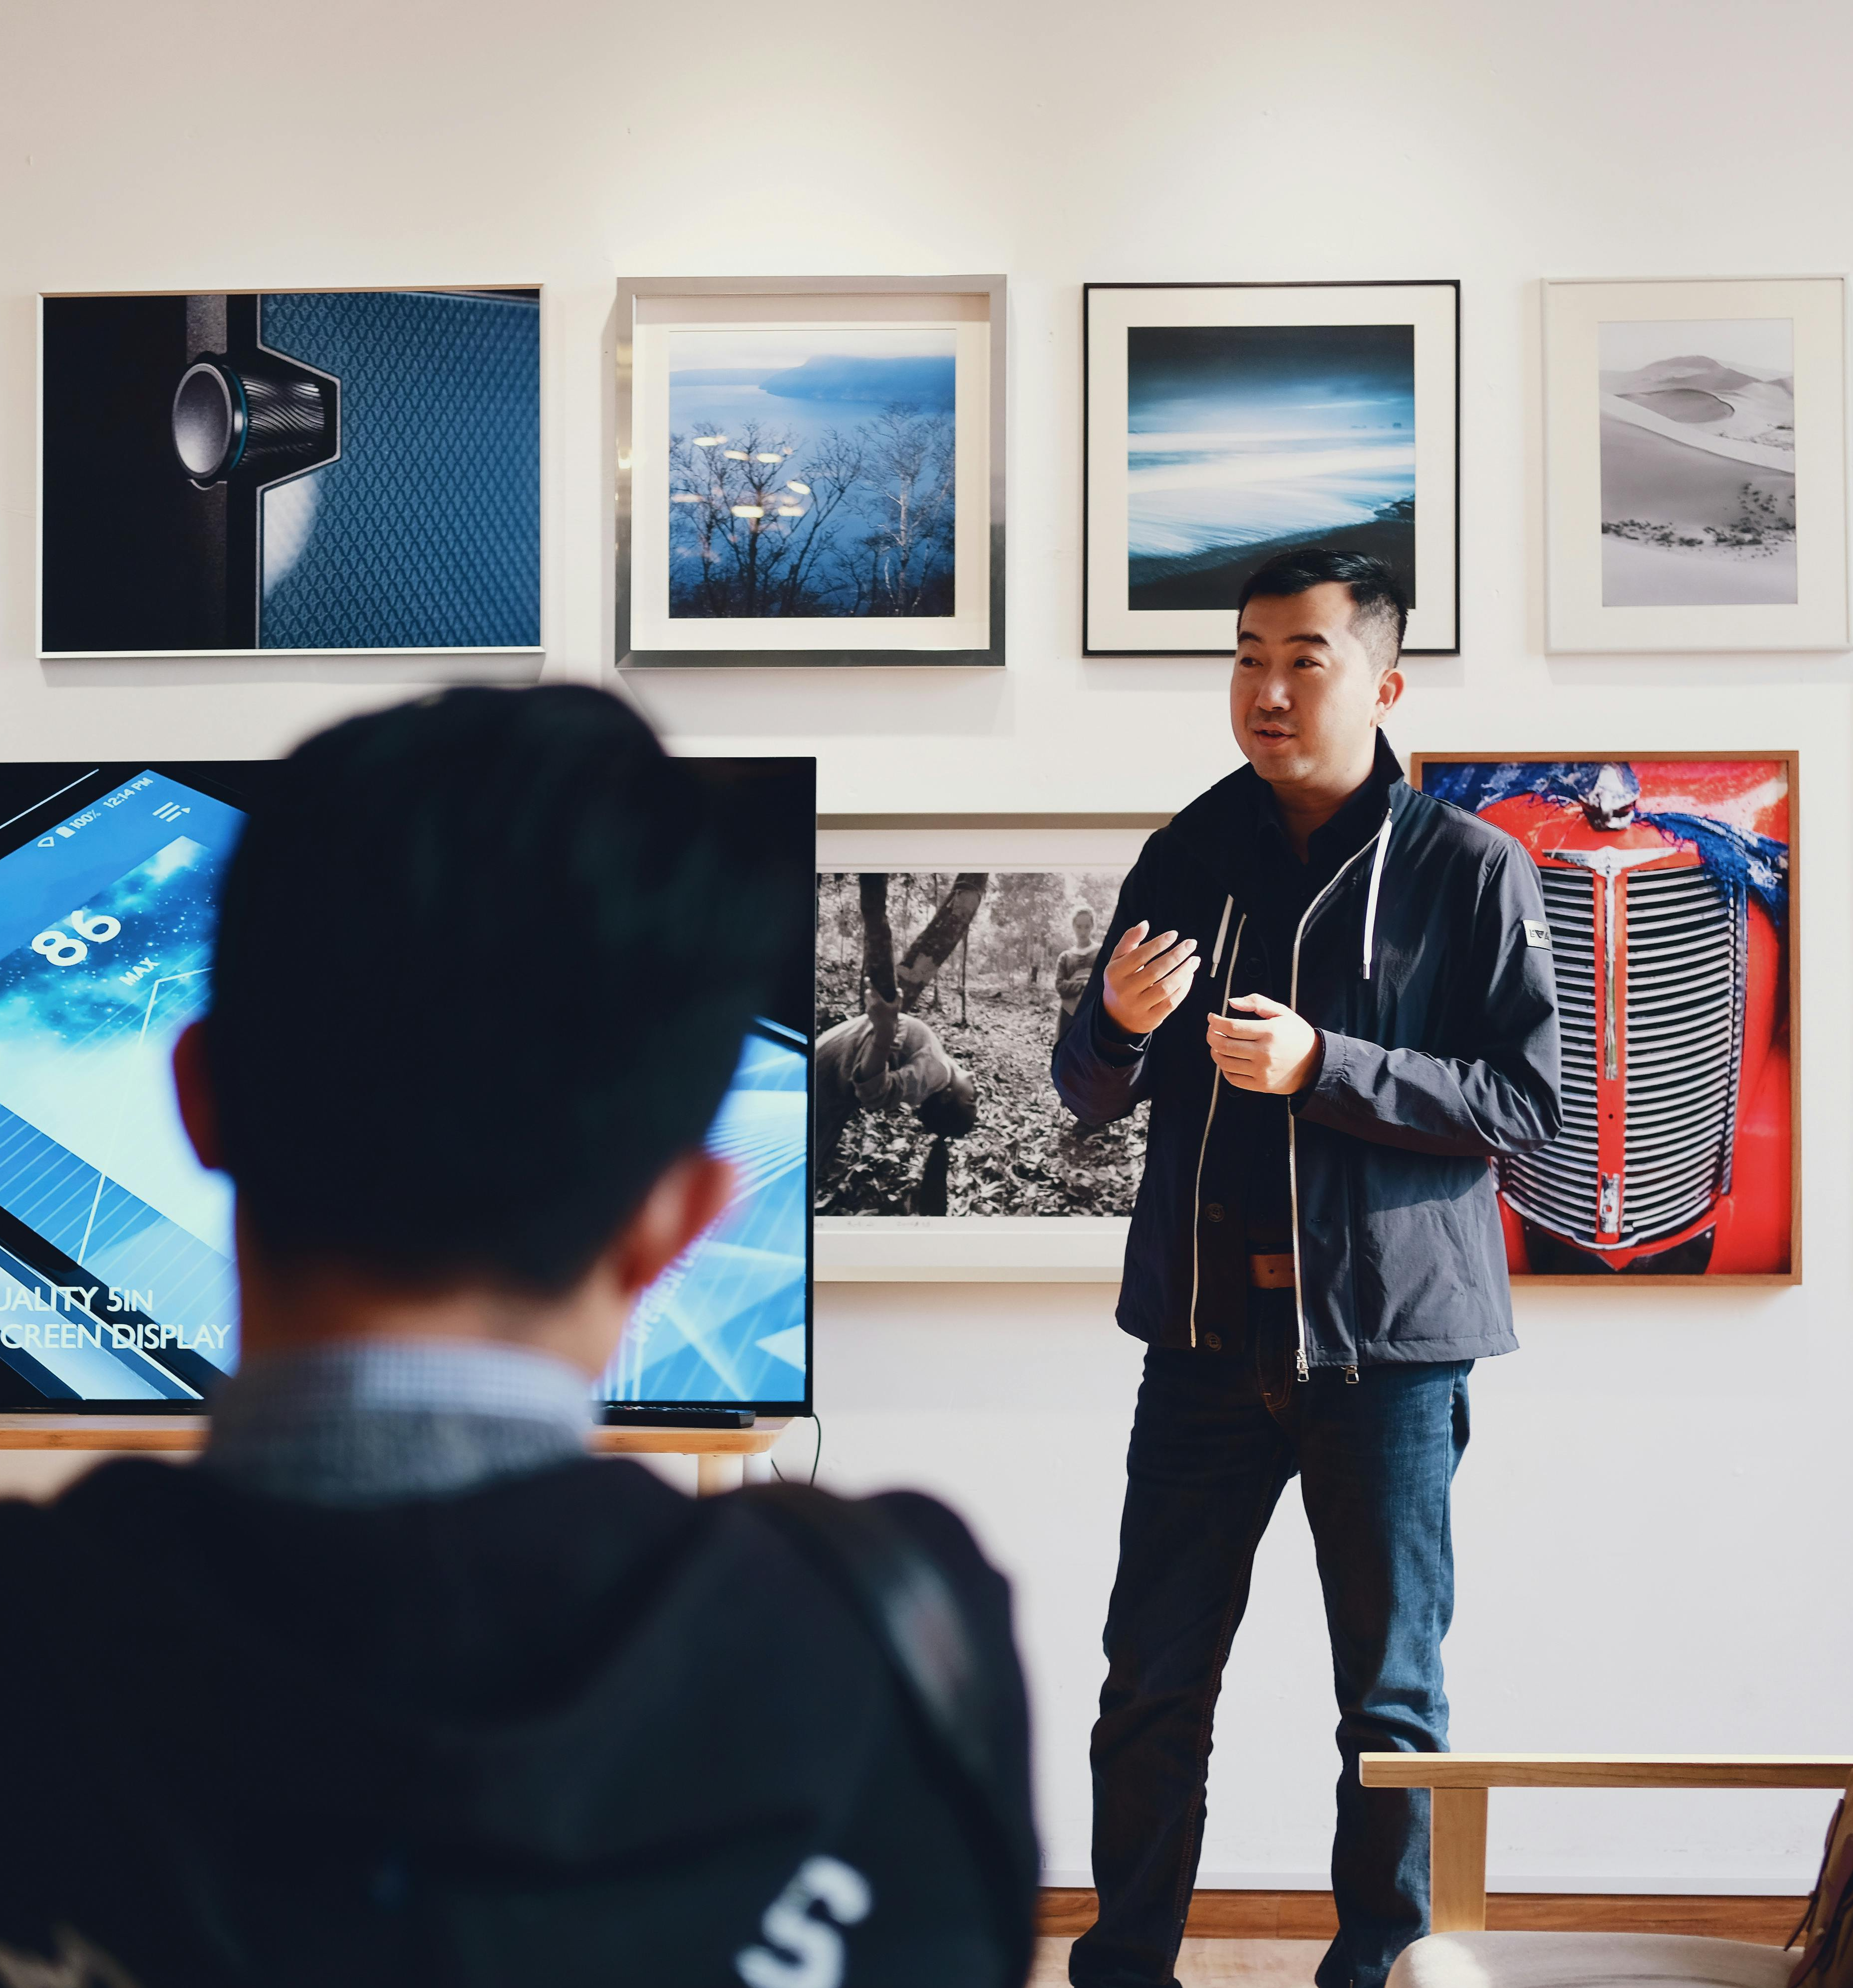
A man shall be commended according to his intelligence; but he that is of a distorted understanding shall be despised.
Judaism
Mishlei (Proverbs), 12: 8

Slide 8
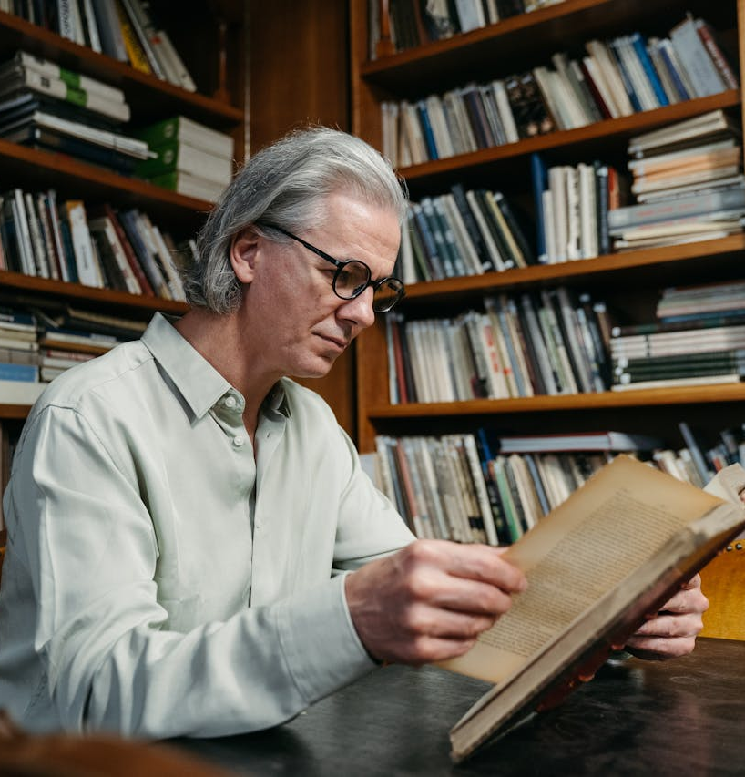
The heart of the discerning acquires knowledge,
for the ears of the wise seek it out.
Judaism
Mishlei (Proverbs), 18:15

Slide 9

He who knows other men is discerning; he who knows himself is intelligent. He who overcomes others is strong; he who overcomes himself is mighty. He who is satisfied with his lot is rich; he who goes on acting with energy has a (firm) will.
Taoism,
Tao Te Ching, 155

Slide 10

The best of ways is the eightfold; the best of truths the four words; the best of virtues passionlessness; the best of men he who has eyes to see.
This is the way, there is no other that leads to the purifying of intelligence.
Buddhism,
The Dhammapada, 305-306

Slide 11

No one serving as a soldier gets entangled in civilian affairs, but rather tries to please his commanding officer. Similarly, anyone who competes as an athlete does not receive the victor’s crown except by competing according to the rules. The hardworking farmer should be the first to receive a share of the crops. Reflect on what I am saying, for the Lord will give you insight into all this.
Christianity,
II Timothy 2: 4-7

Slide 12

The person without the Spirit does not accept the things that come from the Spirit of God but considers them foolishness, and cannot understand them because they are discerned only through the Spirit. The person with the Spirit makes judgments about all things, but such a person is not subject to merely human judgments, for, “Who has known the mind of the Lord so as to instruct him?”
Christianity, 1 Corinthians 2:14-16

Slide 13

Intelligence is the support for man. From Intelligence come insightfulness, understanding, memory and knowledge; and with Intelligence he gains perfection. Intelligence is his guide, his instructor and the key to his affairs. When his Intelligence is supported with light, he becomes a scholar, a keeper (of knowledge), an intelligent recaller and a man of understanding. Through Intelligence he learns the answer to how, why, where or when.
Islam, Al-Kulayni,
Kitab Al-Kafi 1, I.1.90

Slide 14

The Messenger of Allah has said, ‘O Ali, no poverty is more severe than Ignorance and no property is more valuable than Intelligence.
Islam, Al-Kulayni,
Kitab Al-Kafi 1, 154

Slide 15
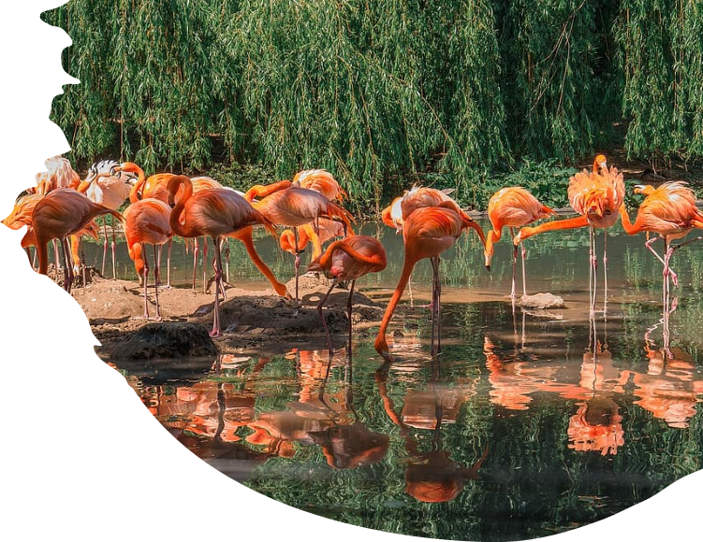

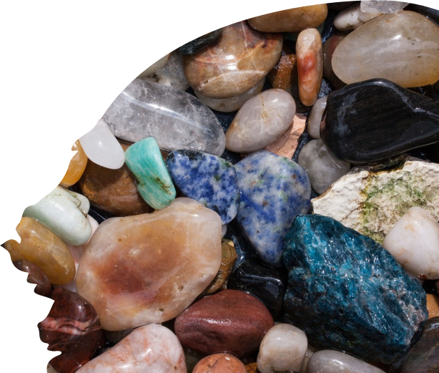
All created things are captives of nature and subject to its laws. They cannot transgress the control of these laws in one detail or particular. The infinite starry worlds and heavenly bodies are nature's obedient subjects. The earth and its myriad organisms, all minerals, plants and animals are thralls of its dominion. But man through the exercise of his scientific, intellectual power can rise out of this condition, can modify, change and control nature according to his own wishes and uses. Science, so to speak, is the breaker of the laws of nature.
Baha’i, ‘Abdu’l-Bahá
Promulgation of Universal Peace, p. 30

Slide 16
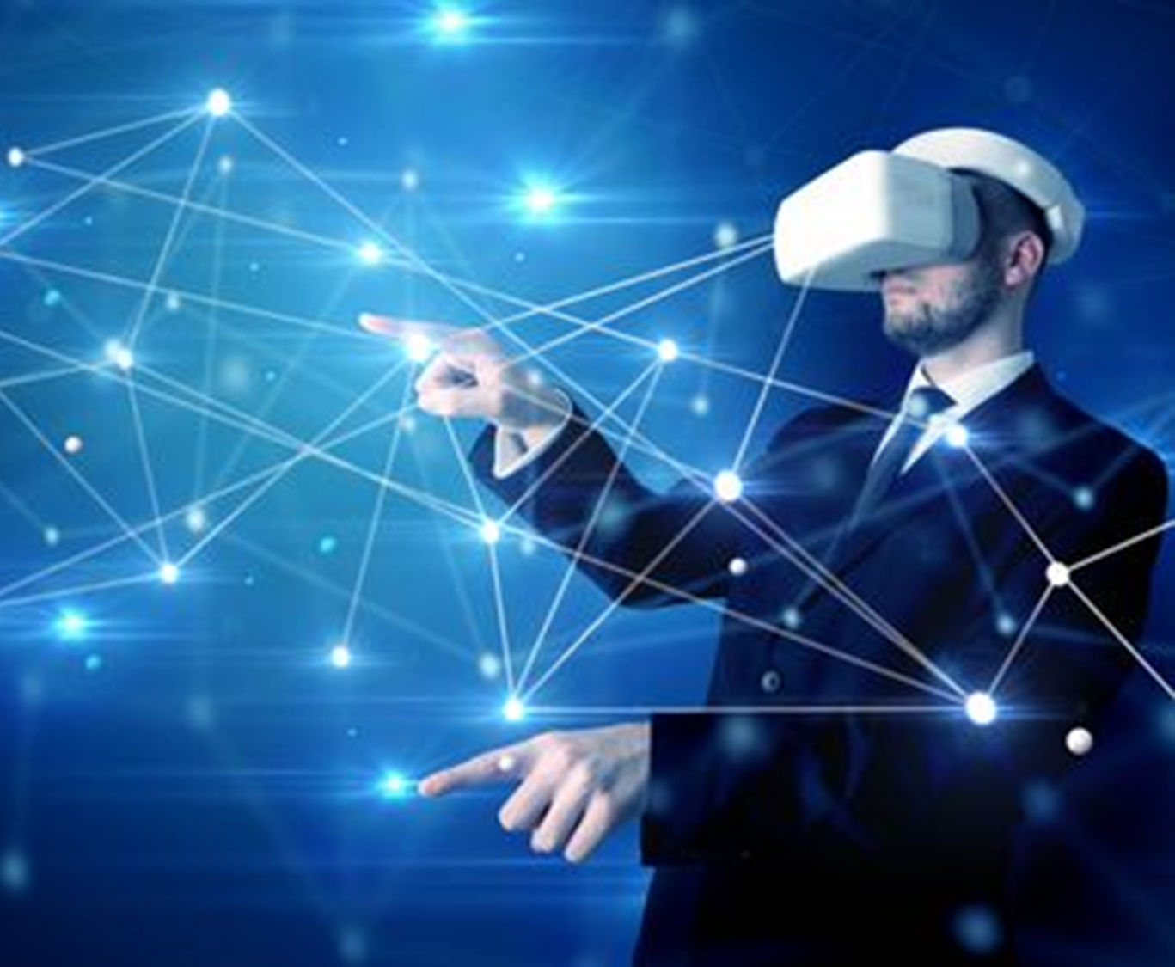
All blessings are divine in origin, but none can be compared with this power of intellectual investigation and research, which is an eternal gift producing fruits of unending delight. Man is ever partaking of these fruits. All other blessings are temporary; this is an everlasting possession.
Baha’i, ‘Abdu’l-Bahá,
Promulgation of Universal Peace, p. 50

Slide 17
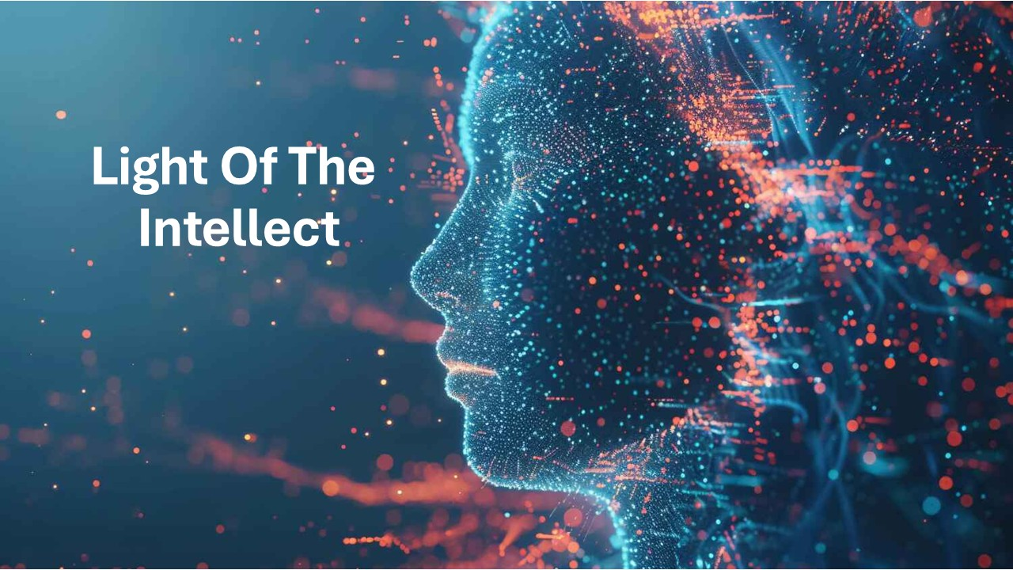
https://www.youtube.com/watch?v=6V7awGpdPIk

