Slide 1
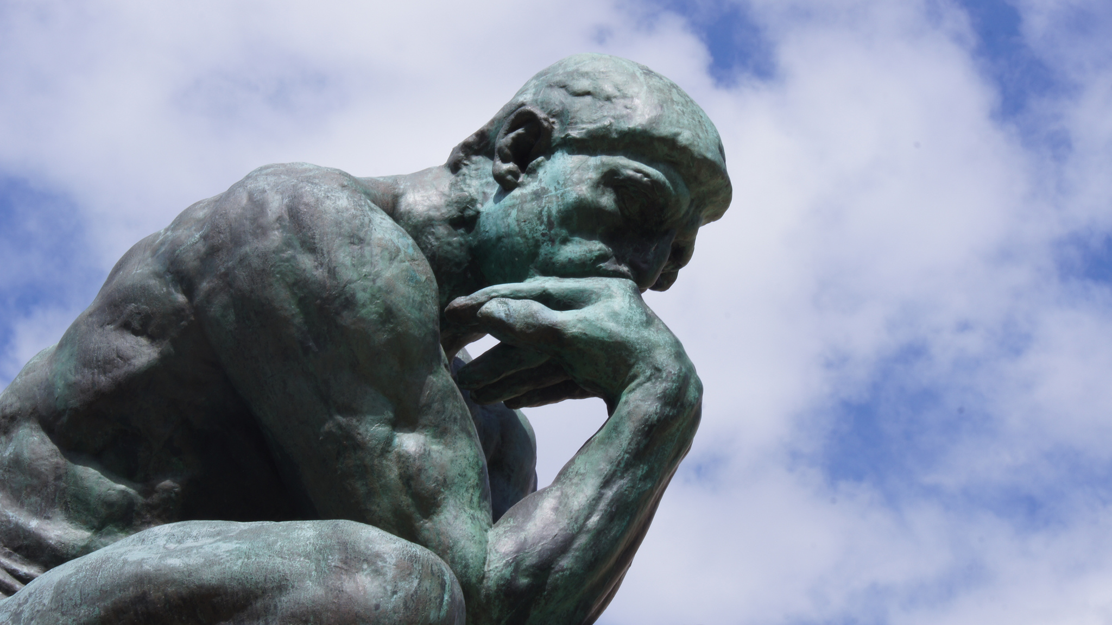
Thought & Thinking
Tucker, GA

Slide 2
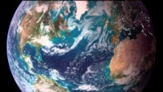
https://www.youtube.com/watch?v=4zo0XIvxKo8

Slide 3
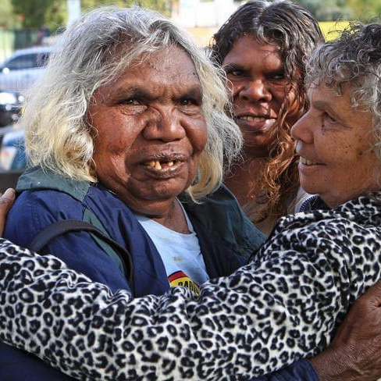
The more you know, the less you need.
Australian Aboriginal Wisdom
This Photo by Unknown Author is licensed under CC BY-NC-ND

Slide 4
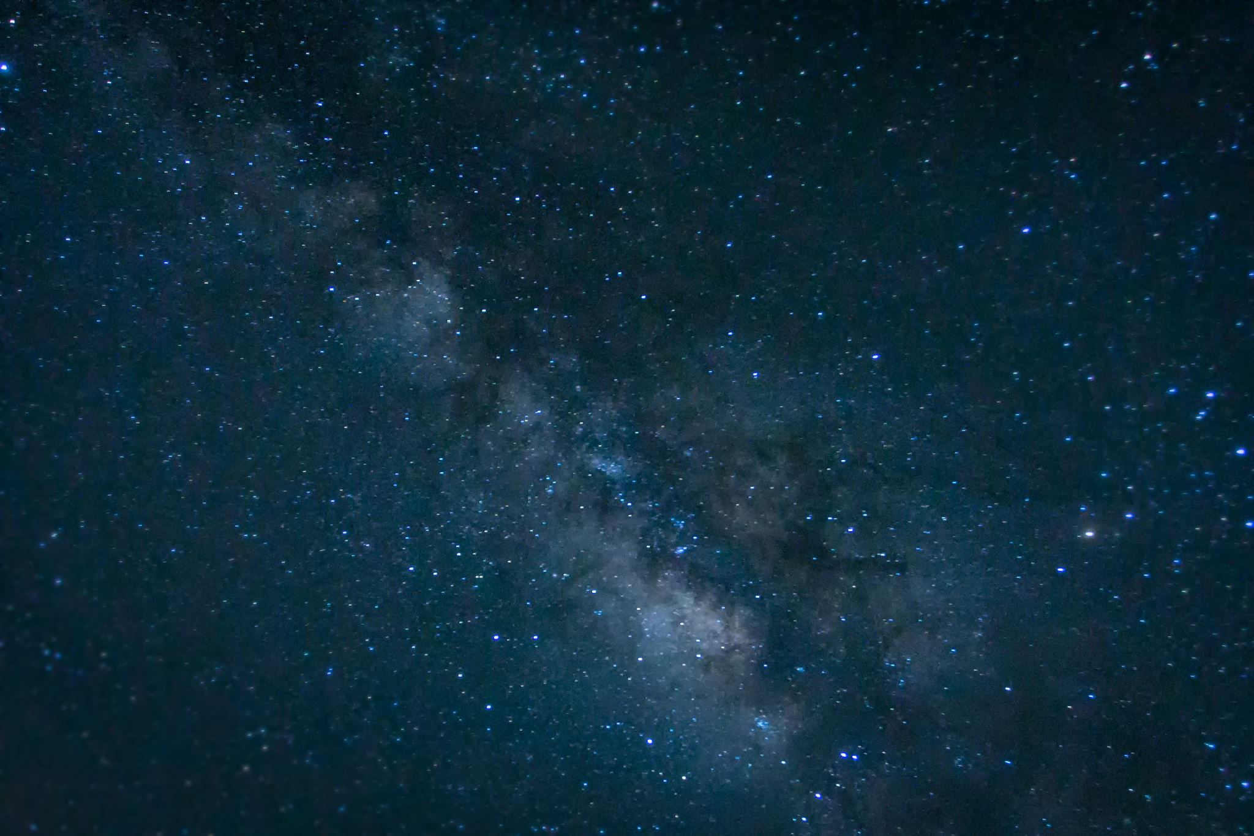

If the thoughts of a man were so fixed on Brahman as they are on the things of this world, who would not then be freed from bondage?
Hinduism, Maitri Upanishad 6.34: 5

Slide 5

For My thoughts are not your thoughts, neither are your ways My ways, saith the Lord.
Judaism,
Yisheyah (Isaiah) 55: 8

Slide 6

My son, attend unto my wisdom; incline thine ear to my understanding; That thou mayest preserve discretion, and that thy lips may keep knowledge.
Judaism, Misheli (Proverbs) 5: 1-2

Slide 7
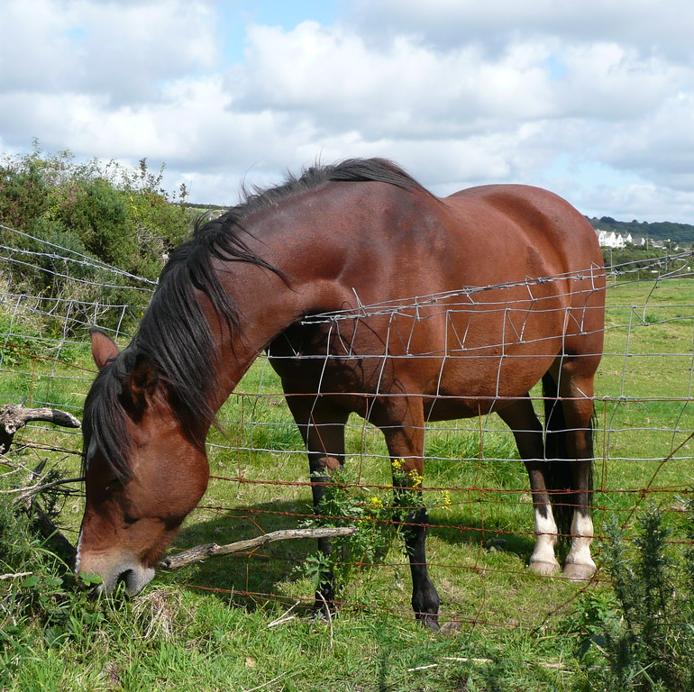
Wise men lay up knowledge; but the mouth of the foolish is an imminent ruin.
Judaism,
Misheli (Proverbs) 10: 14

Slide 8

What we are is the result of what we have thought, is built by our thoughts, is made up of our thoughts. If one speaks or acts with a pure thought, happiness follows one, like a shadow that never leaves.
Buddhism,
Dhammapada 2

Slide 9

Like a beautiful flower, full of color, but without scent, are the fine but fruitless words of those who do not act accordingly. But like a beautiful flower, full of color and full of scent, are the fine and fruitful words of those who do act accordingly.
Buddhism,
Dhammapada 36

Slide 10

Ask, and it will be given you; seek, and you will find; knock, and it will be opened to you. For every one who asks receives, and he who seeks finds, and to him who knocks it will be opened.
Christianity,
Matthew 7: 7-8

Slide 11
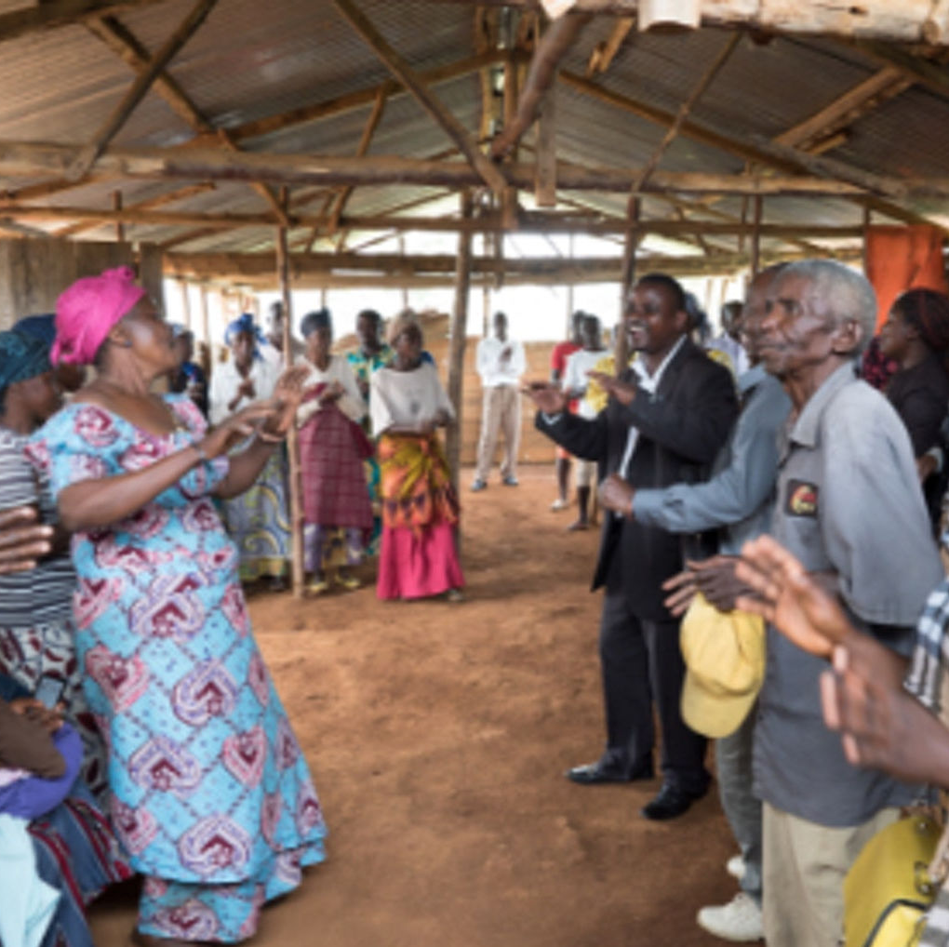
Finally, brethren, whatever is true, whatever is honorable, whatever is just, whatever is pure, whatever is lovely, whatever is gracious, if there is any excellence, if there is anything worthy of praise, think about these things.
Christianity,
Philippians 4: 8

Slide 12
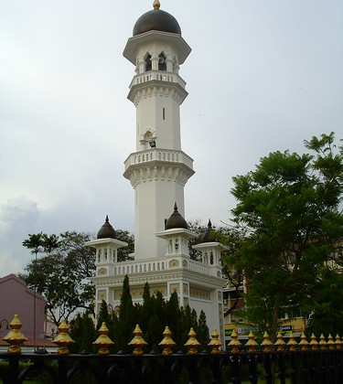
Call unto the way of thy Lord with wisdom and goodly exhortation and argue with them in a way that is best. Surely, thy Lord knows best who has strayed from HIS way; and HE also knows those who are rightly guided.
Islam,
Qur’án 16: 126

Slide 13

Say: “Travel through the earth and see how Allah did originate creation; so will Allah produce a later creation: for Allah has power over all things.
Islam,
Qur’án 29: 20

Slide 14
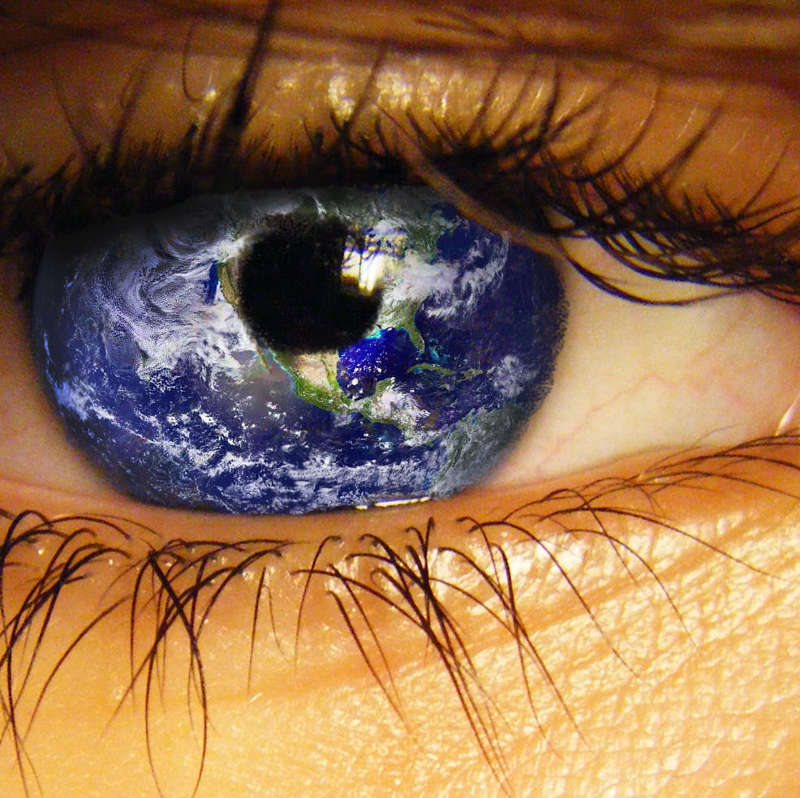
Let your vision be world-embracing, rather than confined to your own self.
Bahá’i, Bahá’u’lláh,
Tablets of Bahá’u’lláh, p. 87

Slide 15
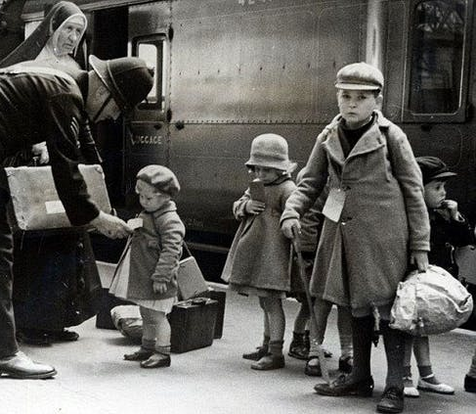
Every soul of the friends of God must concentrate his mind on this, that he may manifest the mercy of God and the bounty of the Forgiving One. He must do good to every soul whom he encounters, and render benefit to him, becoming the cause of improving the morals and correcting the thoughts so that the light of guidance may shine forth and the bounty of His Holiness the Merciful One may encompass. Love is light in whatsoever house it may shine and enmity is darkness in whatsoever abode it dwell.
Bahá’i, Abdu’l-Bahá, Baha'i World Faith, p. 217

Slide 16
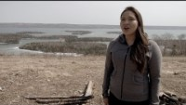
https://www.youtube.com/watch?v=8jYnPr065-4

Slide 17
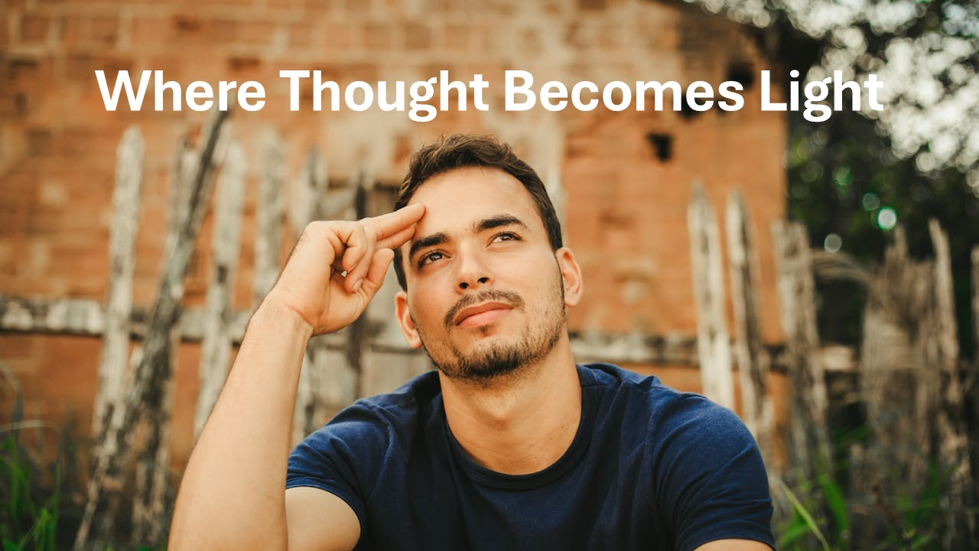
https://www.youtube.com/watch?v=PgWAsPIHtQg

