Slide 1

Knowledge
Tucker, GA

Slide 2

https://www.youtube.com/watch?v=oB3W3_LbOqw

Slide 3
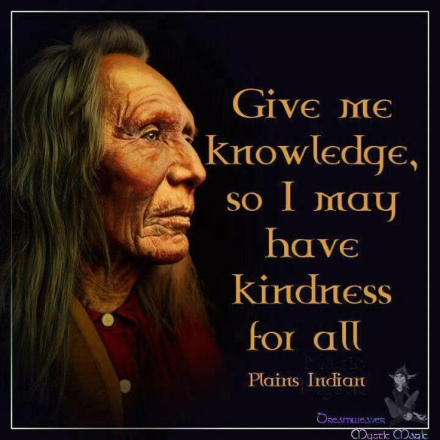

Slide 4

The fixtures and furniture of one's house may be stolen by thieves; but knowledge, the highest treasure, is above all stealing.
Hinduism,
Garuda Purana

Slide 5

The fear of the Lord is the beginning of knowledge; but the foolish despise wisdom and discipline.
Judaism, Misheli (Proverbs) 1: 7

Slide 6

Wise men lay up knowledge; but the mouth of the foolish is an imminent ruin.
Judaism, Misheli (Proverbs) 10: 14

Slide 7

The heart seeketh knowledge.
A man's gift maketh room for him, and bringeth him before great men.
Judaism, Mishlei
(Proverbs) 18: 15-16

Slide 8
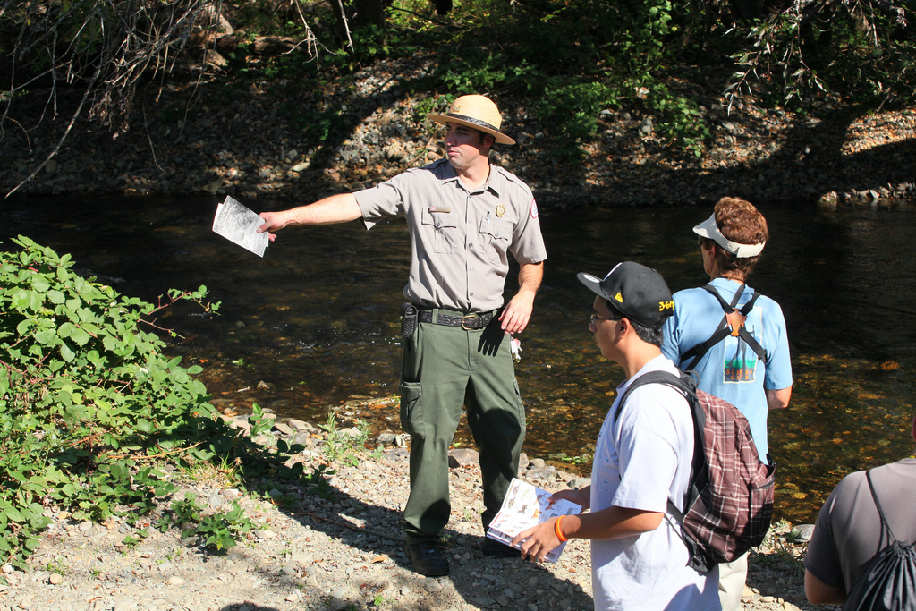
When they think that they know the answers, people are difficult to guide.
When they know that they don't know, people can find their own way.
Taoism, Tao Te Ching, Chapter 65

Slide 9
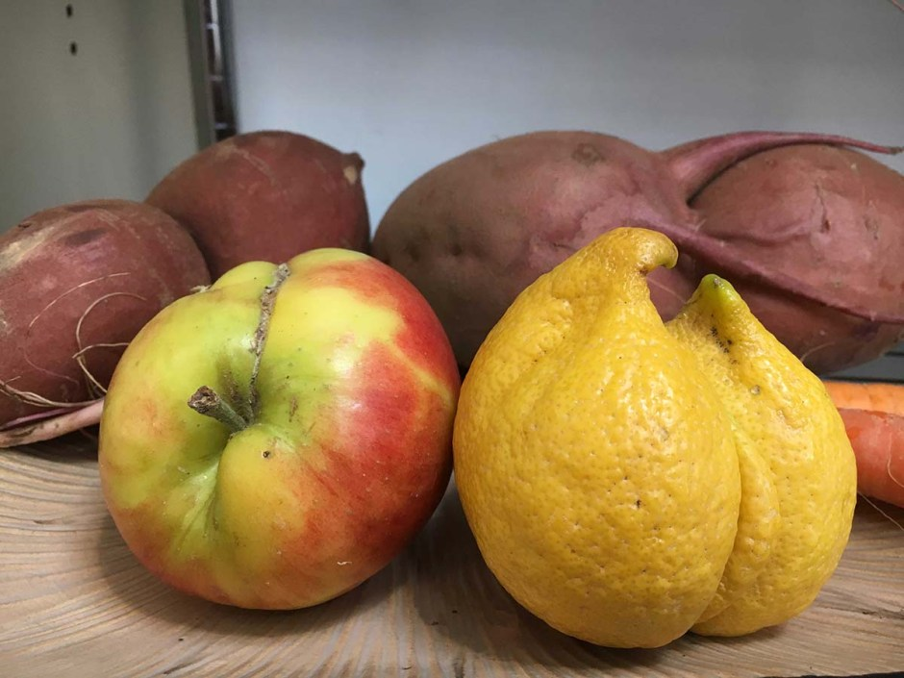
For our knowledge is imperfect and our prophecy is imperfect; but when the perfect comes, the imperfect will pass away.
Christianity, Corinthians I 13: 9-10

Slide 10

A similar (favour have ye already received) in that We have sent among you a Messenger of your own, rehearsing to you Our Signs, and sanctifying you, and instructing you in Scripture and Wisdom, and in new knowledge.
Islam,
Qur’án 2: 151

Slide 11

Now, when trouble touches man, he cries to Us: But when We bestow a favour upon him as from Ourselves, he says, “This has been given to me because of a certain knowledge (I have)!” Nay, but this is but a trial, but most of them understand not!
Islam,
Qur’án 39: 49

Slide 12

We have decreed, O people, that the highest and last end of all learning be the recognition of Him Who is the object of all knowledge.
Bahá’i, Bahá’u’lláh, Kitáb-i-Íqán, p. 197

Slide 13

https://www.youtube.com/watch?v=2rB6_s8y11w

Slide 14

https://www.youtube.com/watch?v=rICivUKq_KY

