Slide 1

Comprehension & Understanding
Tucker, GA

Slide 2

https://www.youtube.com/watch?v=NZkgsmUEWKc

Slide 3

The indigenous peoples understand that they have to recover their cultural identity, or to live it if they have already recovered it. They also understand that this is not a favor or a concession, but simply their natural right to be recognized as belonging to a culture that is distinct from the Western culture, a culture in which they have to live their own faith.
Samuel Ruiz
Mexican Catholic Bishop

Slide 4
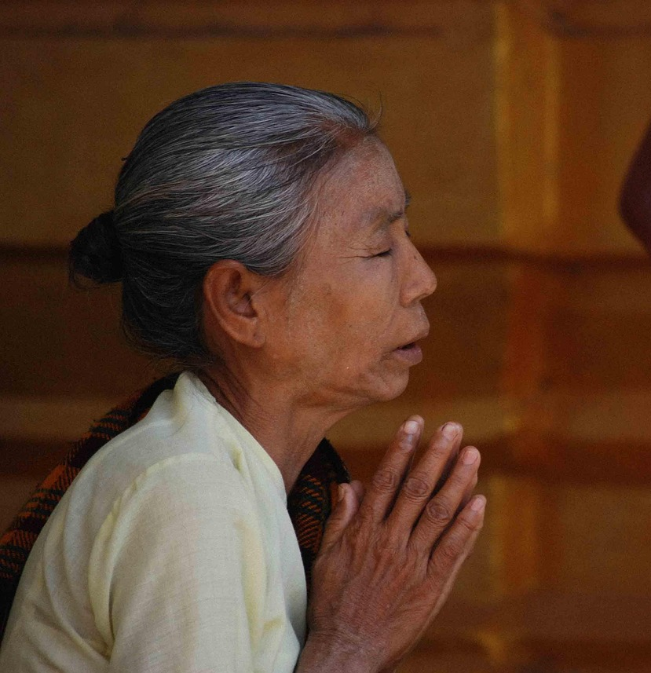
To worship Me — Me only! ceasing not;
Loving all solitudes, and shunning noise
Of foolish crowds; endeavours resolute
To reach perception of the Utmost Soul,
And grace to understand what gain it were
So to attain, — this is true Wisdom, Prince!
And what is otherwise is ignorance!
Hinduism,
The Bhagavad-Gita, 191

Slide 5
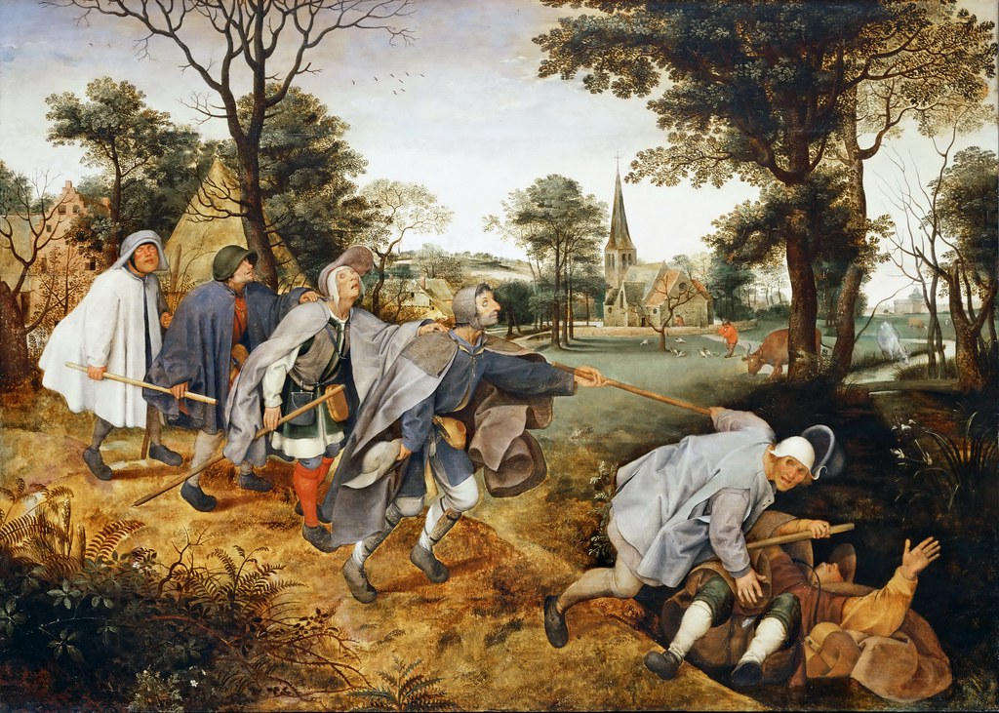
Abiding in the midst of ignorance, thinking themselves wise and learned, fools go aimlessly hither and thither, like blind led by the blind.
Hinduism,
Katha Upanishad 1.2: 5

Slide 6

Hear, ye children, the instruction of a father, and attend to know understanding.
For I give you good doctrine; forsake ye not my teaching.
Judaism,
Mishlei (Proverbs), 4: 1

Slide 7

Forsake all thoughtlessness, and live; and walk in the way of understanding.
Judaism,
Mishlei (Proverbs), 9: 6

Slide 8
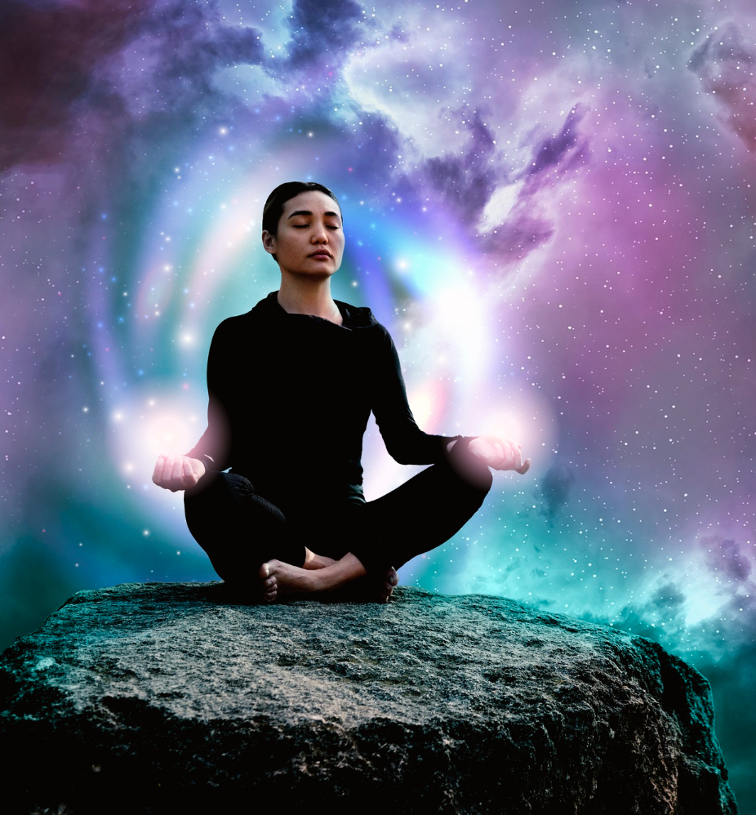
The nature of enlightenment certainly includes understanding. It’s redundant to speak of understanding enlightenment.
Buddhism,
Sutra Collection (S), 689

Slide 9

Whoever gives oneself to distractions and does not give oneself to meditation, forgetting true purpose and grasping at pleasure, will eventually envy the one who practices meditation.
Buddhism,
Dhammapada 209

Slide 10

And he saith unto them, Are ye so without understanding also? Do ye not perceive, that whatsoever thing from without entereth into the man, it cannot defile him; Because it entereth not into his heart, but into the belly, and goeth out into the draught, purging all meats? And he said, That which cometh out of the man, that defileth the man.
Christianity,
Mark, 7: 18

Slide 11
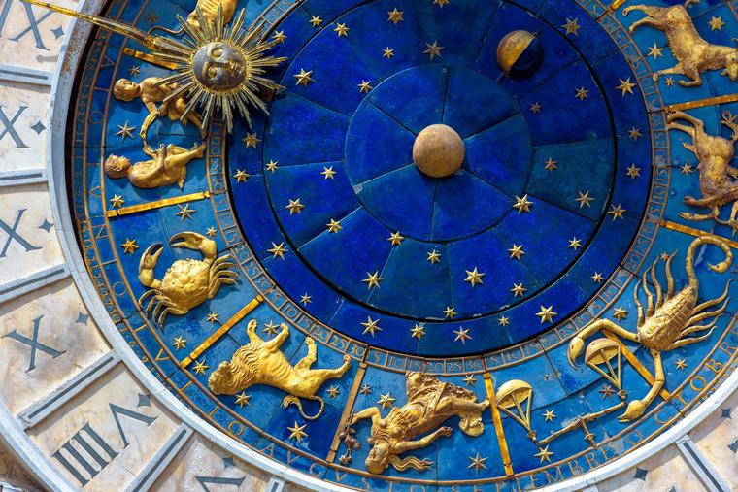
Have nothing to do with godless and silly myths. Train yourself in godliness; for while bodily training is of some value, godliness is of value in every way, as it holds promise for the present life and also for the life to come.
Christianity,
Timothy I 4: 7-8

Slide 12
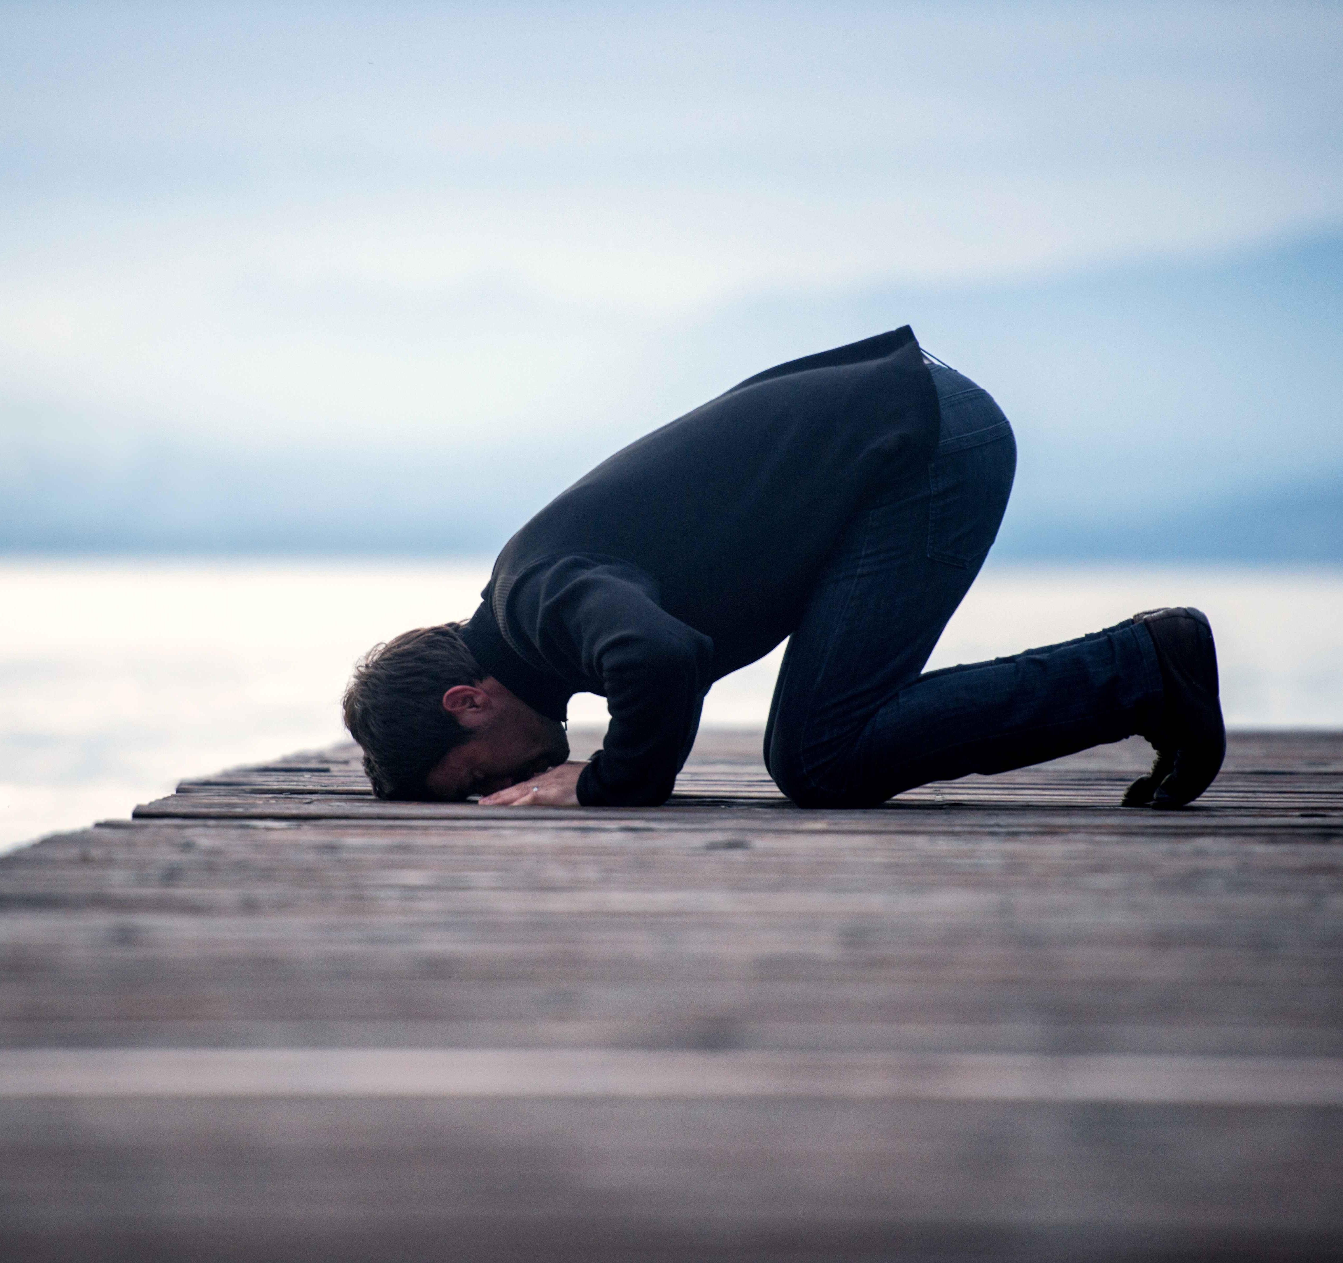
The Apostle is only bound to preach: and God knoweth what ye bring to light, and what ye conceal. SAY: The evil and the good shall not be valued alike, even though the abundance of evil please thee; therefore fear God, O ye of understanding! that it may be well with you.
Islam,
Sura V. The Table, 63

Slide 13
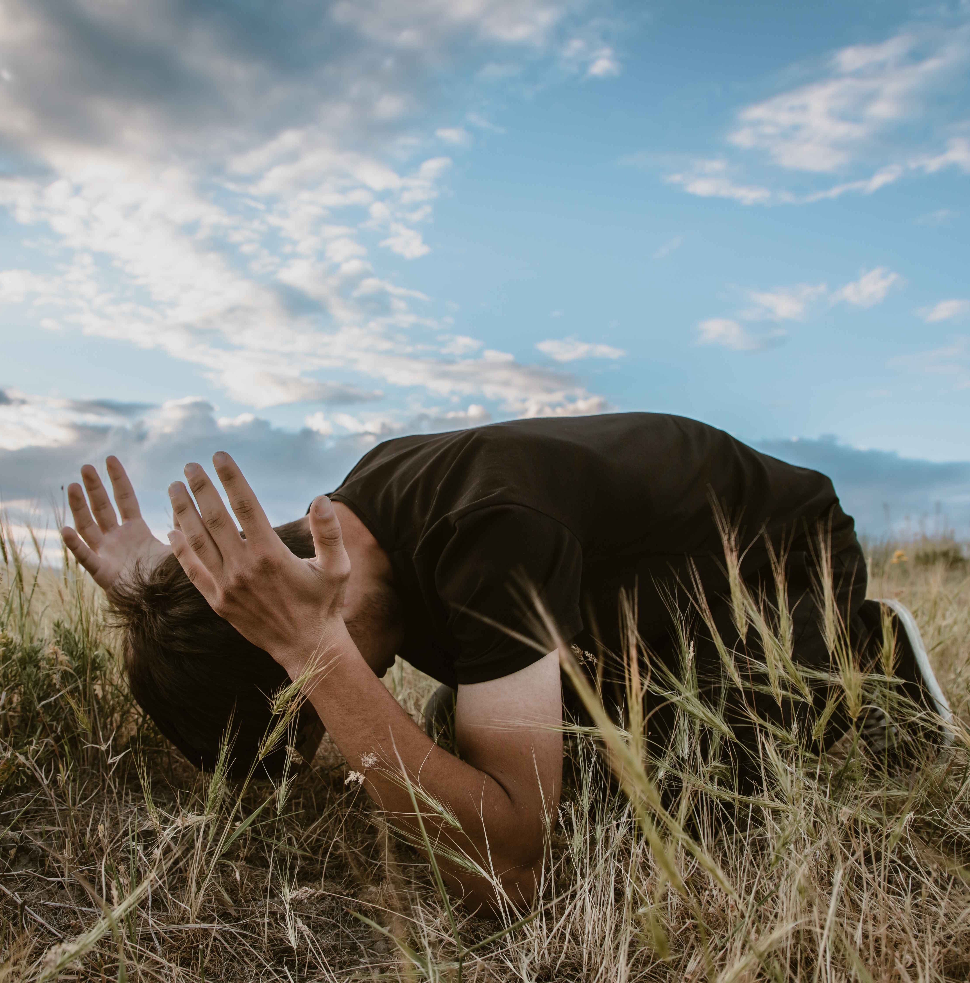
Now have proofs that may be seen, come to you from your Lord; whoso seeth them, the advantage will be his own: and whoso is blind to them, his own will be the loss: I am not made a keeper over you. Thus variously do we apply our signs, that they may say, “Thou hast studied deep:” and that to people of understanding we may make them clear.
Islam,
Sura VI. Cattle, 62

Slide 14

Know thou that, according to what thy Lord, the Lord of all men, hath decreed in His Book, the favors vouchsafed by Him unto mankind have been, and will ever remain, limitless in their range. First and foremost among these favors, which the Almighty hath conferred upon man, is the gift of understanding. His purpose in conferring such a gift is none other except to enable His creature to know and recognize the one true God--exalted be His glory....
Bahá’i, Bahá’u’lláh,
Gleanings, p. 194

Slide 15

For it behooveth no man to interpret the holy words according to his own imperfect understanding, nor, having found them to be contrary to his inclination and desires, to reject and repudiate their truth.
Bahá’i, Bahá’u’lláh,
The Kitáb-i-Íqán, 211

Slide 16
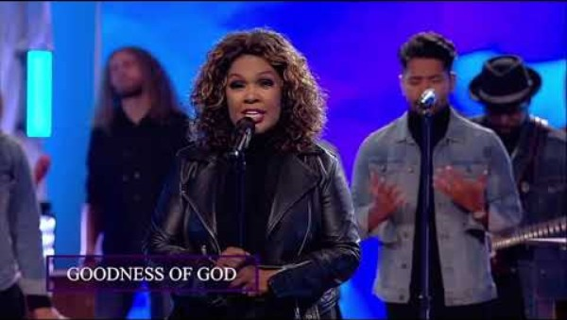
https://www.youtube.com/watch?v=y81yIo1_3o8

Slide 17
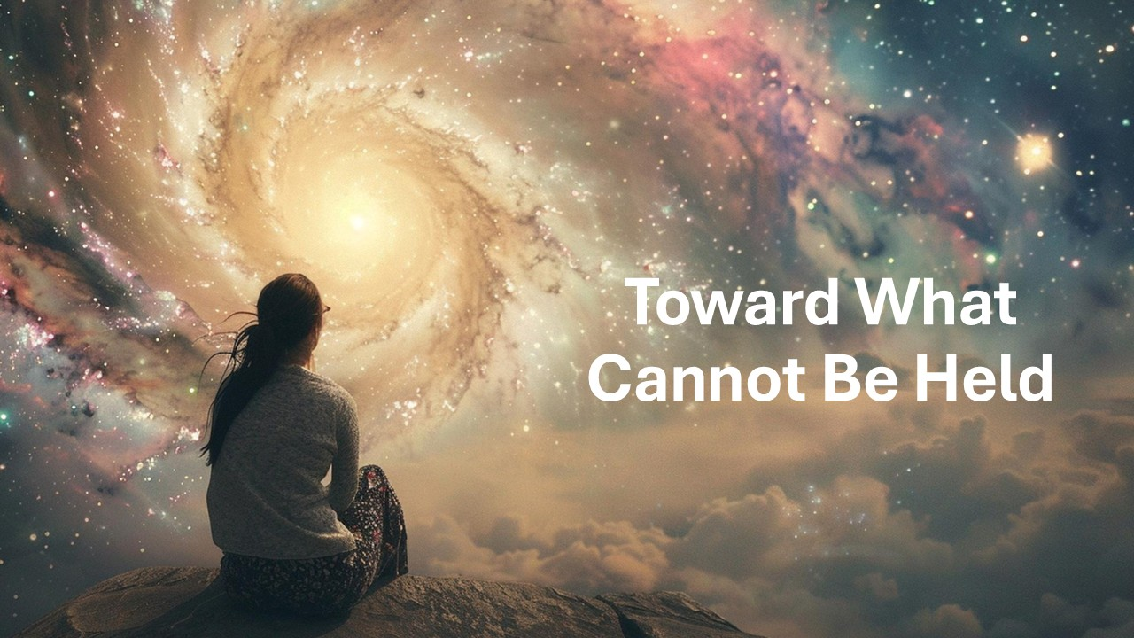
https://www.youtube.com/watch?v=0nkGDgXXyYs

