Slide 1


Slide 2

https://www.youtube.com/watch?v=RAuB-9K3MiI

Slide 3
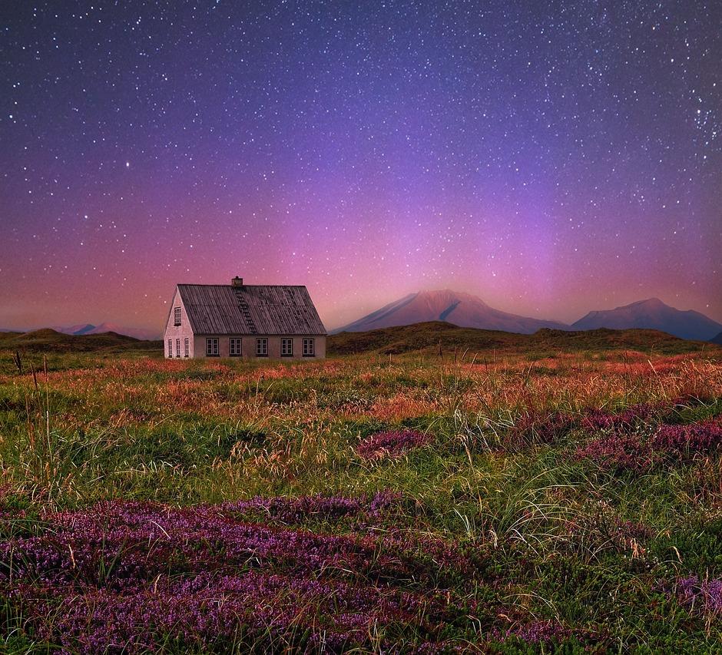
May the stars carry your
sadness away,
May the flowers fill your
heart with beauty,
May hope forever wipe
away your tears,
And, above all, may
silence make you strong.
American Indigenous Religions,
Chief Dan George,
Tsleil-Waututh Nation

Slide 4
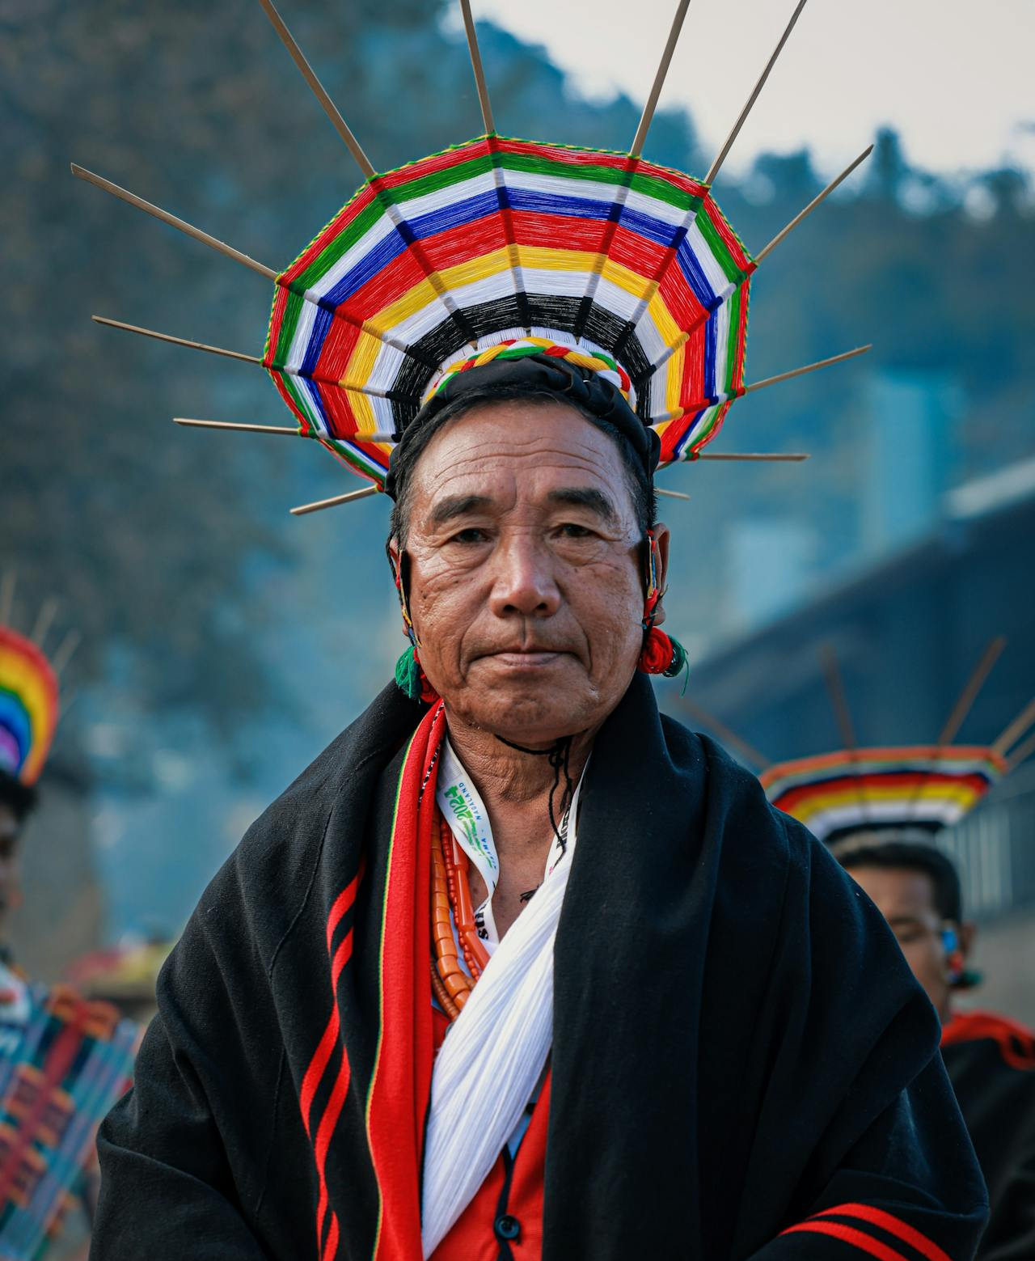
I hope the Great Heavenly Father, who will look down upon us, will give all the tribes His blessing, that we may go forth in peace, and live in peace all our days, and that He will look down upon our children and finally lift us far above the earth...
American Indigenous Religions,
Chief Red Cloud (Makhipiya-Luta)
Sioux Chief

Slide 5

The soul of the ungoverned is not
his,
Nor hath he knowledge of himself;
which lacked,
How grows serenity? and, wanting
that,
Whence shall he hope for
happiness?
Hinduism,
The Bhagavad-Gita, 39

Slide 6
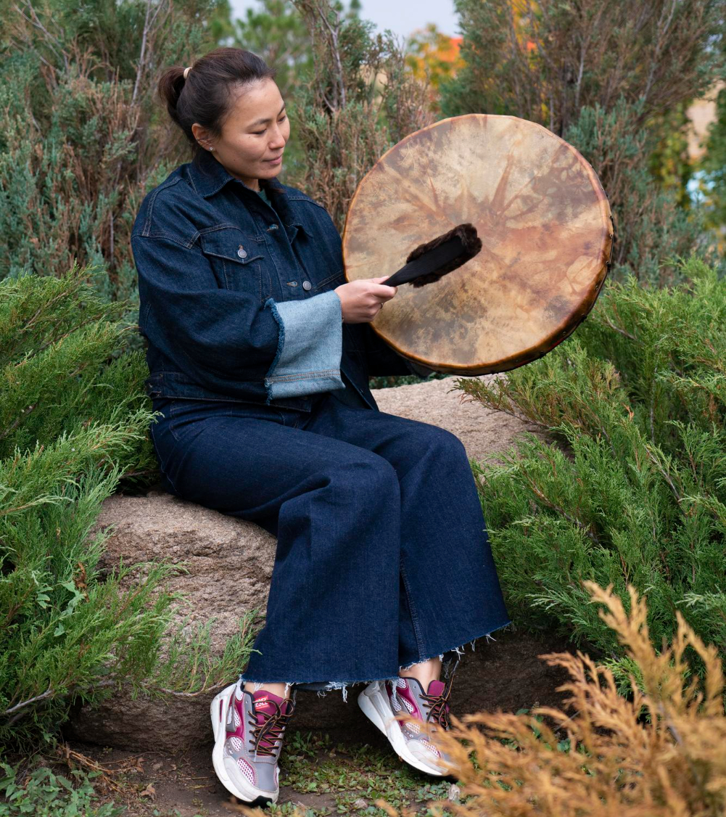
The wise call that man wise;
and such an one,
Renouncing fruit of deeds,
always content.
Always self-satisfying,
if he works,
Doth nothing that shall stain
his separate soul...
Hinduism,
The Bhagavad-Gita, 57

Slide 7
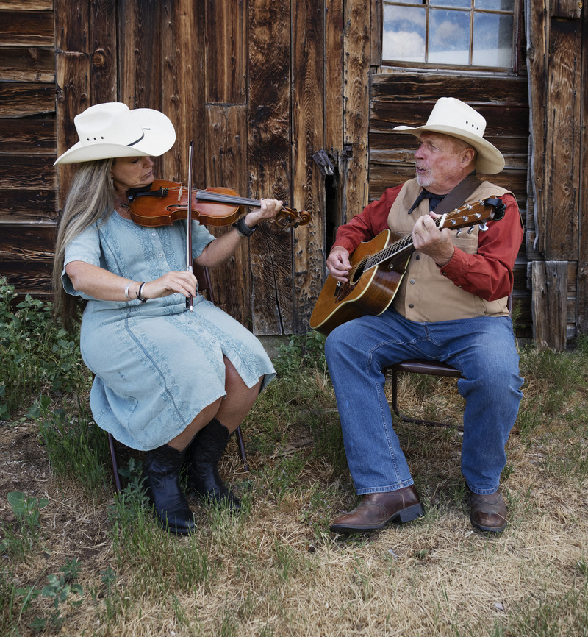
Hope deferred maketh the heart sick; but desire fulfilled is a tree of life.
Judaism,
Misheli (Proverbs) 13: 12

Slide 8

The Holy Spirit rests on him only who has a joyous heart.
Judaism,
Jerusalem Talmud,
Sukkot 5: 1

Slide 9
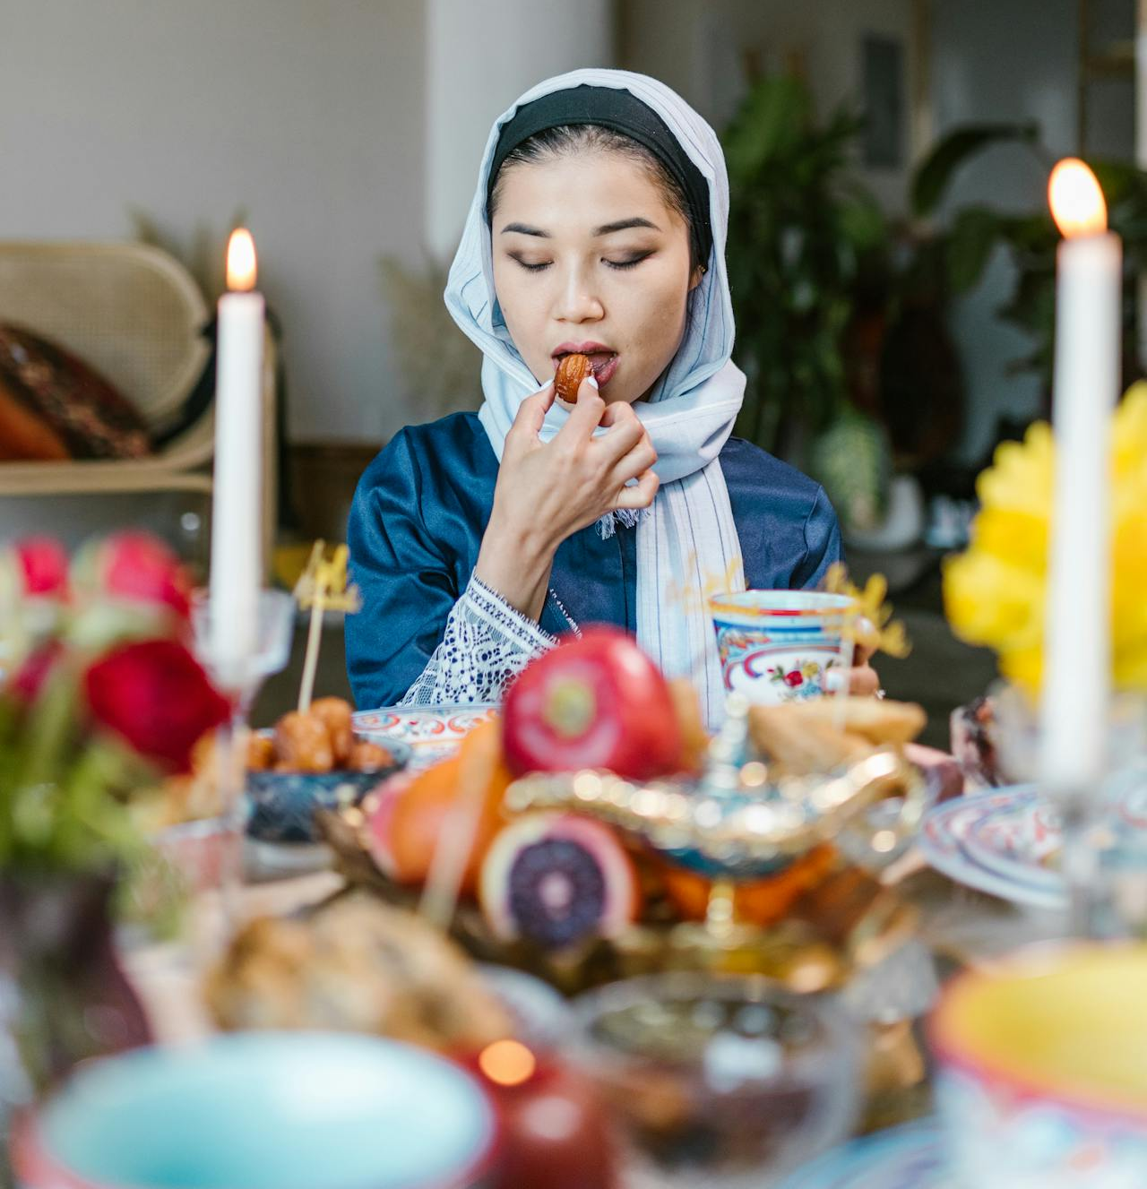
He who hopes for fruit, cultivates the energy that produces joy and the pleasure that brings praise, (while) carrying the human yoke.
Buddhism,
The Sutta Nipata, 346

Slide 10
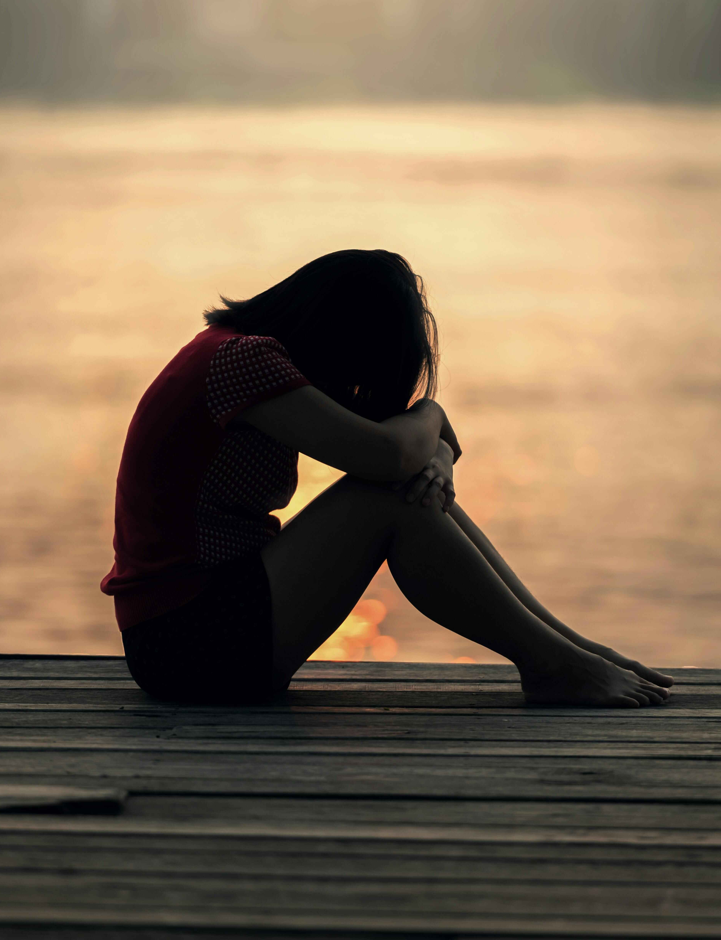
You who suffer from the tribulations of life, you who have to struggle and endure, you who yearn for a life of truth, rejoice at the glad tidings! There is balm for the wounded, and there is bread for the hungry. There is water for the thirsty, and there is hope for the despairing. There is light for those in darkness, and there is inexhaustible blessing for the upright.
Buddhism,
Sutra Collection (D), 1082

Slide 11
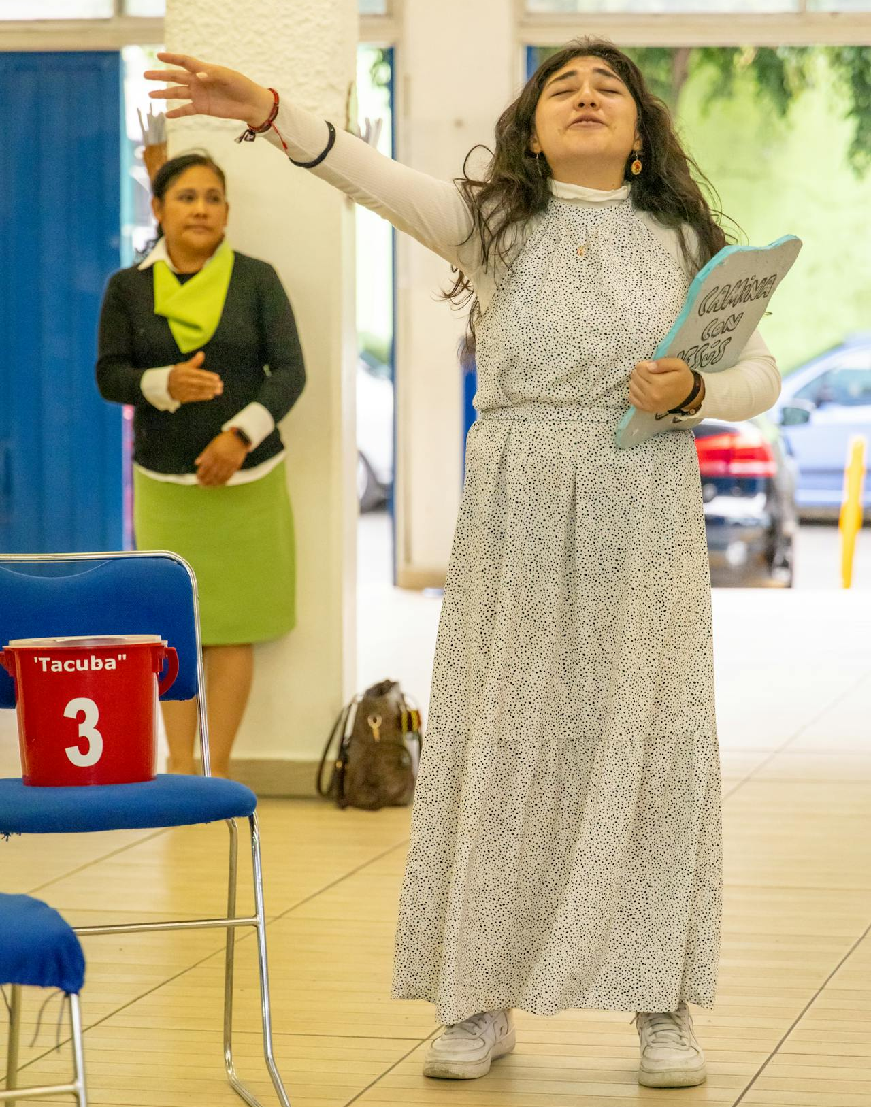
For we are saved by hope: but hope that is seen is not hope: for what a man seeth, why doth he yet hope for? But if we hope for that we see not, then do we with patience wait for it.
Christianity,
Romans, 8: 24

Slide 12
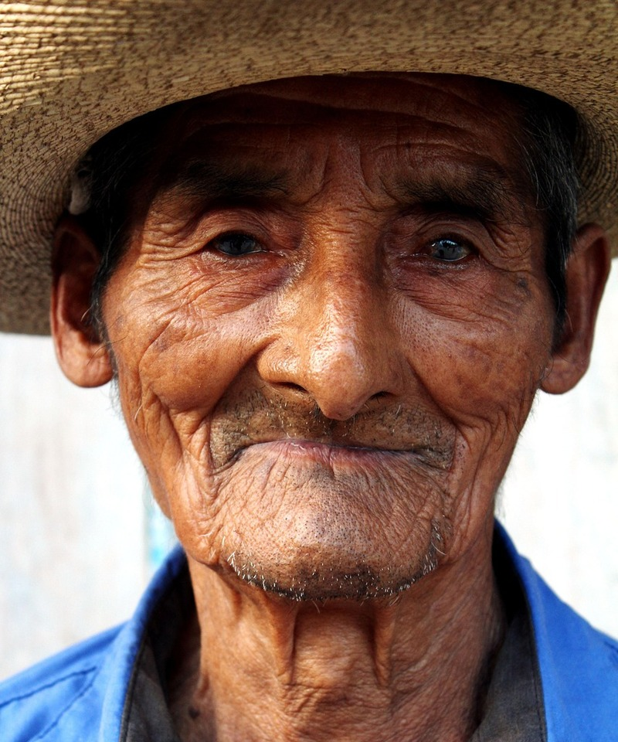
Now faith is the substance of things hoped for, the evidence of things not seen.
Christianity,
Hebrews, 11: 1

Slide 13
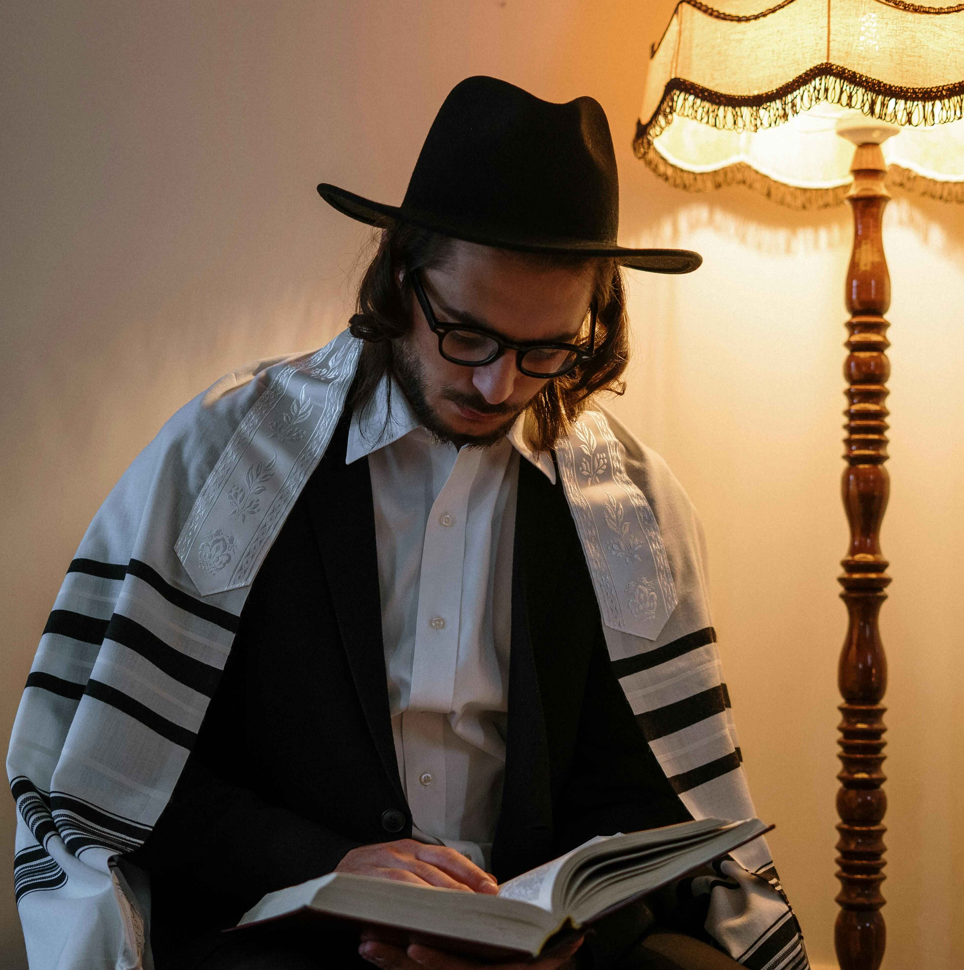
A good example had ye in them, for all who hope in God and in the last day. But let who will turn back, God truly is the Rich, the Praiseworthy! God will, perhaps, establish good will between yourselves and those of them whom ye take to be your enemies: God is Powerful: and God is Gracious, Merciful.
Islam,
Quran, Sura LX. She Who Is Tried, 6

Slide 14
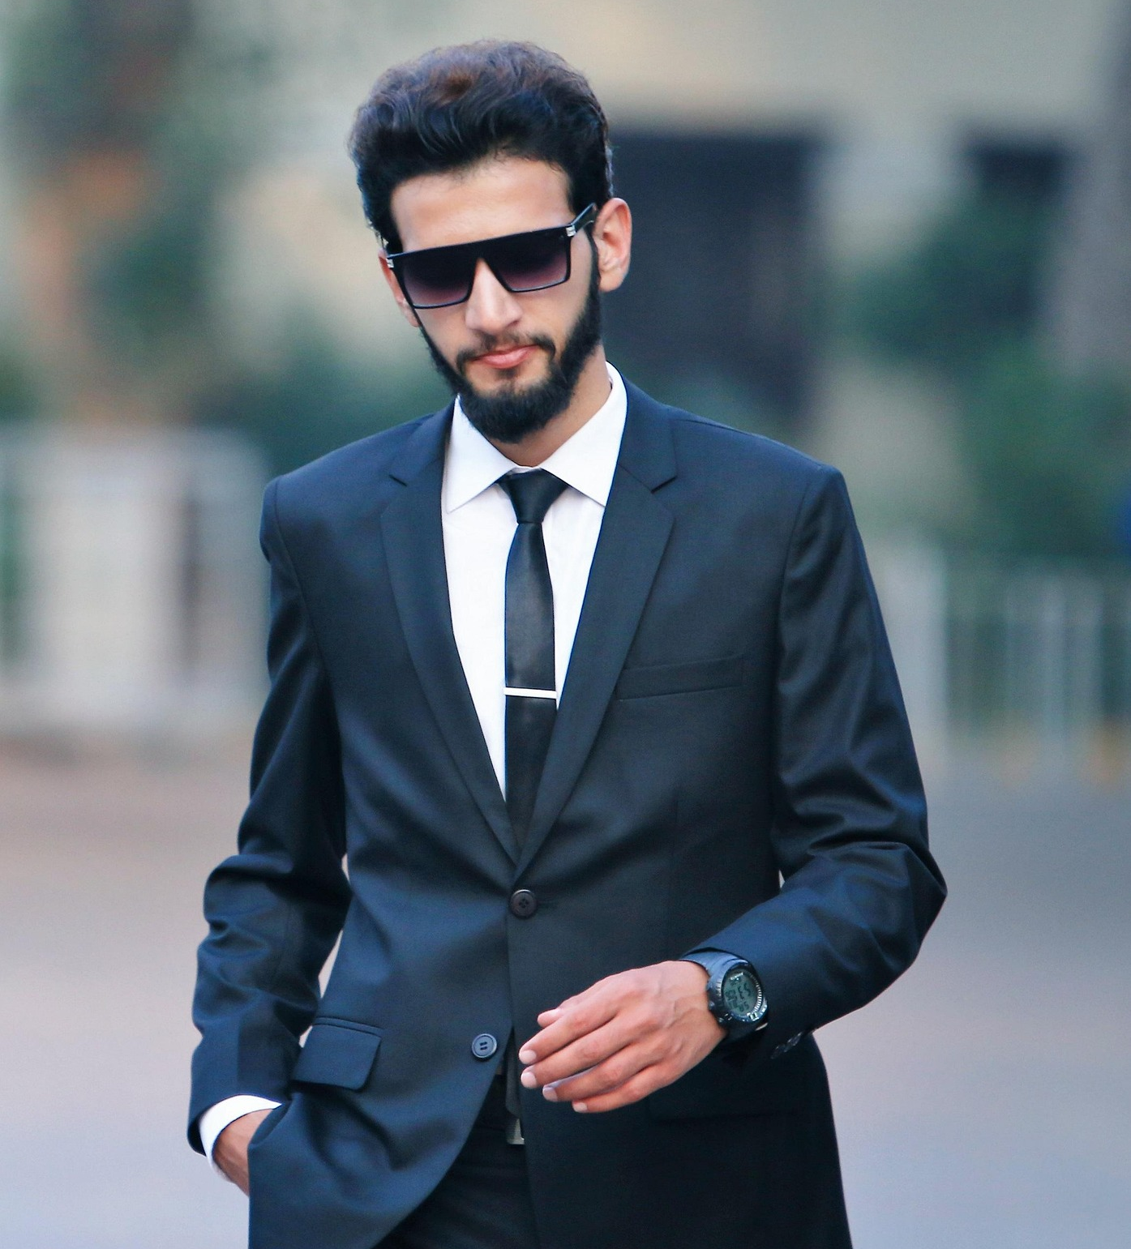
Tell the believers to pardon those who hope not for the days of God in which He purposeth to reward men according to their deeds. He who doth that which is right, doth it to his own behoof, and whoso doth evil, doth it to his own hurt. Hereafter, to your Lord shall ye be brought back.
Islam,
Quran, Sura XLV. The Kneeling, 10

Slide 15

Set all thy hope in God, and cleave tenaciously to His unfailing mercy. Who else but Him can enrich the destitute, and deliver the fallen from his abasement?
Bahá’i, Bahá’u’lláh,
Gleanings, p. 323

Slide 16
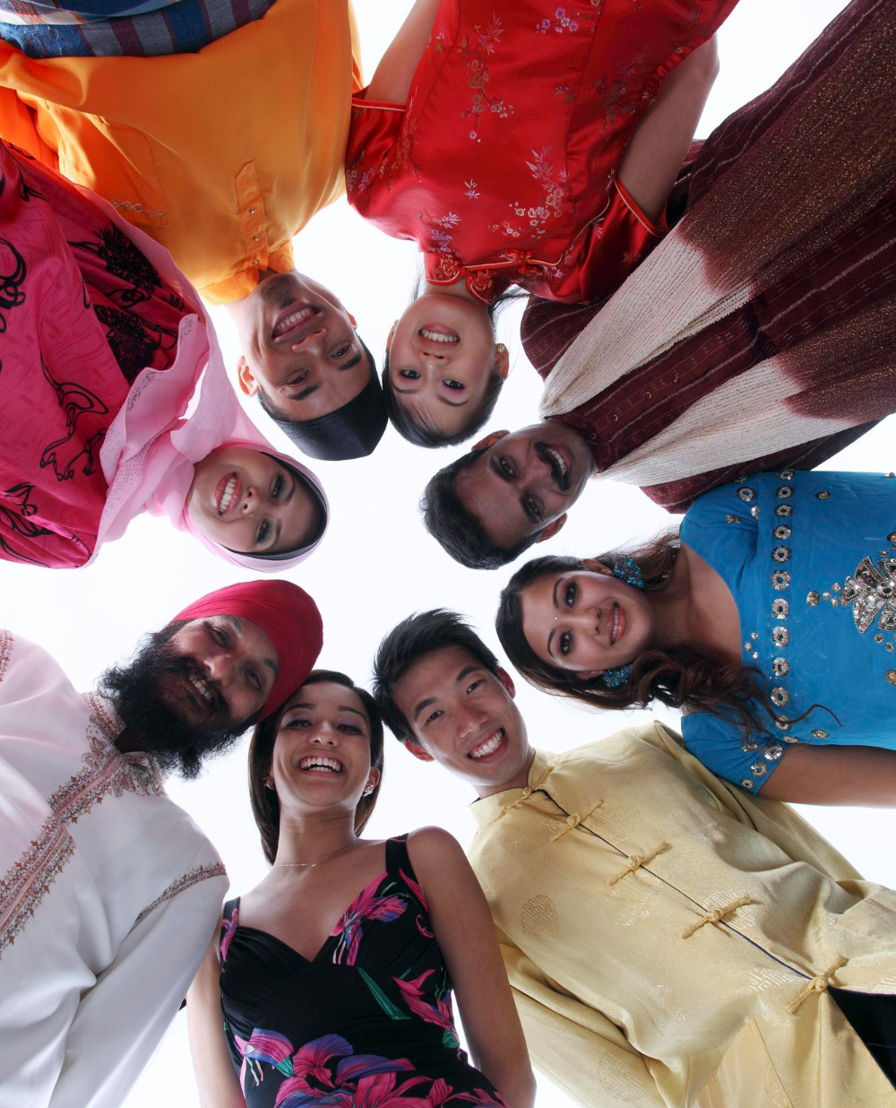
Let us pray to God that the breath of the Holy Spirit may again give hope and refreshment to the people, awakening in them a desire to do the Will of God. May heart and soul be vivified in every man: so will they all rejoice in a new birth.
Bahá’i, ‘Abdu’l-Bahá,
Paris Talks, p. 34

Slide 17

https://www.youtube.com/watch?v=RiU4jt5zW1o

Slide 18

https://www.youtube.com/watch?v=-WUNYHojDp8

