Slide 1

Enlightened & Awakened
Tucker, GA

Slide 2

https://www.youtube.com/watch?v=5sQZmwIBAhs

Slide 3
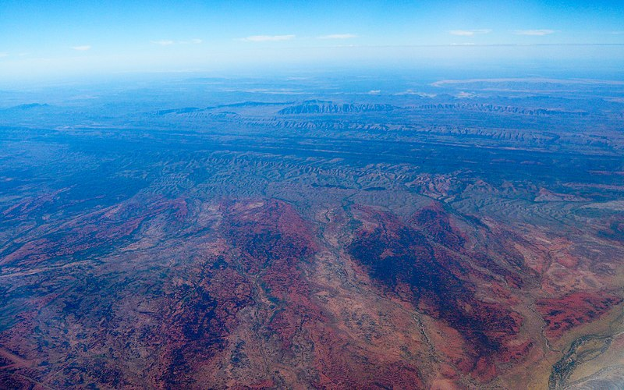
We are all visitors to this time, this place. We are just passing through. Our purpose here is to observe, to learn, to grow, to love… and then we return home.
Australian Aboriginal Wisdom

Slide 4
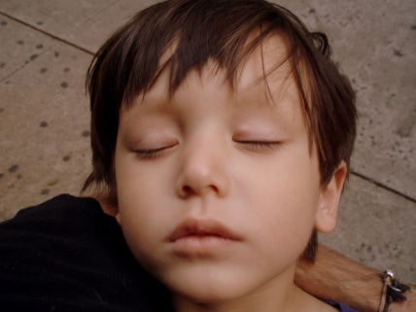
Seek not for life on earth or in heaven. Thirst for life is delusion. Knowing life to be transitory, wake up from this dream of ignorance and strive to attain knowledge and freedom.
Hinduism,
Srimad Bhagavatam 11: 13

Slide 5

Meditation is in truth higher than thought. The earth seems to rest in silent meditation; and the waters and the mountains and the sky and the heavens seem all to be in meditation. Whenever a man attains greatness on this earth, he has his reward according to his meditation.
Hinduism,
Chandogya Upanishad 7: 6

Slide 6
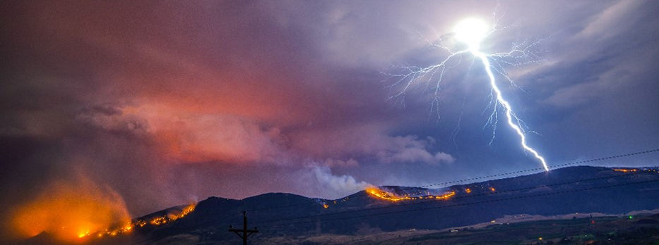
The LORD reigneth; let the earth rejoice; let the multitude of isles be glad thereof.
Clouds and darkness are round about him: righteousness and judgment are the habitation of his throne.
A fire goeth before him, and burneth up his enemies round about.
His lightnings enlightened the world: the earth saw, and trembled.
Judaism, Tehilim (Psalms), 97: 1-4

Slide 7

My heart is fixed, O God, my heart is fixed: I will sing and give praise.
Awake up, my glory; awake, psaltery and harp: I myself will awake early.
I will praise thee, O Lord, among the people: I will sing unto thee among the nations.
For thy mercy is great unto the heavens, and thy truth unto the clouds.
Judaism,
Tehilim (Psalms), 57: 7-10

Slide 8
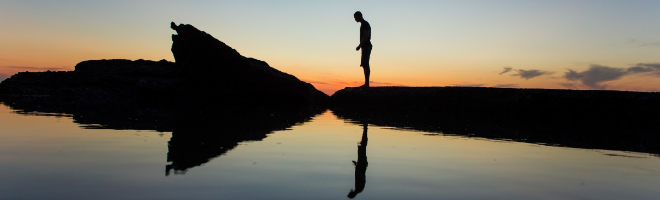
By awakening, by awareness, by restraint and control, the wise may make for oneself an island which no flood can overwhelm.
Buddhism,
Dhammapada 25

Slide 9
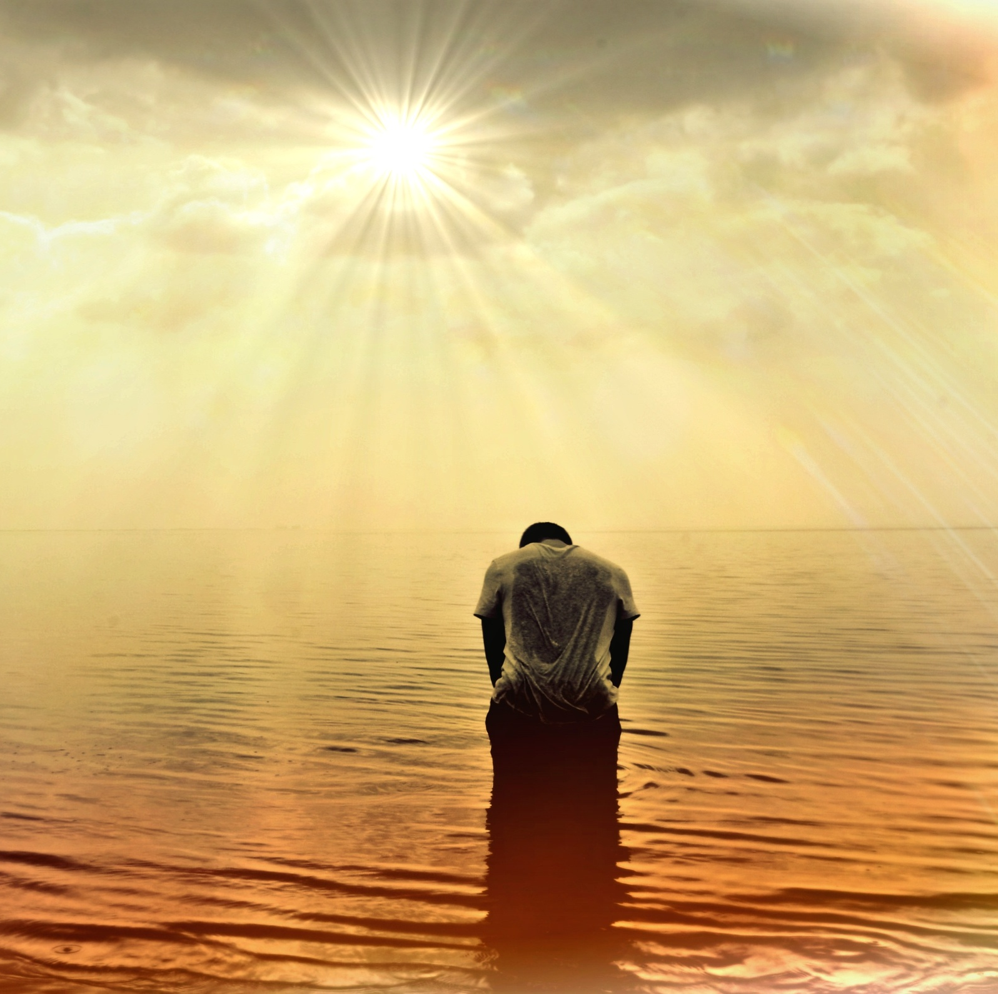
It is difficult to be born as a human being;
difficult is the life of mortals;
difficult is the hearing of the true path;
difficult is the awakening of enlightenment.
Buddhism,
Dhammapada 182

Slide 10
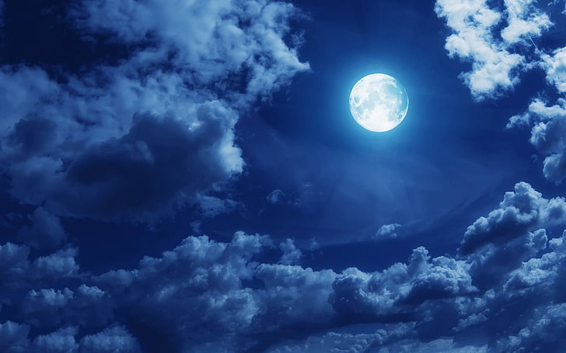
The one who formerly was thoughtless and afterwards became conscientious lights up this world like the moon when freed from a cloud.
The one whose wrong actions are eradicated by good conduct lights up this world like the moon when freed from a cloud.
Buddhism, Dhammapada 124

Slide 11
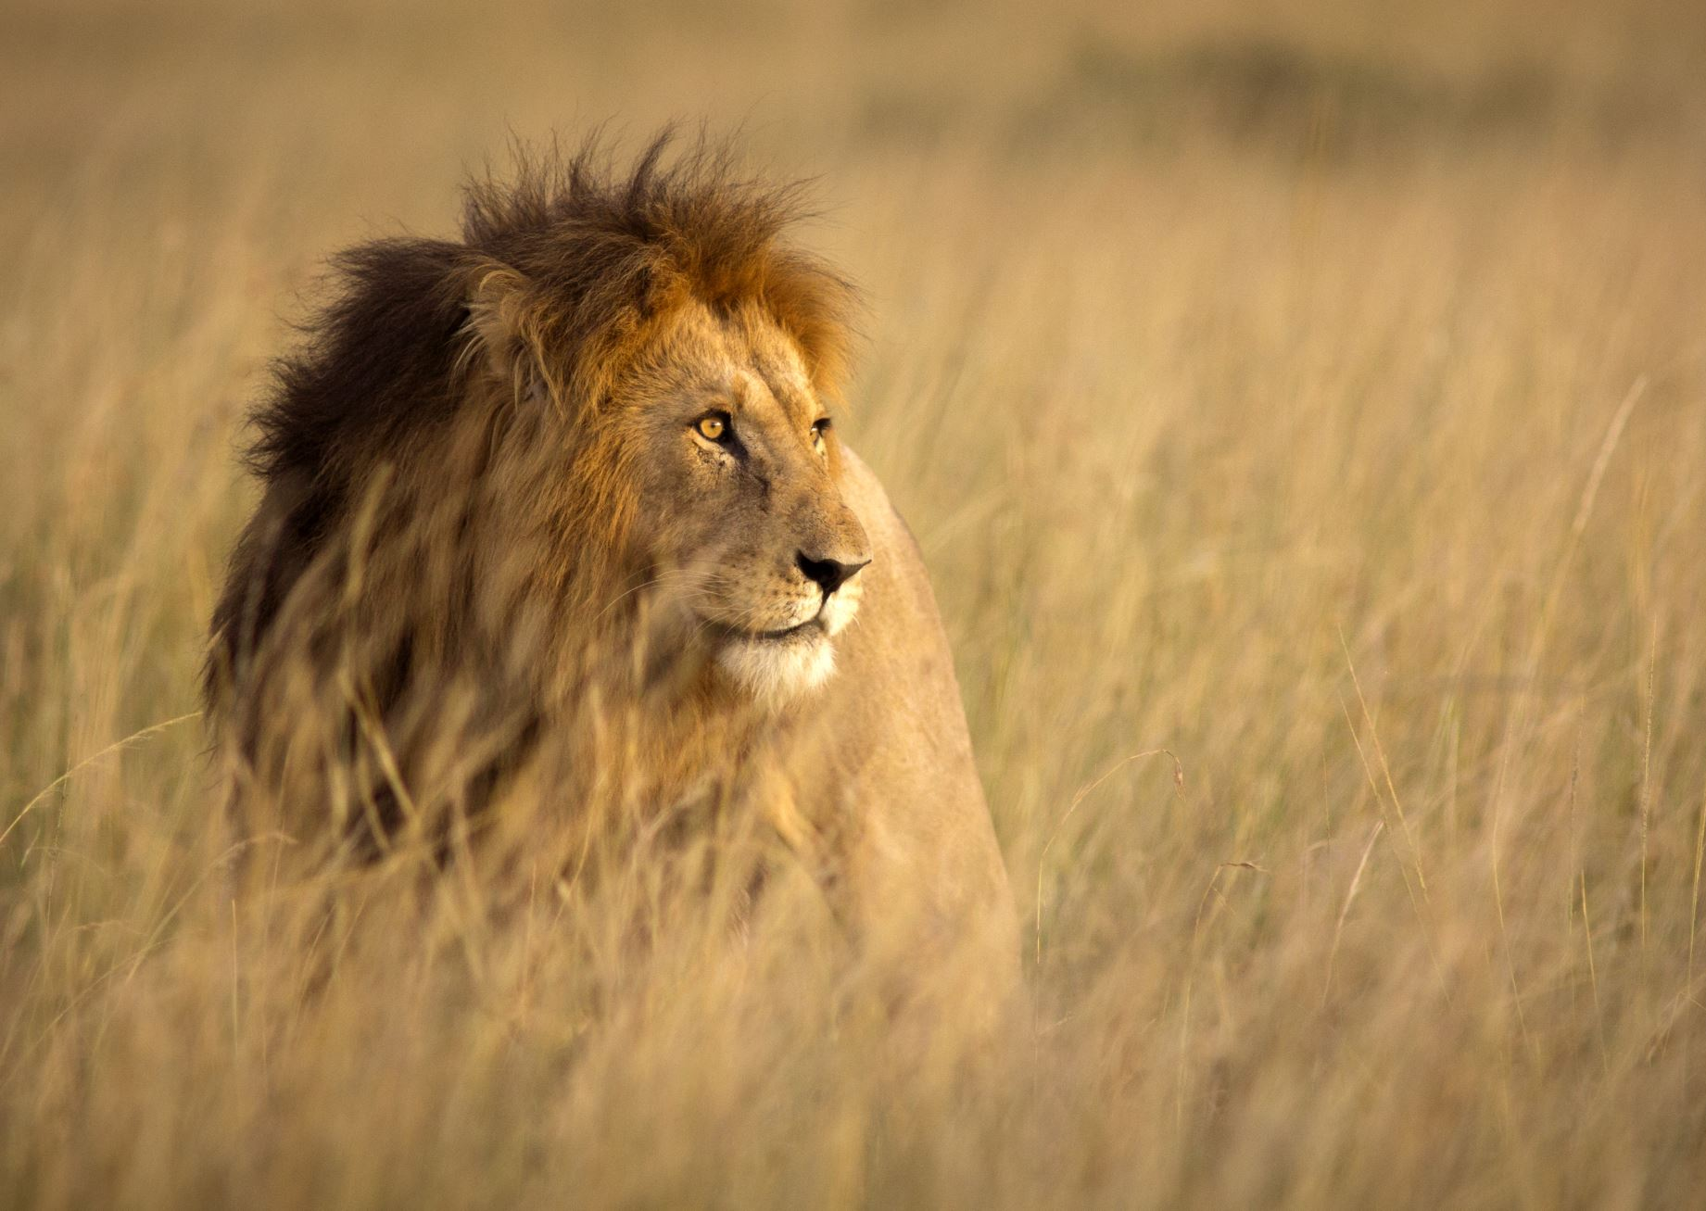
Be careful! Watch out for attacks from the Devil, your great enemy. He prowls around like a roaring lion, looking for some victim to devour.
Christianity,
Peter I 5: 8

Slide 12
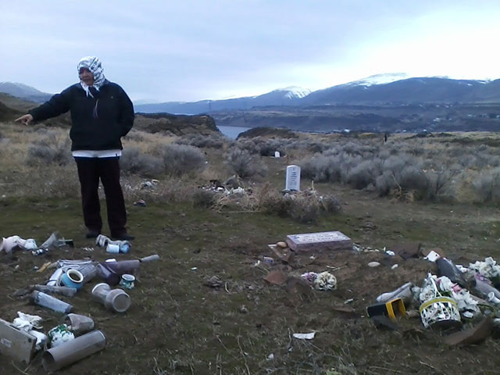
Why do you see the speck that is in your brother‘s eye, but do not notice the log that is in your own eye?…You hypocrite, first take the log out of your own eye, and then you will see clearly to take the speck out of your brother‘s eye.
Christianity,
Matthew 7: 3-5

Slide 13

The most honorable among you in the sight of God is the one who is most God-conscious.
Islam, Qur’án 49: 13

Slide 14

The lamp is lighted, but as it hath not a conscious knowledge of itself, no one hath become glad because of it. Moreover, a soul of excellent deeds and good manners will undoubtedly advance from whatever horizon he beholdeth the lights radiating. Herein lies the difference: By faith is meant, first, conscious knowledge, and second, the practice of good deeds.
‘Abdu’l-Bahá,
Bahá’í World Faith, p. 383

Slide 15

Rise up and struggle, seek education, seek enlightenment.
Bahá’i,
‘Abdu’l-Bahá,
Secret of
Divine Civilization, p. 91

Slide 16

https://www.youtube.com/watch?v=6XP-f7wPM0A
May there be an abundance of well-being in all,
May there be an abundance of peace in all,
May there be an abundance of fulfillment in all,
May there be an abundance of auspiciousness in all,
Peace! Peace! Peace!

Slide 17
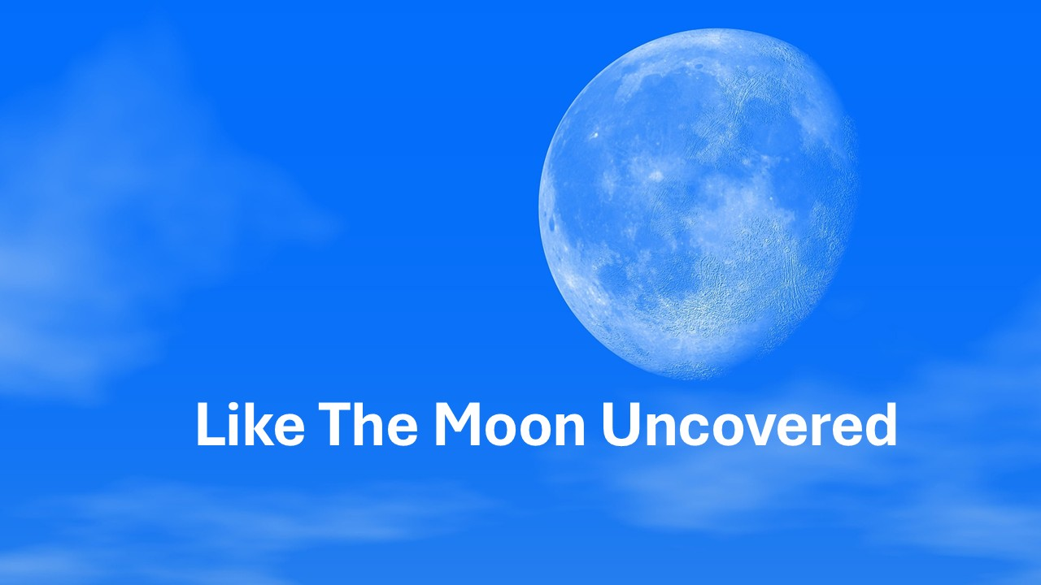
https://www.youtube.com/watch?v=tnHiuLJUqss

