Slide 1


Science & Religion
Tucker, GA

Slide 2
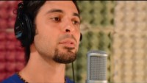
https://www.youtube.com/watch?v=zfPzUZ_25yw

Slide 3
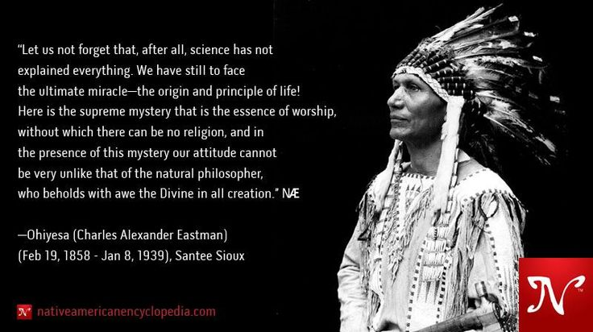

Slide 4
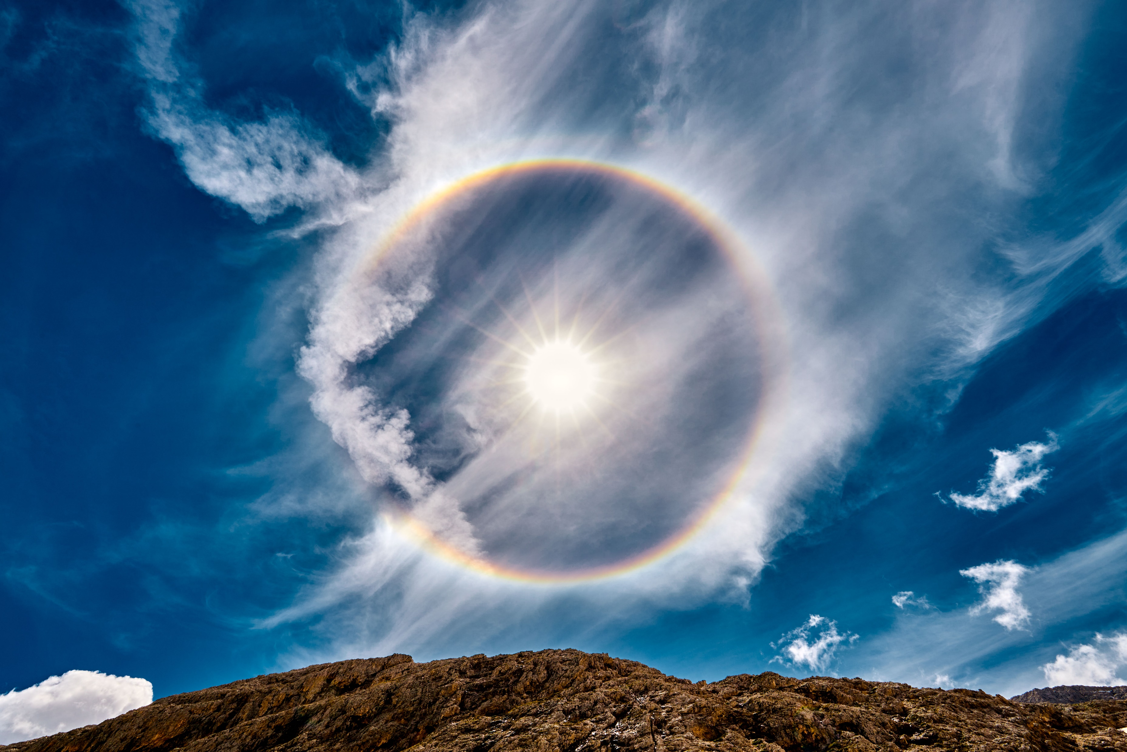


Behold the universe in the glory of God; and all that lives and moves on earth.
Hinduism, Isha Upanishad 1: 1

Slide 5

It is the glory of God to conceal a matter and the glory of kings to search a matter out.
Judaism,
Proverbs 25: 2

Slide 6

Buddhist teachings stress the importance of understanding reality. Therefore, we should pay attention to what modern scientists have actually found through experiment and through measurement the things they have proved to be reality.
Tenzin Gyatso,
the 14th Dalai Lama,
A Collaboration Between Science and Religion, para 4

Slide 7

A good traveler has no fixed plans and is not intent upon arriving.
A good artist lets his intuition lead him wherever it wants.
A good scientist has freed himself of concepts and keeps his mind open to what is.
Taoism, Lao-Tzu,
Tao Te Ching, Chap 27

Slide 8

In matters that are obscure and far beyond our vision, even in such as we may find treated in Holy Scripture, different Interpretations are sometimes possible without prejudice to the faith we have received. In such a case, we should not rush in headlong and so firmly take our stand on one side that, if further progress in the search of truth justly undermines this position, we too fall with it. That would be to battle not for the teaching of Holy Scripture but for our own, wishing its teaching to conform to ours, whereas we ought to wish ours to conform to that of Sacred Scripture.
Christianity, Augustine of Hippo,
De Genesi ad literam
(On the Literal Interpretation
of Genesis), 8: 37

Slide 9
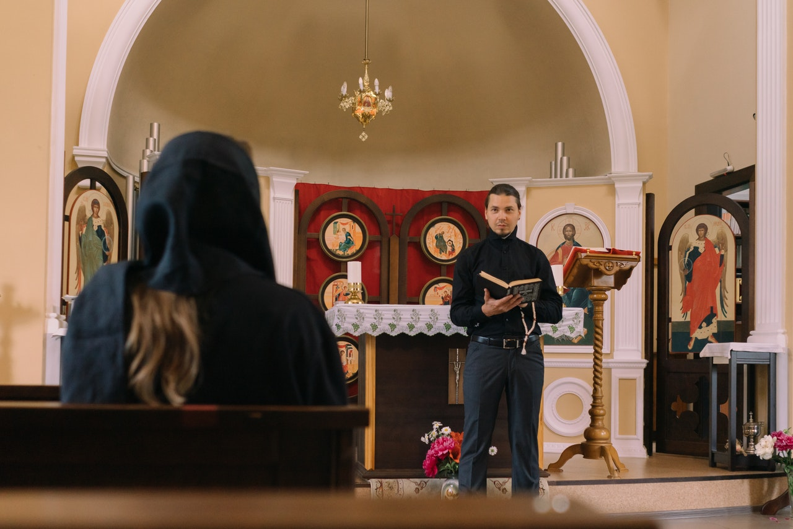
Reckless and incompetent expounders of holy Scripture bring untold trouble and sorrow on their wiser brethren when they are caught in one of their mischievous false opinions and are taken to task by those who are not bound by the authority of our sacred books. For then, to defend their utterly foolish and obviously untrue statements, they will try to call upon Holy Scripture for proof and even recite from memory many passages which they think support their position, although “they understand neither what they say nor the things about which they make assertion.” (1 Timothy 1, 7)
Christianity, Augustine of Hippo,
De Genesi ad literam
(On the Literal Interpretation of Genesis),
19: 39

Slide 10

God is the Light of the heavens and the earth,
The parable of His Light is as if there were a Niche, and within it a Lamp; the Lamp enclosed in Glass:
The Glass as it were a brilliant star: Lit from a blessed Tree, an olive neither of the East nor of the West, whose oil is well-nigh luminous, though fire scarce touched it.
Light upon Light! God guides whom he will to his Light; God sets forth parables for men, and God knows all things.
Islam, Muhammed, Qur’án 2: 35

Slide 11

[I]t is evident that God has destined and intended religion to be the cause and means of cooperative effort and accomplishment among mankind. To this end He has sent the Prophets of God, the holy Manifestations of the Word, in order that the fundamental reality and religion of God may prove to be the bond of human unity, for the divine religions revealed by these holy Messengers have one and the same foundation.
Bahá’i, ‘Abdu’l-Bahá,
Promulgation of Universal Peace, p. 338

Slide 12

God has conferred upon and added to man a distinctive power--the faculty of intellectual investigation into the secrets of creation, the acquisition of higher knowledge--the greatest virtue of which is scientific enlightenment.
Bahá’i, ‘Abdu’l-Bahá,
Promulgation of Universal Peace, p. 31

Slide 13

A question or principle which is religious in its nature must be sanctioned by science. Science must declare it to be valid, and reason must confirm it in order that it may inspire confidence. If religious teaching, however, be at variance with science and reason, it is unquestionably superstition.
Bahá’i, ‘Abdu’l-Bahá,
Promulgation of Universal Peace, p. 394

Slide 14
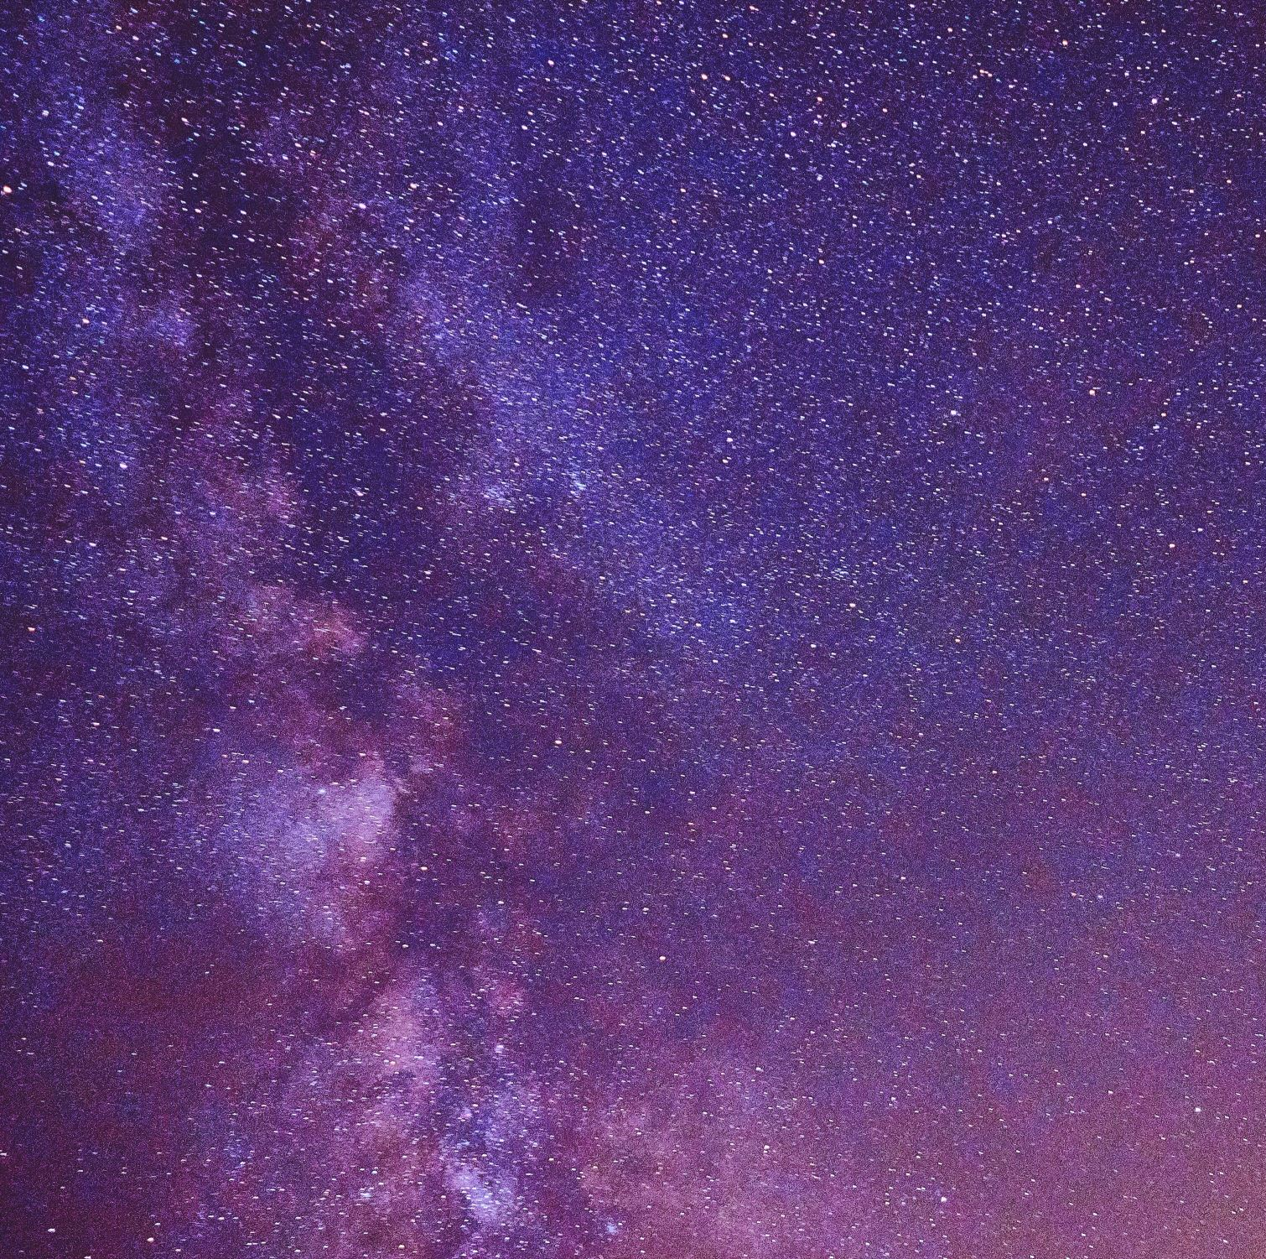
The Bible shows the way to go to heaven, not the way the heavens go.
Scientist, Galileo Galilei,
Letter to Dowager Grand Duchess, Christina

Slide 15
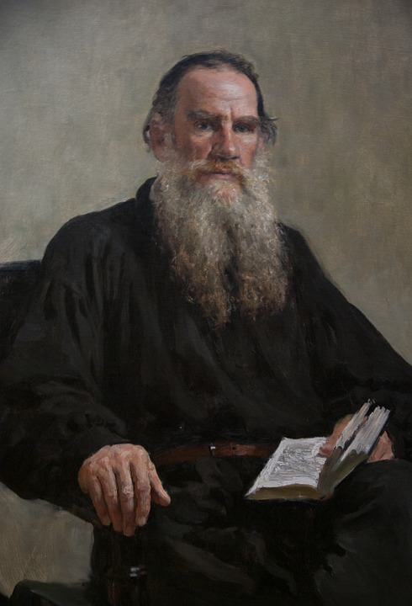
Religion reveals the meaning of life, and science only applies this meaning to the course of circumstances.
Leo Tolstoy, Russian Author

Slide 16
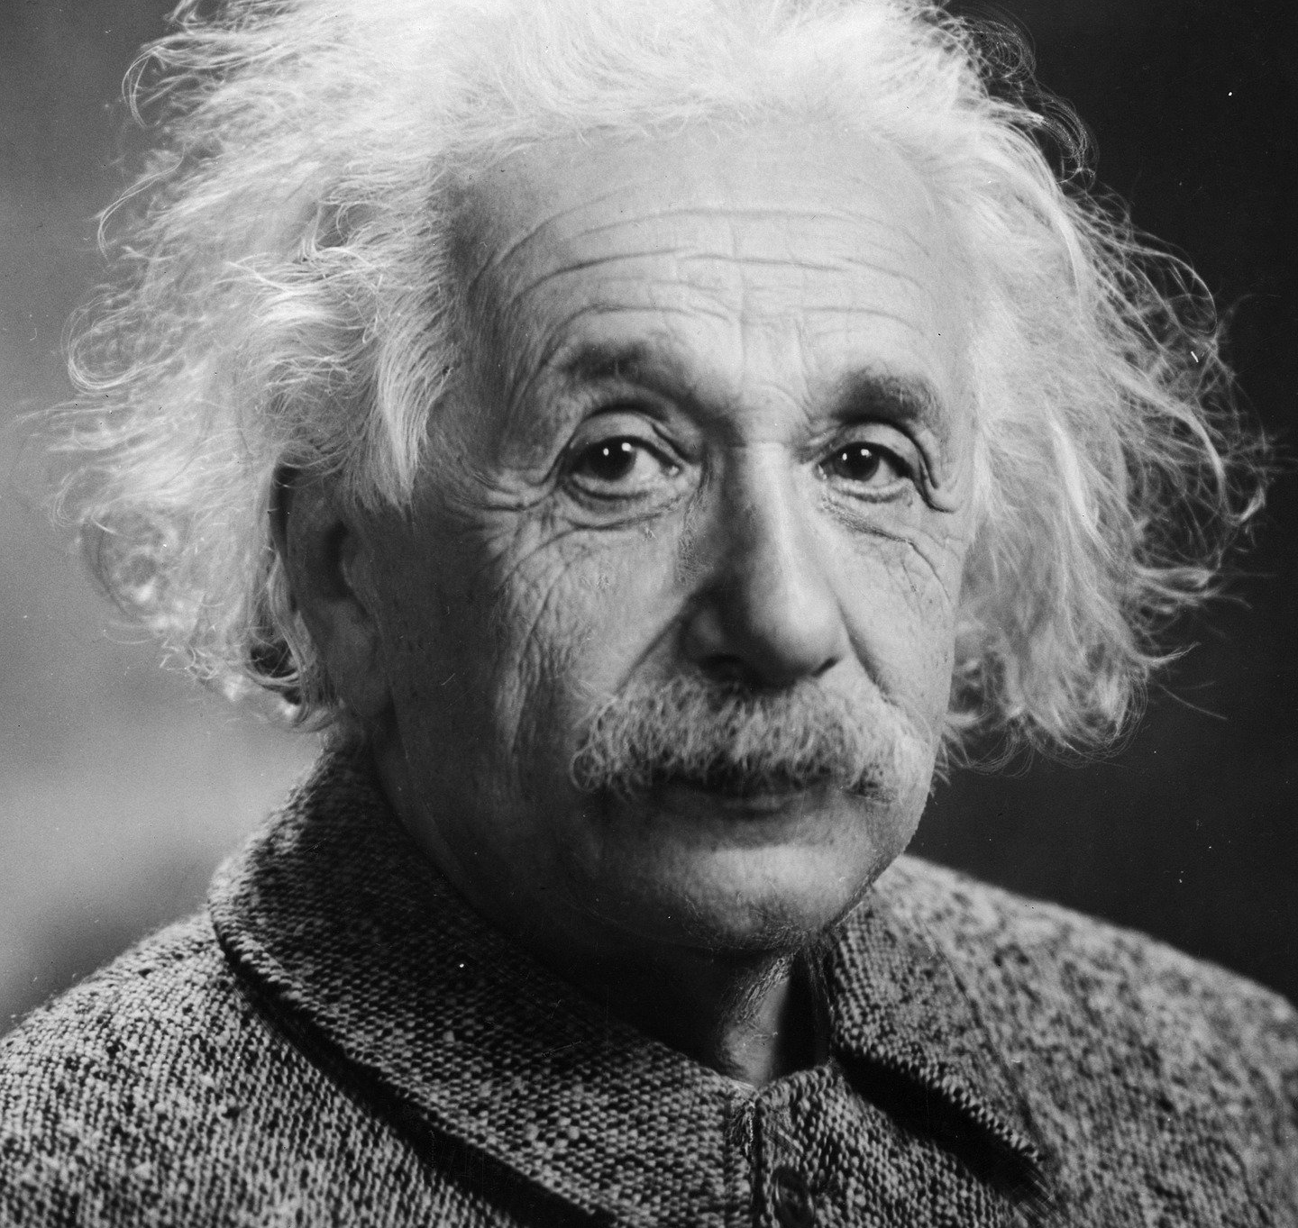
But science can only be created by those who are thoroughly imbued with the aspiration towards truth and understanding. This source of feeling, however, springs from the sphere of religion. To this there also belongs the faith in the possibility that the regulations valid for the world of existence are rational, that is, comprehensible to reason. I cannot conceive of a genuine scientist without that profound faith. The situation may be expressed by an image: Science without religion is lame, religion without science is blind.
Scientist, Albert Einstein,
Out of My Later Years, p. 26

Slide 17
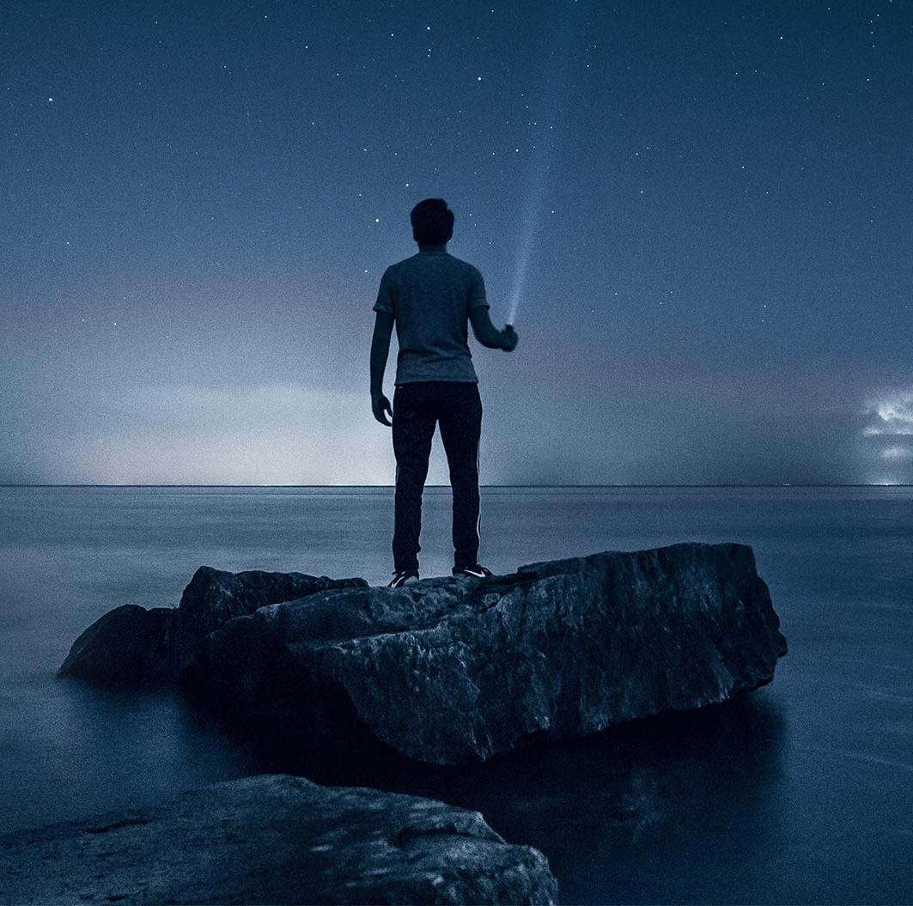
Science and religion find common ground in their search for universal truths. Universal truths cannot be compartmentalized. From this perspective, if a scientist genuinely searches for universal truths, he or she will be naturally led to religion, and correspondingly, a sincere member of a religious faith will be open to the results of scientific investigation.
Scientist, Anjam Khursheed,
The Spiritual Foundations
of Science, p. 20

Slide 18

For a parallel to the lesson of atomic theory…[we must turn] to those kinds of epistemological problems with which already thinkers like the Buddha and Lao Tzu have been confronted, when trying to harmonize our position as spectators and actors in the great drama of existence.
Scientist, Niels Bohr,
Speech on Quantum Theory

Slide 19

https://www.youtube.com/watch?v=ulK_GE9XjO8

Slide 20

https://www.youtube.com/watch?v=m4pq_nWvPf0

