Slide 1
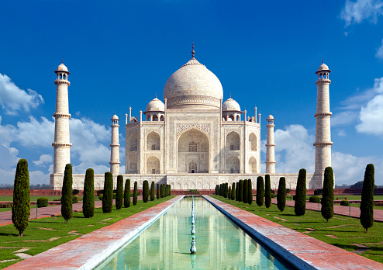
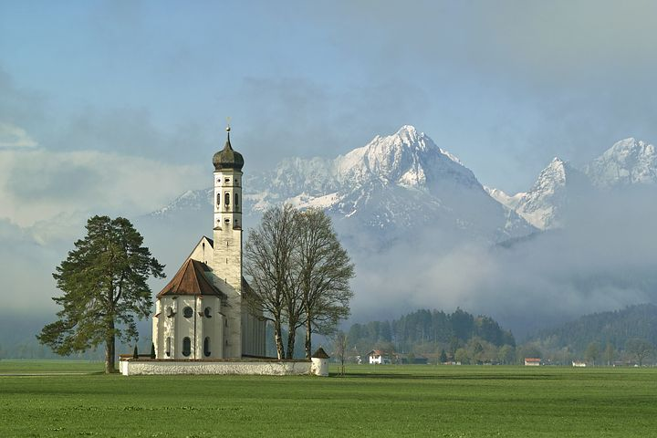

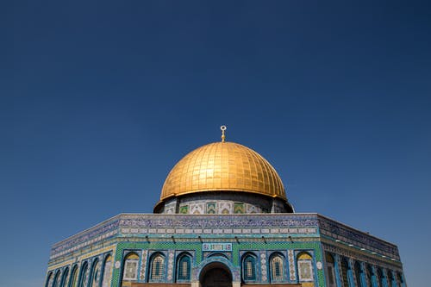
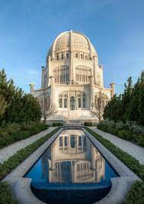

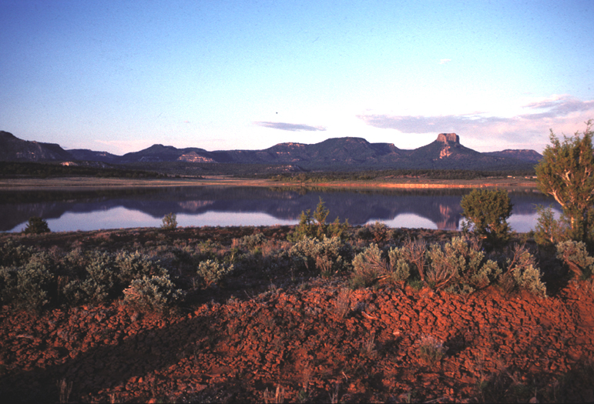
Oneness of Religion
Tucker, GA

Slide 2

https://www.youtube.com/watch?v=O2OU776PGMk

Slide 3
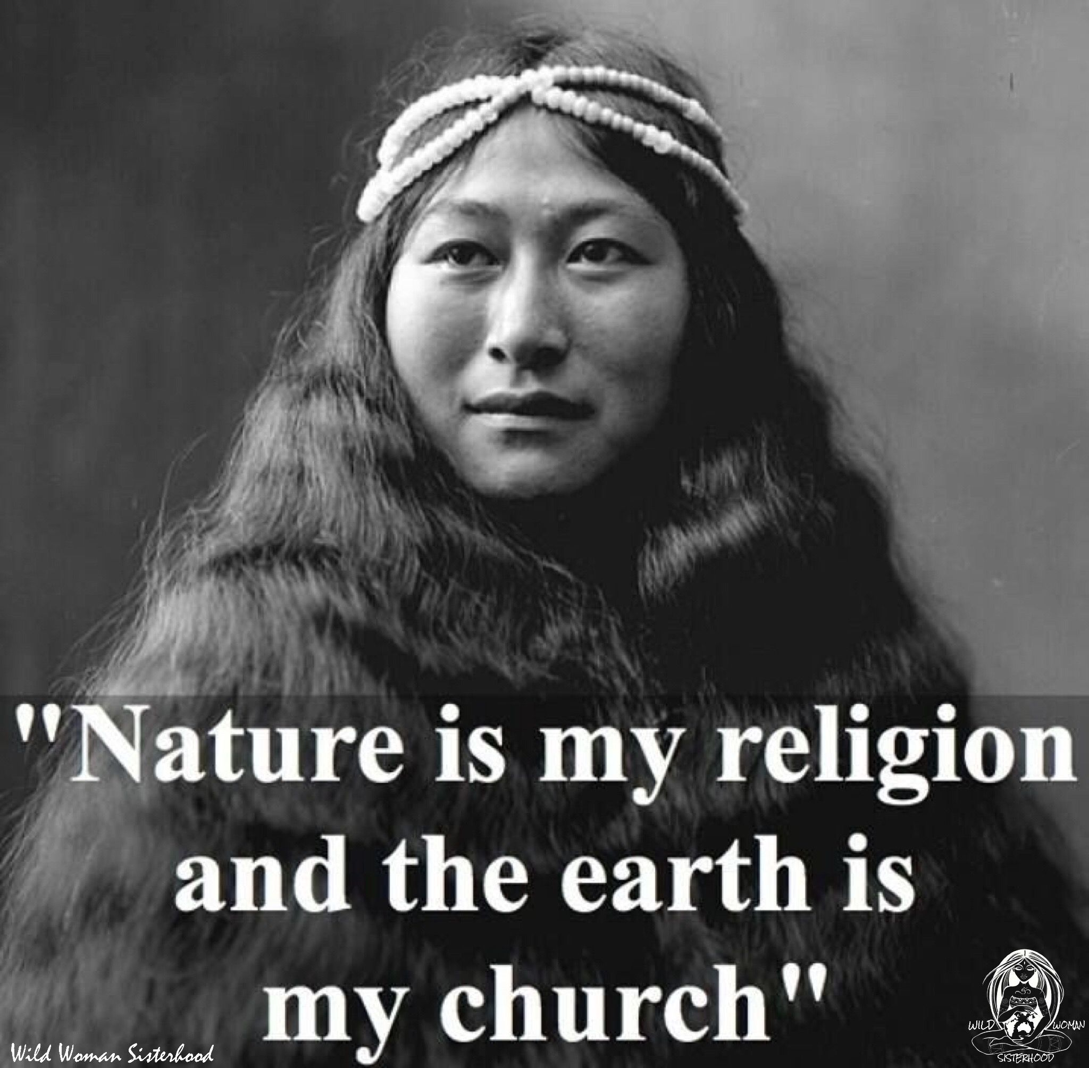

Slide 4
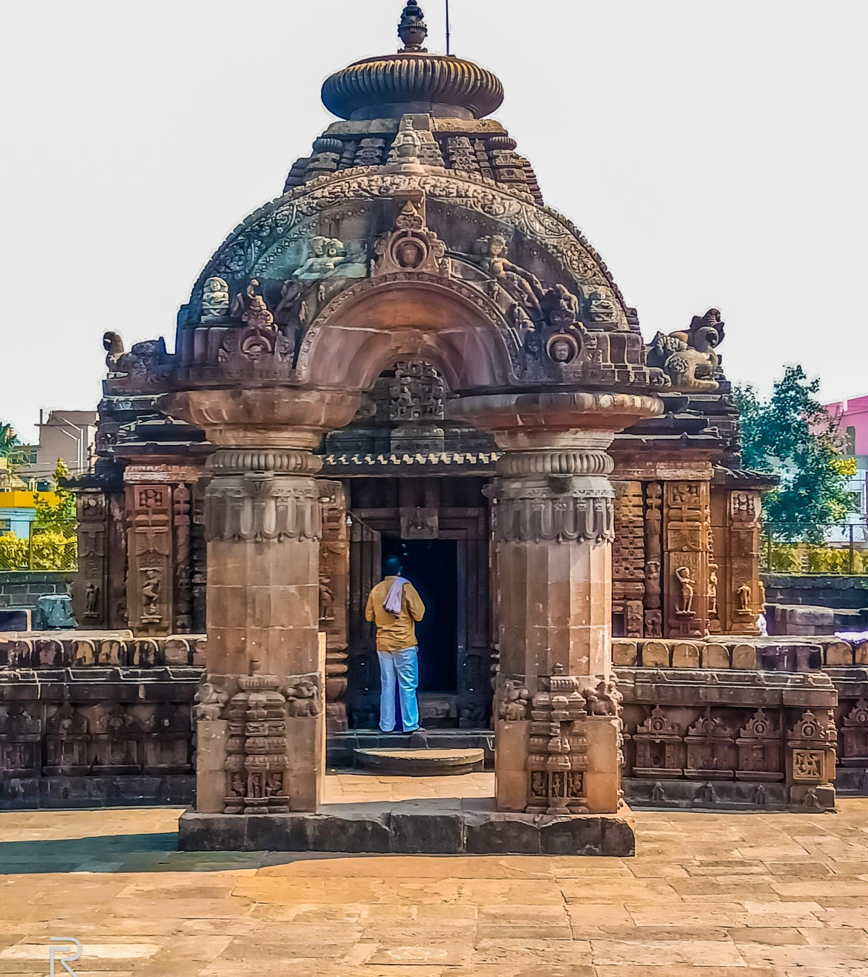
Whenever there is decline in righteousness, O Bharat, and a rise in irreligion, then I send forth My Spirit.
For the Salvation of those who are good, for the destruction of evil in men, for the fulfillment of the kingdom of righteousness, I manifest Myself from age to age.
  Hinduism,
  Bhagavad Gita 4: 7-8

Slide 5
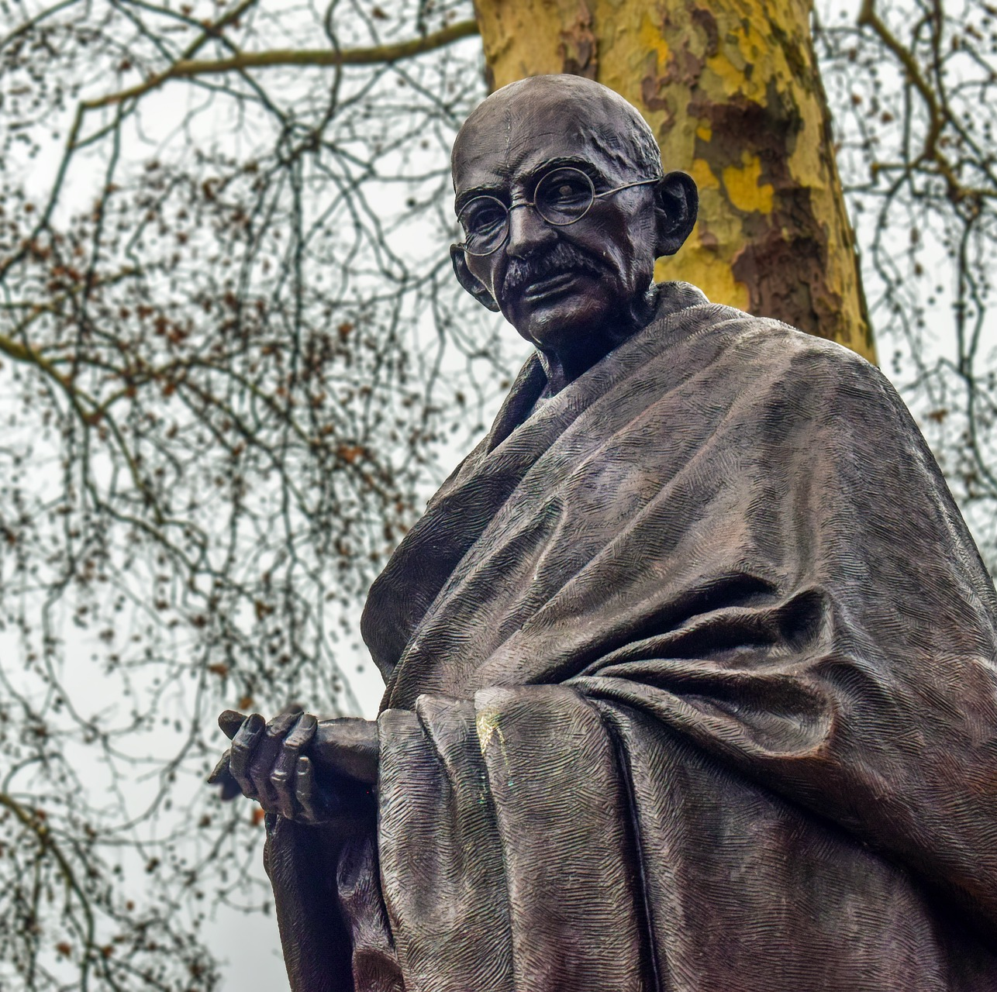
“The Allah of Islam is the same as the God of Christians and the Ishwara of Hindus. Even as there are numerous names of God in Hinduism, there are many names of God in Islam. The names do not indicate individuality but attributes, and little man has tried in his humble way to describe mighty God by giving Him attributes, though He is above all attributes, Indescribable, Immeasurable.”
Mahatma Gandhi

Slide 6
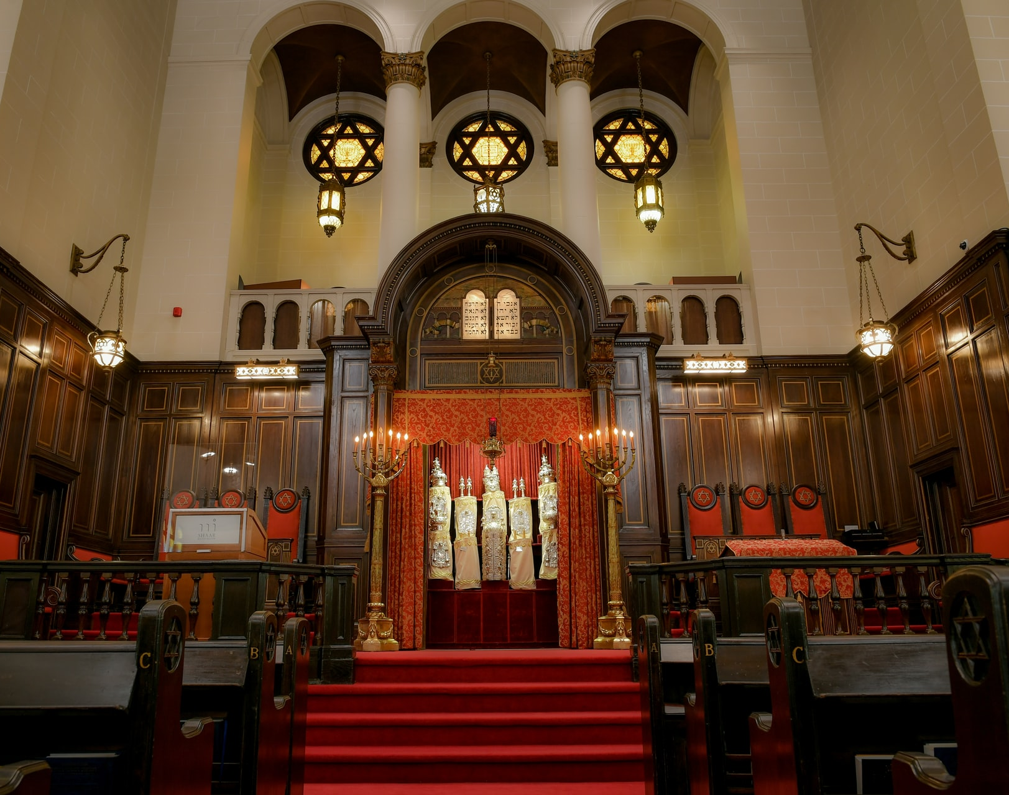
Have we not all one Father? hath not one God created us? why do we deal treacherously every man against his brother, profaning the covenant of our fathers?
Judaism,
Malachi 2: 10

Slide 7

I am known by uncounted trillions of names. They address Me by different names not realizing that they are all names of the one Tathagata. Some recognize Me as Tathagata, some as The Self-existent One, some as Gautama the Ascetic, some as Buddha. Then there are others who recognize Me as Brahma, as Vishnu, as Ishvara; some see Me as Sun, as Moon; some as a reincarnation of the ancient sages; some as one of ‘the ten powers;’ some as Rama, some as Indra, and some as Varuna...
Buddhism, Buddha, Lankavatara Sutra

Slide 8
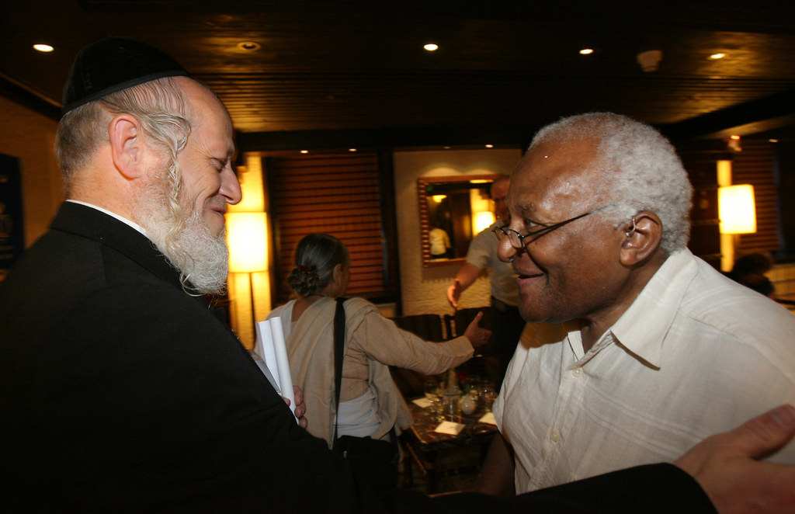
“God’s love is too great to be confined to any one side of a conflict or to any one religion.”
Christianity, Archbishop Desmond Tutu,
God Has a Dream: A Vision of Hope for Our Time

Slide 9
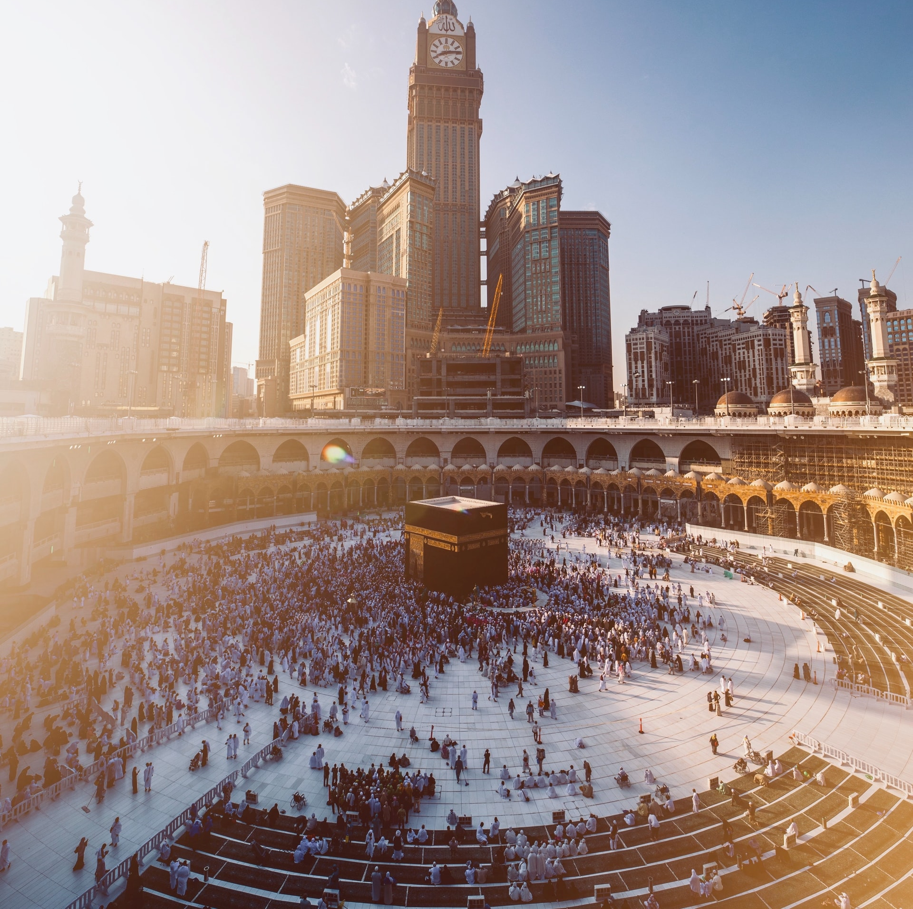
Verily We have raised in every nation a Messenger, proclaiming, “Serve God and shun false gods.”
Islam, Qur’án 16: 36

Slide 10
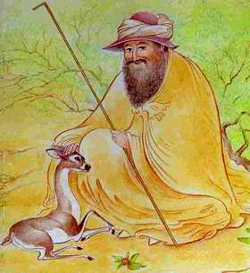
I am in love with every church
And mosque
And temple
And any kind of shrine
Because I know it is there
That people say the different names
Of the One God.
Islam, Hafiz,
Would You Think
It a Little Odd?

Slide 11
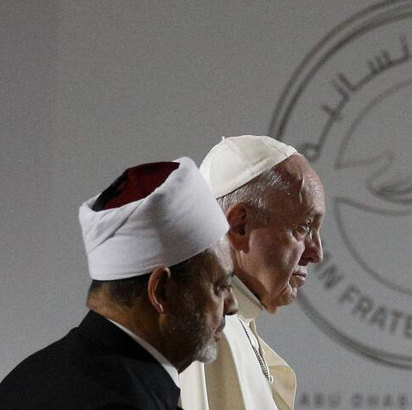
Moreover, we resolutely declare that religions must never incite war, hateful attitudes, hostility and extremism, nor must they incite violence or the shedding of blood. These tragic realities are the consequence of a deviation from religious teachings. They result from a political manipulation of religions and from interpretations made by religious groups who, in the course of history, have taken advantage of the power of religious sentiment in the hearts of men and women in order to make them act in a way that has nothing to do with the truth of religion. This is done for the purpose of achieving objectives that are political, economic, worldly and short-sighted.
Pope Francis and
Grand Imam Ahmed el-Tayeb,
Document on Human Fraternity for World Peace and Living Together

Slide 12
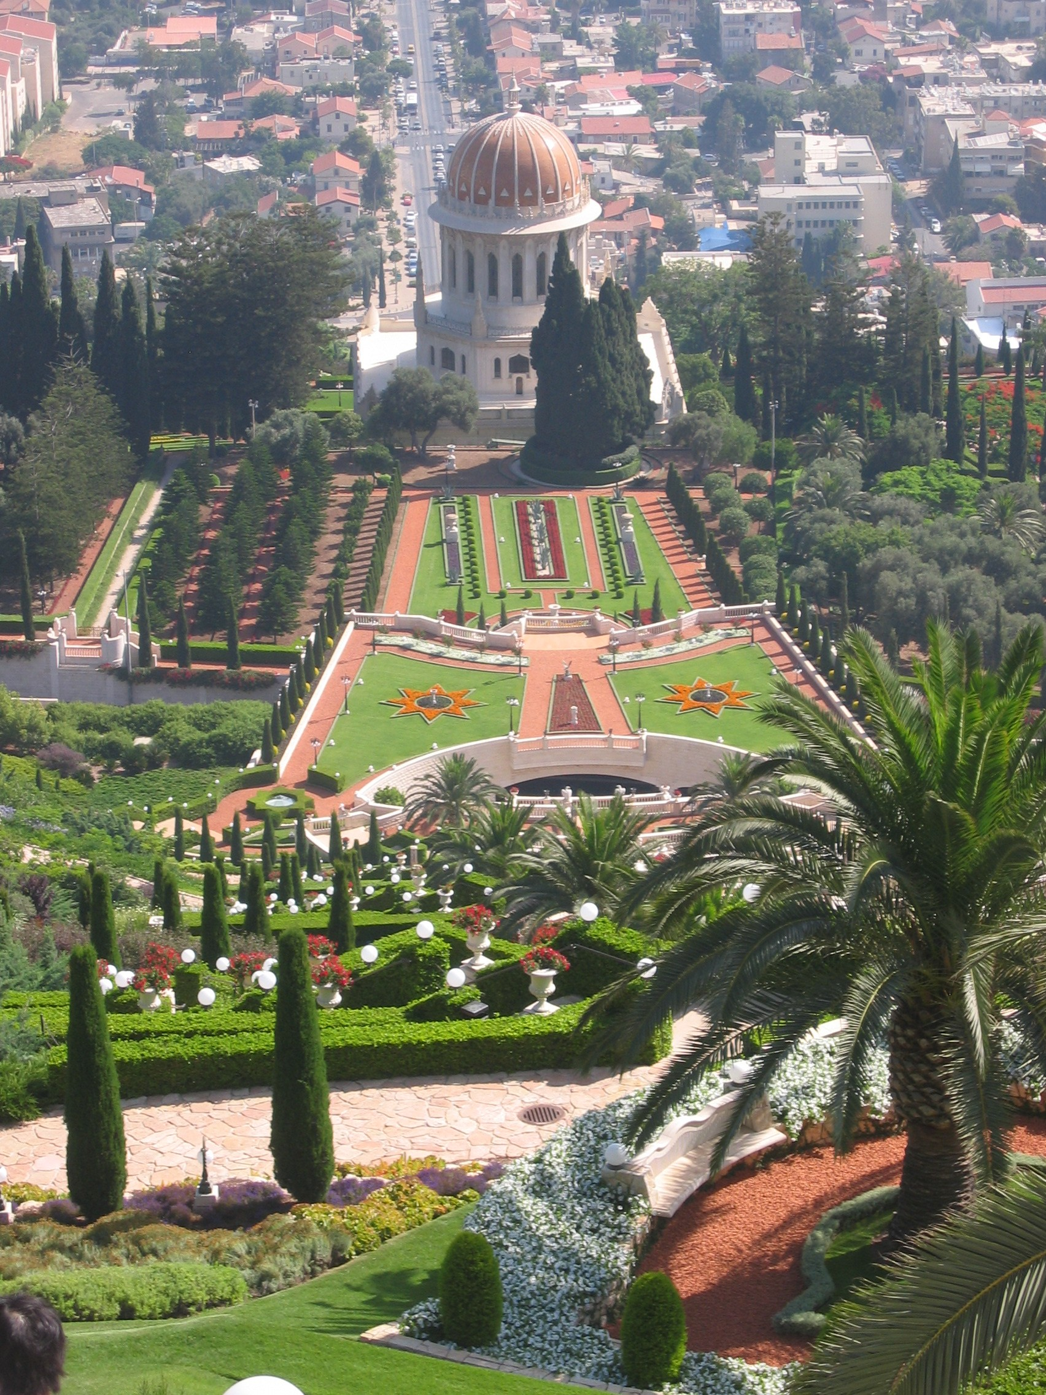
[I]t is evident that God has destined and intended religion to be the cause and means of cooperative effort and accomplishment among mankind. To this end He has sent the Prophets of God, the holy Manifestations of the Word, in order that the fundamental reality and religion of God may prove to be the bond of human unity, for the divine religions revealed by these holy Messengers have one and the same foundation.
Bahá’i, ‘Abdu’l-Bahá,
Promulgation of Universal Peace, p. 338

Slide 13
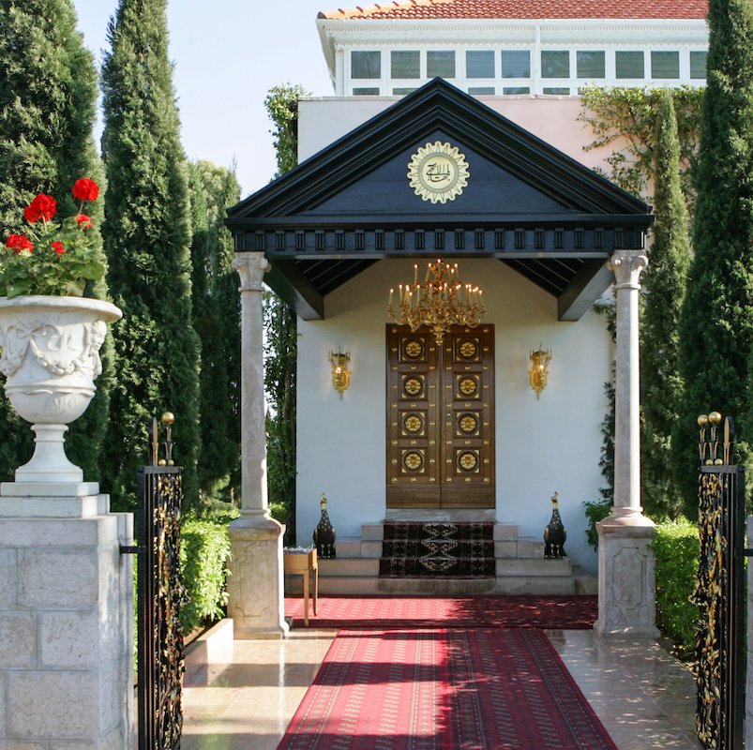
Know of a certainty that in every Dispensation the light of Divine Revelation hath been vouchsafed unto men in direct proportion to their spiritual capacity. Consider the sun. How feeble its rays the moment it appeareth above the horizon. How gradually its warmth and potency increase as it approacheth its zenith, enabling meanwhile all created things to adapt themselves to the growing intensity of its light. How steadily it declineth until it reacheth its setting point. Were it, all of a sudden, to manifest the energies latent within it, it would, no doubt, cause injury to all created things...
Baha’i, Baha’u’llah,
Gleanings, p. 87-88

Slide 14
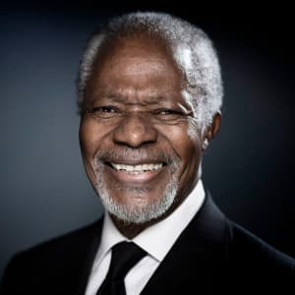
We must stress the basic values that are common to all religions: compassion; solidarity; respect for the human person; the Golden Rule of “do as you would be done by.” At the same time, we need to get away from stereotypes, generalizations and preconceptions, and take care not to let crimes committed by individuals or small groups dictate our image of an entire people, an entire region, or an entire religion.
UN Secretary-General Kofi Annan,
Nobel Peace Prize Laureate

Slide 15
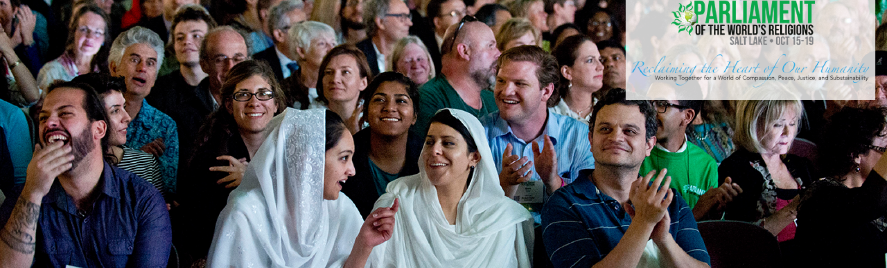
There is a principle [Golden Rule] which is found and has persisted in many religious and ethical traditions of humankind for thousands of years: ‘What you do not wish done to yourself, do not do to others.’ Or in positive terms: ‘What you wish done to yourself, do to others!’ This should be the irrevocable, unconditional norm for all areas of life, for families and communities, for races, nations, and religions.
Parliament of the World’s Religions,
The Declaration of a Global Ethic

Slide 16
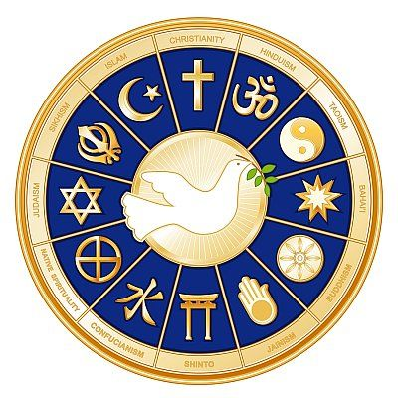
“This is the sum of duty; do naught onto others what you would not have them do unto you.” ―Hinduism
“Treat not others in ways that you yourself would find hurtful.” ―Buddhism
“What is hateful to you, do not do to your neighbour. This is the entire Law; all the rest is commentary. Go and learn it.” ―Judaism
“In everything, do to others as you would have them do to you; for this is the law and the prophets.” ―Christianity
“Not one of you truly believes until you wish for others what you wish for yourself.” ―Islam
“Lay not on any soul a load that you would not wish to be laid upon you, and desire not for anyone the things you would not desire for yourself.” ―Baha’i Faith

Slide 17

https://www.youtube.com/watch?v=HzTHDZh35Vs

Slide 18
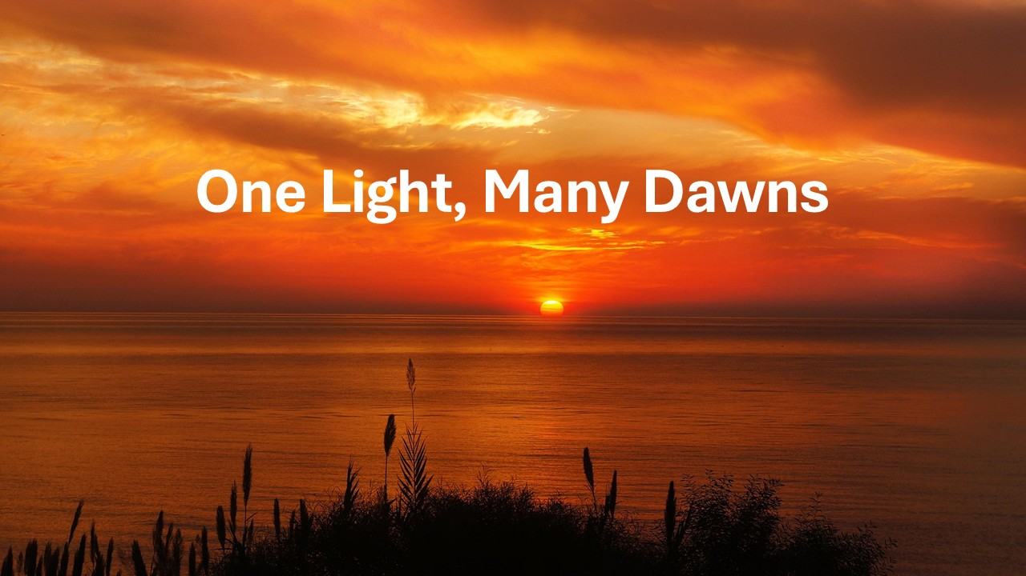
https://www.youtube.com/watch?v=JueMVxFw1M0

