Slide 1
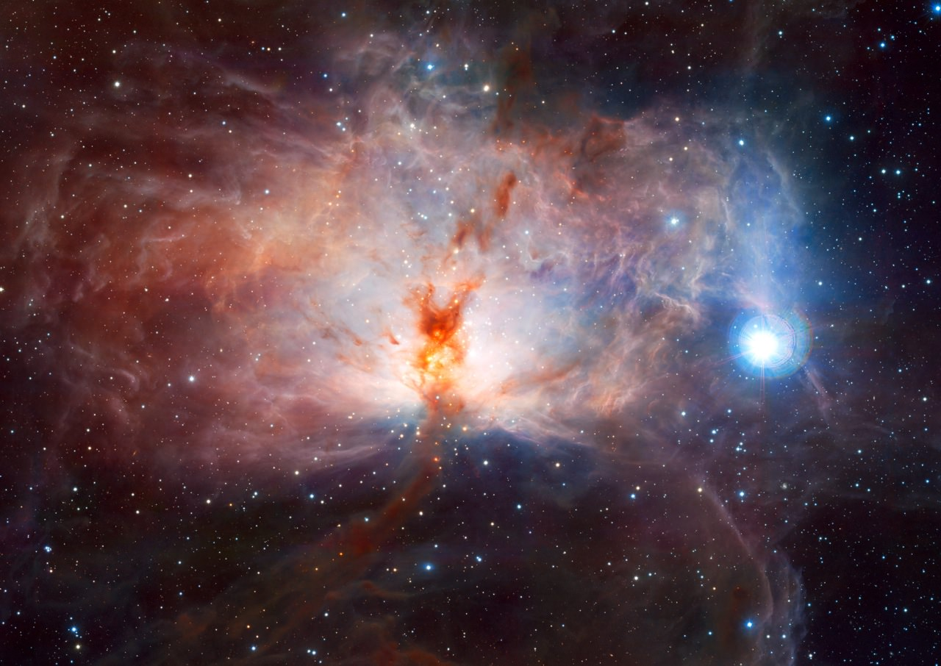
Humanity’s Relationship With God
Tucker, GA

Slide 2

https://www.youtube.com/watch?v=SSWV0Fayqj4

Slide 3


Slide 4


Slide 5
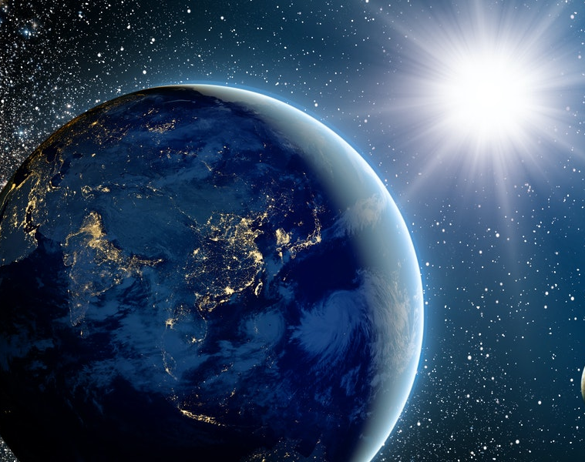
Even as the radiance of the sun sheds light in all regions, so does that glorious Lord, single and adored rule over all His creation... He is the One, the only God, who rules over the whole universe.
Hinduism, Ramayana,
Vana-Gamana-Adesa, section 7

Slide 6
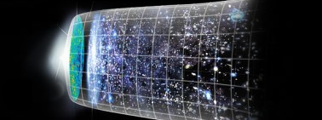
Behold the universe in the glory of God; and all that lives and moves on earth.
Hinduism, Isha Upanishad 1: 1

Slide 7
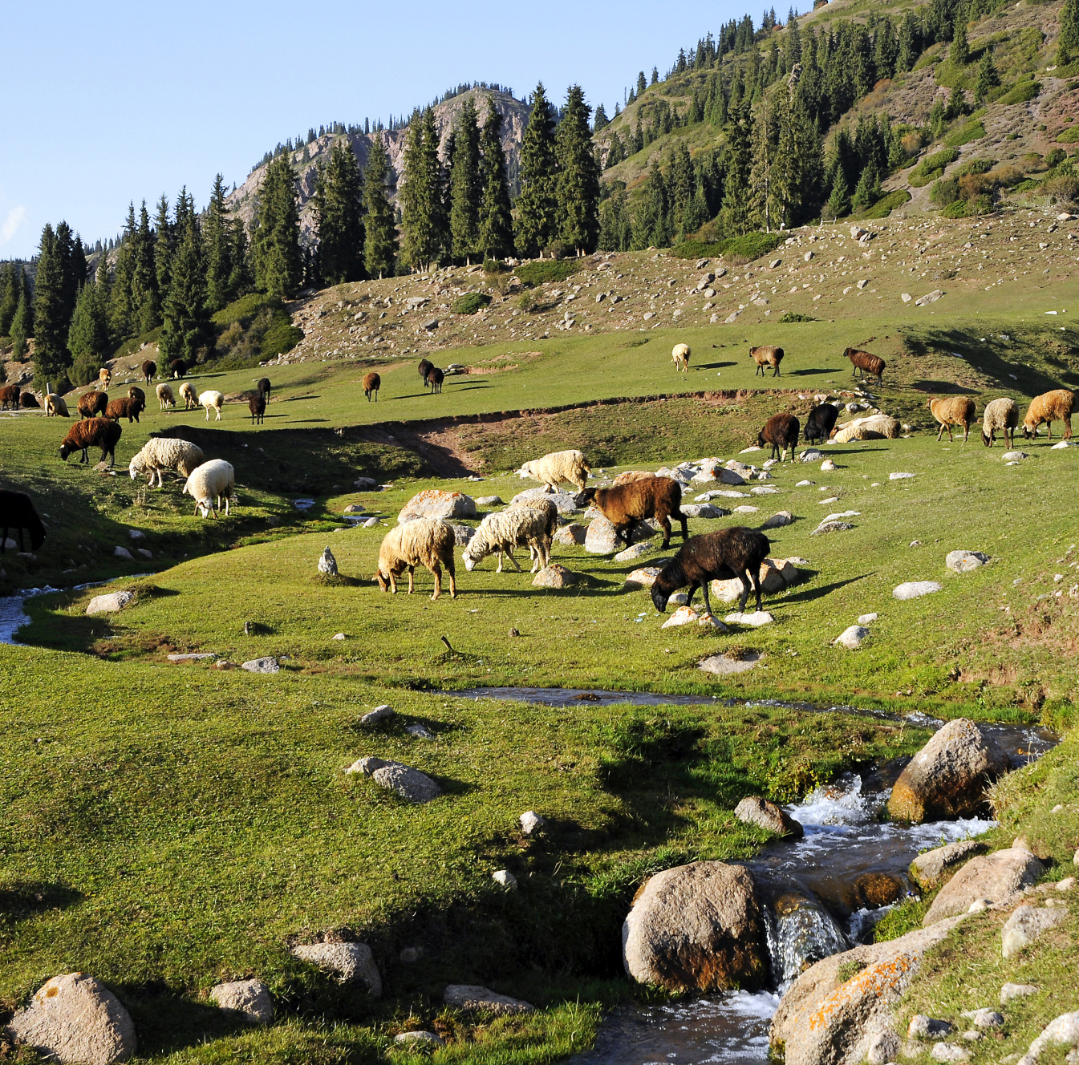
Know ye that HaShem He is G-d; it is He that hath made us, and we are His, His people, and the flock of His pasture.
Judaism,
Tehilim (Psalms) 100: 3

Slide 8
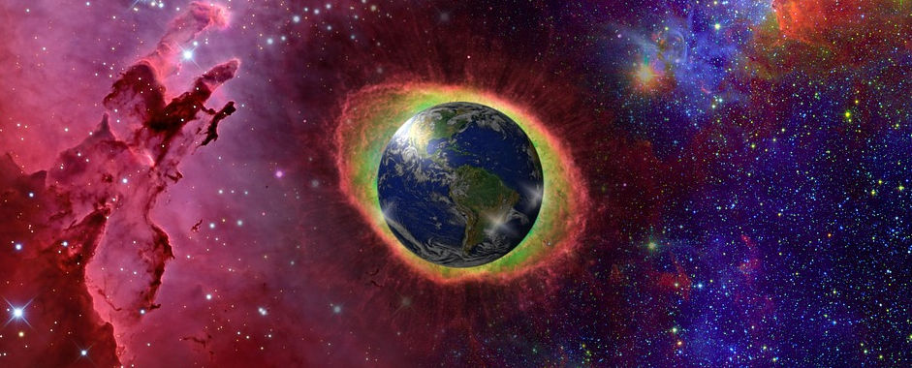
Just as God fills the whole world, so the soul fills the body.
Just as God sees, but is not seen, so the soul sees, but is not itself seen.
Just as God feeds the whole world, so the soul feeds the whole body.
Just as God is pure, so the soul is pure....
Judaism, Talmud, Berakot 10a

Slide 9
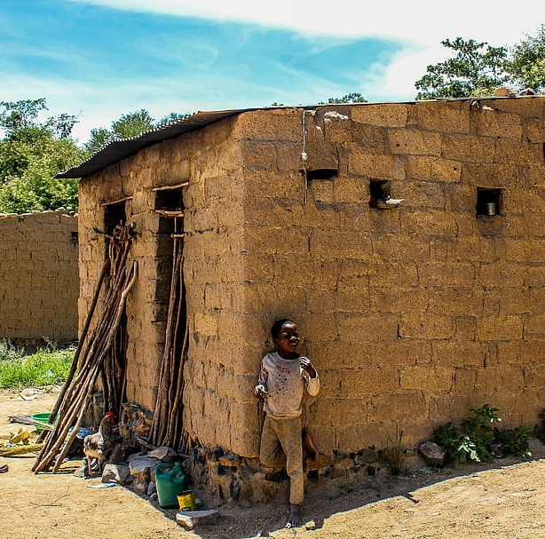
Every being has the Buddha Nature. This is the self. Such a self is, since the very beginning, under cover of innumerable illusions. That is why a man cannot see it.
O good man! There was a poor woman who had gold hidden somewhere in her house, but no one knew where it was. But there was a stranger who, by expediency, speaks to the poor woman, “I shall employ you to weed the lawn.” The woman answered, “I cannot do it now, but if you show my son where the gold is hidden, I will work for you.” The man says, “I know the way; I will show it to your son.” The woman replies, “No one in my house, big or small, knows where the gold is hidden. How can you know?”
Buddhism, Mahaparinirvana Sutra
214: Parable of the Hidden Treasure

Slide 10
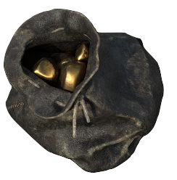
The man then digs out the hidden gold and shows it to the woman. She is glad, and begins to respect him.
O good man! The same is the case with a man’s Buddha Nature. No one can see it. It is like the gold which the poor woman possessed and yet
could not locate. I now let people see the Buddha Nature which they possess, but which was hidden by illusions.
The Tathagata shows all beings the storehouse of enlightenment, which is the cask of true gold--their Buddha Nature.
Buddhism, Mahaparinirvana Sutra
214-15: Parable of the Hidden Treasure

Slide 11
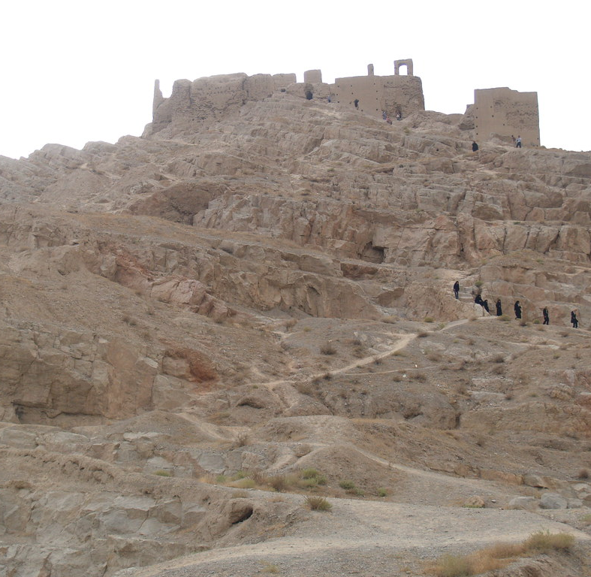
This do I ask, O Lord, reveal unto me the truth!
Zoroastrianism,
Zvesta,
Yasna 44: 3

Slide 12
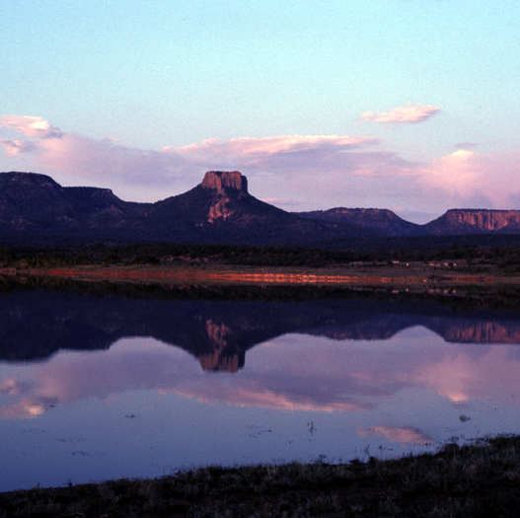
By faith we understand that the world was created by the word of God, so that what is seen was made out of things which do not appear.
Christianity, Hebrews 11: 3

Slide 13
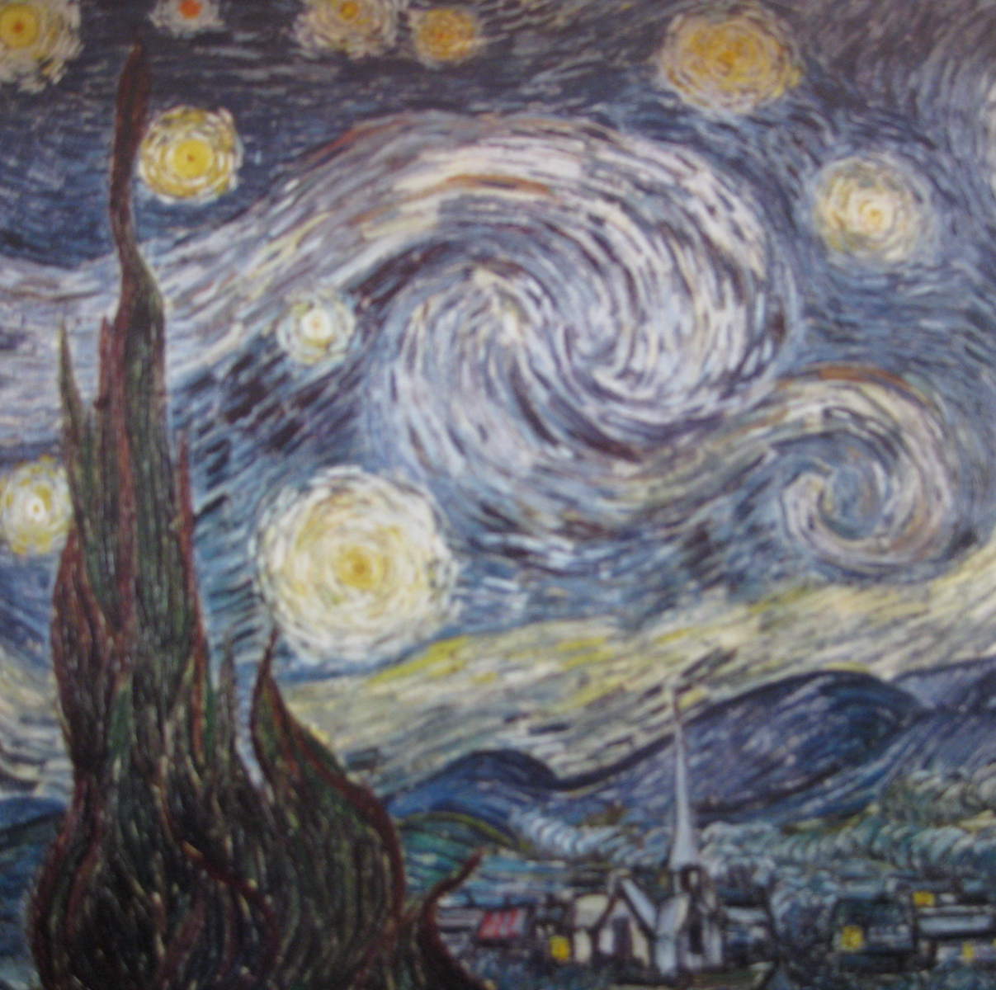
The God who made the world and all things in it, since He is Lord of heaven and earth, does not dwell in temples made with hands; nor is He served by human hands, as though He needed anything, since He Himself gives to all people life and breath and all things…
Christianity, Acts 17: 24-25

Slide 14

God is the Light of the heavens and the earth,
The parable of His Light is as if there were a Niche, and within it a Lamp; the Lamp enclosed in Glass:
The Glass as it were a brilliant star:
Lit from a blessed Tree, an olive neither of the East nor of the West, whose oil is well-nigh luminous, though fire scarce touched it.
Light upon Light! God guides whom he will to his Light;
God sets forth parables for men, and God knows all things.
Islam,
Qur’án 2: 35

Slide 15

I have breathed into man of My spirit.
Islam,
Qur’án 15: 29

Slide 16

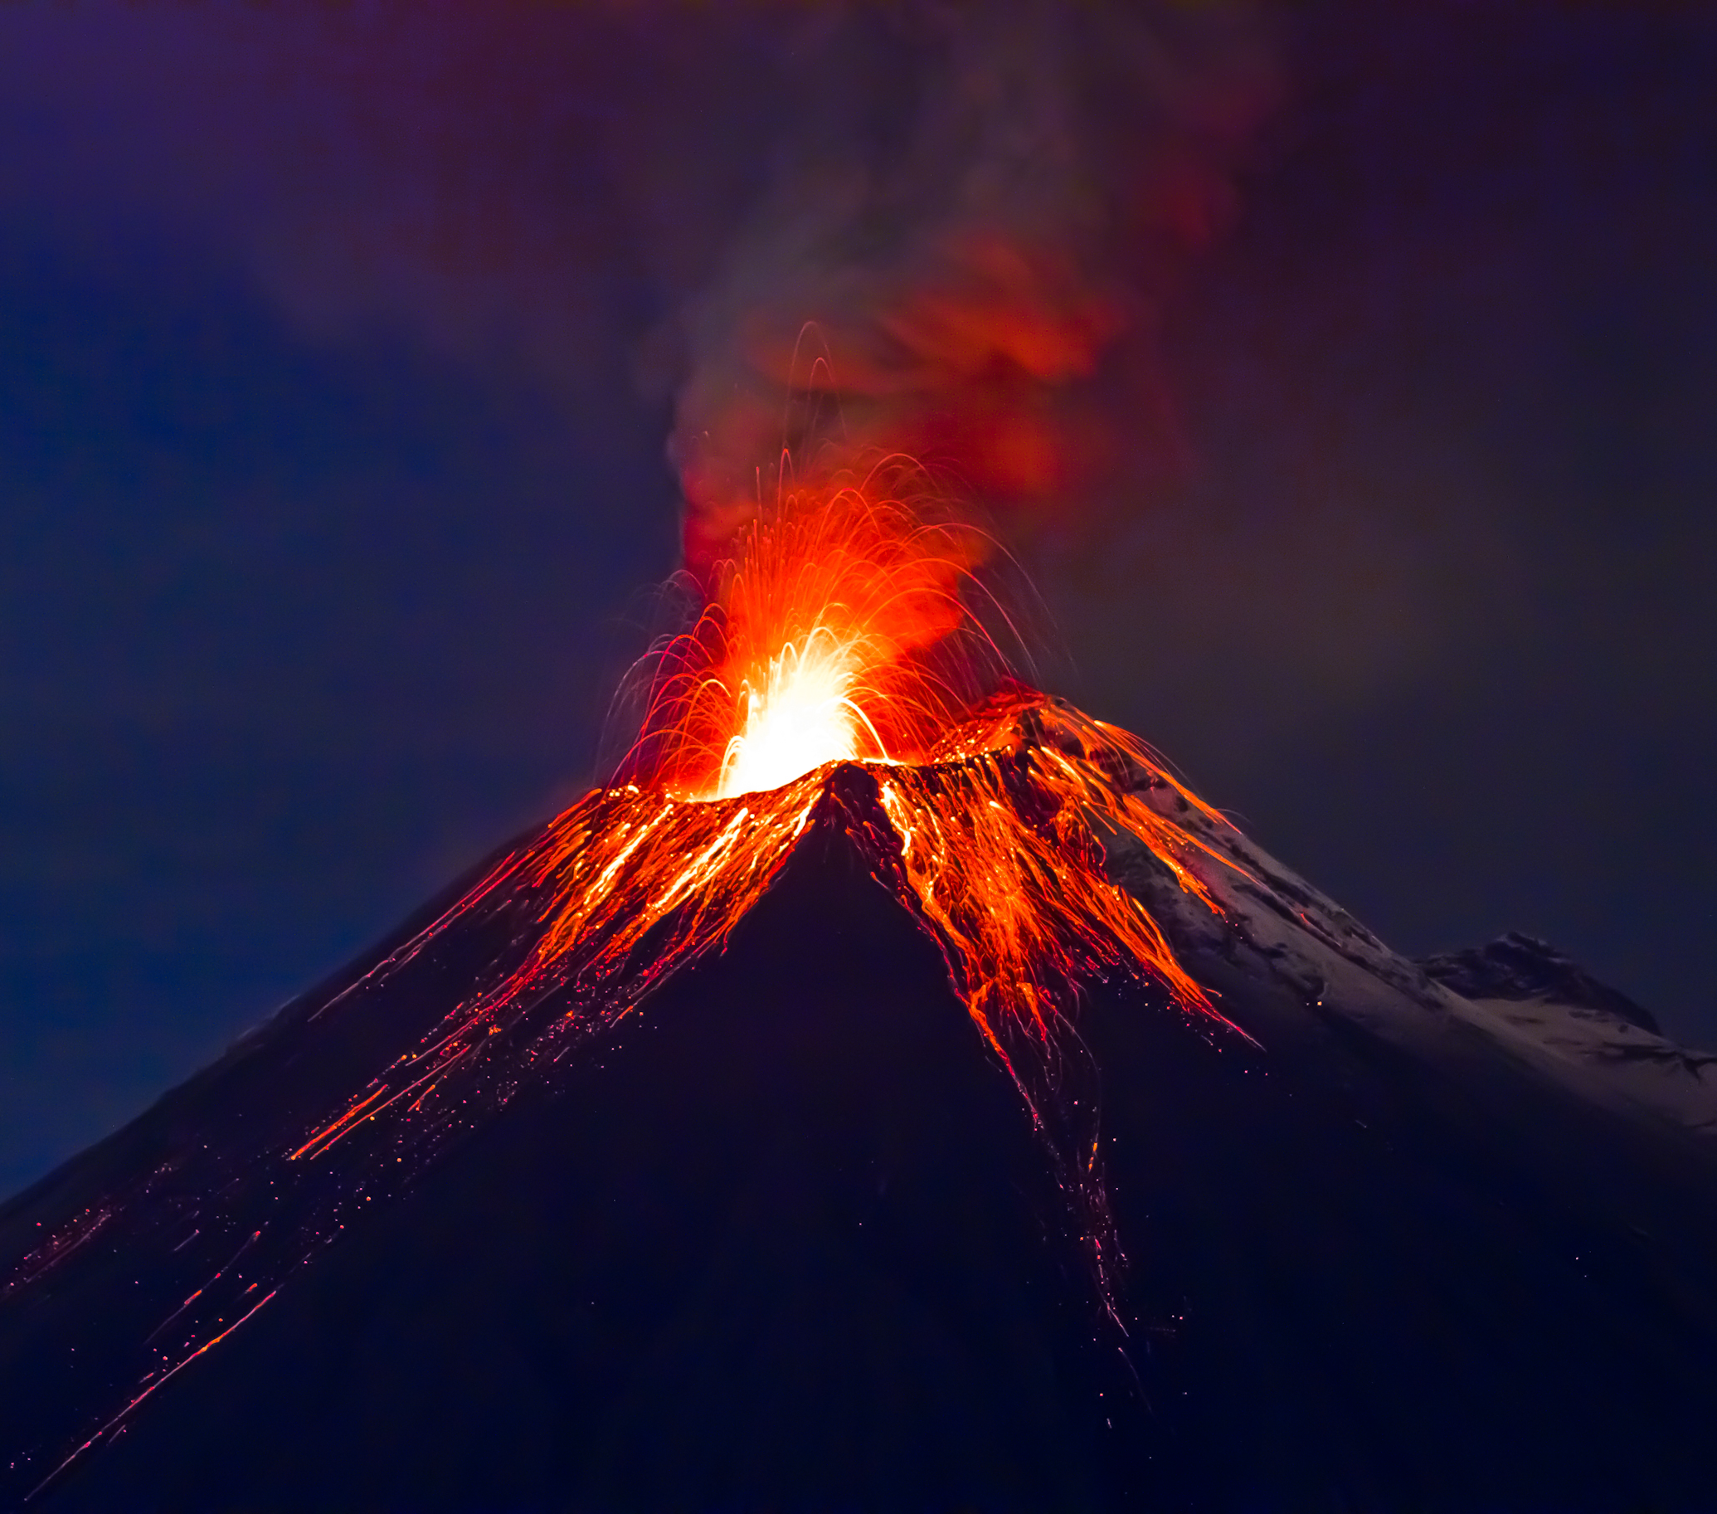
Fire and paradise both bow down and prostrate themselves before God. That which is worthy of His Essence is to worship Him for His sake, without fear of fire, or hope of paradise.
Bahá’i, The Báb,
Selections from the Báb, p. 78

Slide 17

It is from the bounty of God that man is selected for the highest degree; and the differences which exist between men in regard to spiritual progress and heavenly perfections are also due to the choice of the Compassionate One. For faith, which is life eternal, is the sign of bounty, and not the result of justice. The flame of the fire of love, in this world of earth and water, comes through the power of attraction and not by effort and striving.
Bahá’i, ‘Abdu’l-Bahá,
Some Answered Questions, p. 130

Slide 18
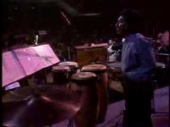
https://www.youtube.com/watch?v=UOe5GpqFJrE

Slide 19

https://www.youtube.com/watch?v=vyMUW9_4iLw

