Slide 1
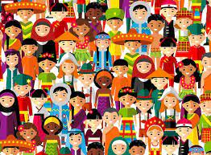
Oneness of Humanity
Tucker, GA

Slide 2

https://www.youtube.com/watch?v=nS1RBSrOGng

Slide 3
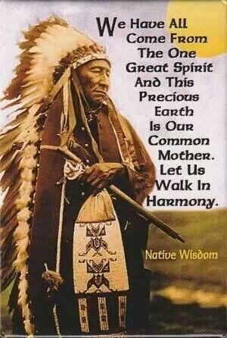

Slide 4
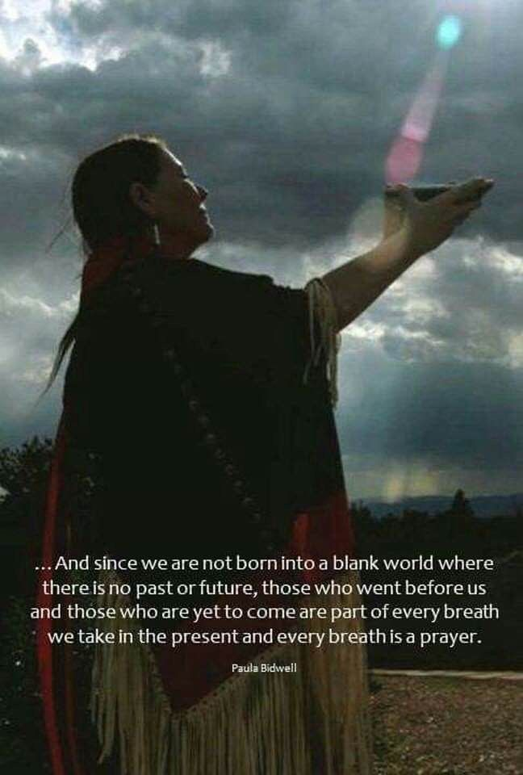

Slide 5
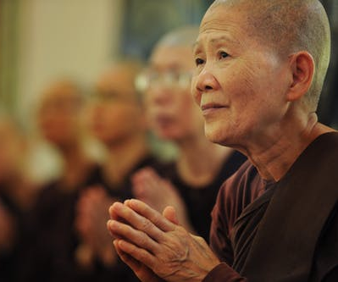

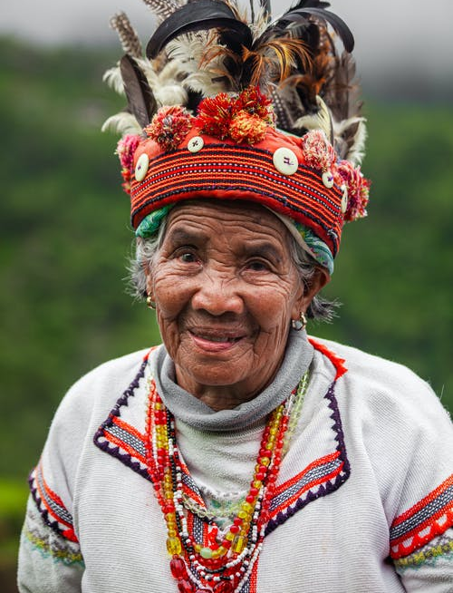
I look upon all creatures equally; none are less dear to me and none more dear.
Hinduism,
Bhagavad Gita 9: 29

Slide 6



He who regards well-wishers, friends, foes, neutrals, mediators, the objects of hatred, relatives, the virtuous and the sinful alike, he stands supreme.
Hinduism, Bhagavad Gita 6: 9

Slide 7



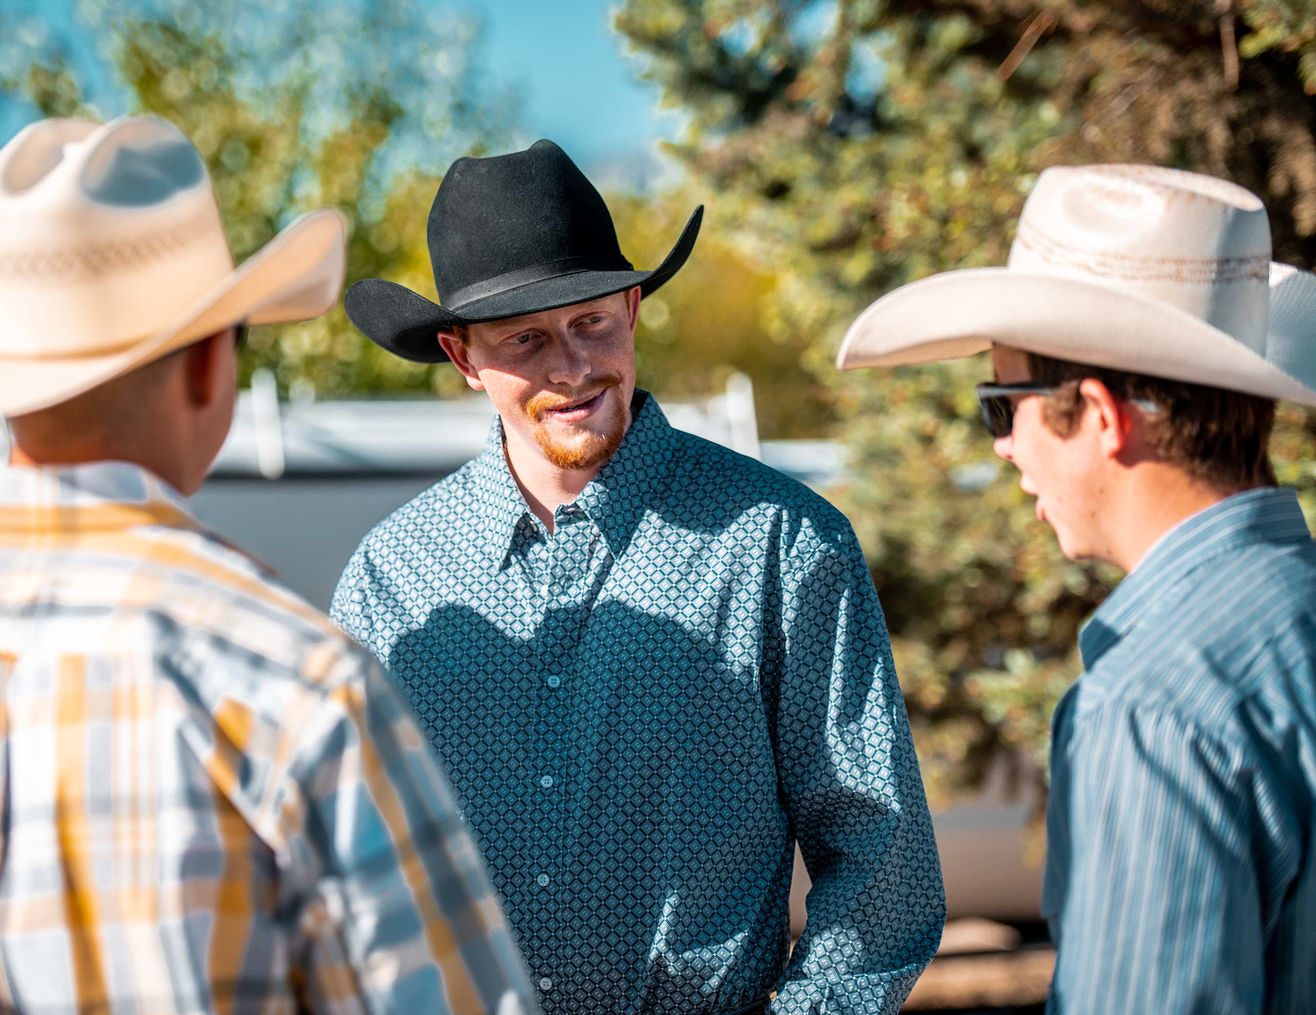
And G-d created humankind in the divine image, creating it in the image of G-d—creating them male and female.
Judaism,
Genesis 1: 27

Slide 8

G-d formed the Human from the soil’s humus, blowing into his nostrils the breath of life: the Human became a living being.
Judaism, Genesis 2: 7

Slide 9
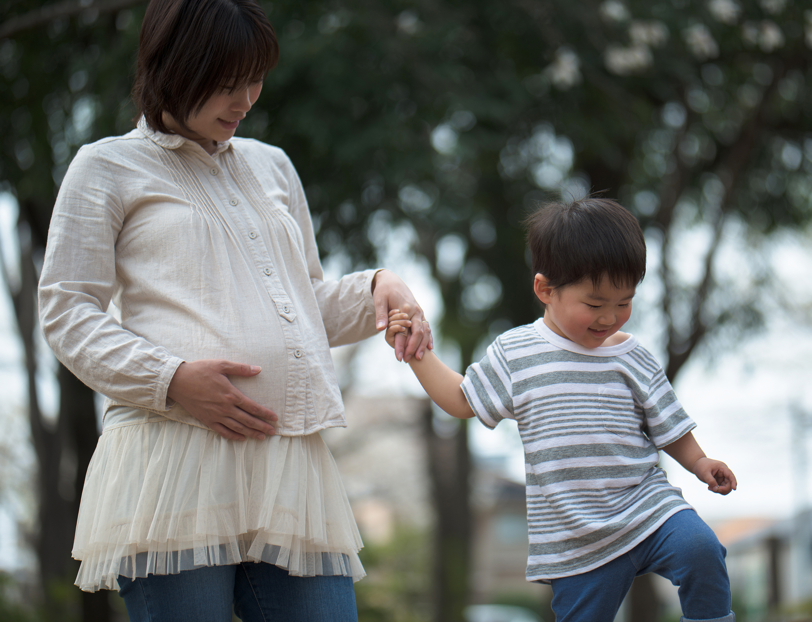
In working for the good and oneness of humanity I don’t think of myself just as a Tibetan or a Buddhist, but as a human being. We have to think of the whole of humanity. Being human is the common ground in our efforts to create a better and a more compassionate world because we all survive in dependence on others.
Buddhism, The Dalai Lama,
Dali Lama Foundation

Slide 10

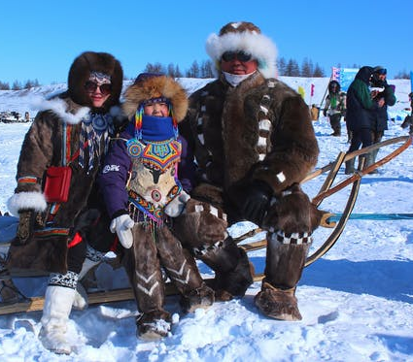
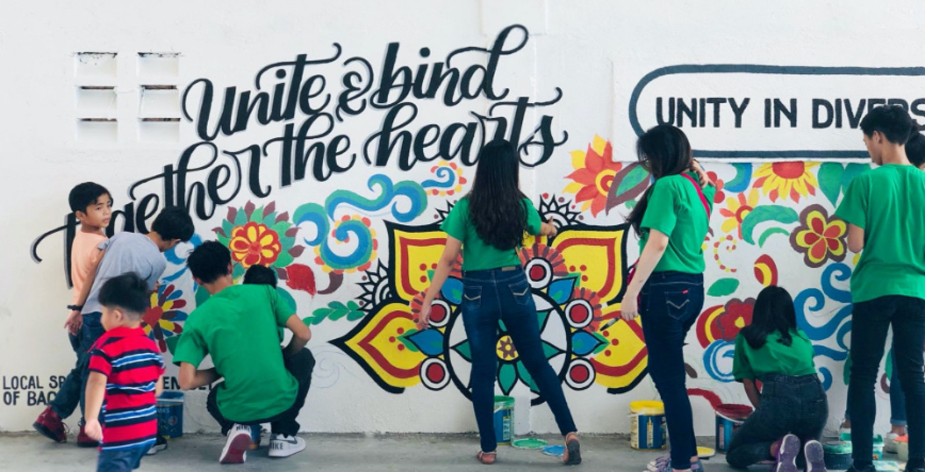
This directly relates to the matter of creating harmony amid diversity, a fundamental issue of the twenty-first century. While highly respecting the unique characteristics of different races and cultures, we have to create solidarity based on our common humanity. In the absence of such solidarity, the human race has no future. Diversity should beget not conflict in the world but richness.
Buddhism, Daisaku Ikeda,
The Wisdom of the Lotus Sutra
Vol. II, p. 82

Slide 11
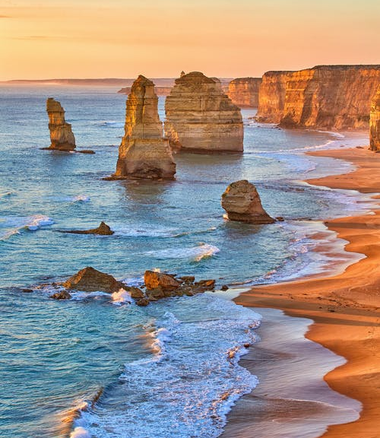
The God who made the world and all things in it, since He is Lord of heaven and earth, does not dwell in temples made with hands; nor is He served by human hands, as though He needed anything, since He Himself gives to all people life and breath and all things…
Christianity, Acts 17: 24-25

Slide 12
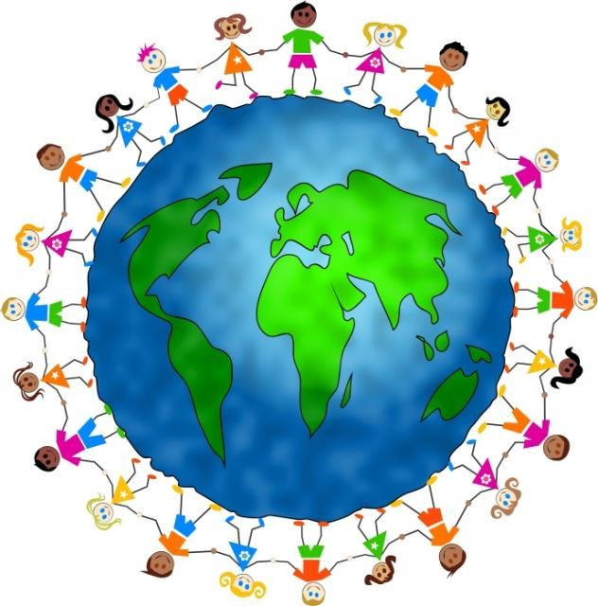
…He made from one man every nation of mankind to live on all the face of the earth, having determined their appointed times and the boundaries of their habitation, that they would seek God…
Christianity, Acts 17: 26-27

Slide 13
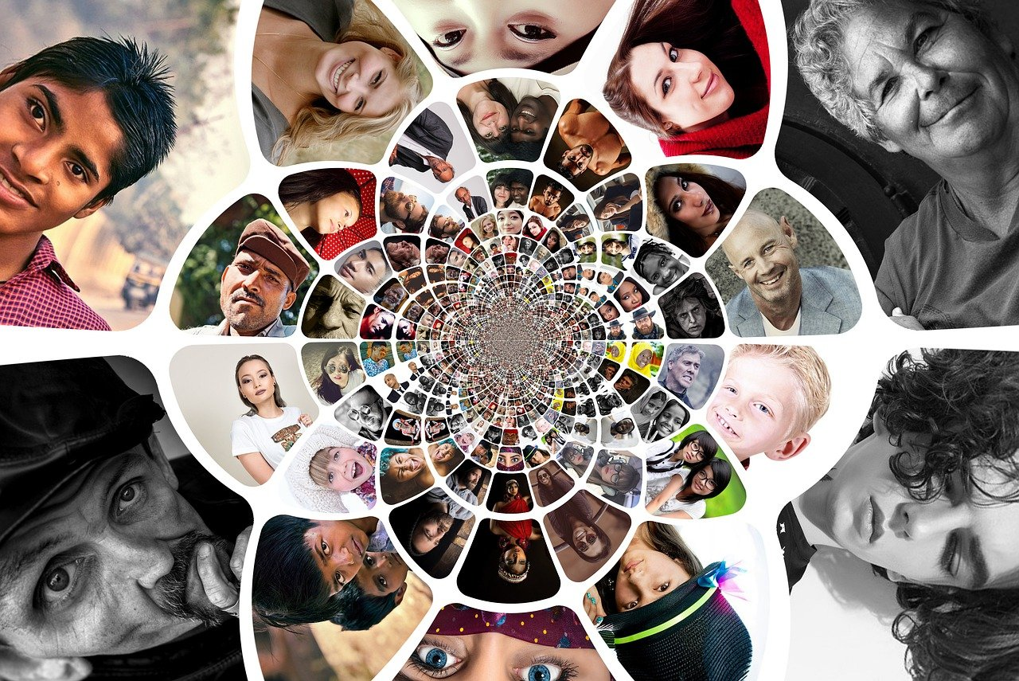
Mankind was one single nation, and Allah sent Messengers with glad tidings and warnings; and with them He sent the Book in truth, to judge between people in matters wherein they differed; but the People of the Book, after the clear Signs came to them, did not differ among themselves, except through selfish contumacy. Allah by His Grace guided the believers to the Truth, concerning that wherein they differed. For Allah guided whom He wills to a path that is straight.
Islam, Qur’án 2: 213

Slide 14
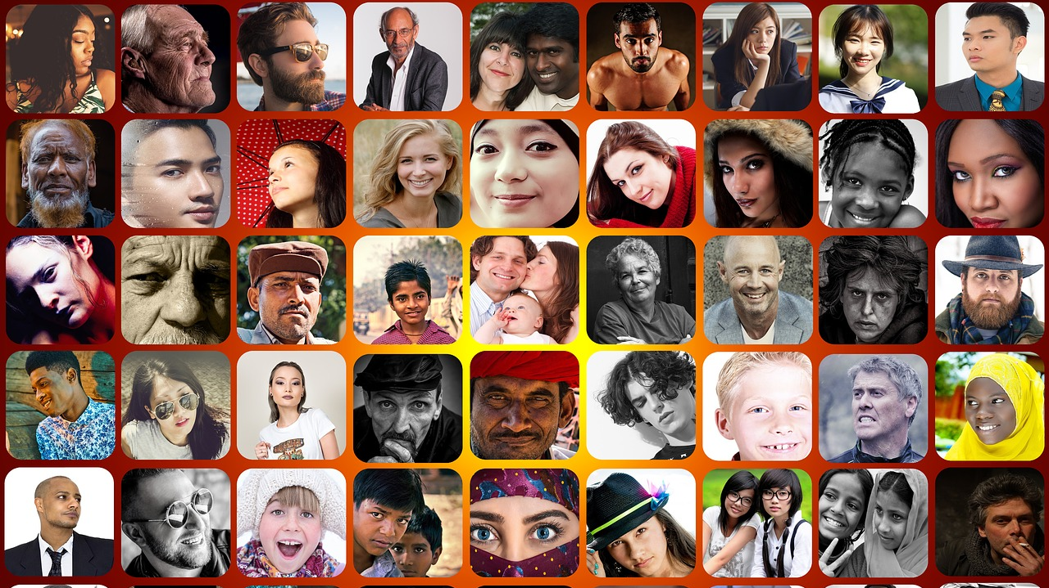
O mankind! Reverence your Guardian-Lord, who created you from a single soul, created, of like nature, the mate, and from them twain scattered (like seeds) countless men and women;- reverence Allah, through whom ye demand your mutual (rights), and (reverence) the wombs (That bore you): for Allah ever watches over you."
Islam,
Qur’án 4:1

Slide 15

Ye are the fruits of one tree, and the leaves of one branch. Deal ye one with another with the utmost love and harmony, with friendliness and fellowship.
Bahá’i, Bahá’u’lláh,
Epistle to the Son of the Wolf, p. 14

Slide 16

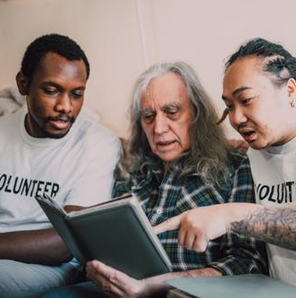
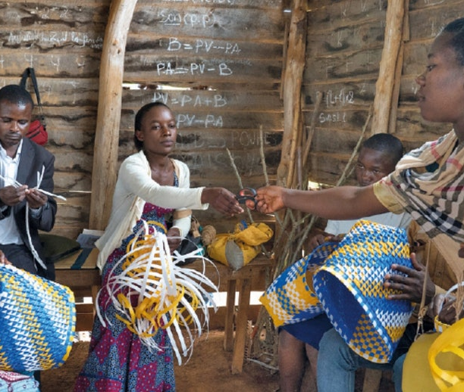
Therefore, we must exercise extreme patience, sympathy and love toward all mankind, considering no soul as rejected. If we look upon a soul as rejected, we have disobeyed the teachings of God. God is loving to all. Shall we be unjust or unkind to anyone? Is this allowable in the sight of God? God provides for all. Is it befitting for us to prevent the flow of His merciful provisions for mankind?
Bahá’i, ‘Abdu’l-Bahá,
Promulgation of Universal Peace,
pp. 286-287

Slide 17
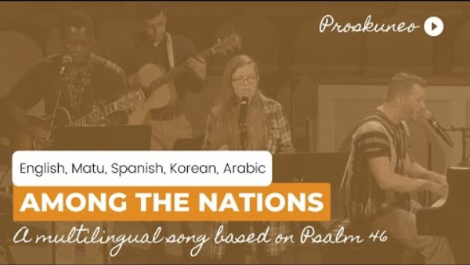
https://www.youtube.com/watch?v=j5H2GE5-nAE

Slide 18
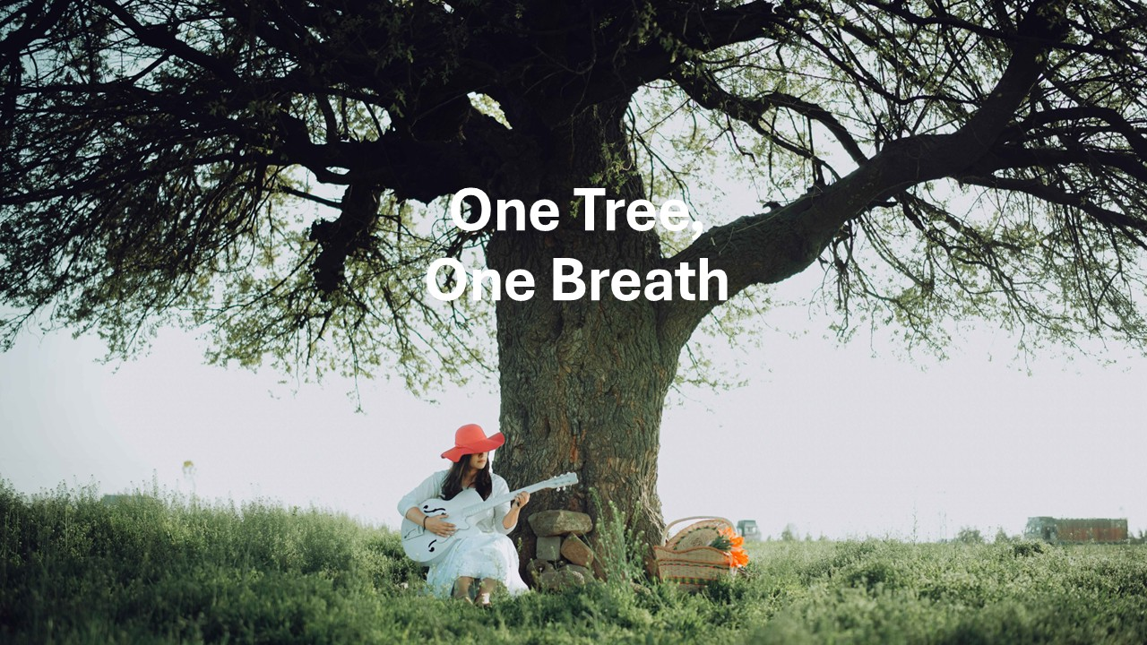
https://www.youtube.com/watch?v=QDDWEU27fyY

