Slide 1

Physical/ Material Death
Tucker, GA

Slide 2

https://www.youtube.com/watch?v=Zv-nCJcMoow&t=3s

Slide 3


There is no death. Only a change in worlds.
Chief Seattle
Suquamish and Duwamish chief

Slide 4

We are all visitors to this time, this place. We are just passing through. Our purpose here is to observe, to learn, to grow, to love… and then we return home.
Australian
Aboriginal Saying

Slide 5

[T]his body is mortal and always held by death. It is the abode of that Self which is immortal and without body. When in the body (by thinking this body is I and I am this body) the Self is held by pleasure and pain. So long as he is in the body, he cannot get free from pleasure and pain. But when he is free of the body (when he knows himself different from the body), then neither pleasure nor pain touches him.
Hinduism,
Chandogya Upanishad, 8: 12.1

Slide 6
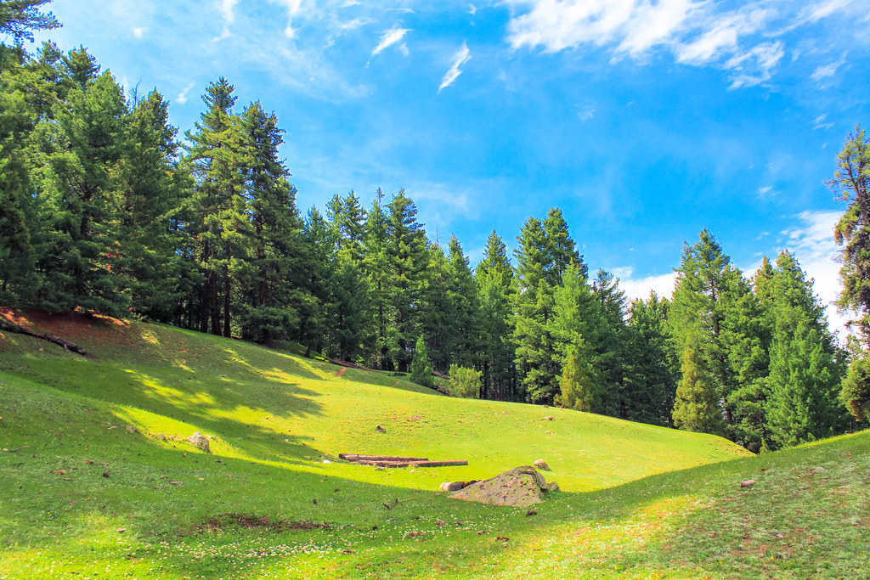
The Lord is my shepherd: I shall not want. He maketh me to lie down in green pastures: he leadeth me beside the still waters. He restoreth my soul: he guideth me in the paths of righteousness for his name’s sake. Yea, though I walk through the valley of the shadow of death, I will fear no evil; for thou art with me: thy rod and thy staff, they comfort me.
Judaism,
Psalm 23: 1-4

Slide 7
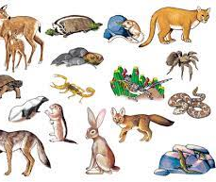
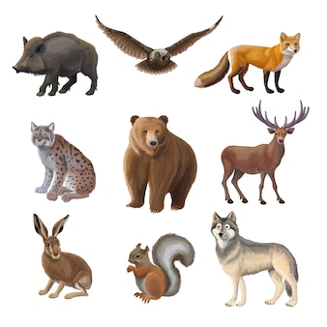
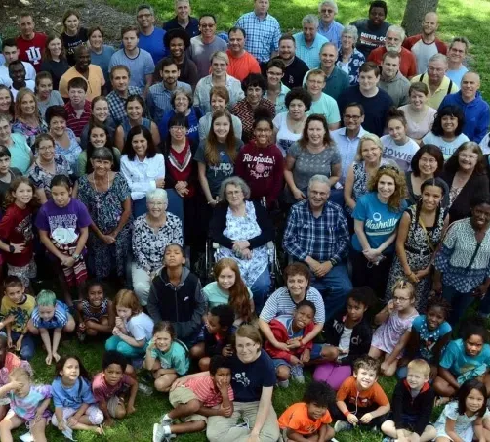
“All created things perish.” Whoever realizes this transcends pain; this is the clear path.
Buddhism,
Dhammapada 277

Slide 8

Death subdues a man who is gathering flowers, and whose mind is distracted, before he is satiated in his pleasures.
Buddhism,
The Dhammapada, IV: 48

Slide 9


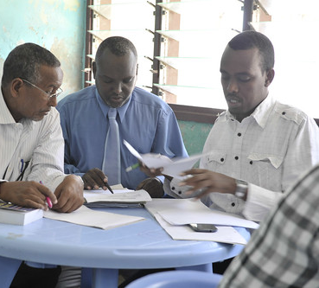
…Be faithful unto death, and I will give you the crown of life.
Christianity,
Revelation 2: 10

Slide 10
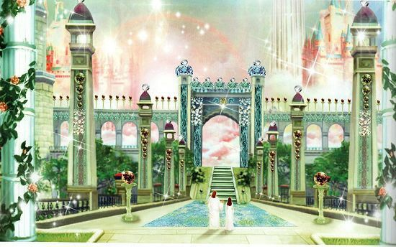
Do not let your hearts be troubled. You believe in God; believe also in me. My Father's house has many rooms; if that were not so, would I have told you that I am going there to prepare a place for you? And if I go and prepare a place for you, I will come back and take you to be with me that you also may be where I am. You know the way to the place where I am going.
Christianity,
John 14: 1-4

Slide 11
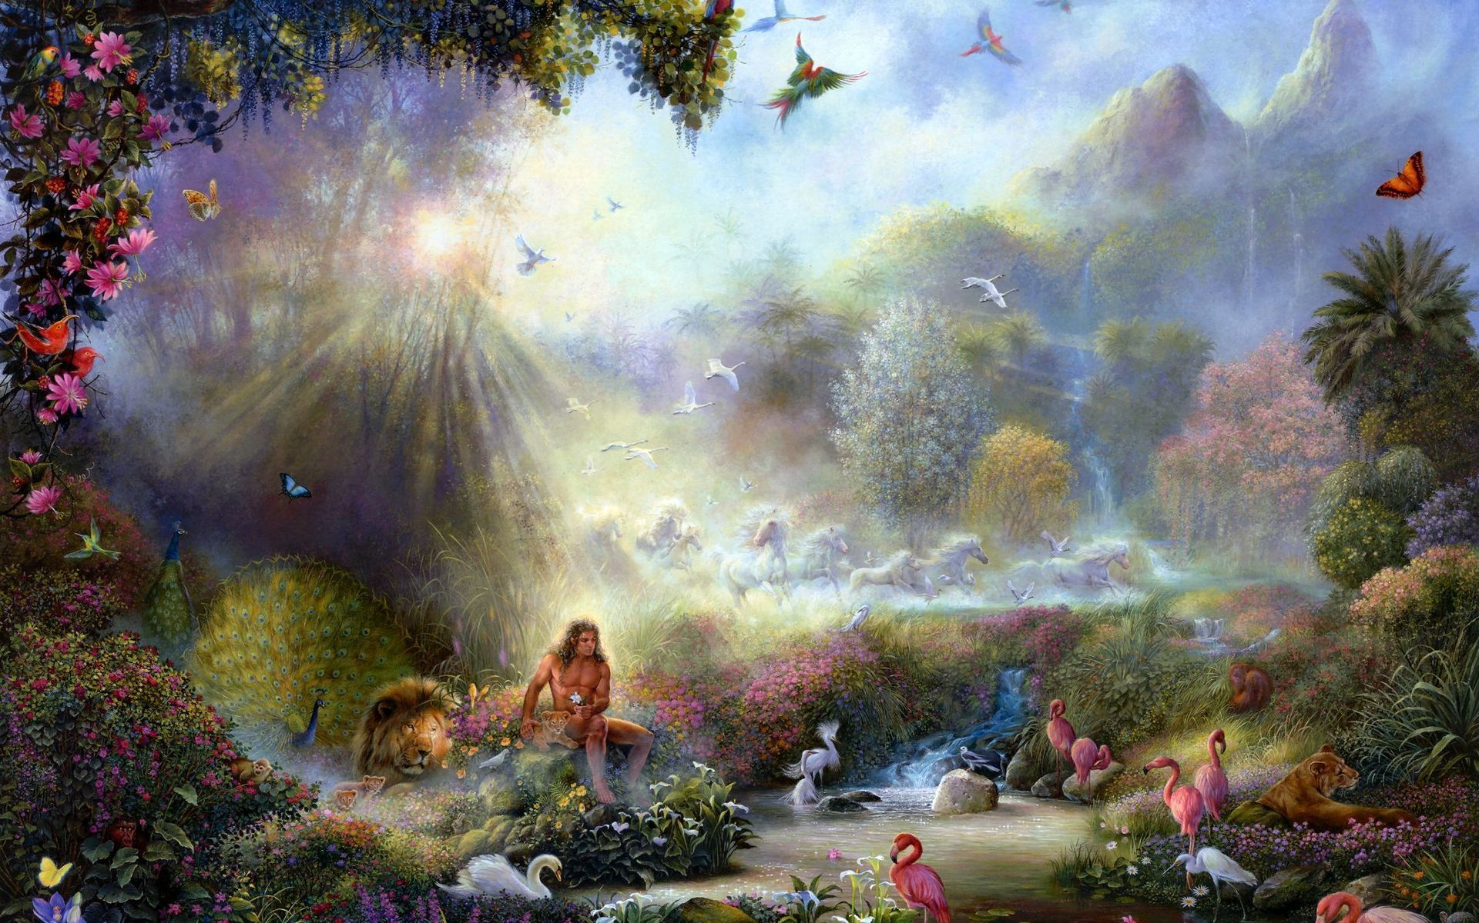
Every self will taste death. You will be paid your wages in full on the Day of Rising. Anyone who is distanced from the Fire and admitted to the Garden, has triumphed. The life of this world is only the enjoyment of delusion.
Islam,
Qur’án, 3: 185

Slide 12

When their specified time arrives, they cannot delay it for a single hour nor can they bring it forward.
Islam,
Qur’án, 16: 61

Slide 13

In the world of spirit there is no retrogression. The world of mortality is a world of contradictions, of opposites; motion being compulsory everything must either go forward or retreat. In the realm of spirit there is no retreat possible, all movement is bound to be towards a perfect state. `Progress' is the expression of spirit in the world of matter. The intelligence of man, his reasoning powers, his knowledge, his scientific achievements, all these being manifestations of the spirit, partake of the inevitable law of spiritual progress and are, therefore, of necessity, immortal.
Bahá’i, ‘Abdu’l-Bahá
Paris Talks, p. 90

Slide 14
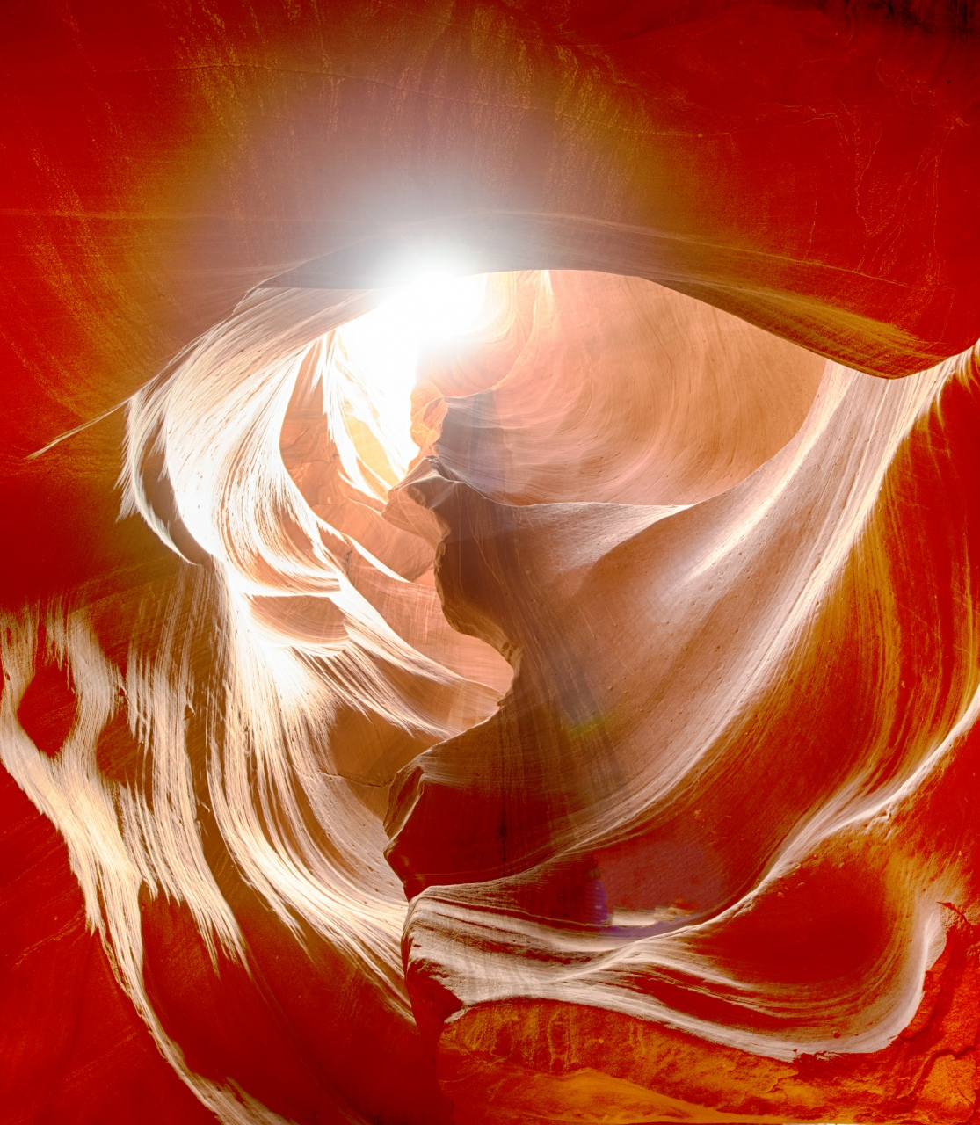
Man--the true man--is soul, not body; though physically man belongs to the animal kingdom, yet his soul lifts him above the rest of creation. Behold how the light of the sun illuminates the world of matter: even so doth the Divine Light shed its rays in the kingdom of the soul. The soul it is which makes the human creature a celestial entity!
Bahá’i, ‘Abdu’l-Bahá
Paris Talks, p. 85

Slide 15

To consider that after the death of the body the spirit perishes is like imagining that a bird in a cage will be destroyed if the cage is broken, though the bird has nothing to fear from the destruction of the cage. Our body is like the cage, and the spirit is like the bird. We see that without the cage this bird flies in the world of sleep; therefore, if the cage becomes broken, the bird will continue and exist. Its feelings will be even more powerful, its perceptions greater, and its happiness increased.
Bahá’i, ‘Abdu’l-Bahá
Some Answered Questions, p. 228

Slide 16
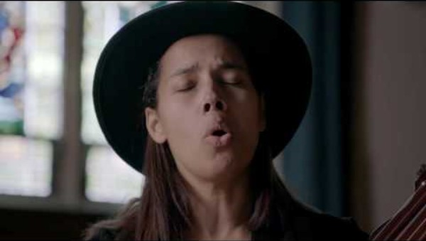
https://www.youtube.com/watch?v=b1Z4PAZX9Bs

Slide 17

https://www.youtube.com/watch?v=JNjJxRzUpWE

