Slide 1
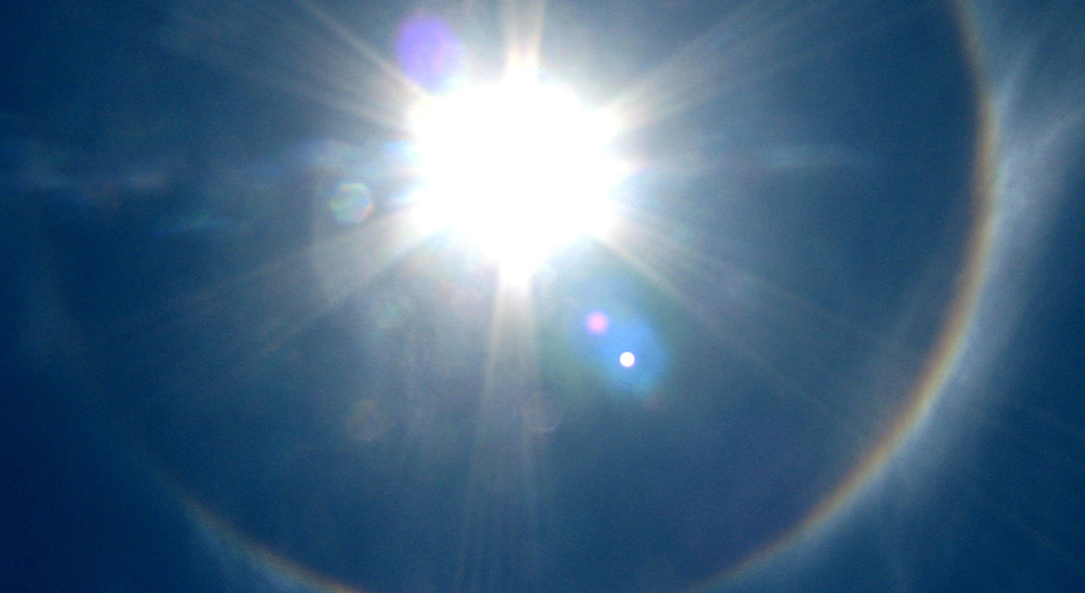
Spirituality
Tucker, GA

Slide 2

https://www.youtube.com/watch?v=ZpVaX3gRDJM&t=1s

Slide 3



The Great Spirit is in all things, is in the air we breathe. The Great Spirit is our Father, but the Earth is our Mother. She nourishes us; that which we put into the ground, She returns to us....
American Indigenous
(Wabanaki Algonquin),
Big Thunder [Bedagi]

Slide 4
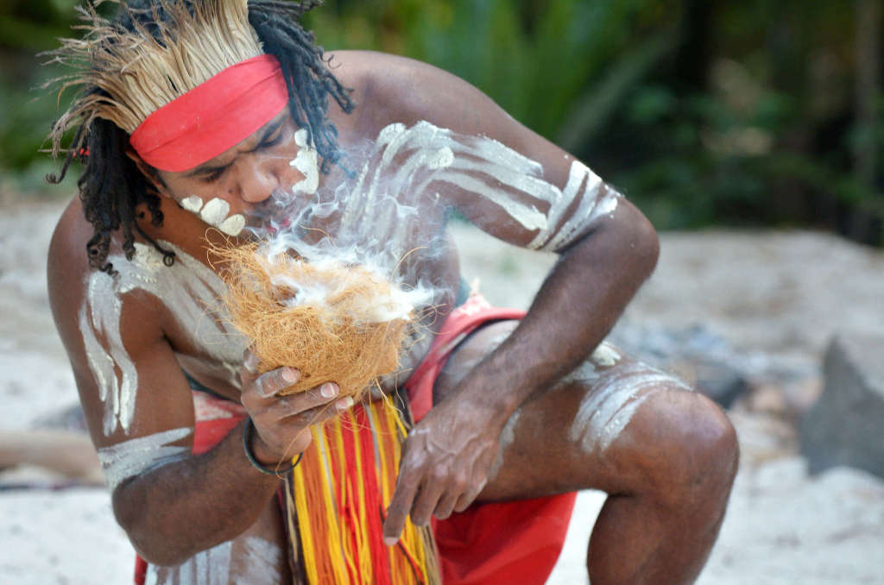
We are all visitors to this time, this place. We are just passing through. Our purpose here is to observe, to learn, to grow, to love… and then we return home.
Australian Aboriginal Wisdom

Slide 5
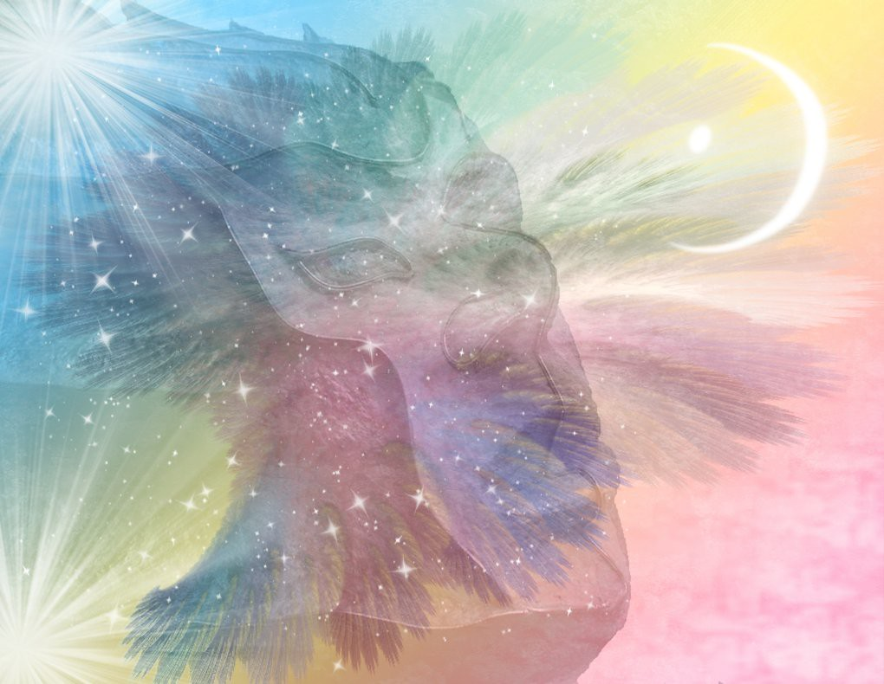
There is no death. Only a change of worlds.
American Indigenous Religions,
Chief Seattle (Suquamish)

Slide 6
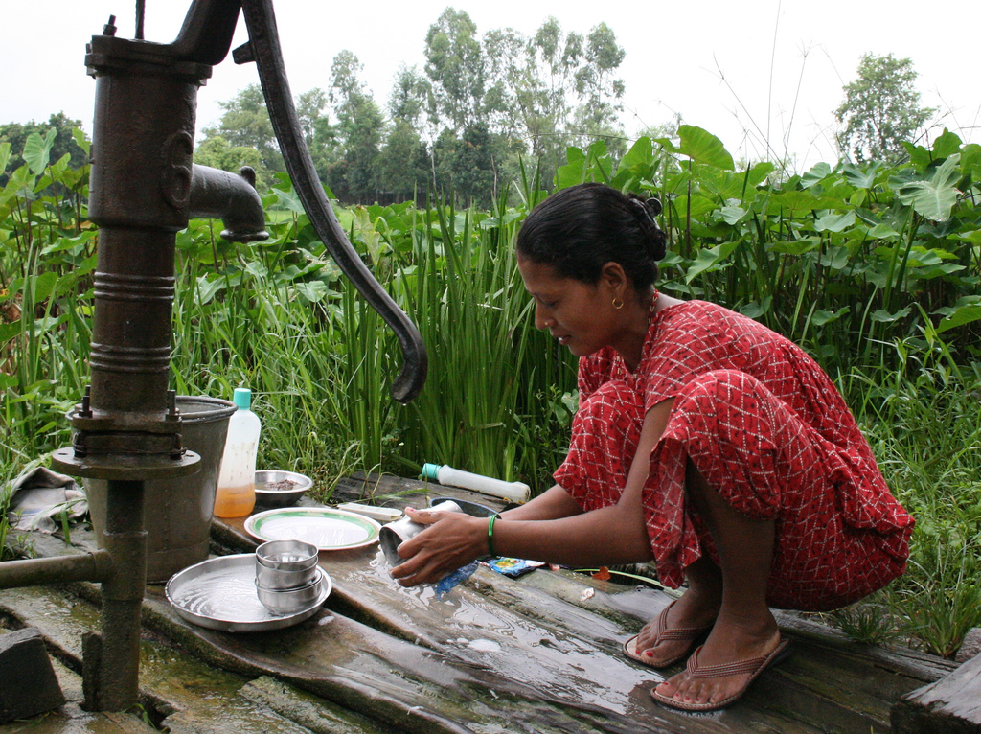
Perform all thy actions with mind concentrated on the Divine, renouncing attachment and looking upon success and failure with an equal eye. Spirituality implies equanimity.
Hinduism,
Bhagavad-Gita 2: 47-48

Slide 7

Where can I go to escape your Spirit? Where can I flee from your presence? If I climb up to heaven, you are there; if I lie down in Sh'ol, you are there. If I fly away with the wings of the dawn and land beyond the sea, even there your hand would lead me, your right hand would hold me fast.
Judaism,
Psalm 139: 7-10

Slide 8

Create in me a clean heart, God; renew in me a resolute spirit...
Restore my joy in your salvation, and let a willing spirit uphold me.
Judaism,
Psalm 51: 10, 12

Slide 9
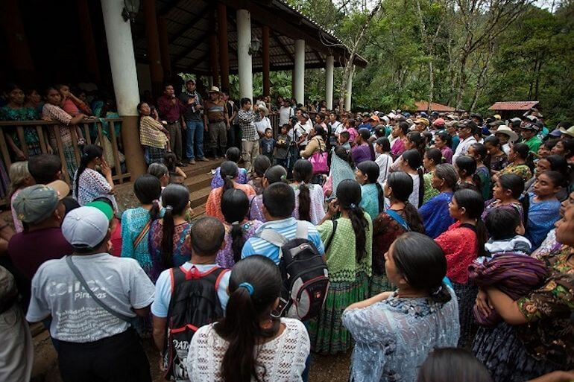
Whoever takes refuge with the awakened one, the truth, and the community, who with clear understanding perceives the four noble truths: namely suffering, the origin of suffering, the cessation of suffering, and the eightfold holy way that leads to the cessation of suffering, that is the safe refuge; that is the best refuge; having gone to that refuge, a person is delivered from all pains.
Buddhism,
Dhammapada 137

Slide 10

People driven by fear go for refuge to mountains and forests, to sacred groves and shrines. That is not a safe refuge; that is not the best refuge. After having got to that refuge, a person is not delivered from all pains.
Buddhism,
Dhammapada 136

Slide 11
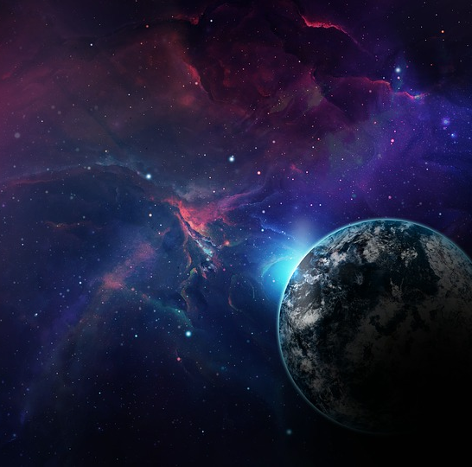
The God who made the world and all things in it, since He is Lord of heaven and earth, does not dwell in temples made with hands; nor is He served by human hands, as though He needed anything, since He Himself gives to all people life and breath and all things…
Christianity,
Acts 17: 24-25

Slide 12
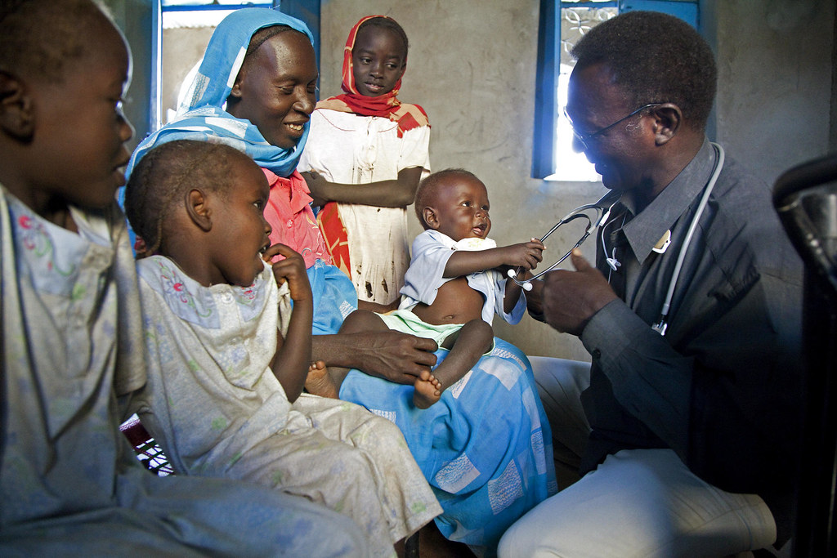
He who loves his life loses it, and he who hates his life in this world will keep it to life eternal. If anyone serves Me, he must follow Me; and where I am, there My servant will be also; if anyone serves Me, the Father will honor him.
Christianity,
John 12: 25-26

Slide 13
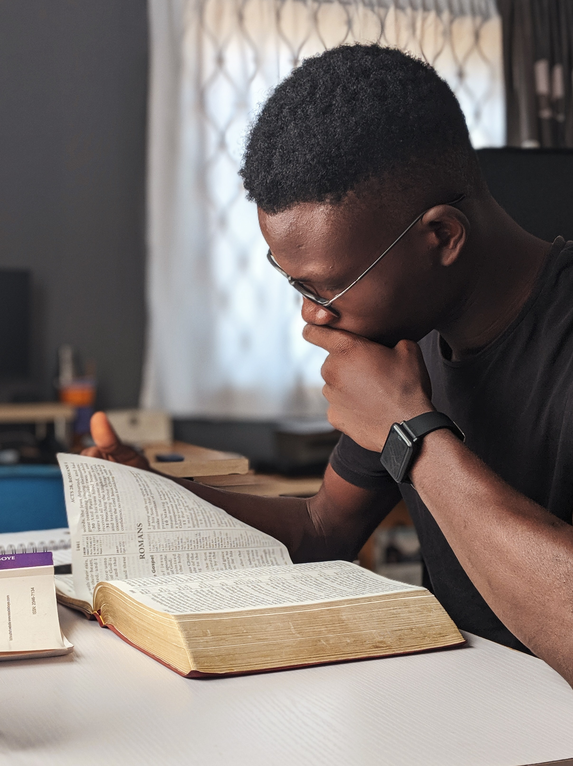
Do you enjoined others to do what is good and forget your ownselves, while you read the book? Will you not then understand? And seek help with patience and prayer, and this indeed is hard except for the humble in spirit, Who know for certain that they will meet their Lord, and to HIM will they return.
Islam, Qur’án 2: 45-47

Slide 14
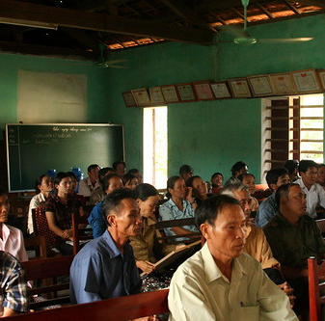
The true believers are those whose hearts are filled with awe at the mention of God, and whose faith grows stronger as they listen to His revelations. They put their trust in their Lord, pray steadfastly, and give in alms of that which We have given them. Such are the true believers. They shall be exalted and forgiven by their Lord, and a generous provision shall be made for them.
Islam,
Qur’án 8: 2-4

Slide 15

Know, verily, that the soul is a sign of God, a heavenly gem whose reality the most learned of men hath failed to grasp, and whose mystery no mind, however acute, can ever hope to unravel. It is the first among all created things to declare the excellence of its Creator, the first to recognize His glory, to cleave to His truth, and to bow down in adoration before Him. If it be faithful to God, it will reflect His light, and will, eventually, return unto Him. If it fail, however, in its allegiance to its Creator, it will become a victim to self and passion, and will, in the end, sink in their depths.
Bahá’i, Baha’u’lláh,
Gleanings, p. 158

Slide 16
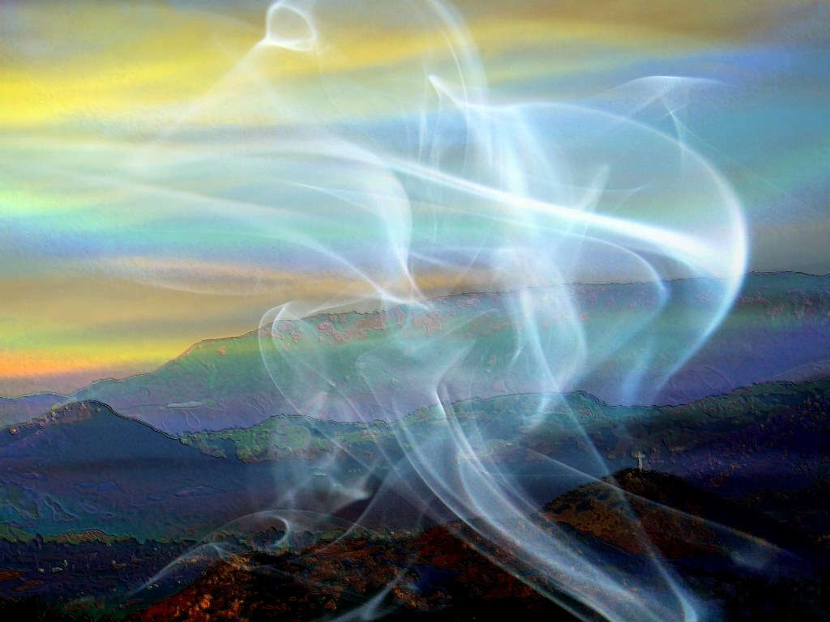
Just as the physical body of man is in need of its force of life, even so the human soul is in need of the divine animus and vivification emanating from the Holy Spirit. Without this vivification and sustenance, man would be an animal, nay, rather, dead.
Bahá’i, ‘Abdu’l-Bahá,
Promulgation of Universal Peace, p. 317

Slide 17

Spirit cannot be perceived by the material senses of the physical body, excepting as it is expressed in outward signs and works. The human body is visible, the soul is invisible. It is the soul nevertheless that directs a man's faculties, that governs his humanity.
Bahá’i, ‘Abdu’l-Bahá,
Paris Talks, p. 86

Slide 18

https://www.youtube.com/watch?v=EHIGm7qYVz4

Slide 19
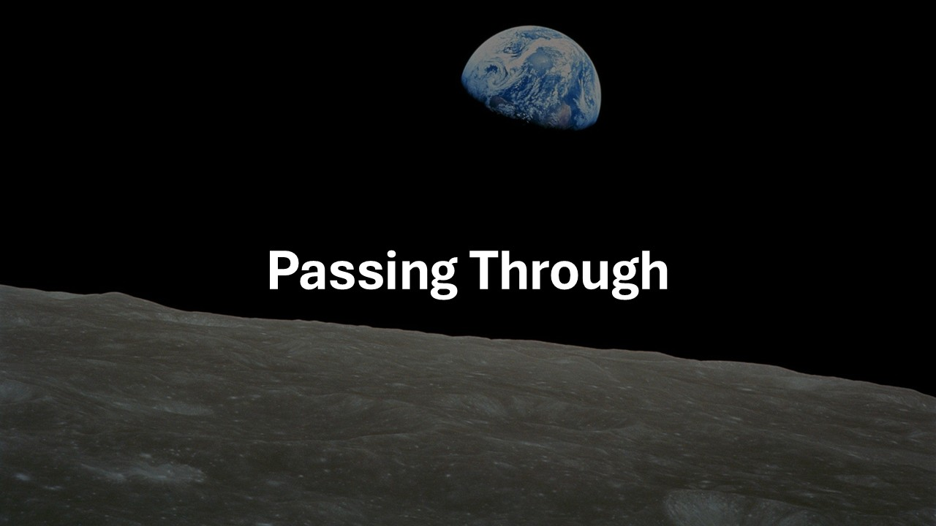
https://www.youtube.com/watch?v=ldI6EUWTwWA

