Slide 1
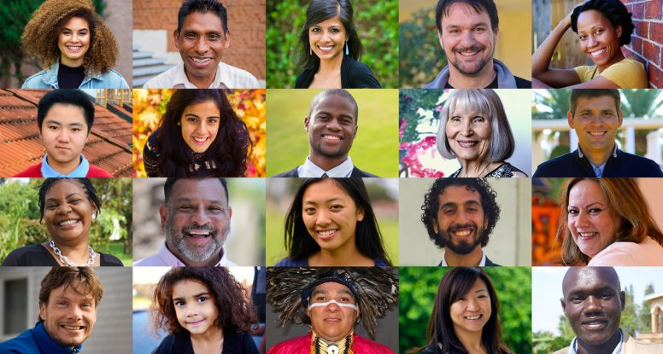
The Distinction of Humanity
Tucker, GA

Slide 2
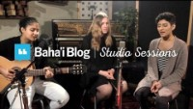
https://www.youtube.com/watch?v=8YrU0-BFjKA

Slide 3
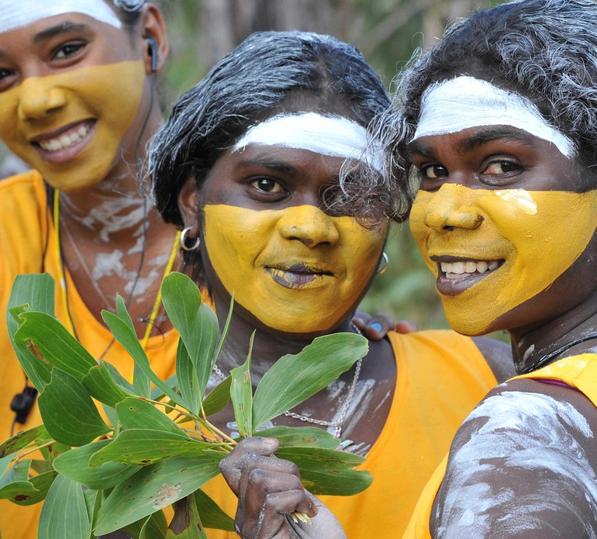
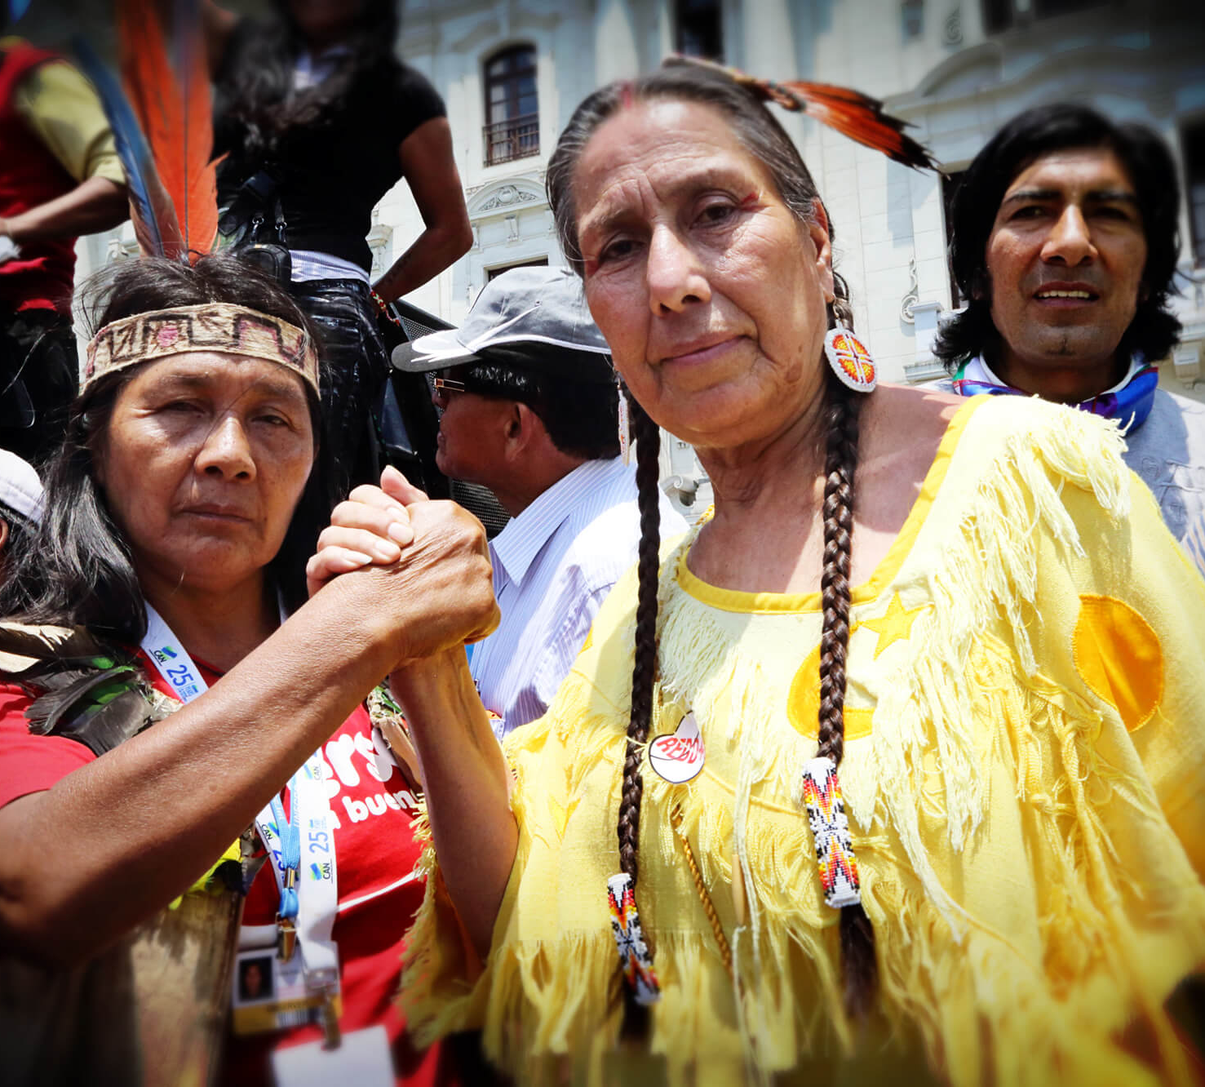
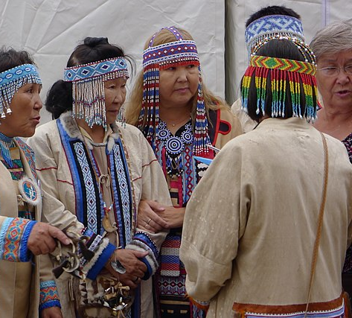
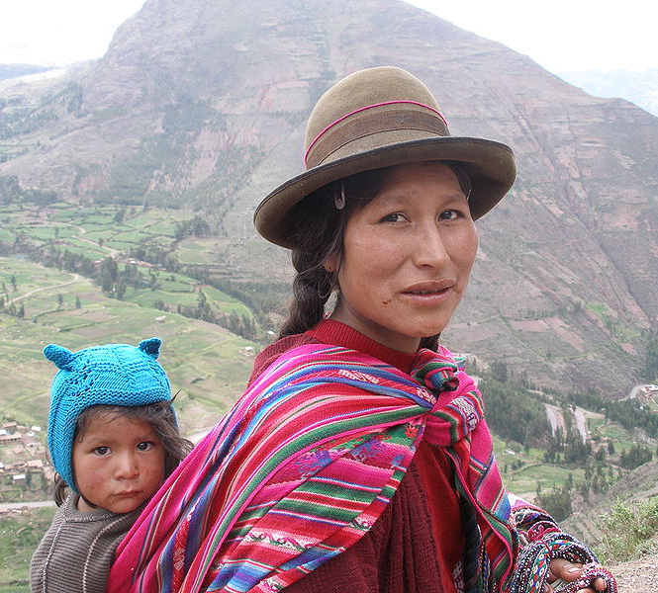
Indigenous people from every corner of the globe recognize that other species are part of nature and as human beings, we are also part of nature.
  Chad Indigenous,
  Hindou Oumarou Ibrahim,
  Mbororo

Slide 4
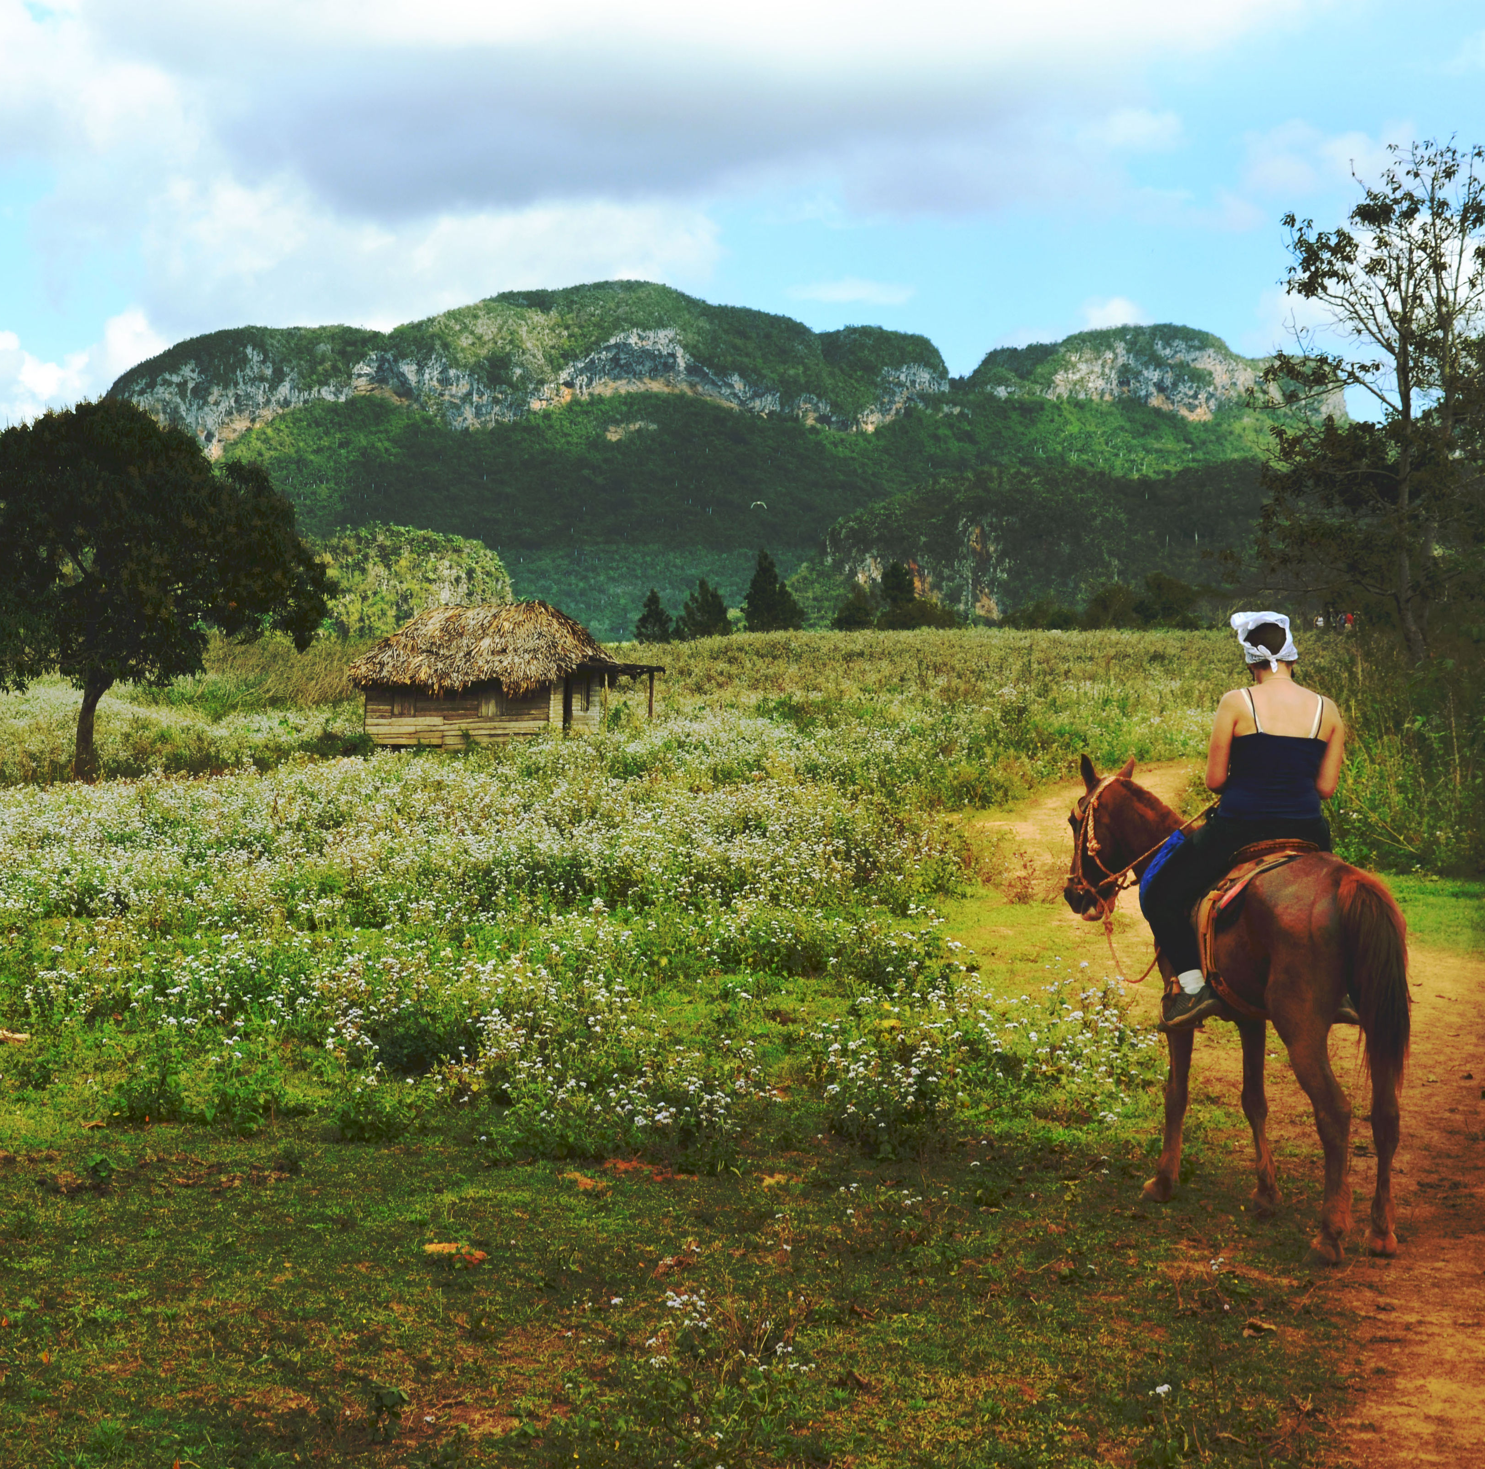
Humankind has not woven the web of life. We are but one thread within it. Whatever we do to the web, we do to ourselves. All things are bound together. All things connect.
American Indigenous (Suquamish),
Chief Seattle

Slide 5
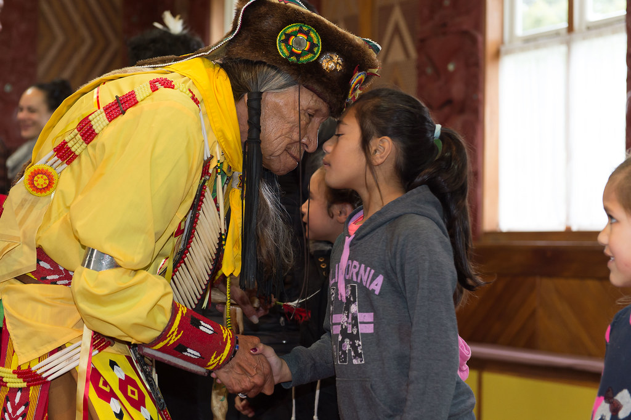
Because thou art greatly loved by Me, therefore I shall tell thee what is good for thee.
Hinduism, Bhagavad Gita
18: 64

Slide 6
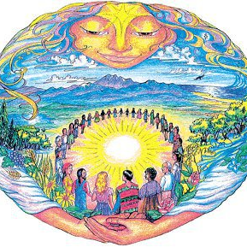
Unity is the reality; separateness the illusion. The nearer we come to reality, the nearer we come to unity of heart. Sympathy, compassion, kindness are modes of this unity of heart, whereby we rejoice with those who rejoice, and weep with those who weep. These things are learned by desiring to learn them.
Hinduism,
The Yoga Sutras of Patanjali

Slide 7
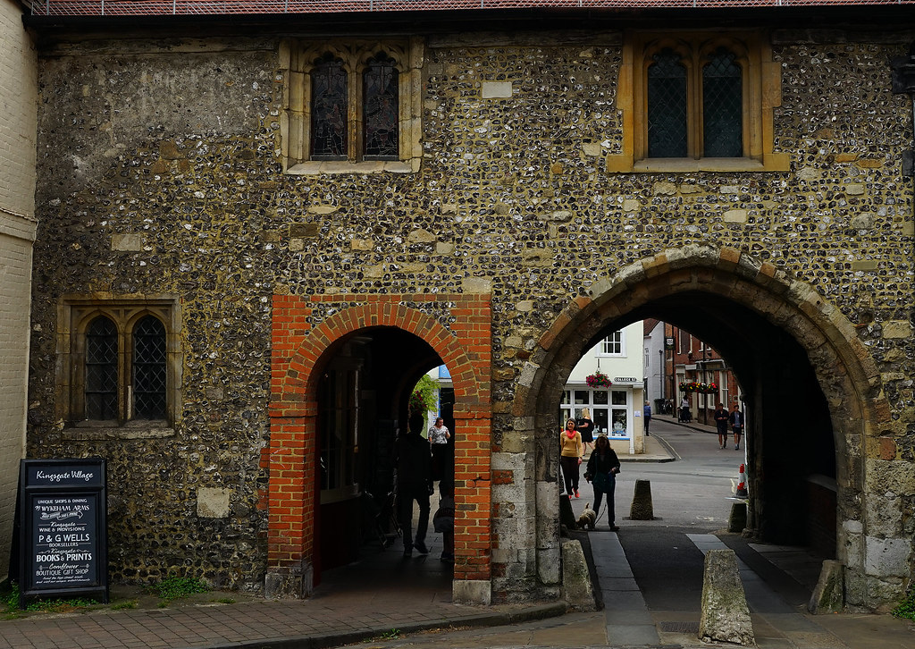
Enter into His gates with thanksgiving, and into His courts with praise; give thanks unto Him, and bless His name. For HaShem is good; His mercy endureth for ever; and His faithfulness unto all generations.
Judaism,
Tehilim (Psalms)
100: 4-5

Slide 8

I will lift up mine eyes unto the mountains: from whence shall my help come? My help cometh from HaShem, who made heaven and earth.
Judaism, Tehilim (Psalms)
121: 1-2

Slide 9
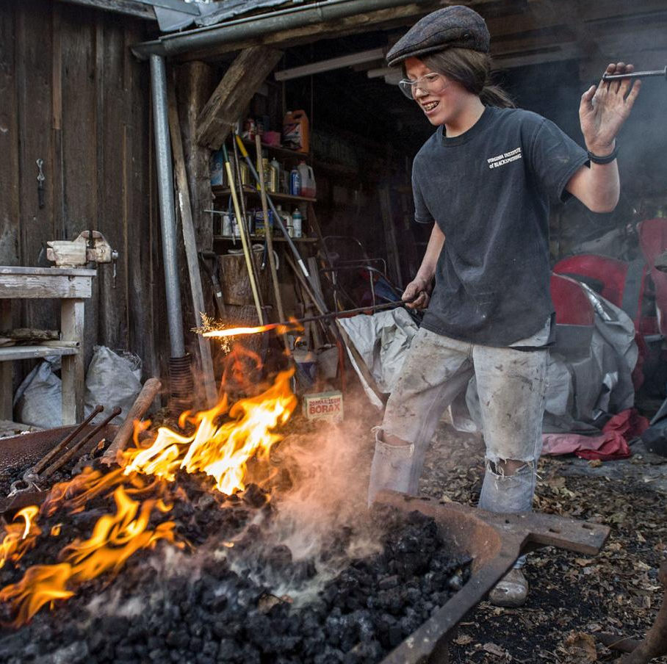
As a smith removes the impurities from silver, so let the wise remove the impurities from oneself little by one by one, little, again and again.
Buddhism,
Dhammapada 239

Slide 10
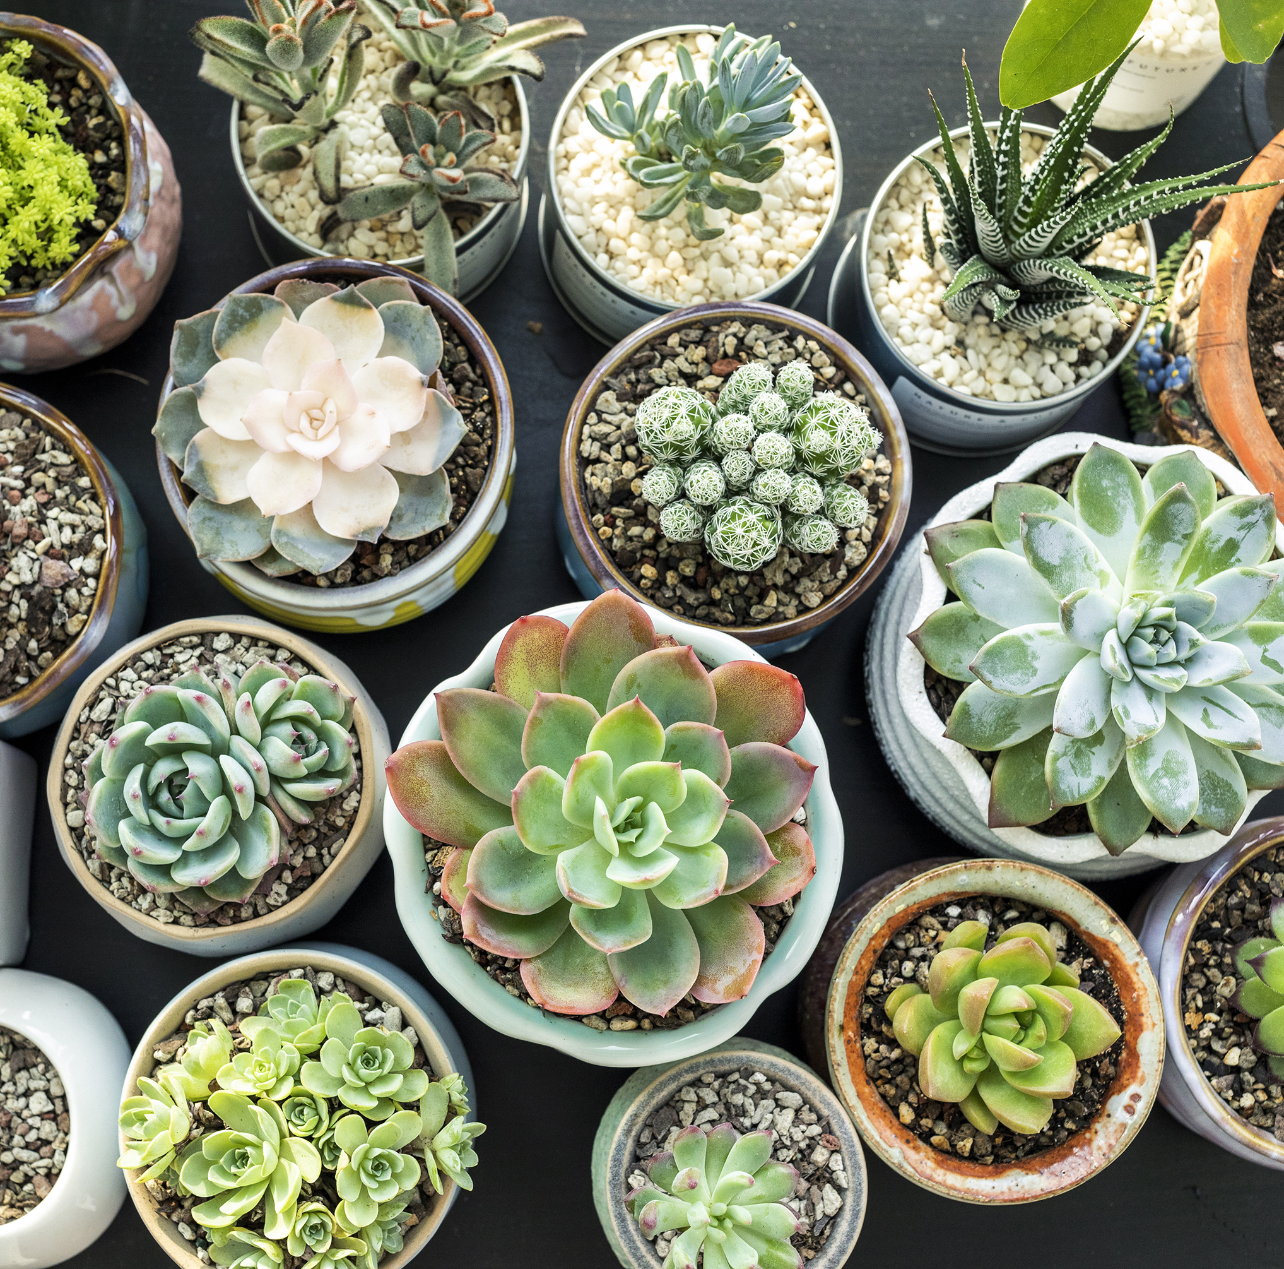
We join spokes together in a wheel, but it is the center hole that makes the wagon move.
We shape clay into a pot, but it is the emptiness inside that holds whatever we want.
We hammer wood for a house, but it is the inner space that makes it livable.
We work with being, but non-being is what we use.
Taoism, Lao Tzu,
Tao Te Ching, Ch 11

Slide 11

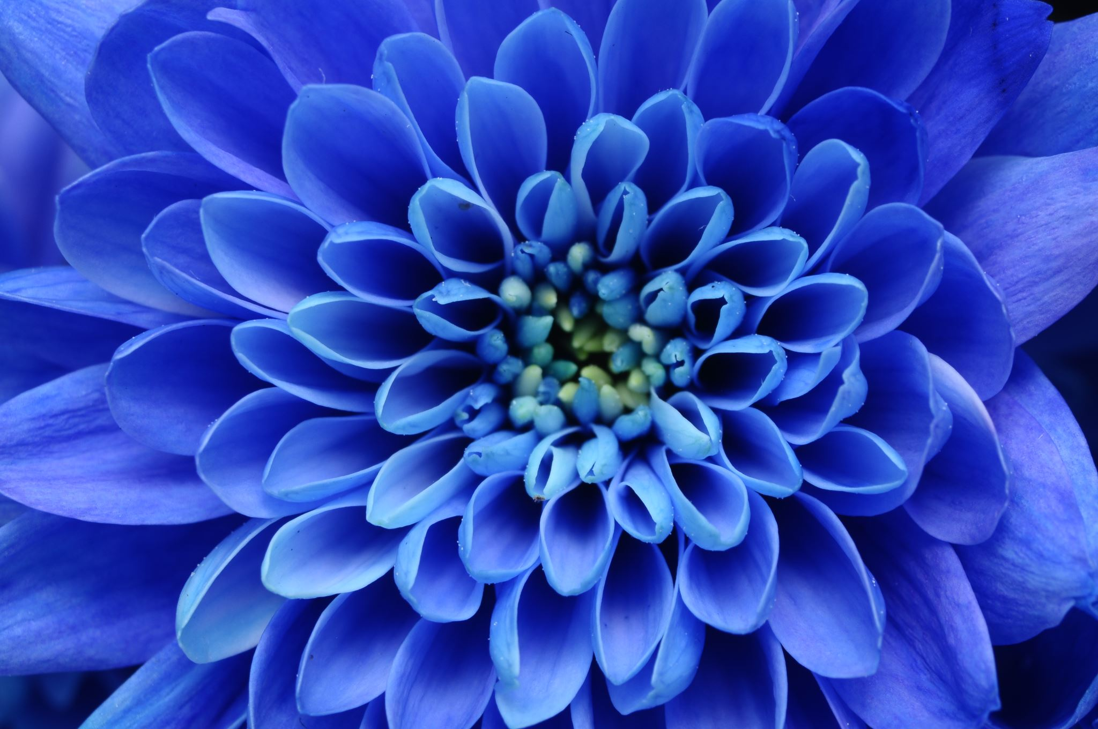


Finally, brethren, whatever is true, whatever is honorable, whatever is just, whatever is pure, whatever is lovely, whatever is gracious, if there is any excellence, if there is anything worthy of praise, think about these things.
Christian,
Philippians 4: 8

Slide 12

Behold, I stand at the door and knock; if anyone hears My voice and opens the door, I will come in to him and will dine with him, and he with Me.
Christian,
Revelation 3: 20

Slide 13

We indeed created man; and We know what his soul whispers within him, and We are nearer to him than the jugular vein.
Islam,
Qur’án 50: 1

Slide 14
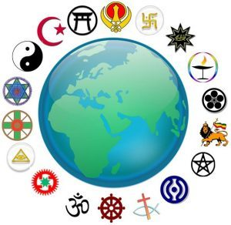
And We have sent you to men as a Messenger; God suffices for a witness. Whosoever obeys the Messenger, thereby obeys God; and whosoever turns his back-- We have not sent you to be a watcher over them.
Islam,
Qur’án 4: 79-80

Slide 15
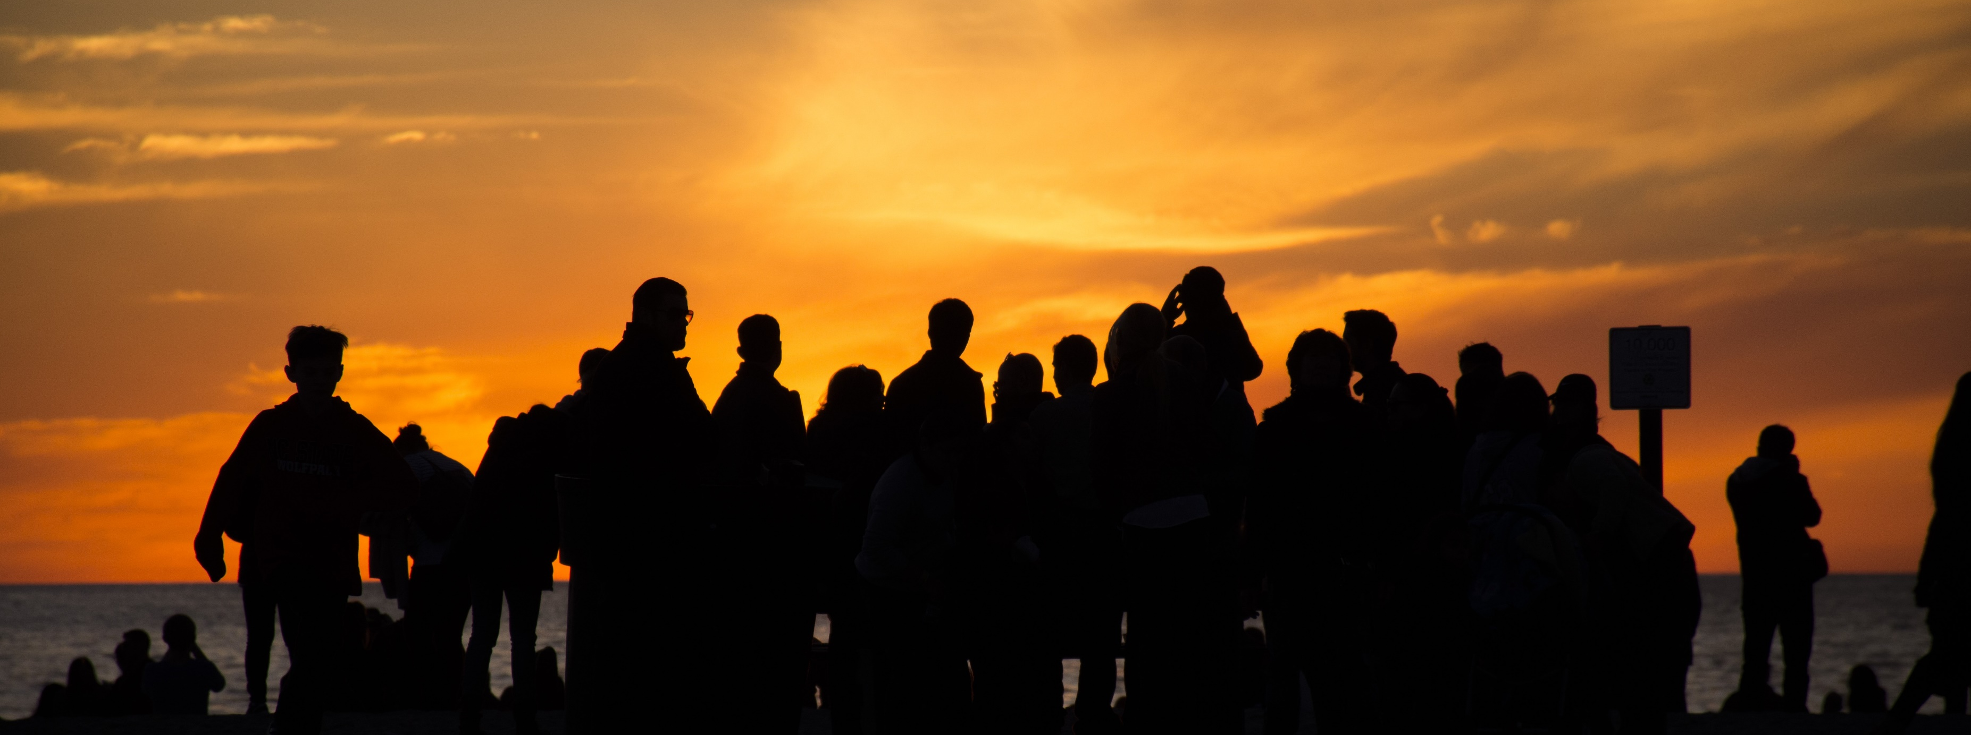
Let each morn be better than its eve and each morrow richer than its yesterday.
Bahá’i, Bahá’ulláh, Gleanings, p. 138

Slide 16
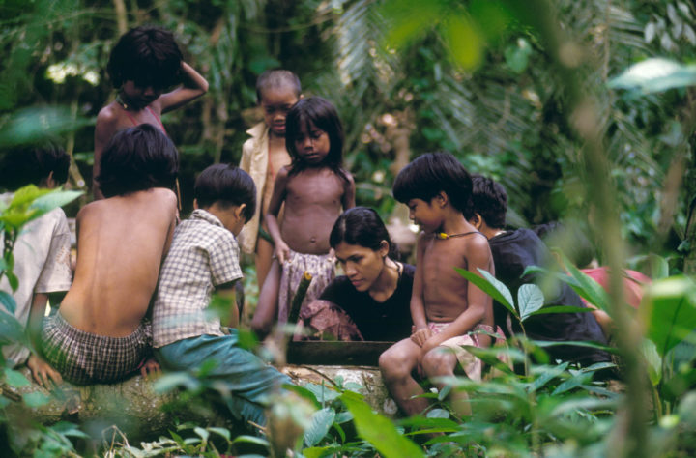
Now we need an educator who will be at the same time a material, human, and spiritual educator, and whose authority will be effective in all conditions. So if anyone should say, “I possess perfect comprehension and intelligence, and I have no need of such an educator”, he would be denying that which is clear and evident, as though a child should say, “I have no need of education; I will act according to my reason and intelligence, and so I shall attain the perfections of existence”; or as though the blind should say, “I am in no need of sight, because many other blind people exist without difficulty.”
Bahá’i, ‘Abdu’l-Bahá,
Some Answered Questions, p. 8

Slide 17
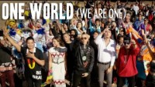
https://www.youtube.com/watch?v=XHhbeRJudY4&t=3s

Slide 18
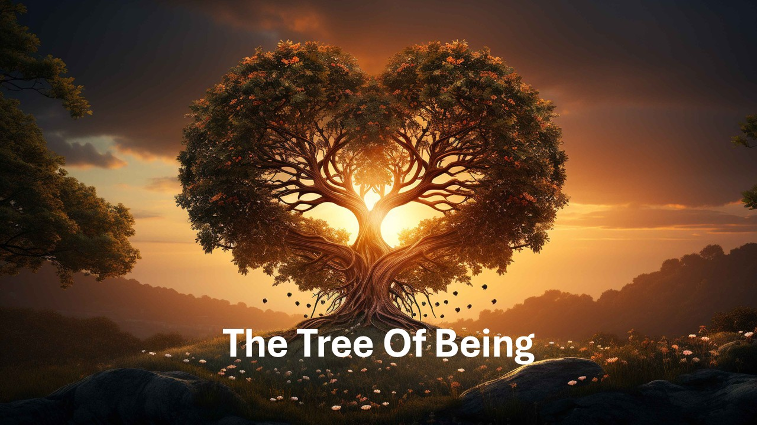
https://www.youtube.com/watch?v=uaFumnbqTyA

