Slide 1
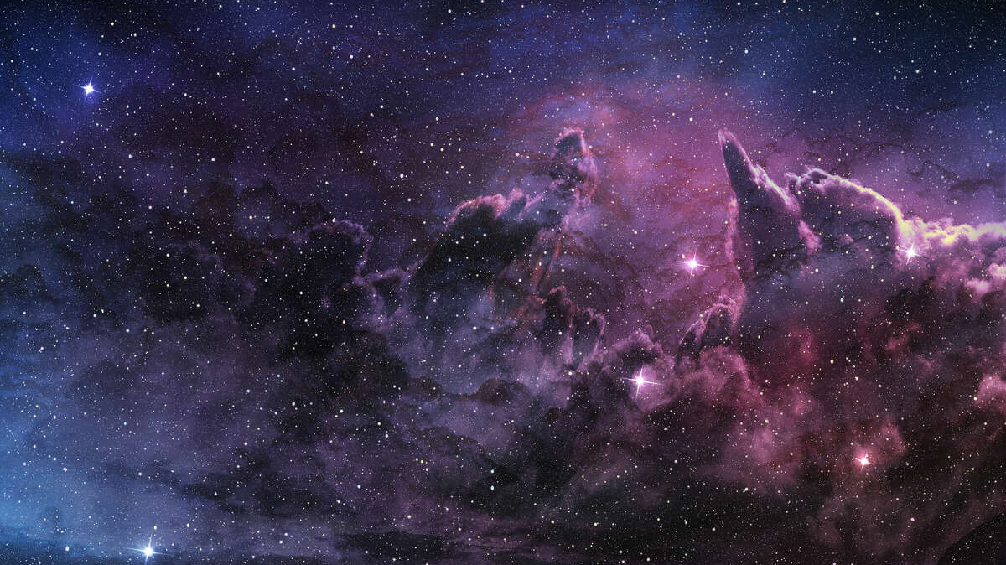
Existence of God
Tucker, GA

Slide 2
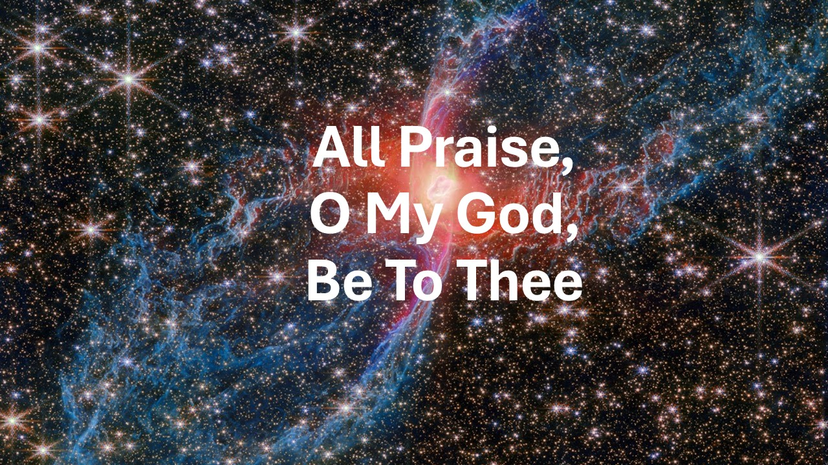
https://www.youtube.com/watch?v=Zu8wDejM-aw

Slide 3
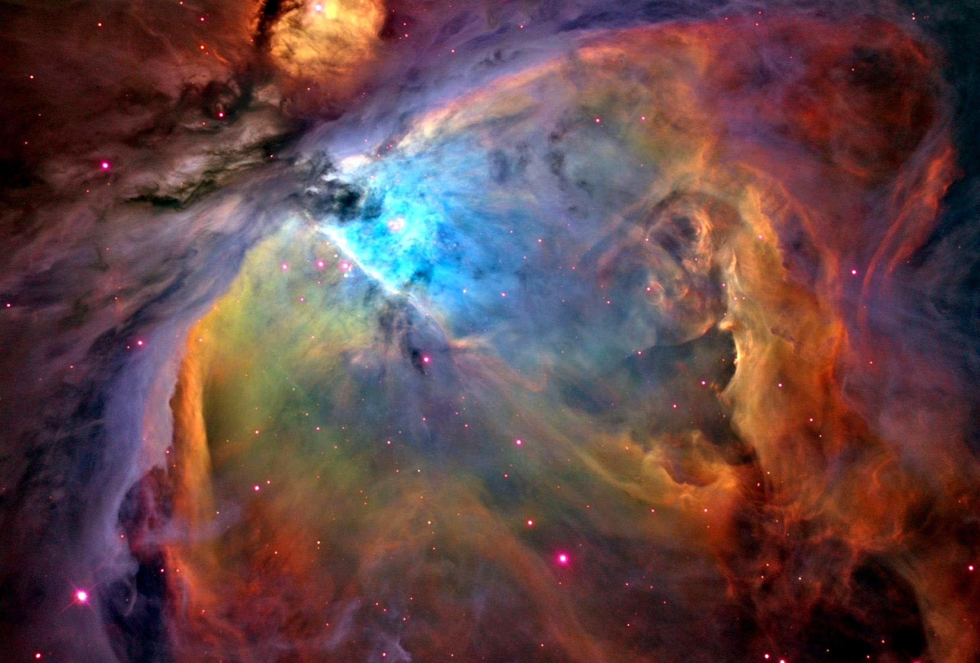
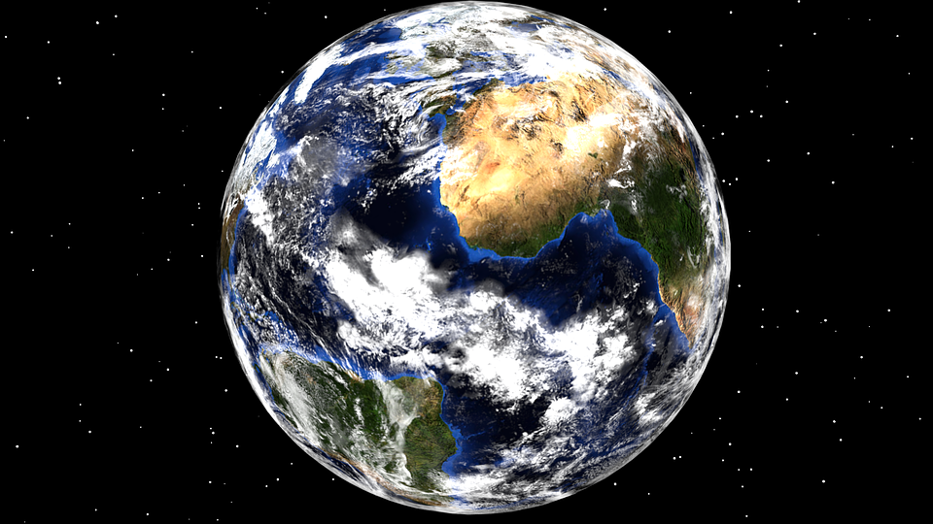

The Great Spirit is in all things. He is in the air we breathe. The Great Spirit is our Father, but the Earth is our Mother. She nourishes us.....That which we put into the ground she returns to us.
Big Thunder Wabanaki, Algonquin

Slide 4
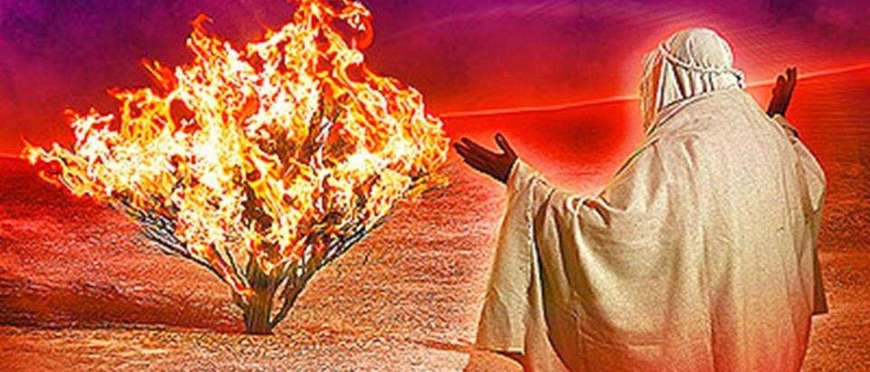
And when the LORD saw that he turned aside to see, God called unto him out of the midst of the bush, and said, Moses, Moses. And he said, Here am I.
And he said, Draw not nigh hither: put off thy shoes from off thy feet, for the place whereon thou standest is holy ground.
Moreover he said, I am the God of thy father, the God of Abraham, the God of Isaac, and the God of Jacob. And Moses hid his face; for he was afraid to look upon God.
Judaism,
Exodus, 3:4-6

Slide 5
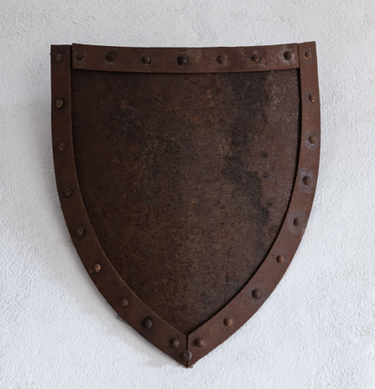
Every word of God is tried; He is a shield unto them that take refuge in Him.
Judaism,
Mishlei (Book of Proverbs), 30.5

Slide 6
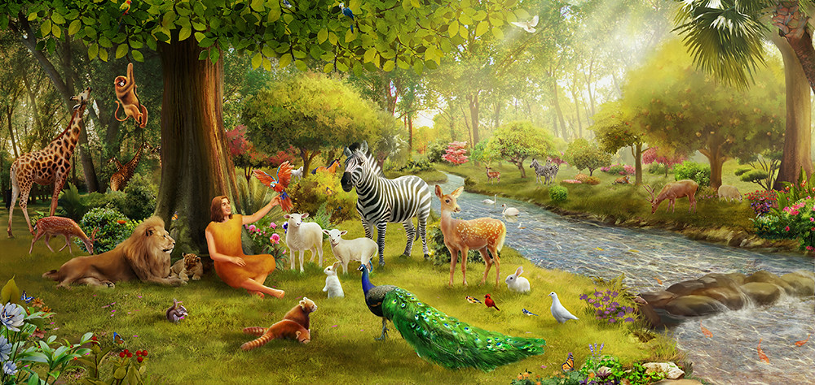
He who is Brahmā—the Great Brahmā, the Undefeated, the Champion, the Universal Seer, the Wielder of Power, the Lord God, the Maker, the Author, the Best, the Begetter, the Controller, the Father of those who have been born and those yet to be born — is permanent, everlasting, eternal, imperishable, remaining the same for all eternity.
Buddhism,
Dīghanikāya: Long Discourses, XXIV: 6.10

Slide 7
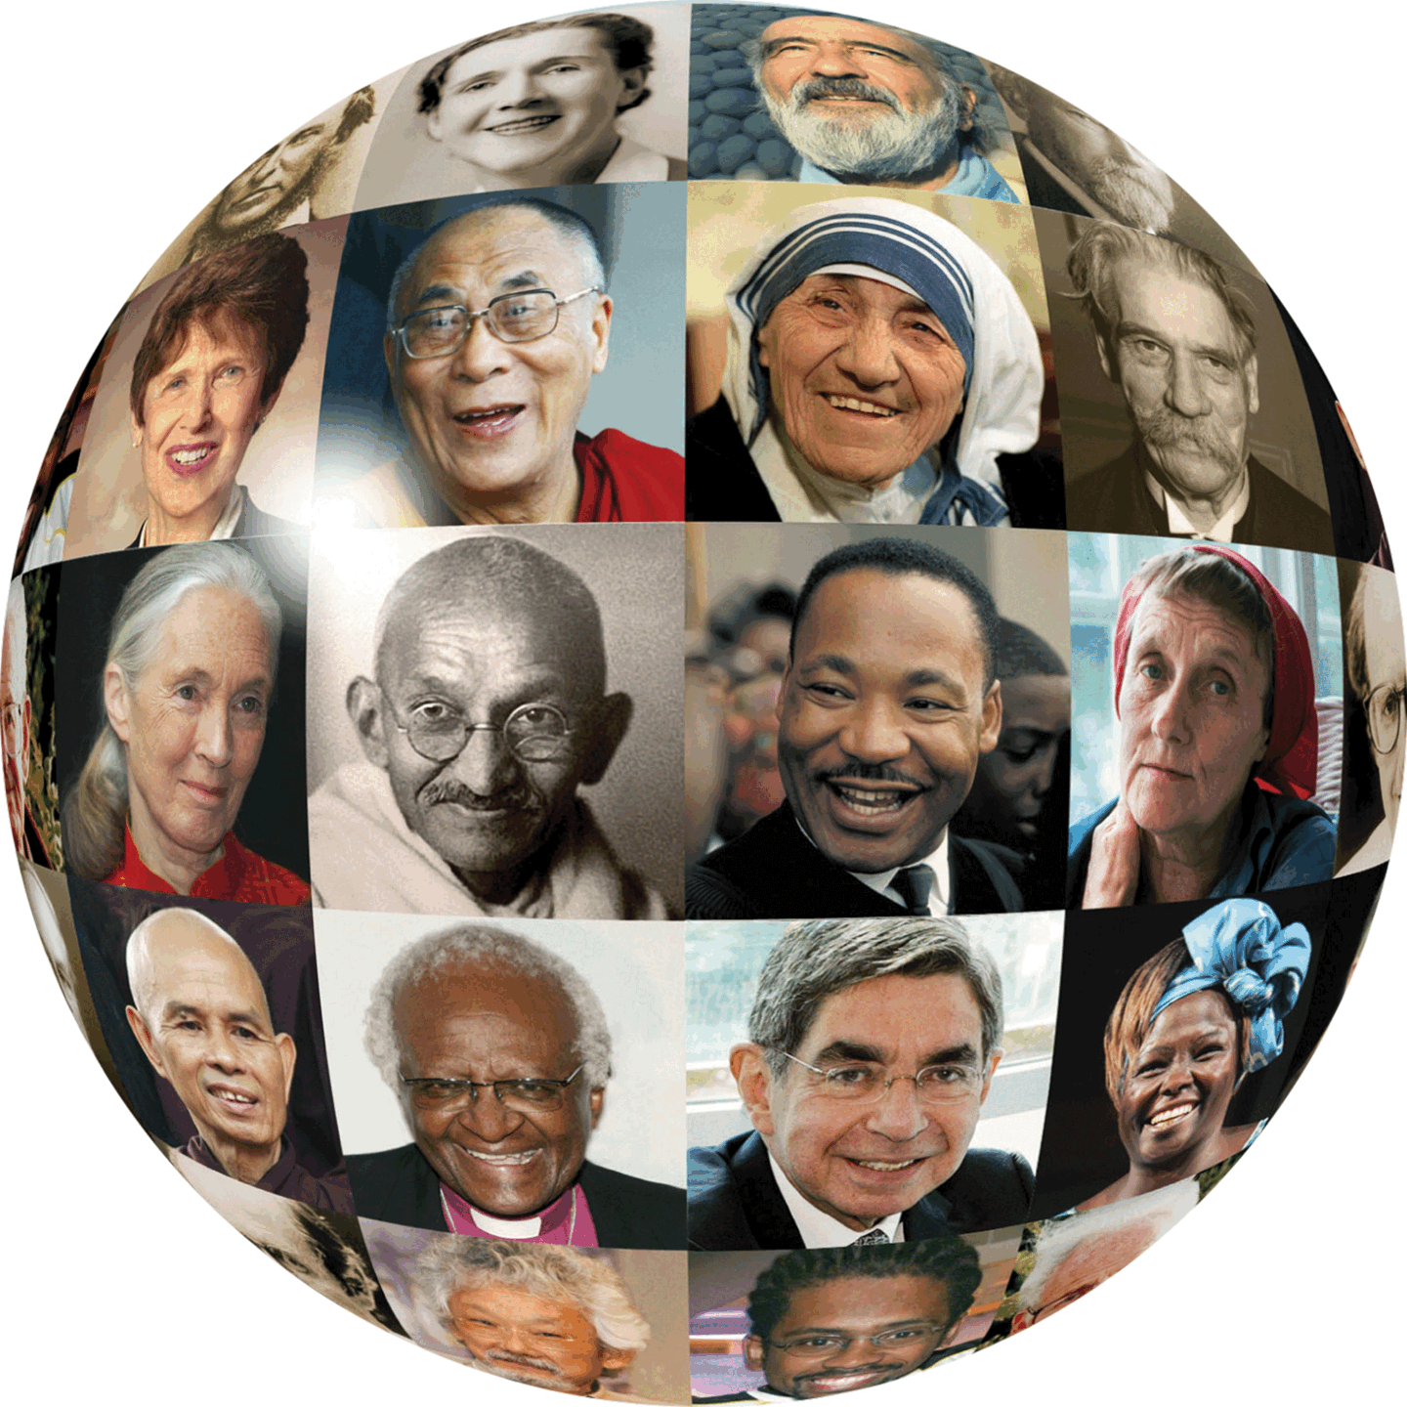
Blessed are the pure in heart: for they shall see God.
Blessed are the peacemakers: for they shall be called the children of God.
Christianity,
Matthew 5: 8-9

Slide 8

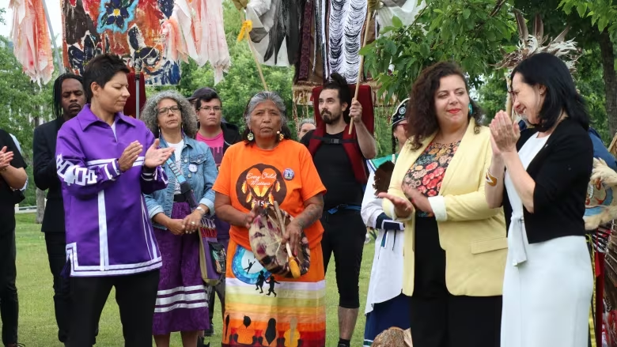

And Jesus answered him, The first of all the commandments is, Hear, O Israel; The Lord our God is one Lord: And thou shalt love the Lord thy God with all thy heart, and with all thy soul, and with all thy mind, and with all thy strength: this is the first commandment.
And the second is like, namely this, Thou shalt love thy neighbour as thyself. There is none other commandment greater than these.
Christianity, Mark 12: 28-29

Slide 9
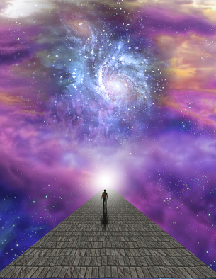
O ye who believe! Obey God, and obey The Apostle, and make Not vain your deeds!
Those who reject God, And hinder (men) from the Path Of God, then die rejecting God, — God will not forgive them.
Islam,
Qur’án, 47: 33-34

Slide 10

Say: “O men! I am sent Unto you all, as the Apostle Of God, to Whom belongeth The dominion of the heavens And the earth: there is no god But He: it is He that giveth Both life and death. So believe In God and His Apostle, The unlettered Prophet, Who believeth in God And His Words: follow him That (so) ye may be guided.”
Islam,
Qur’án 7.158

Slide 11
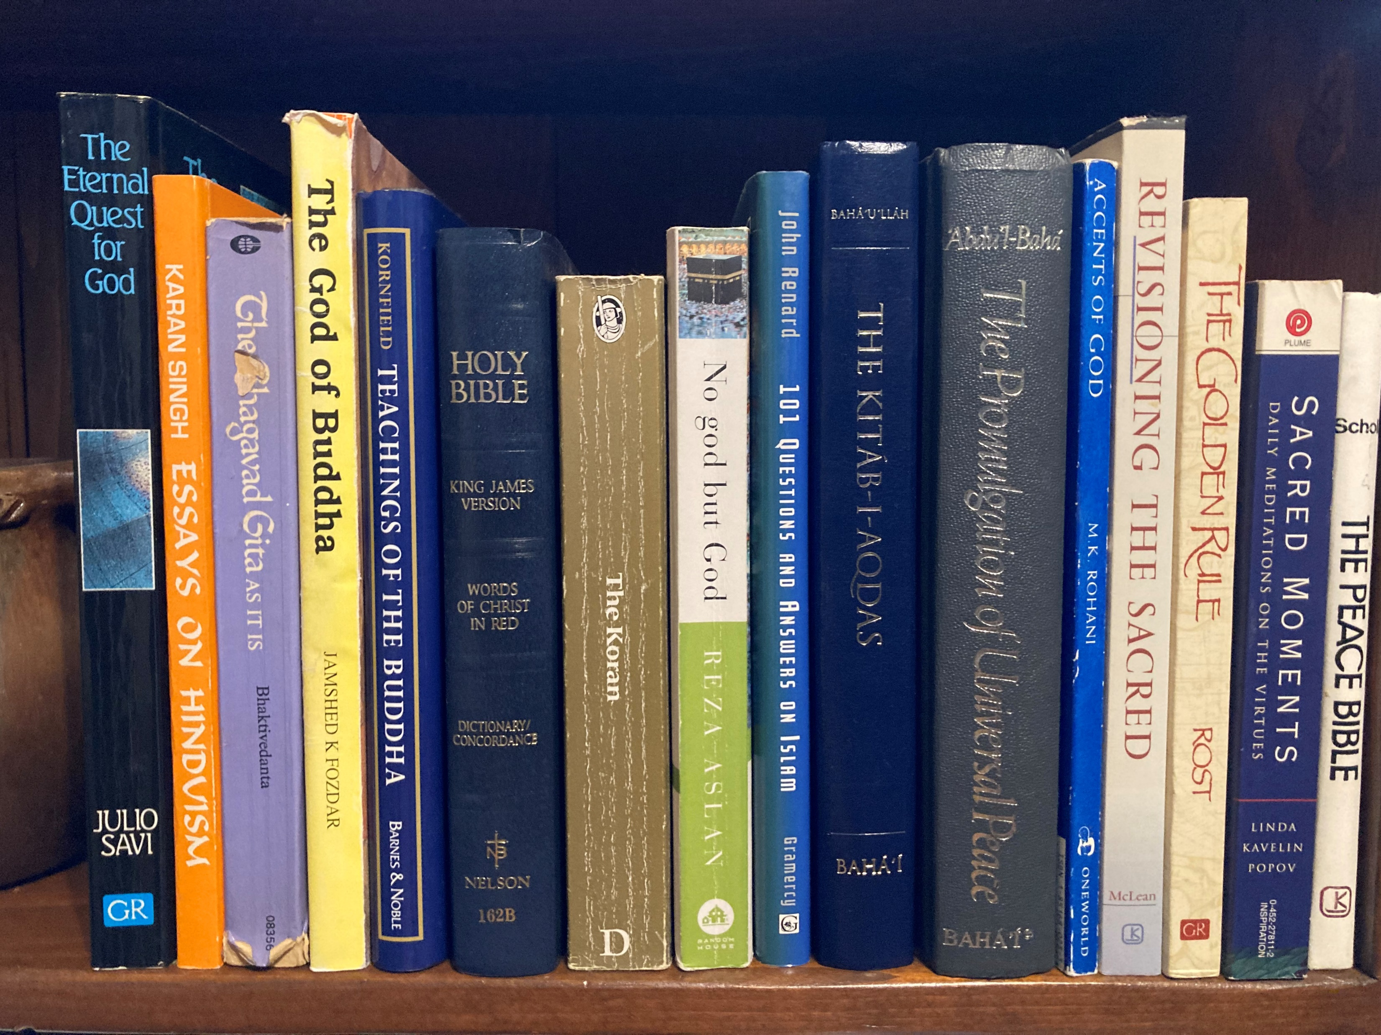
Everything must needs have an origin and every building a builder. Verily, the Word of God is the Cause which hath preceded the contingent world-- a world which is adorned with the splendours of the Ancient of Days, yet is being renewed and regenerated at all times. Immeasurably exalted is the God of Wisdom Who hath raised this sublime structure.
Bahá’i, Bahá’u’lláh,
Tablets of Bahá’u’lláh, p. 141

Slide 12

The reality of the Divinity is sanctified and exalted beyond the comprehension of all created things, can in no wise be imagined by mortal mind and understanding, and transcends all human conception. That reality admits of no division, for division and multiplicity are among the characteristics of created and hence contingent things, and not accidents impinging upon the Necessary Being.
Bahá’i, ‘Abdu’l-Bahá
Some Answered Questions, 27.2

Slide 13
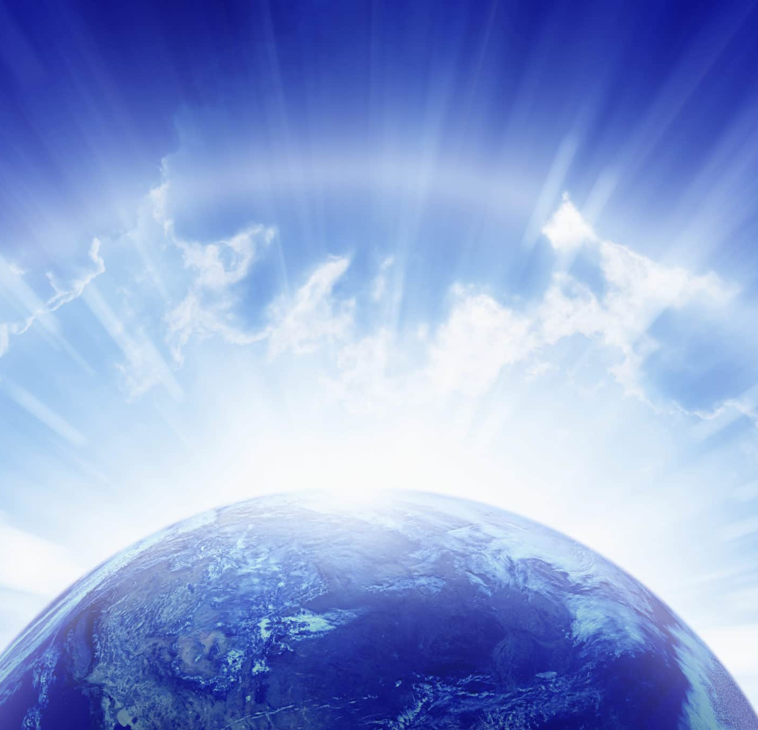
Praised be Thou, O Lord my God! I bear witness that from eternity Thou wert exalted in Thy transcendent majesty and might, and wilt to eternity abide in Thy surpassing power and glory. None in the kingdoms of earth and heaven can frustrate Thy purpose; none throughout the realms of revelation and of creation can prevail against Thee. At Thy command Thou doest what Thou willest, and by the power of Thy sovereignty Thou rulest as Thou pleasest.
Bahá’i, Bahá’u’lláh,
Prayers and Meditations, p. 32

Slide 14
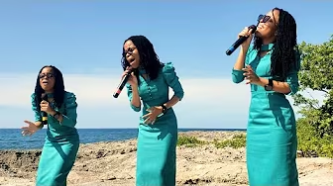
Goodness of God
https://www.youtube.com/watch?v=sz7xZ_-_uHM&t=2s

Slide 15
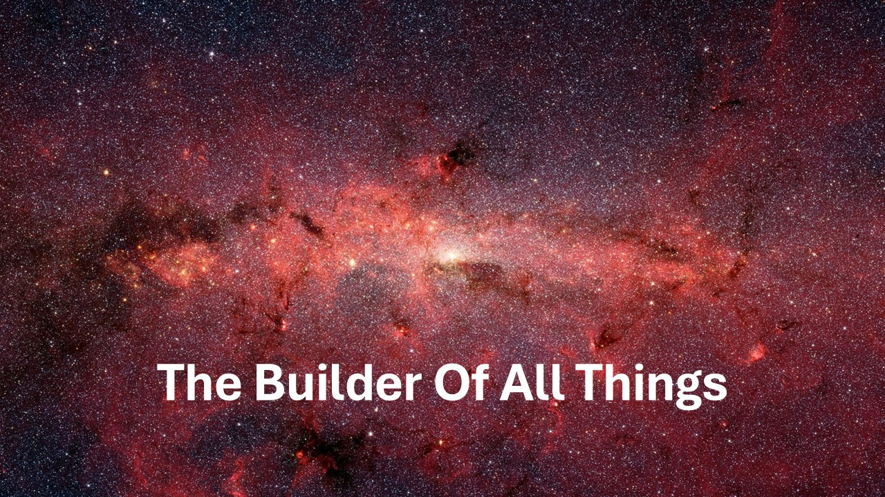
https://www.youtube.com/watch?v=Z4myj9Zo0to

