Slide 1
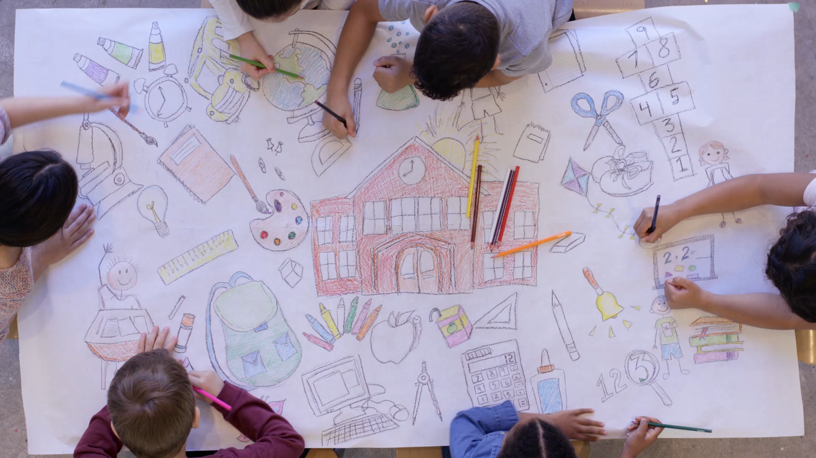
Family
Tucker, GA

Slide 2

https://www.youtube.com/watch?v=FCTidB5cswA&t=2s

Slide 3

All the virtues must be taught the family. The integrity of the family bond must be constantly considered, and the rights of the individual members must not be transgressed.
‘Abdu’l-Bahá
Promulgation of Universal Peace, p. 168

Slide 4

Note ye how easily, where unity existeth in a given family, the affairs of that family are conducted; what progress the members of that family make, how they prosper in the world. Their concerns are in order, they enjoy comfort and tranquillity, they are secure, their position is assured, they come to be envied by all.
‘Abdu’l-Bahá
Selections from the
Writings of ‘Abdu’l-Bahá, 221.9

Slide 5

Say, O My people! Show honour to your parents and pay homage to them. This will cause blessings to descend upon you from the clouds of the bounty of your Lord, the Exalted, the Great.
Bahá’u’lláh
Compilation of Compilations, Vol I (Family Life), p. 386

Slide 6
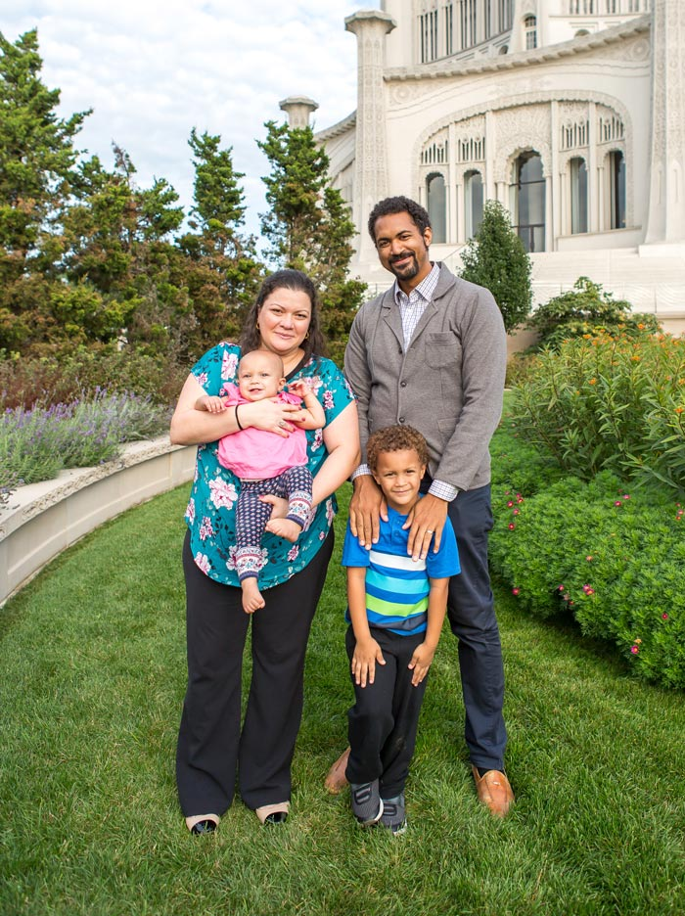
Truly, the Lord loveth union and harmony and abhorreth separation and divorce.
Bahá'u'lláh
The Kitáb-i-Áqdás, K 44

Slide 7

Consider the harmful effect of discord and dissension in a family; then reflect upon the favors and blessings which descend upon that family when unity exists among its various members. What incalculable benefits and blessings would descend upon the great human family if unity and brotherhood were established!
‘Abdu’l-Bahá
The Promulgation of Universal Peace, 82.5

Slide 8


Compare the nations of the world to the members of a family. A family is a nation in miniature. Simply enlarge the circle of the household, and you have the nation. Enlarge the circle of nations, and you have all humanity.
‘Abdu’l-Bahá
The Promulgation
of Universal Peace, 58.2

Slide 9
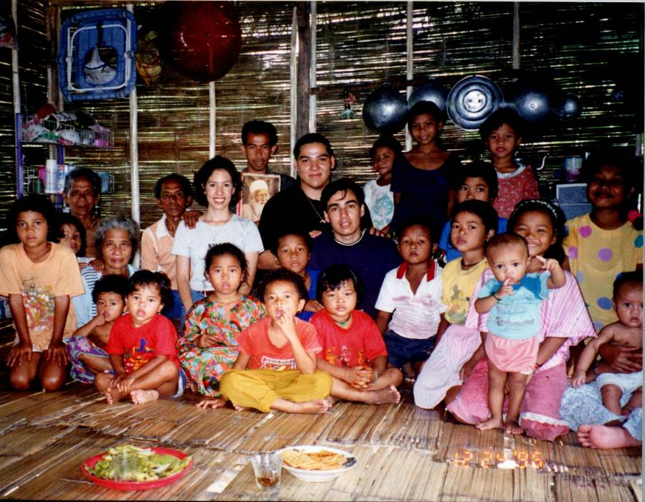
If love and agreement are manifest in a single family, that family will advance, become illumined and spiritual; but if enmity and hatred exist within it, destruction and dispersion are inevitable. This is, likewise, true of a city...In the same way, the people of a nation develop and advance toward civilization and enlightenment through love and accord and are disintegrated by war and strife. Finally, this is true of humanity itself in the aggregate.
‘Abdu’l-Bahá
The Promulgation of Universal Peace, 54.3

Slide 10
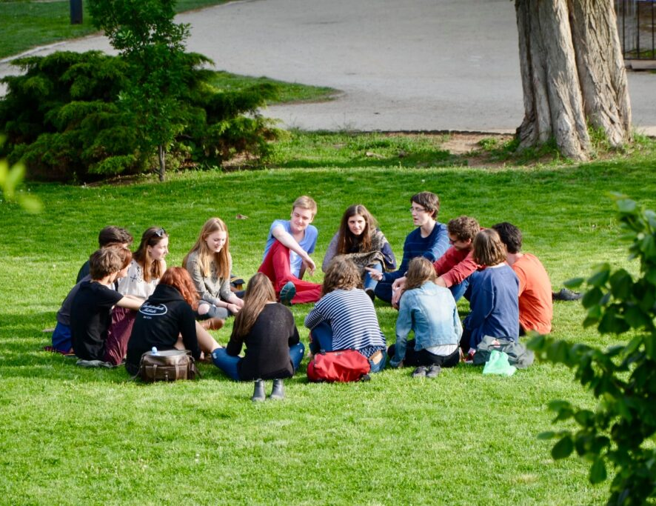

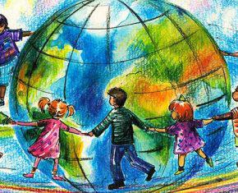
Every imperfect soul is self-centered and thinketh only of his own good. But as his thoughts expand a little he will begin to think of the welfare and comfort of his family. If his ideas still more widen, his concern will be the felicity of his fellow citizens; and if still they widen, he will be thinking of the glory of his land and of his race. But when ideas and views reach the utmost degree of expansion and attain the stage of perfection, then will he be interested in the exaltation of humankind.
‘Abdu’l-Bahá
Selections from the
Writings of ‘Abdu’l-Bahá, 34.2

Slide 11

Just as the son has certain obligations to his father, the father, likewise, has certain obligations to his son. The mother, the sister and other members of the household have their certain prerogatives. All these rights and prerogatives must be conserved, yet the unity of the family must be sustained. The injury of one shall be considered the injury of all; the comfort of each, the comfort of all; the honor of one, the honor of all.
‘Abdu’l-Bahá
The Promulgation
of Universal Peace, 60.15

Slide 12
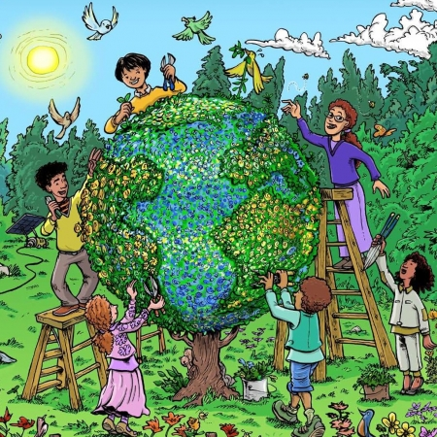
The purport is this, that we are all inhabiting one globe of earth. In reality we are one family, and each one of us is a member of this family. We must all be in the greatest happiness and comfort, under a just rule and regulation which is according to the good pleasure of God, thus causing us to be happy, for this life is fleeting.
‘Abdu’l-Bahá
The Promulgation
of Universal Peace, 102.26

Slide 13

https://brilliantstar19.org/videos/bahai/bh-55-HomeOfLight.mp4

