Slide 1

Moderation
Tucker, GA

Slide 2

https://www.youtube.com/watch?v=fh10F3xw4x4

Slide 3

In all matters moderation is desirable. If a thing is carried to excess, it will prove a source of evil.
Bahá'u'lláh
Tablets of Bahá’u’lláh, p. 69
This Photo by Unknown Author is licensed under CC BY-NC

Slide 4

Moderation is indeed highly desirable. Every person who in some degree turneth towards the truth can himself later comprehend most of what he seeketh. However, if at the outset a word is uttered beyond his capacity, he will refuse to hear it and will arise in opposition.
Bahá'u'lláh
Guidelines for Teaching, p. 293

Slide 5

A good character is in the sight of God and His chosen ones and the possessors of insight, the most excellent and praiseworthy of all things, but always on condition that its center of emanation should be reason and knowledge and its base should be true moderation.
'Abdu'l-Bahá
Secret of Divine Civilization, p. 60

Slide 6
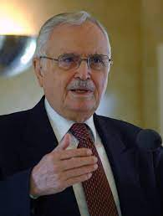
Human utterance is an essence which aspireth to exert its influence and needeth moderation. As to its influence, this is conditional upon refinement which in turn is dependent upon hearts which are detached and pure. As to its moderation, this hath to be combined with tact and wisdom as prescribed in the Holy Scriptures and Tablets.
Bahá'u'lláh
Tablets of Bahá’u’lláh, p. 172

Slide 7

Whoso cleaveth to justice, can, under no circumstances, transgress the limits of moderation.
Bahá'u'lláh
Gleanings, p. 342

Slide 8

How often has it happened that an individual who was graced with every attribute of humanity and wore the jewel of true understanding, nevertheless followed after his passions until his excellent qualities passed beyond moderation and he was forced into excess. His pure intentions changed to evil ones, his attributes were no longer put to uses worthy of them, and the power of his desires turned him aside from righteousness and its rewards into ways that were dangerous and dark.
'Abdu'l-Bahá
Secret of Divine Civilization, pp. 59-60

Slide 9

It is incumbent upon the loved ones of God to exercise the greatest care and prudence in all things, whether great or small, to take counsel together and unitedly resist the onslaught of the stirrers up of strife and the movers of mischief. They must endeavour to consort in a friendly spirit with everyone, must follow moderation in their conduct, must have respect and consideration one for another and show loving-kindness and tender regard to all the peoples of the world.
Abdu'l-Bahá
Selections from the Writings of ‘Abdu’l-Bahá, p. 233

Slide 10

A chaste and holy life must be made the controlling principle in the behavior and conduct of all Bahá'ís, both in their social relations with the members of their own community, and in their contact with the world at large...Such a chaste and holy life, with its implication of modesty, purity, temperance, decency, and clean-mindedness, involves no less than the exercise of moderation in all that pertains to dress, language, amusements, and all artistic and literary avocations.
Shoghi Effendi
Advent of Divine Justice, p. 24

Slide 11

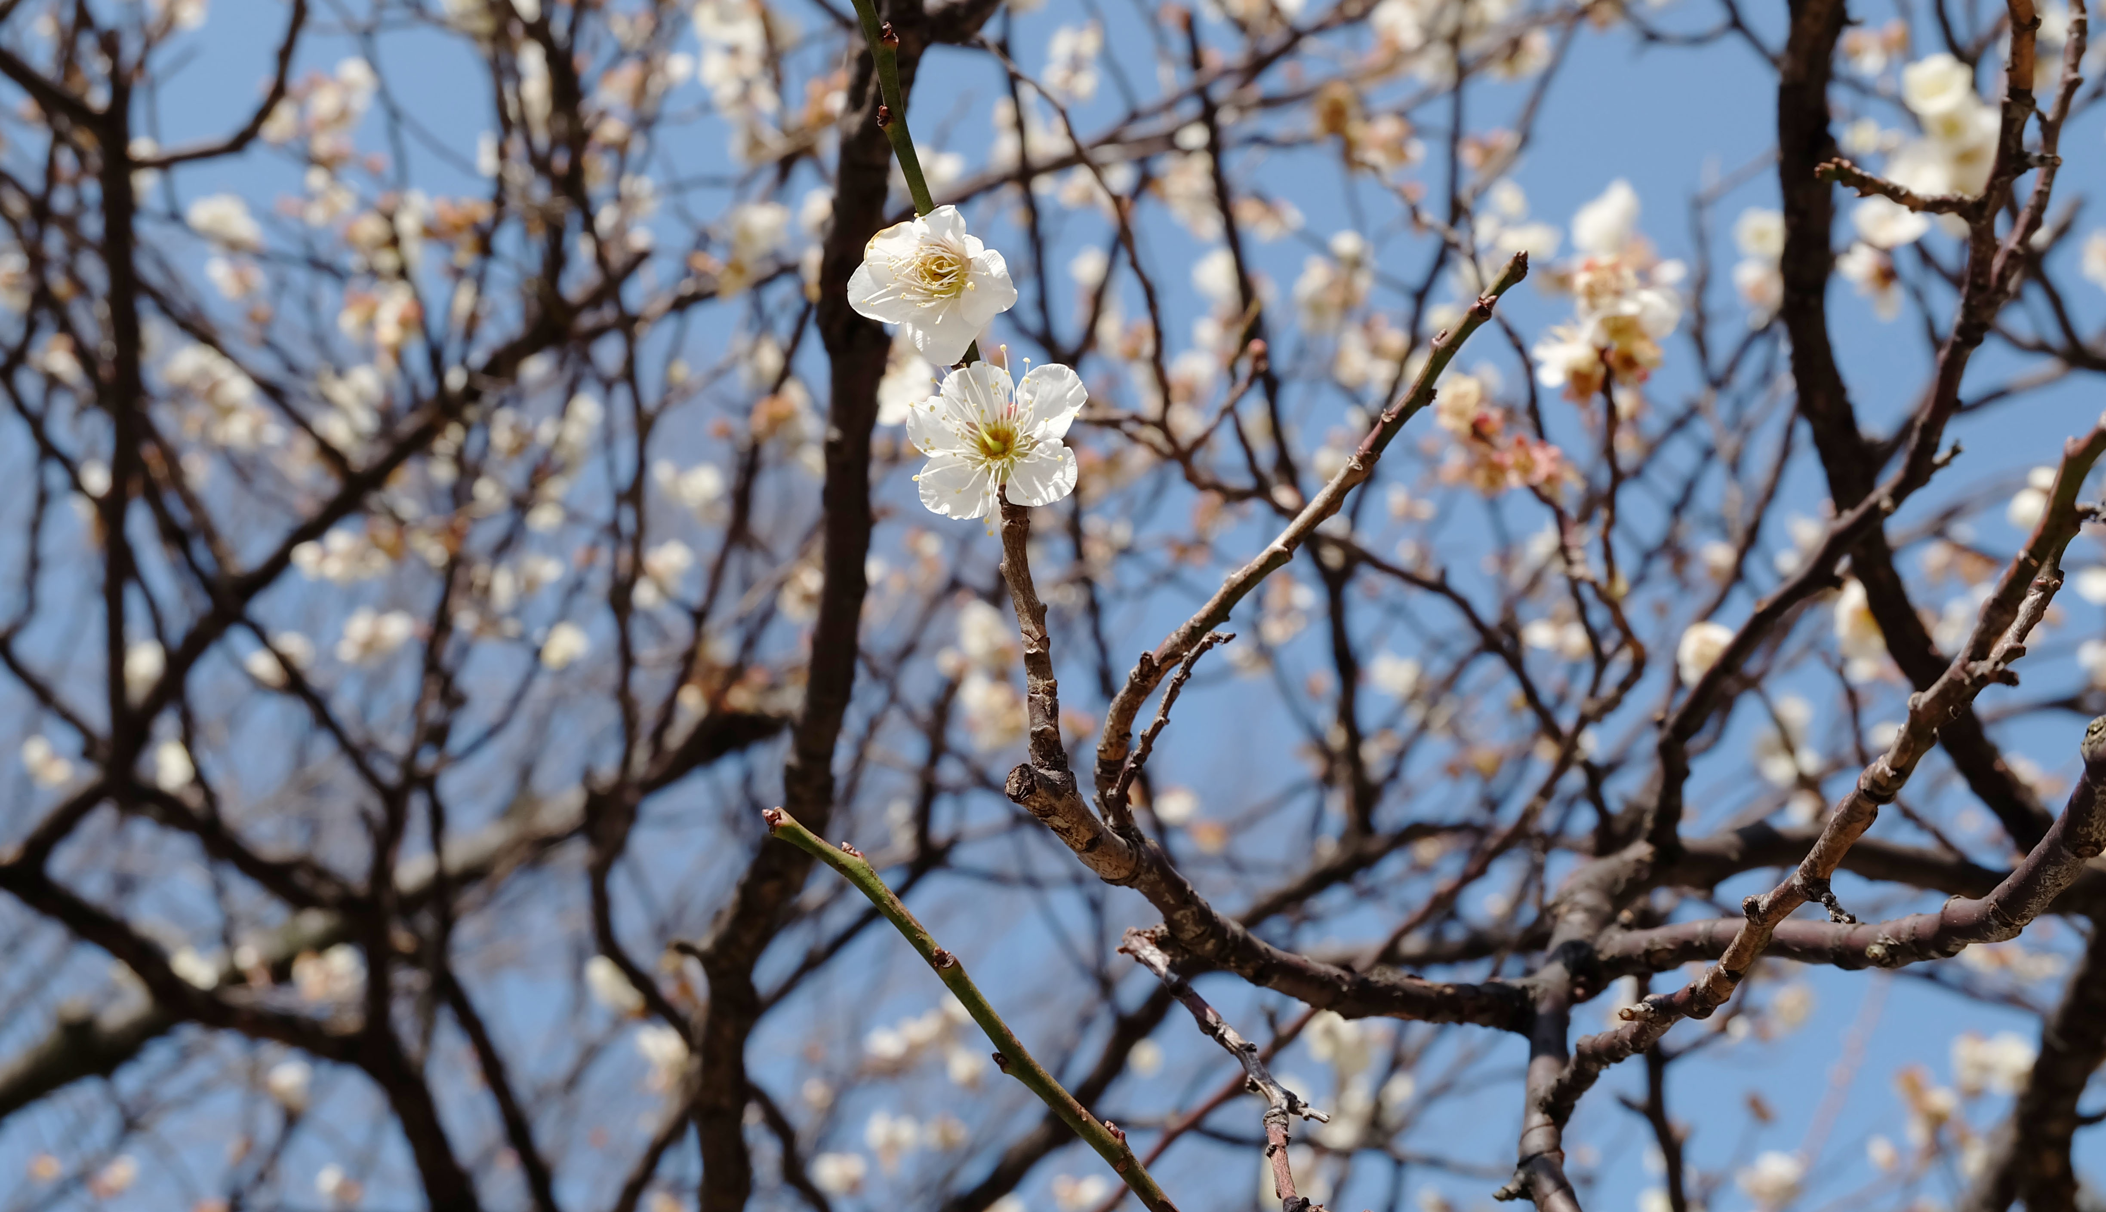
Unless the season of winter appear, thunder roll, lightning flash, snow and rain fall, hail and frost descend and the intensity of cold execute its command, the season of the soul-refreshing spring would not come, the fragrant breeze would not waft, the moderation of temperature would not be realized, the roses and hyacinths would not grow, the surface of the earth would not become a delectable paradise, the trees would not bloom, neither would they bring forth fruits and leaves.
‘Abdu’l-Bahá
Tablets of ‘Abdu’l-Bahá ‘Abbás vol. 1-3, 692.4

Slide 12


...with regard to the peoples who clamor for freedom: the moderate freedom which guarantees the welfare of the world of mankind and maintains and preserves the universal relationships, is found in its fullest power and extension in the teachings of Bahá’u’lláh.
‘Abdu’l-Bahá
Selections from the
Writings of ‘Abdu’l-Bahá, 227.27

Slide 13
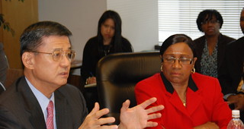
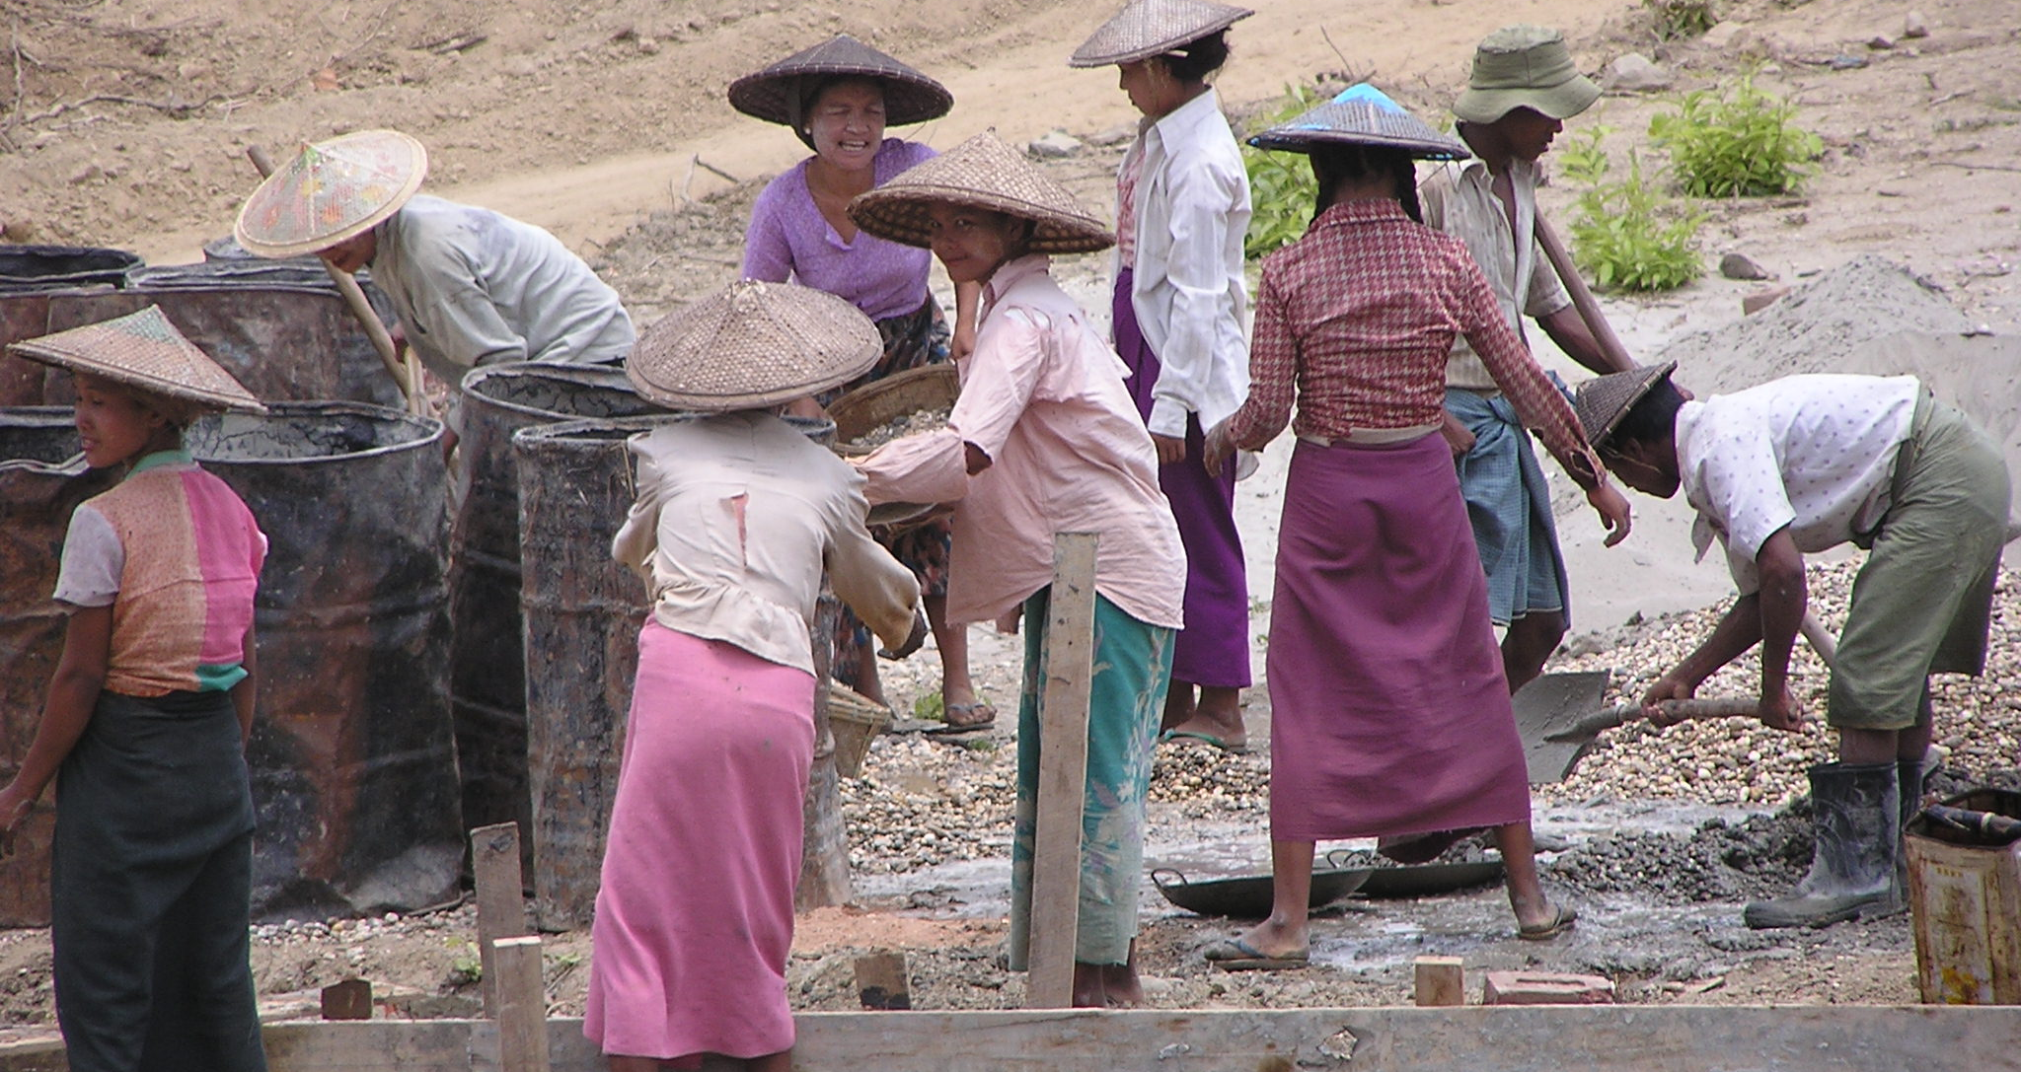
It would be well, with regard to the social rights of manufacturers, workmen and artisans, that laws be established, giving moderate profits to manufacturers, and to workmen the necessary means of existence and security for the future.
‘Abdu’l-Bahá
Bahá’í World Faith (‘Abdu’l-Bahá section), 18.8

Slide 14

https://brilliantstar19.org/videos/bahai/bh-53-TheCenterOfBalance.mp4

