Slide 1
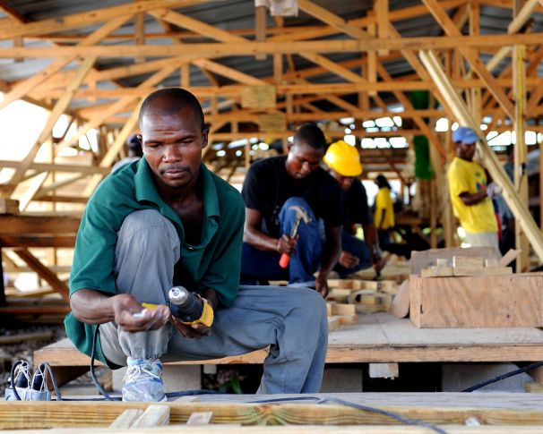

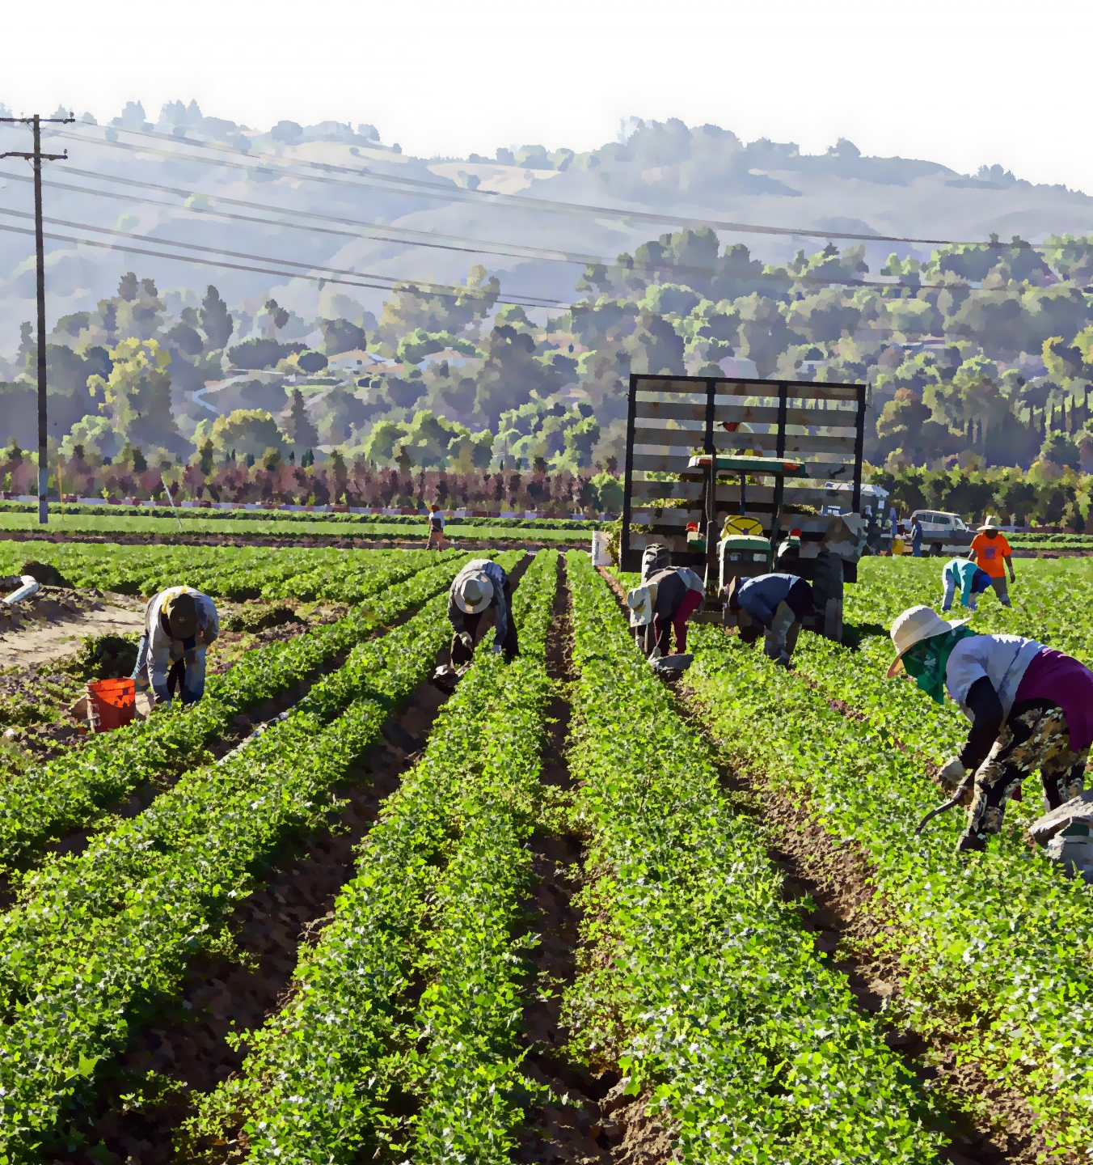
Work & Earn
A Livelihood
Tucker, GA

Slide 2


Slide 3
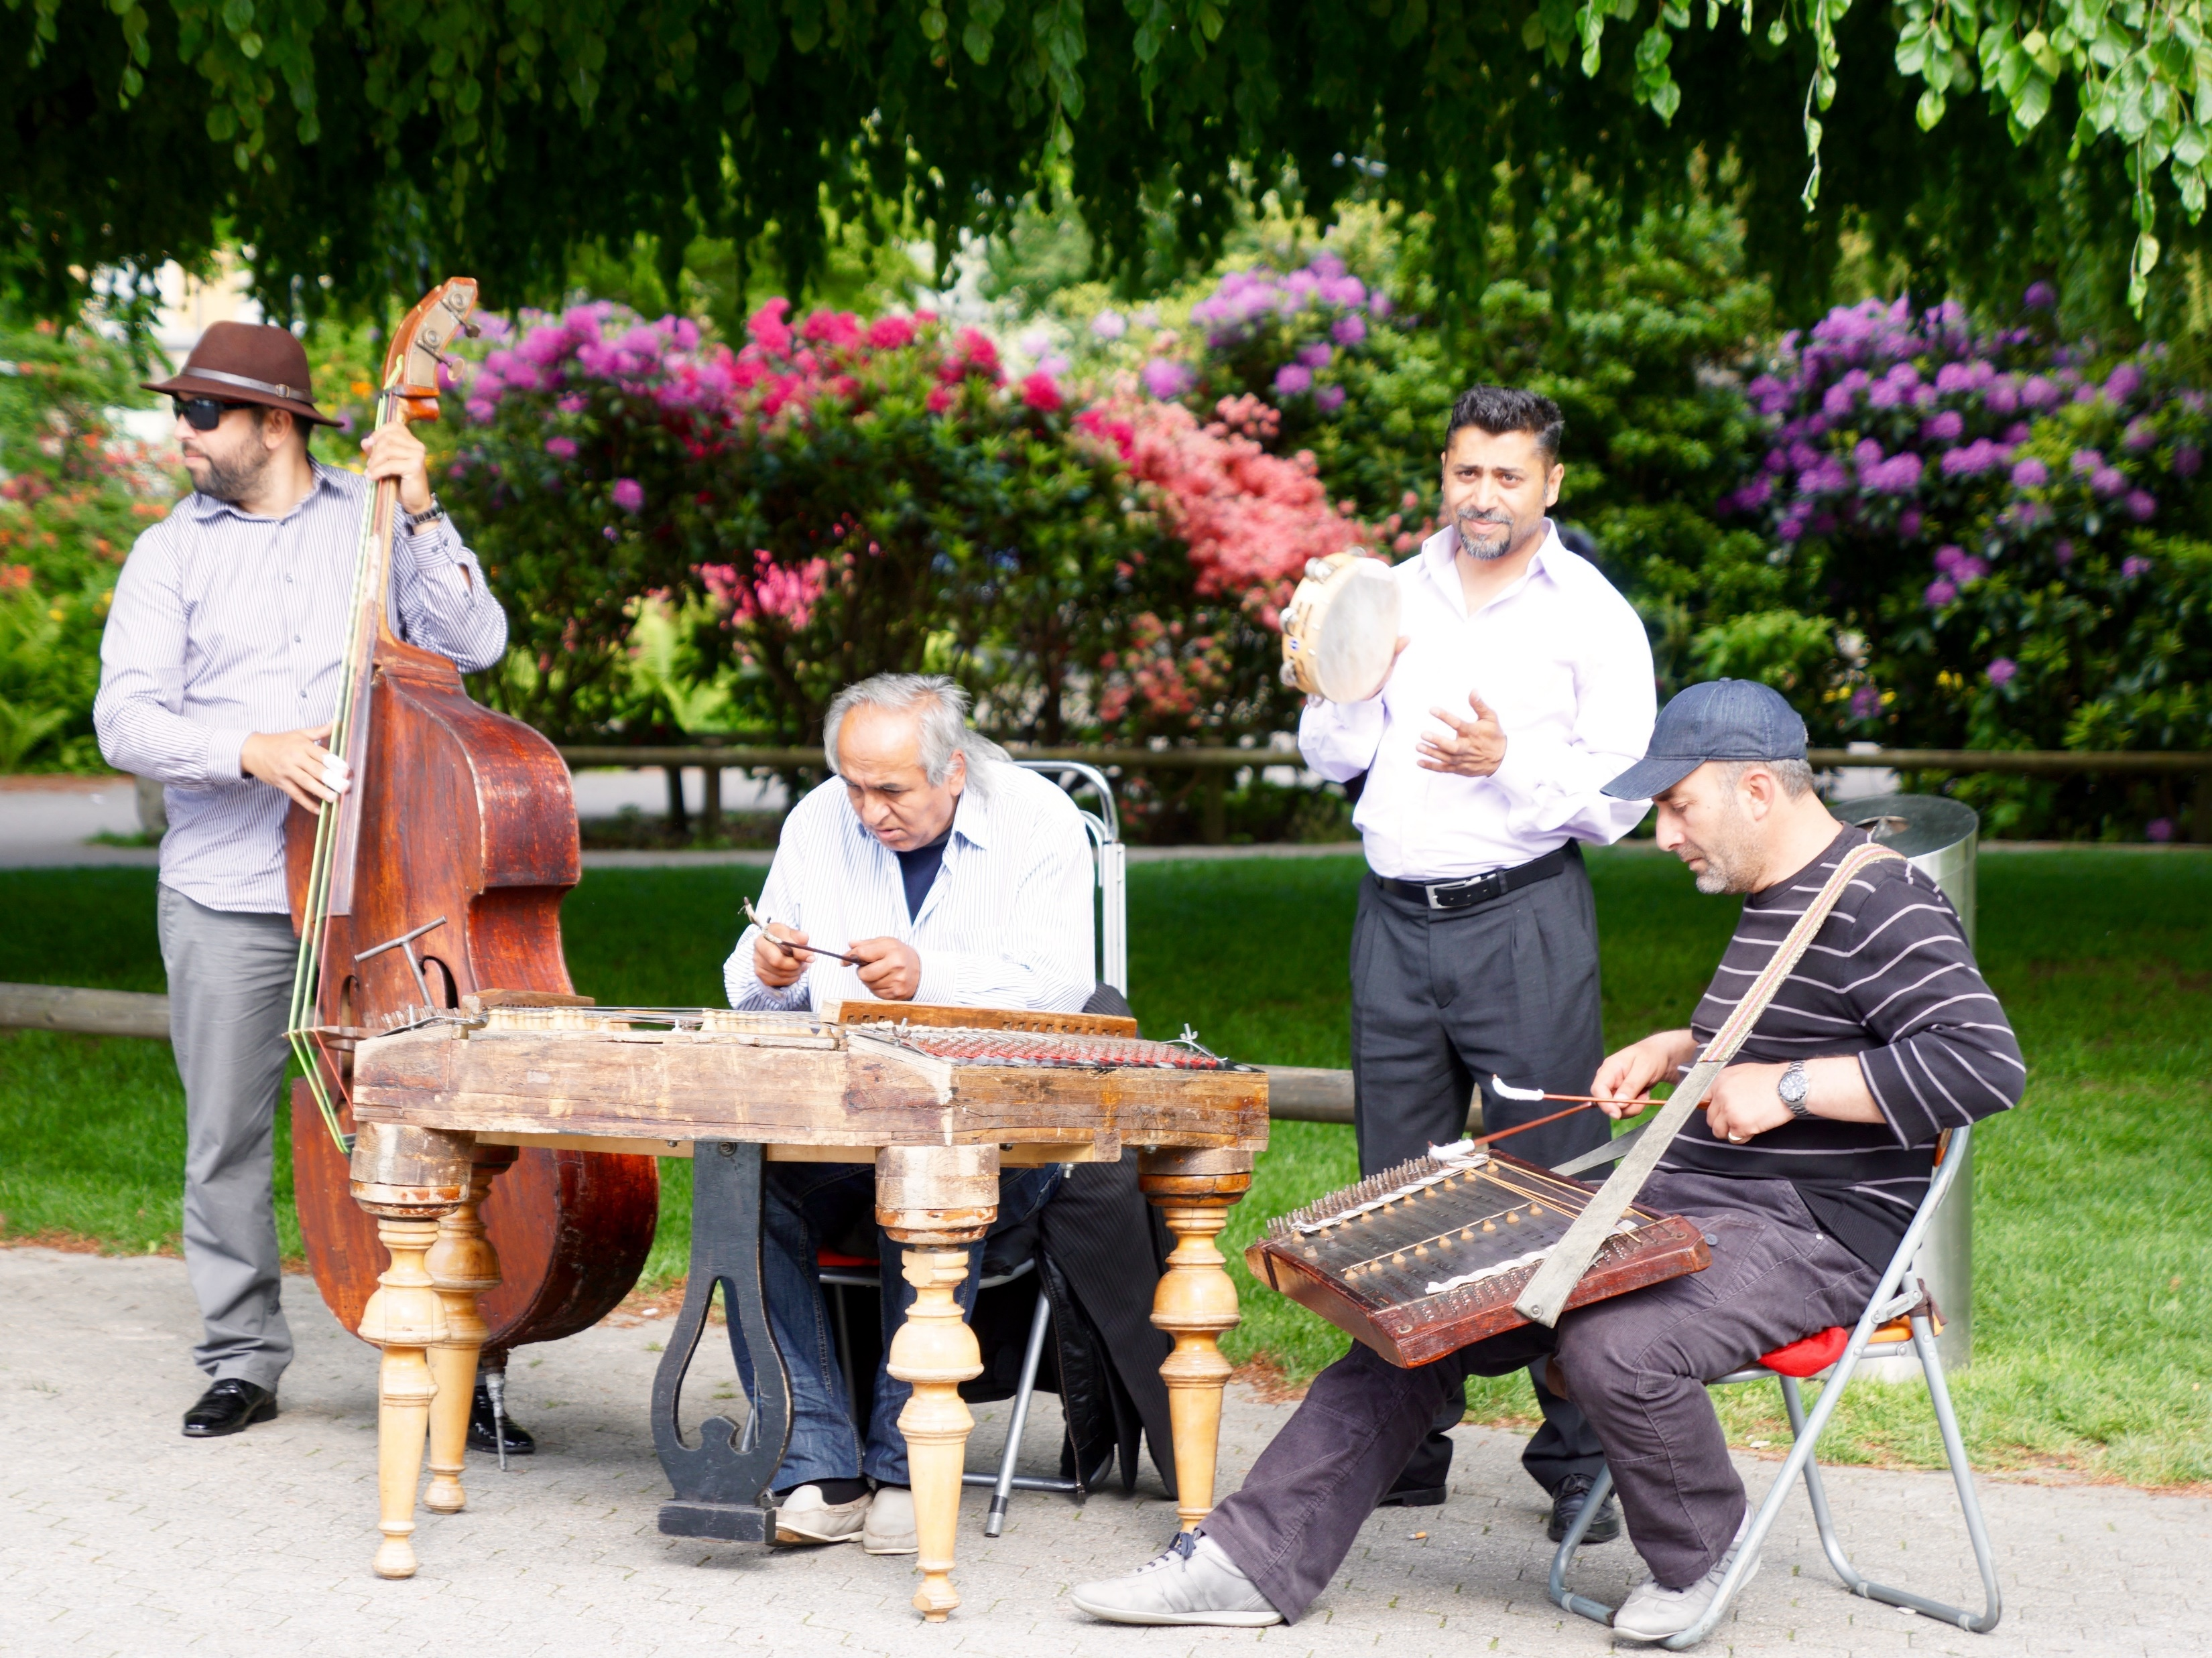


All humanity must obtain a livelihood by sweat of the brow and bodily exertion; at the same time seeking to lift the burden of others, striving to be the source of comfort to souls, and facilitating the means of living. This in itself is devotion to God.
‘Abdu’l-Bahá,
Promulgation of
Universal Peace, p. 182

Slide 4

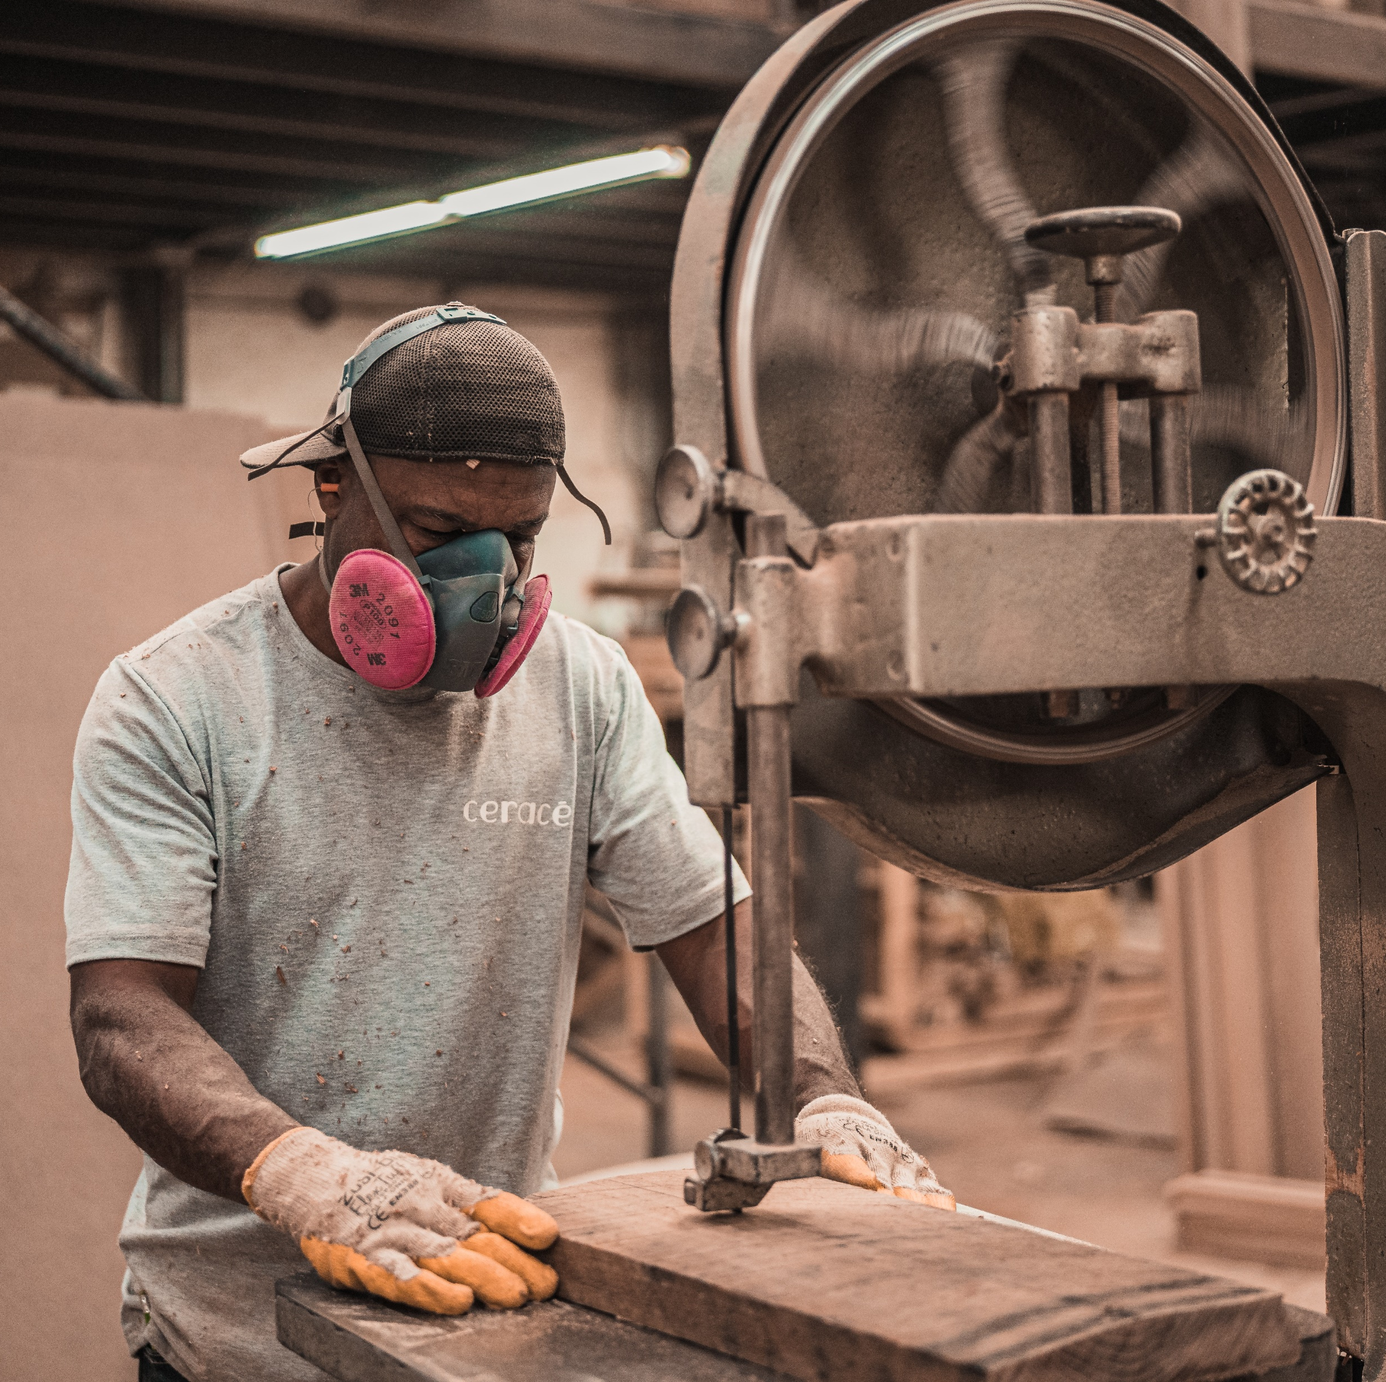

It is incumbent upon each one of you to engage in some occupation--such as a craft, a trade or the like. We have exalted your engagement in such work to the rank of worship of the one true God.
Bahá’u’lláh
The Kitáb-i-Áqdás, K 33

Slide 5
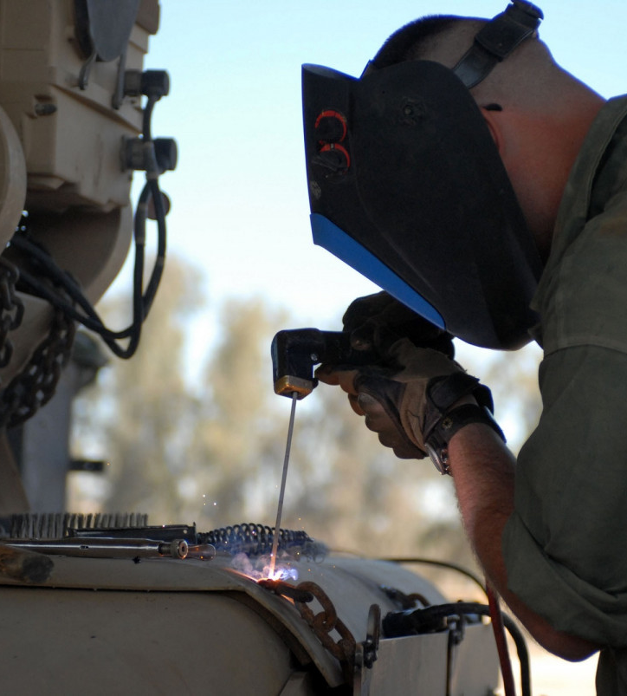

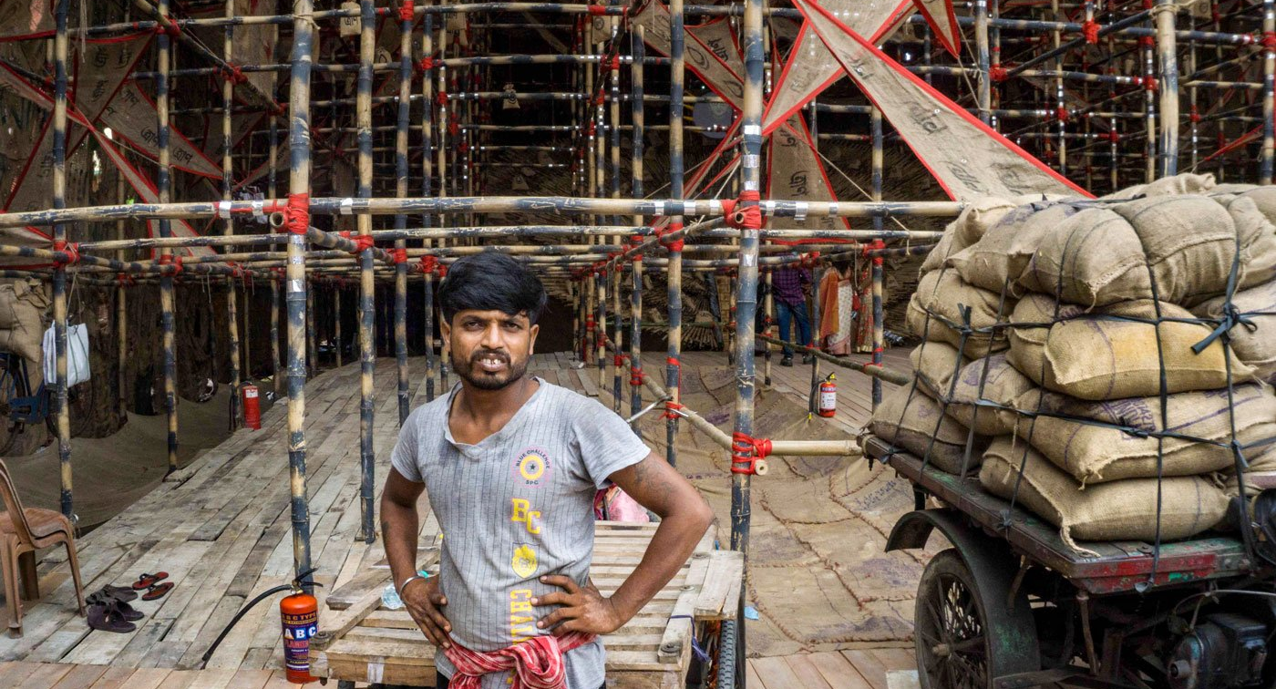
O MY SERVANT!
The best of men are they that earn a livelihood by their calling and spend upon themselves and upon their kindred for the love of God, the Lord of all worlds.
Bahá'u'lláh
Hidden Words, Persian #82

Slide 6



It is enjoined upon every one of you to engage in some form of occupation, such as crafts, trades and the like. We have graciously exalted your engagement in such work to the rank of worship unto God, the True One.
Bahá'u'lláh
Tablets of Bahá’u’lláh, p. 26

Slide 7
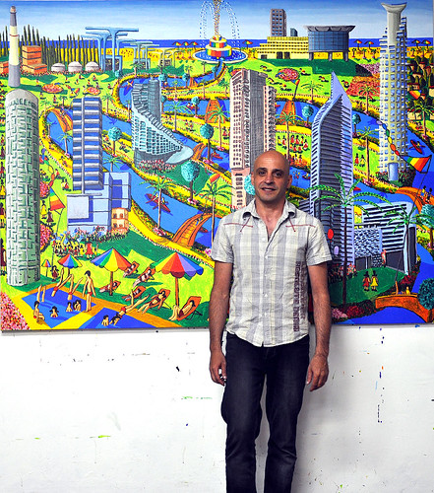
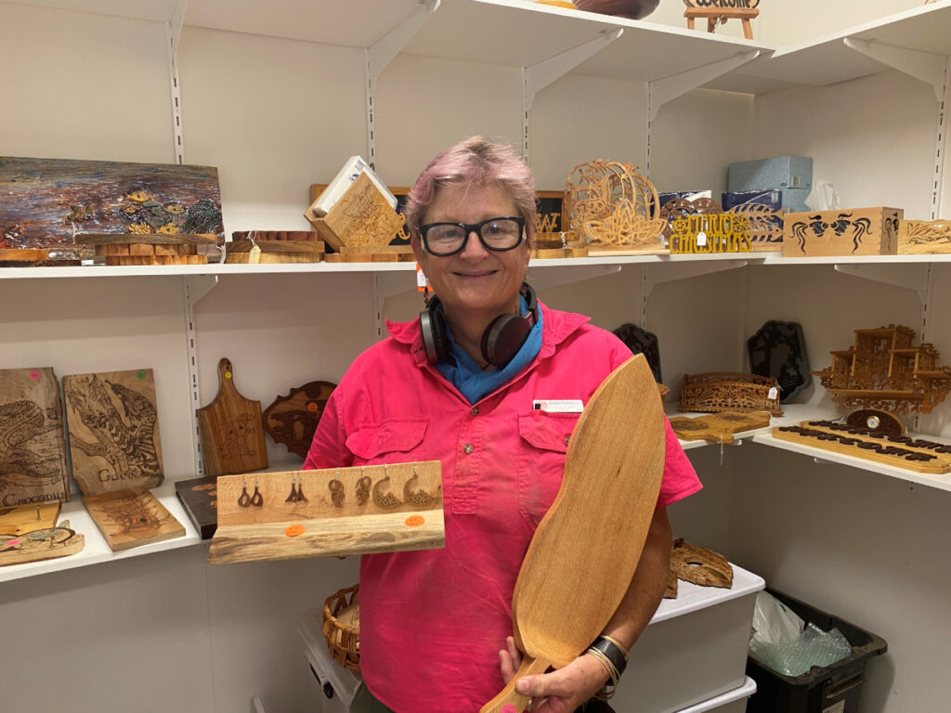
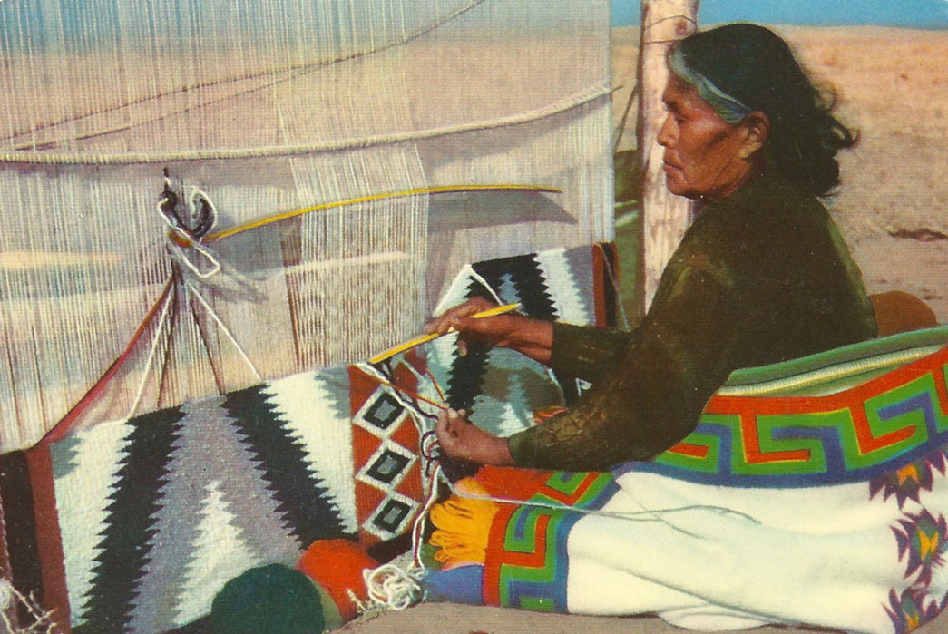
O MY SERVANT!
Ye are the trees of My garden; ye must give forth goodly and wondrous fruits, that ye yourselves and others may profit therefrom. Thus it is incumbent on every one to engage in crafts and professions, for therein lies the secret of wealth, O men of understanding! For results depend upon means, and the grace of God shall be all-sufficient unto you. Trees that yield no fruit have been and will ever be for the fire.
Bahá'u'lláh
Hidden Words, Persian #80

Slide 8


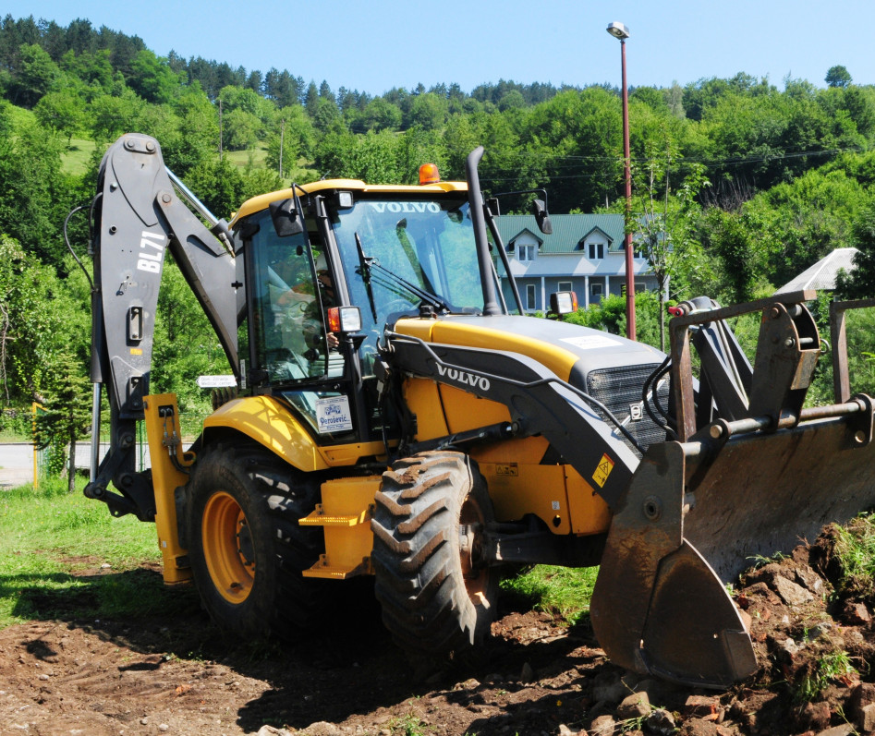
It is incumbent on every one to engage in some occupation, such as arts, trades, and the like. We have made this — your occupation — identical with the worship of God, the true one. Reflect, O people, upon the mercy of God and upon his favors, then thank him in mornings and evenings.
‘Abdu’l-Bahá
Divine Philosophy, b.18

Slide 9

Concerning the means of livelihood, thou shouldst, while placing thy whole trust in God, engage in some occupation. He will assuredly send down upon thee from the heaven of His favor that which is destined for thee. He is in truth the God of might and power.
Bahá’u’lláh
Fountain of Wisdom, 17.133

Slide 10



O people of Bahá! The source of crafts, sciences and arts is the power of reflection. Make ye every effort that out of this ideal mine there may gleam forth such pearls of wisdom and utterance as will promote the well-being and harmony of all the kindreds of the earth.
Bahá'u'lláh
Tablets of Bahá’u’lláh, p. 72

Slide 11
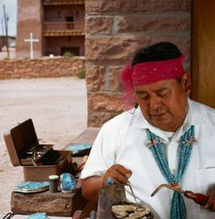

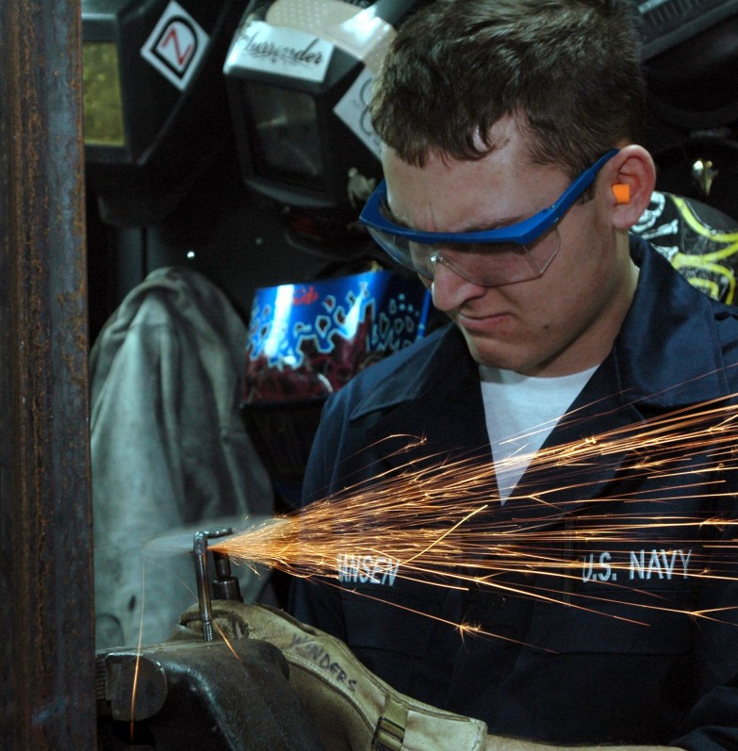
The most despised of men in the sight of God are those who sit idly and beg. Hold ye fast unto the cord of material means, placing your whole trust in God, the Provider of all means. When anyone occupieth himself in a craft or trade, such occupation itself is regarded in the estimation of God as an act of worship; and this is naught but a token of His infinite and all-pervasive bounty.
Bahá’u’lláh
Fountain of Wisdom, 3.21

Slide 12
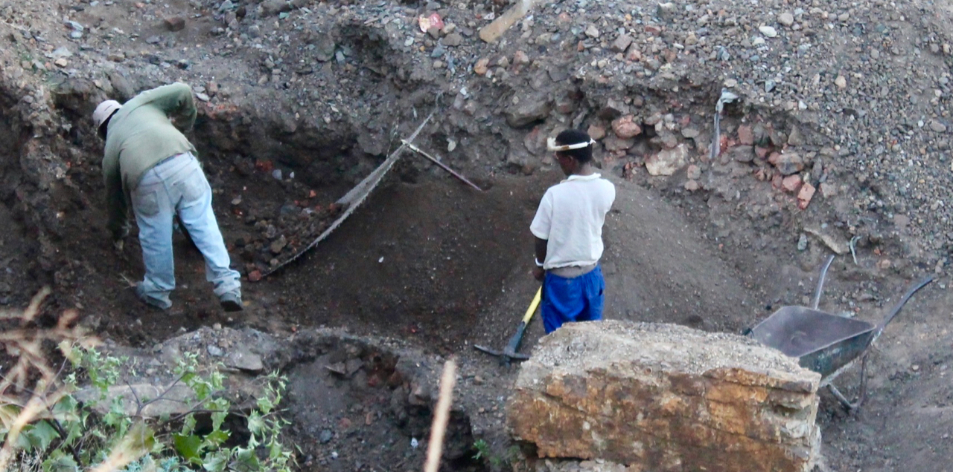
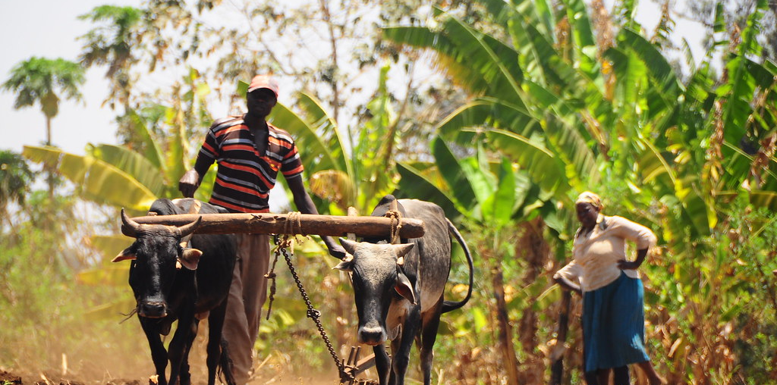

Please God, the poor may exert themselves and strive to earn the means of livelihood. This is a duty which, in this most great Revelation, hath been prescribed unto every one, and is accounted in the sight of God as a goodly deed. Whoso observeth this duty, the help of the invisible One shall most certainly aid him. He can enrich, through His grace, whomsoever He pleaseth. He, verily, hath power over all things.…
Bahá’u’lláh
Gleanings from the
Writings of Bahá’u’lláh, 100.5

Slide 13
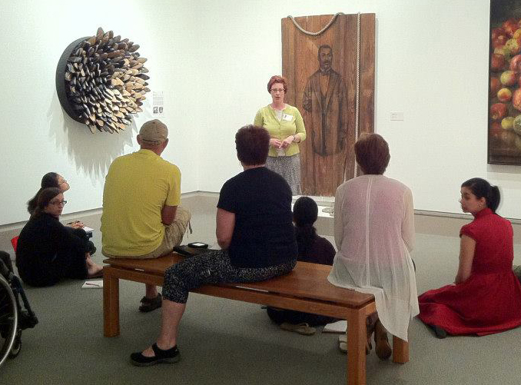
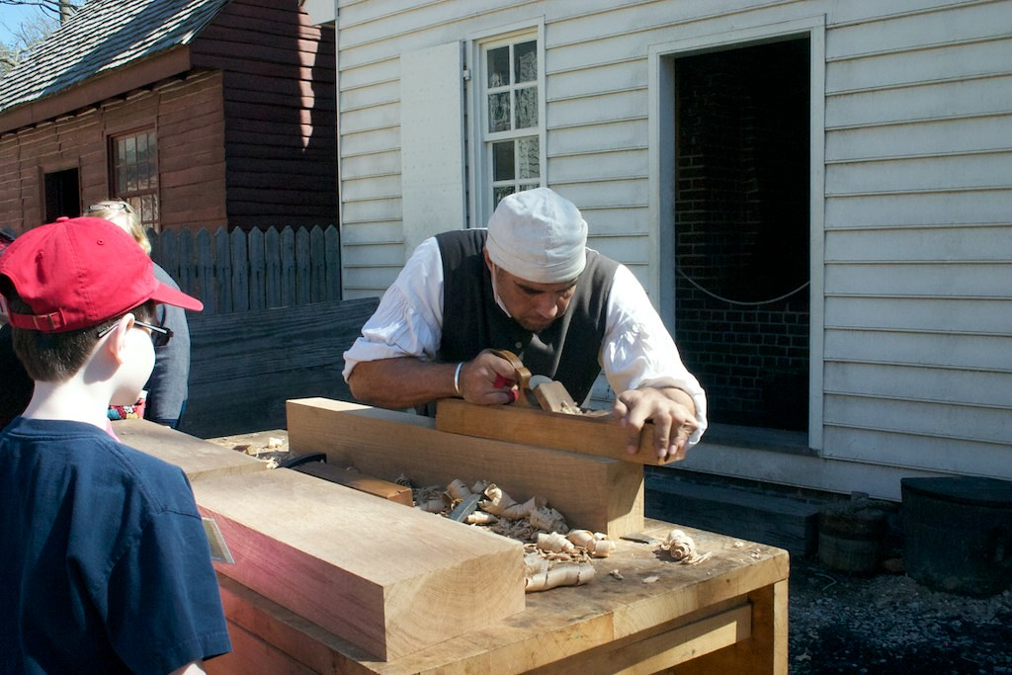

In this great dispensation, art (or a profession) is identical with an act of worship and this is a clear text of the Blessed Perfection.
‘Abdu’l-Bahá,
Bahá’í World Faith, p. 377

Slide 14


Slide 15

https://brilliantstar19.org/videos/bahai/bh-52-TheLaborOfLight.mp4

