Slide 1

Service & Servitude
Tucker, GA

Slide 2


Slide 3

Know that the conditions of existence are limited to the conditions of servitude, of prophethood and of Deity, but the divine and the contingent perfections are unlimited.
‘Abdu’l-Bahá,
Some Answered Questions, p. 130

Slide 4
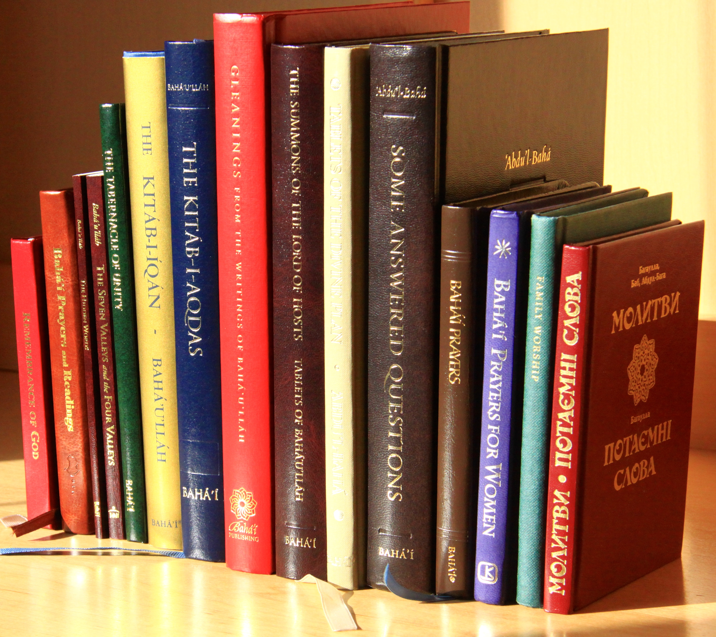
Say: True liberty consisteth in man’s submission unto My commandments, little as ye know it...The liberty that profiteth you is to be found nowhere except in complete servitude unto God, the Eternal Truth. Whoso hath tasted of its sweetness will refuse to barter it for all the dominion of earth and heaven.
Bahá’u’lláh
Gleanings, 159.4

Slide 5

Man’s merit lieth in service and virtue and not in the pageantry of wealth and riches.
Bahá’u’lláh
Tablets of Bahá’u’lláh, p. 138

Slide 6
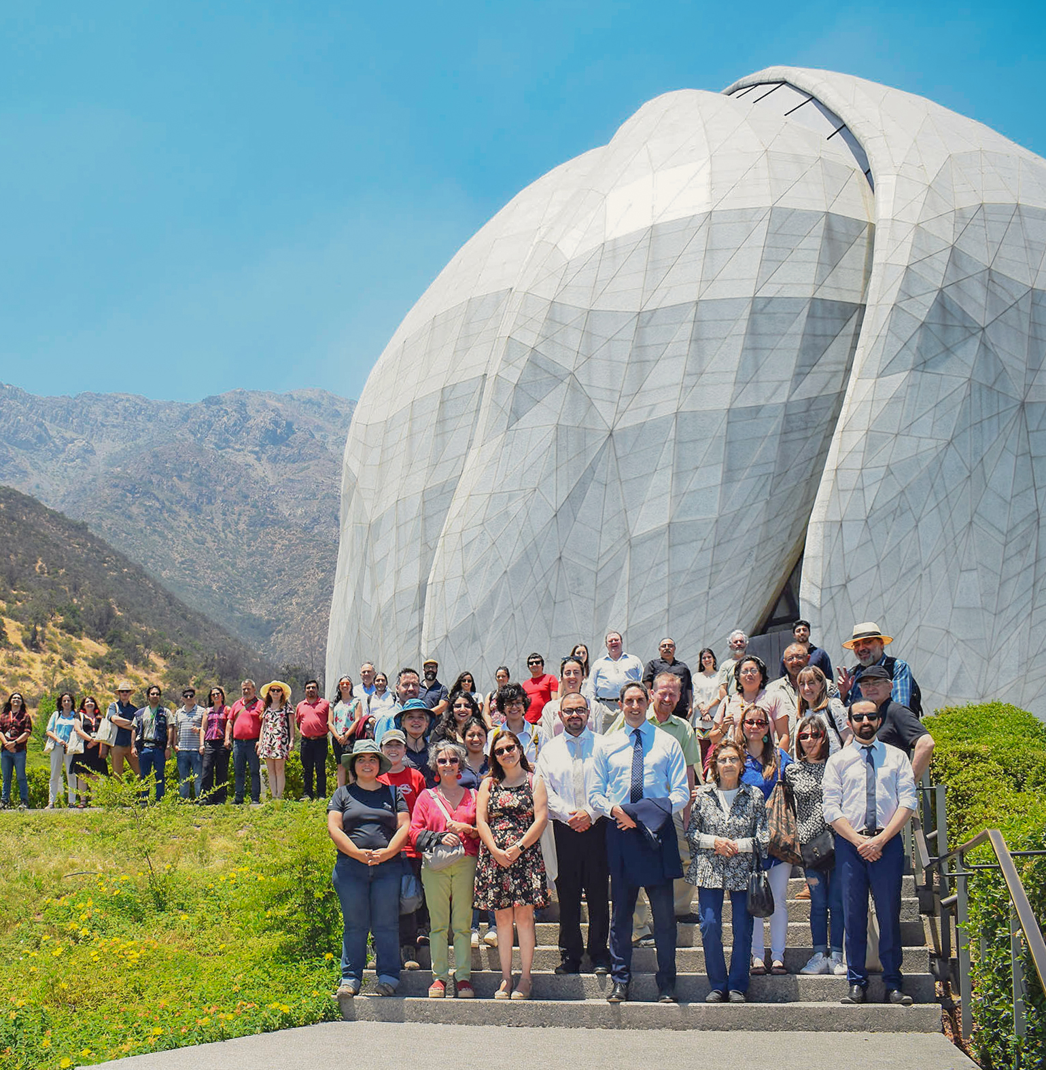
They who follow Me must strive, under all circumstances, to promote the welfare of whosoever will arise for the triumph of My Cause, and must at all times prove their devotion and fidelity unto him. Happy is the man that hearkeneth and observeth My counsel. Woe unto him that faileth to fulfil My wish.
Bahá'u'lláh
Gleanings, p. 207

Slide 7
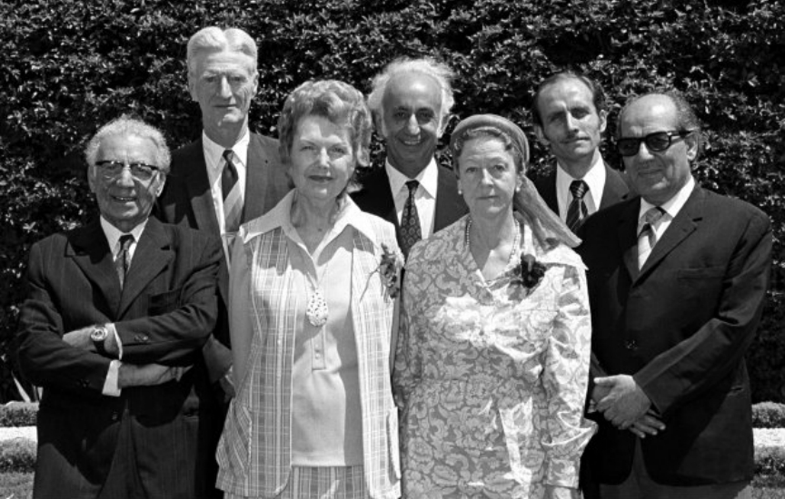
The teaching work should under all conditions be actively pursued by the believers because divine confirmations are dependent upon it. Should a Bahá'í refrain from being fully, vigorously and wholeheartedly involved in the teaching work he will undoubtedly be deprived of the blessings of the Abhá Kingdom.
‘Abdu'l-Bahá
Selections From the Writings of ‘Abdu’l-Bahá, p. 268

Slide 8
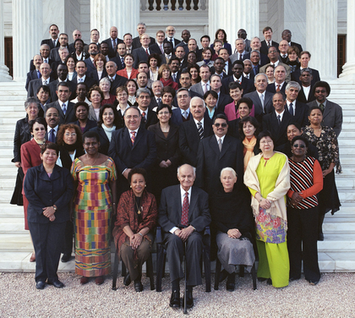
Arise ye, under all conditions, to render service to the Cause, for God will assuredly assist you through the power of His sovereignty which overshadoweth the worlds.
Bahá'u'lláh
The Kitáb-i-Áqdás, K 74

Slide 9


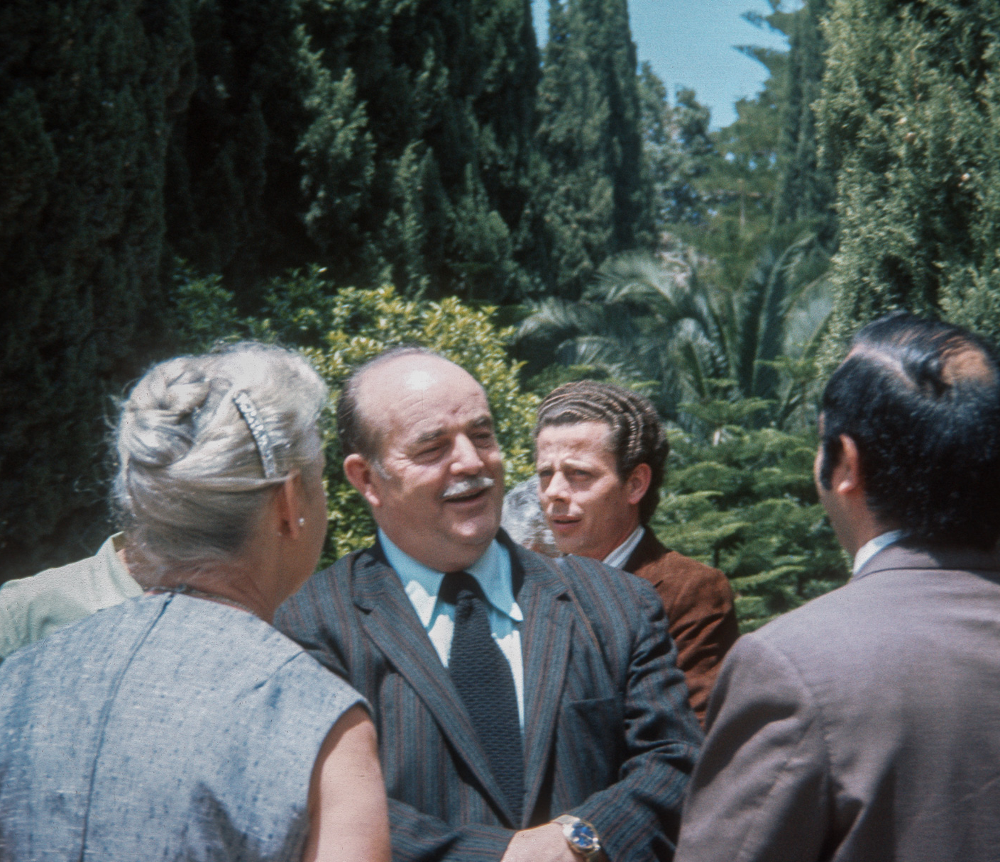
Now is the time for service, and for servitude unto the Lord. Release yourselves from all distracting thoughts, deliver the Message with an eloquent tongue, adorn your assemblages with praise of the Beloved, till bounty shall descend in overwhelming floods and dress the world in fresh greenery and blossoms. This streaming bounty is even the counsels, admonitions, instructions, and injunctions of Almighty God.
'Abdu'l-Bahá
Selections From the Writings of ‘Abdu’l-Bahá, p. 318

Slide 10



Wherefore, rest ye neither day nor night and seek no ease. Tell ye the secrets of servitude, follow the pathway of service, till ye attain the promised succour that cometh from the realms of God.
'Abdu'l-Bahá
Selections From the Writings of ‘Abdu’l-Bahá, p. 271

Slide 11

Thy day of service is now come... Arise for the triumph of My Cause, and, through the power of thine utterance, subdue the hearts of men.
Bahá'u'lláh
Gleanings, p. 92

Slide 12

Spread abroad the sweet savors of thy Lord, and hesitate not, though it be for less than a moment, in the service of His Cause. The day is approaching when the victory of thy Lord, the Ever-Forgiving, the Most Bountiful, will be proclaimed.
Bahá'u'lláh
Gleanings, p. 43

Slide 13

That one indeed is a man who, today, dedicateth himself to the service of the entire human race. The Great Being saith: Blessed and happy is he that ariseth to promote the best interests of the peoples and kindreds of the earth. In another passage He hath proclaimed: It is not for him to pride himself who loveth his own country, but rather for him who loveth the whole world. The earth is but one country, and mankind its citizens.
Bahá’u’lláh
Tablets of Bahá’u’lláh, p. 167

Slide 14

https://brilliantstar19.org/videos/bahai/bh-51-ServiceIsFreedom.mp4

