Slide 1
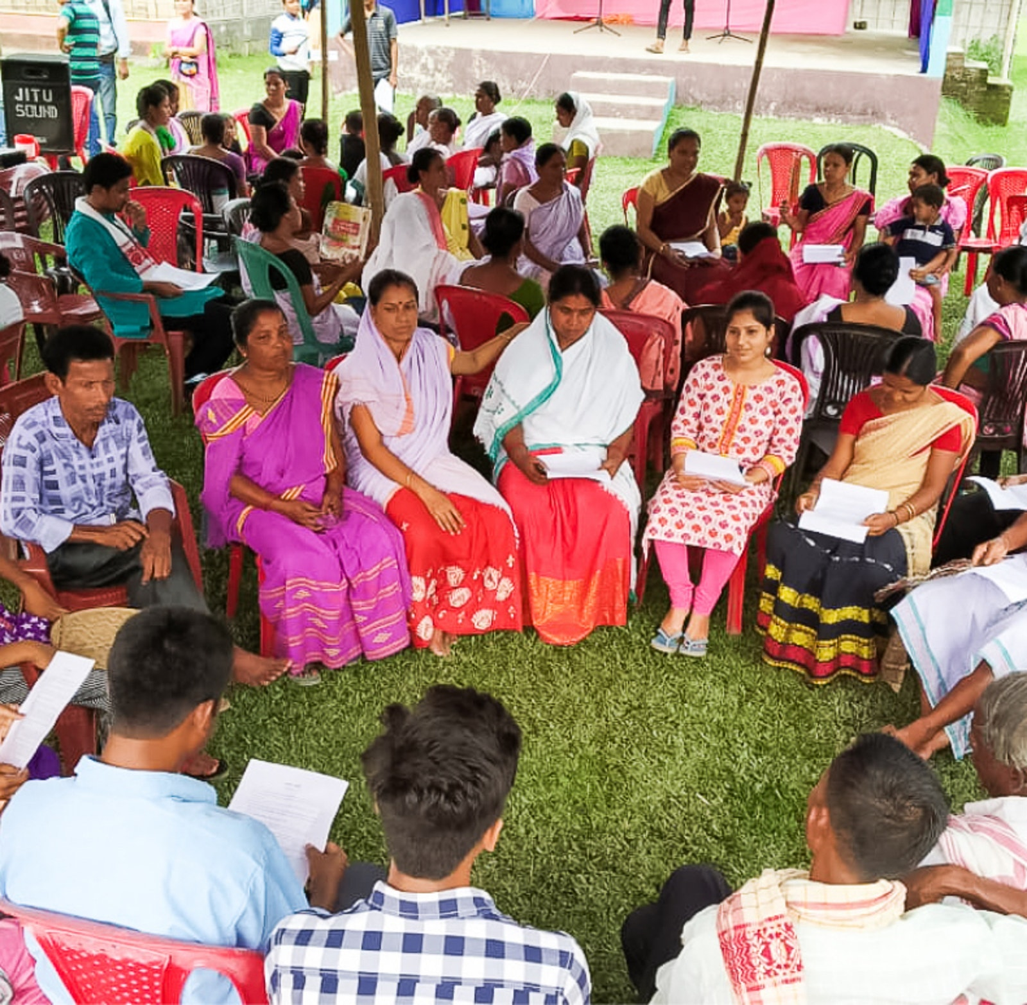
Consultation & Decision Making
Tucker, GA

Slide 2

https://www.youtube.com/watch?v=gisxkoG6NuA

Slide 3
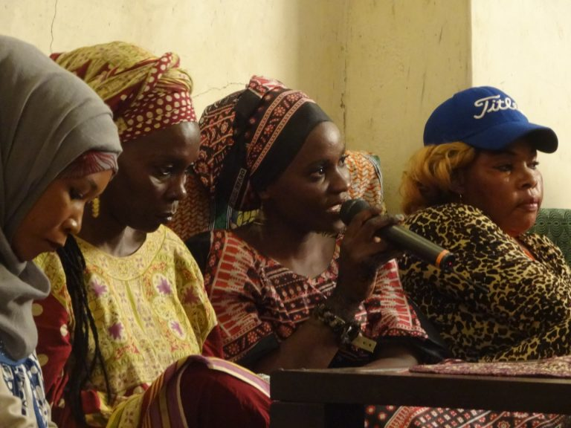
The heaven of divine wisdom is illumined with the two luminaries of consultation and compassion. Take ye counsel together in all matters, inasmuch as consultation is the lamp of guidance which leadeth the way, and is the bestower of understanding.
Bahá’u’lláh
Tablets of Bahá’u’lláh Revealed
After the Kitáb-i-Aqdas, p. 168

Slide 4

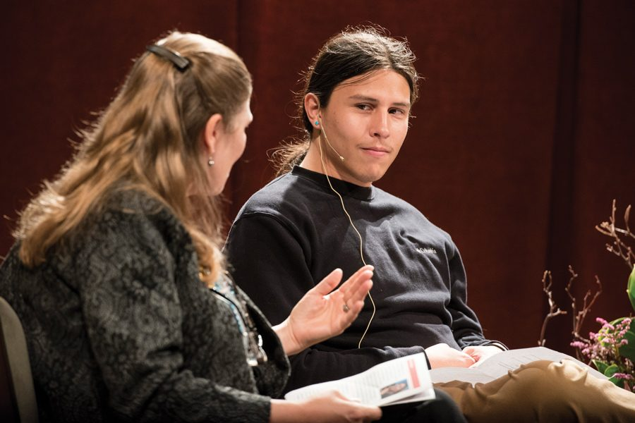

Take ye counsel together in all matters, inasmuch as consultation is the lamp of guidance which leadeth the way, and is the bestower of understanding.
Bahá'u'lláh
Tablets of Bahá’u’lláh, p. 168

Slide 5

Be united in counsel, be one in thought.
Bahá'u'lláh
Tablets of Bahá’u’lláh, p. 138

Slide 6
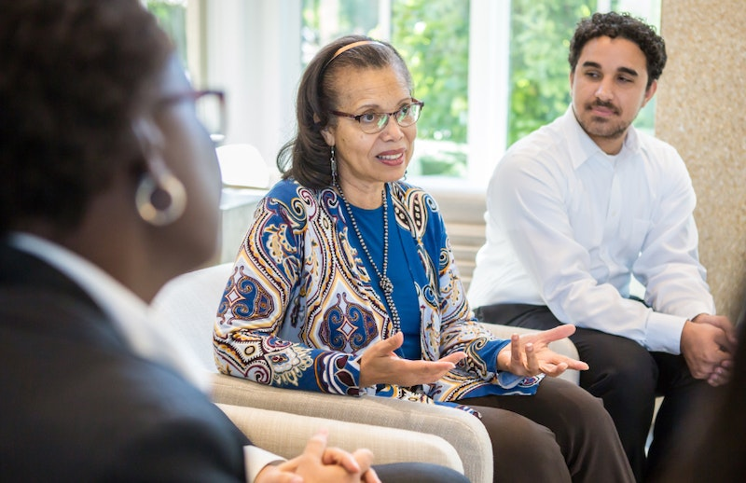
When meeting for consultation, each must use perfect liberty in stating his views and unveiling the proof of his demonstration. If another contradicts him, he must not become excited because if there be no investigation or verification of questions and matters, the agreeable view will not be discovered neither understood. The brilliant light which comes from the collision of thoughts is the “lightener” of facts.
‘Abdu’l-Bahá
Bahá’í World Faith (‘Abdu’l-Bahá section), 117.2

Slide 7
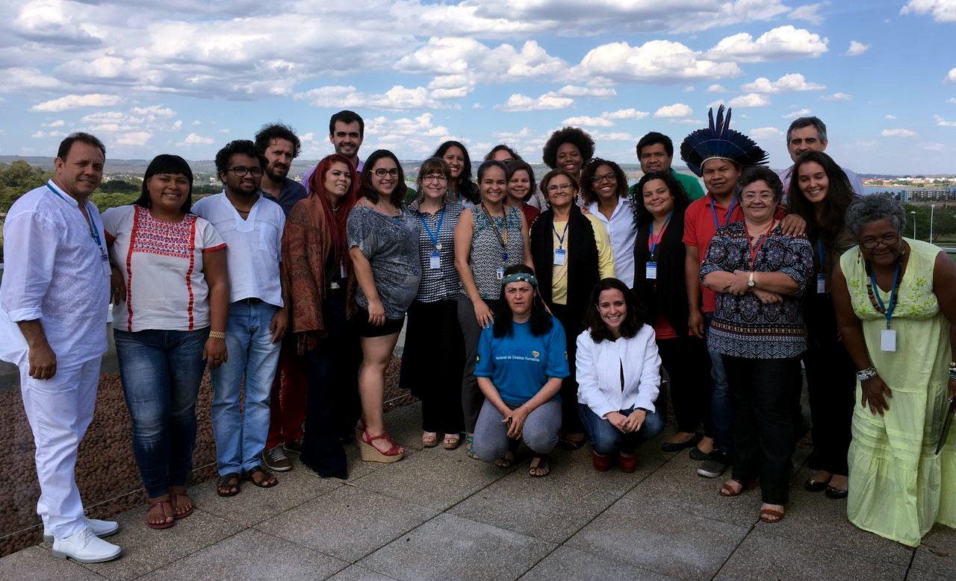
I beseech God at all times, with all supplication, humility and lowliness, to confirm these souls who have no purpose in their deliberation and consultations save to seek the merciful bounties and the divine invisible confirmations.
‘Abdu’l-Bahá
Tablets of ‘Abdu’l-Bahá ‘Abbás vol. 1-3, 86.3

Slide 8
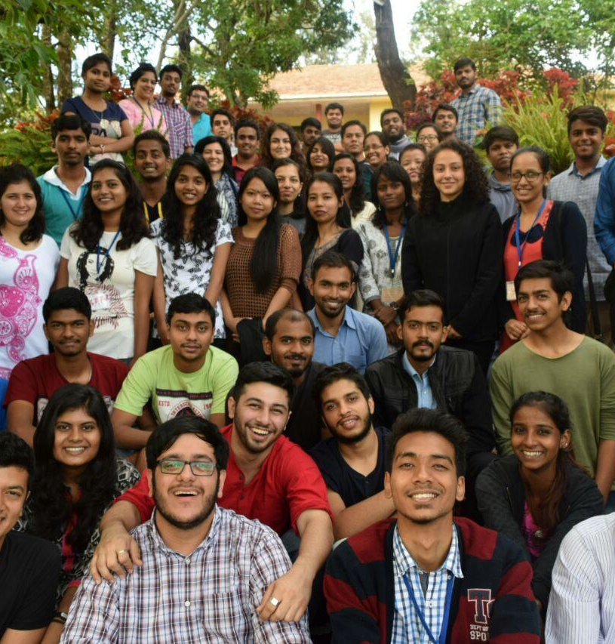
...true consultation is spiritual conference in the attitude and atmosphere of love. Members must love each other in the spirit of fellowship in order that good results may be forthcoming. Love and fellowship are the foundation.
‘Abdu’l-Bahá
The Promulgation of Universal Peace, 31.2

Slide 9



...consultation must have for its object the investigation of truth. He who expresses an opinion should not voice it as correct and right but set it forth as a contribution to the consensus of opinion, for the light of reality becomes apparent when two opinions coincide. A spark is produced when flint and steel come together. Man should weigh his opinions with the utmost serenity, calmness and composure.
‘Abdu’l-Bahá
The Promulgation of Universal Peace, 31.2

Slide 10

In this Cause consultation is of vital importance, but spiritual conference and not the mere voicing of personal views is intended.
‘Abdu’l-Bahá
The Promulgation of Universal Peace, 31.1

Slide 11
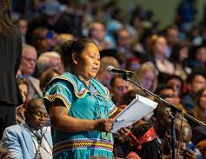
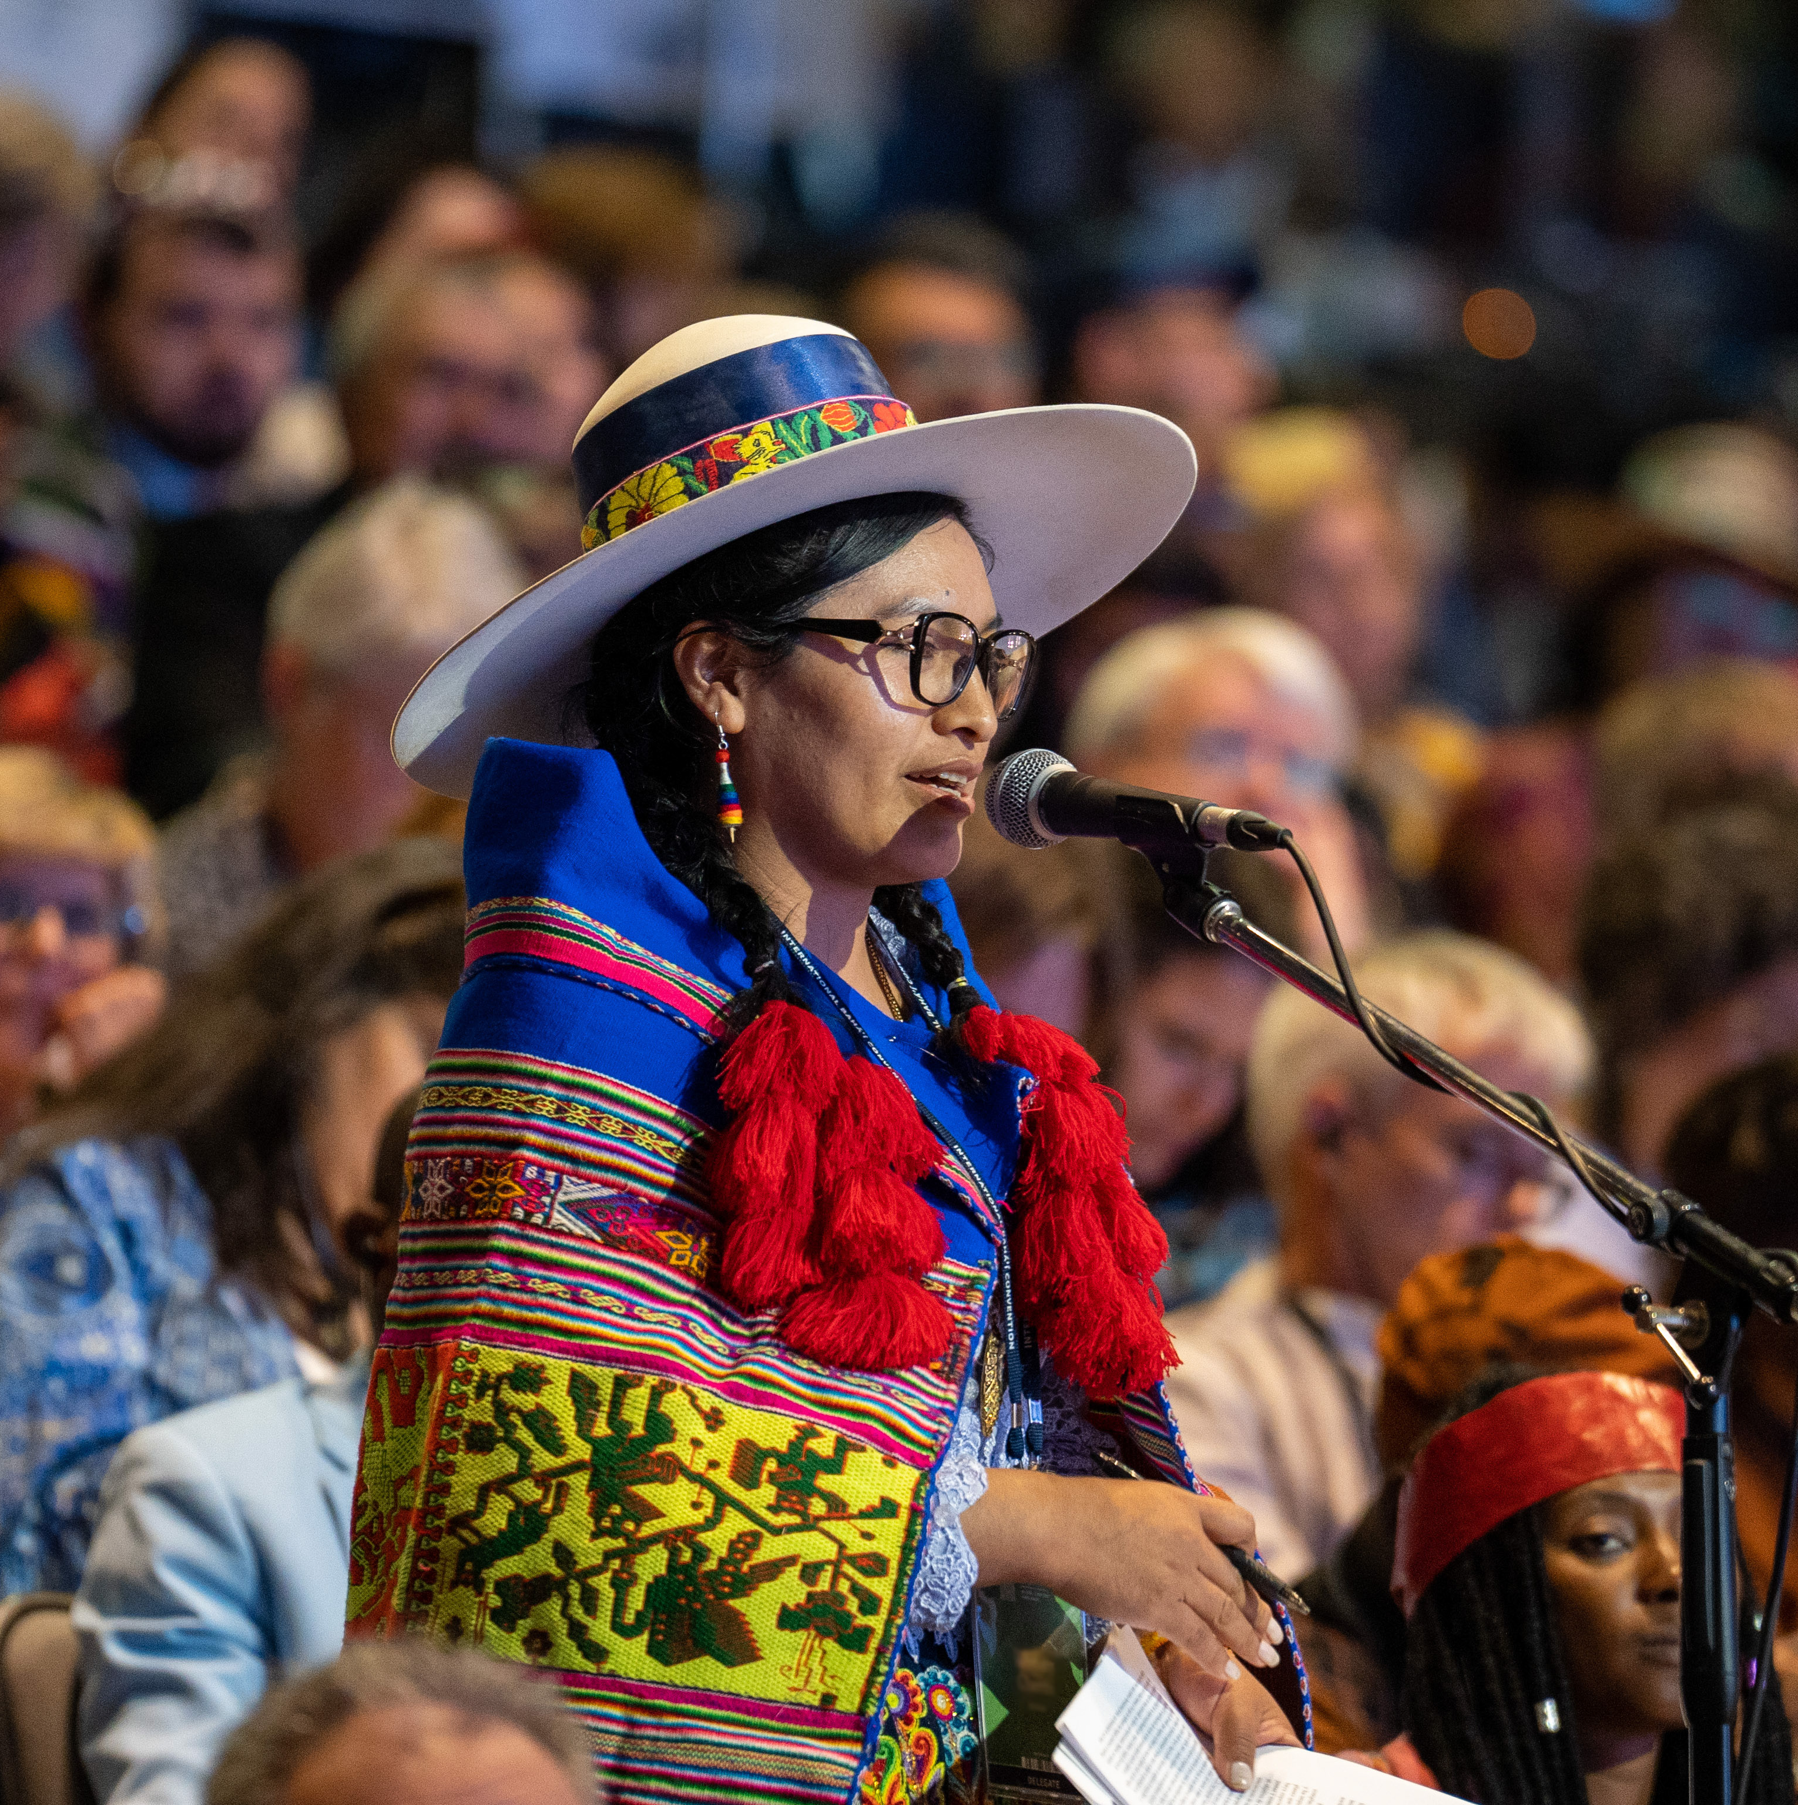
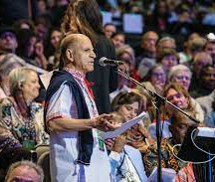
Consult upon every matter, and when one presents the point of view of reality itself, that shall be acceptable to all. Then will spiritual unity increase among you, individual illumination will be greater, happiness will be more abundant, and you will draw nearer and nearer to the Kingdom of God.
‘Abdu’l-Bahá
The Promulgation of Universal Peace, 64.1

Slide 12

Regarding thy question about consultation of a father with his son, or a son with his father, in matters of trade and commerce, consultation is one of the fundamental elements of the foundation of the Law of God. Such consultation is assuredly acceptable, whether between father and son, or with others. There is nothing better than this. Man must consult in all things for this will lead him to the depths of each problem and enable him to find the right solution.
‘Abdu’l-Bahá,
Compilation of Compilations,
Vol I, p. 98

Slide 13


Slide 14
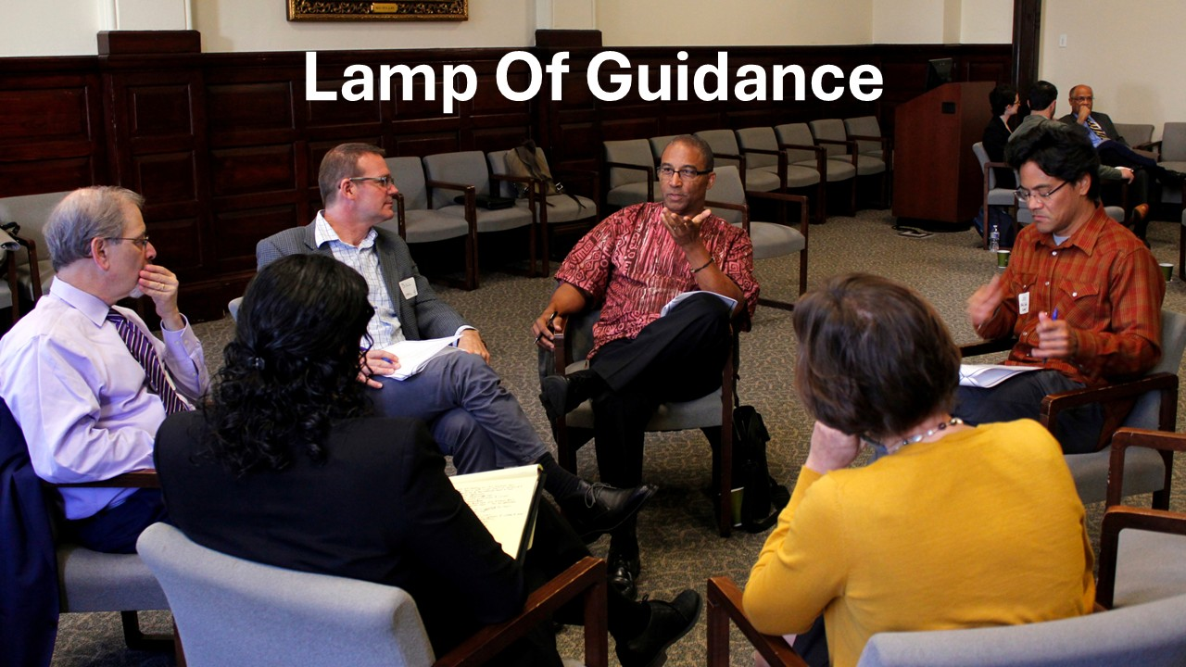
https://brilliantstar19.org/videos/bahai/bh-50-LampOfGuidance.mp4

