Slide 1

Elimination of Prejudice
Tucker, GA

Slide 2


Slide 3


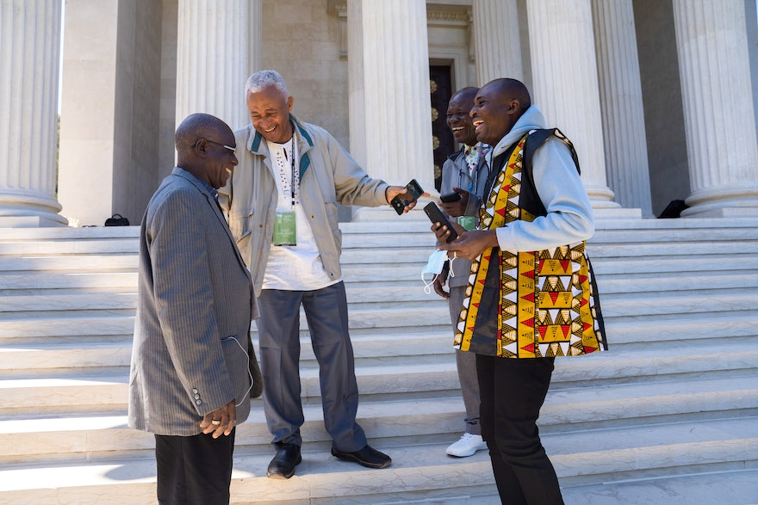
Today the one overriding need is unity and harmony among the beloved of the Lord, for they should have among them but one heart and soul and should, so far as in them lieth, unitedly withstand the hostility of all the peoples of the world; they must bring to an end the benighted prejudices of all nations and religions and must make known to every member of the human race that all are the leaves of one branch, the fruits of one bough.
‘Abdu’l-Bahá
Selections from the
Writings of ‘Abdu’l-Bahá, 221.4

Slide 4

When we review history from the beginning of human existence to the present age in which we live, it is evident all war and conflict, bloodshed and battle, every form of sedition has been due to some form of prejudice — whether religious, racial or national — to partisan bias and selfish prejudice of some sort.
‘Abdu’l-Bahá
The Promulgation
of Universal Peace, 109.2

Slide 5

In every period war has been waged in one country or another and that war was due to either religious prejudice, racial prejudice, political prejudice or patriotic prejudice. It has therefore been ascertained and proved that all prejudices are destructive of the human edifice. As long as these prejudices persist, the struggle for existence must remain dominant, and bloodthirstiness and rapacity continue.
‘Abdu’l-Bahá
Selections from the
Writings of ‘Abdu’l-Bahá, 227.11

Slide 6

...as to religious, racial, national and political bias: all these prejudices strike at the very root of human life; one and all they beget bloodshed, and the ruination of the world. So long as these prejudices survive, there will be continuous and fearsome wars.
‘Abdu’l-Bahá
Selections from the Writings of ‘Abdu’l-Bahá, 202.10

Slide 7

Consider the prejudice of patriotism. This is one globe, one land, one country. God did not divide it into national boundaries. He created all the continents without national divisions. Why should we make such division ourselves? These are but imaginary lines and boundaries.
‘Abdu’l-Bahá
The Promulgation of
Universal Peace, 98.6

Slide 8

Ye who are servants of the human race, strive ye with all your heart to deliver mankind out of this darkness and these prejudices that belong to the human condition and the world of nature, so that humanity may find its way into the light of the world of God.
‘Abdu’l-Bahá
Selections from the
Writings of ‘Abdu’l-Bahá, 202.13

Slide 9
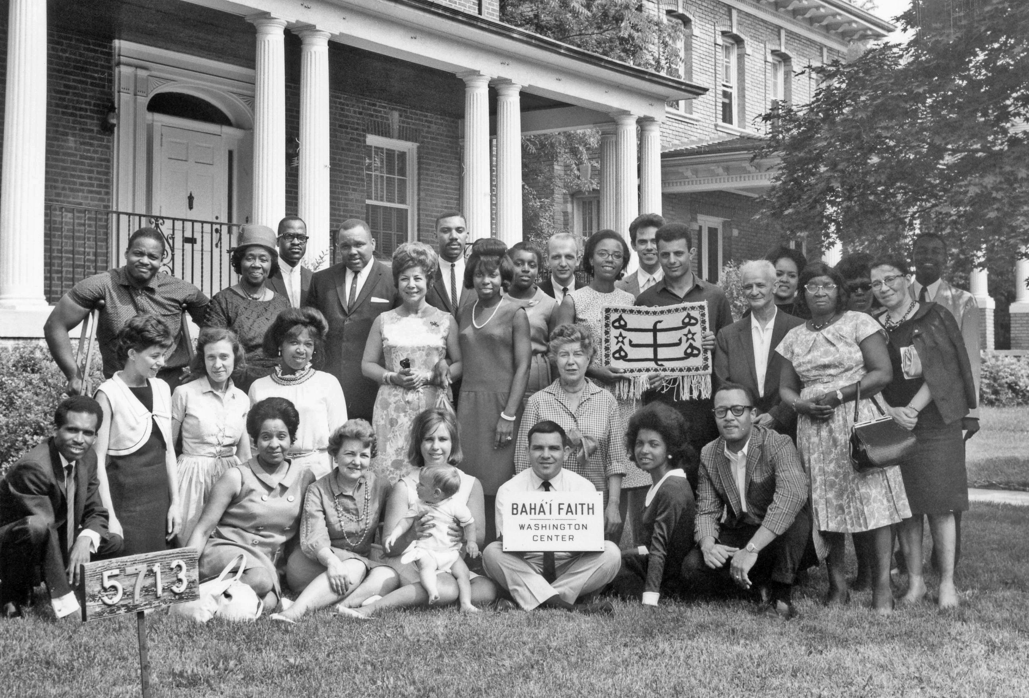
Today I am most happy, for I see here a gathering of the servants of God. I see white and black sitting together. There are no whites and blacks before God. All colors are one, and that is the color of servitude to God. Scent and color are not important. The heart is important. If the heart is pure, white or black or any color makes no difference. God does not look at colors; He looks at the hearts. He whose heart is pure is better. He whose character is better is more pleasing. He who turns more to the Abhá Kingdom is more advanced.
'Abdu'l-Bahá
Promulgation of Universal Peace, p. 44

Slide 10
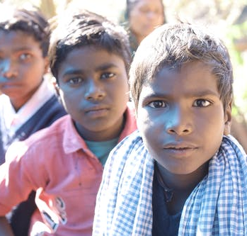
Then it is evident that excellence does not depend upon color. Character is the true criterion of humanity. Anyone who possesses a good character, who has faith in God and is firm, whose actions are good, whose speech is good--that one is accepted at the threshold of God no matter what color he may be.
‘Abdu’l-Bahá
Promulgation of Universal Peace, pp. 427-428

Slide 11
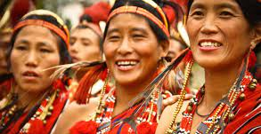
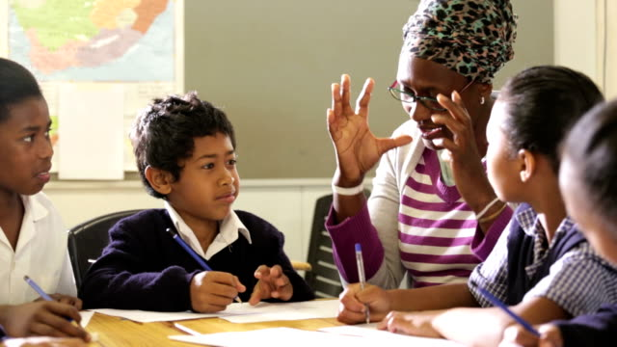

Let them at all times concern themselves with doing a kindly thing for one of their fellows, offering to someone love, consideration, thoughtful help. Let them see no one as their enemy, or as wishing them ill, but think of all humankind as their friends; regarding the alien as an intimate, the stranger as a companion, staying free of prejudice, drawing no lines.
‘Abdu’l-Bahá
Selections from the
Writings of ‘Abdu’l-Bahá, 1.3

Slide 12

The divine religions must be the cause of oneness among men, and the means of unity and love; they must promulgate universal peace, free man from every prejudice, bestow joy and gladness, exercise kindness to all men and do away with every difference and distinction.
‘Abdu’l-Bahá
Selections from the
Writings of ‘Abdu’l-Bahá, 13.1

Slide 13
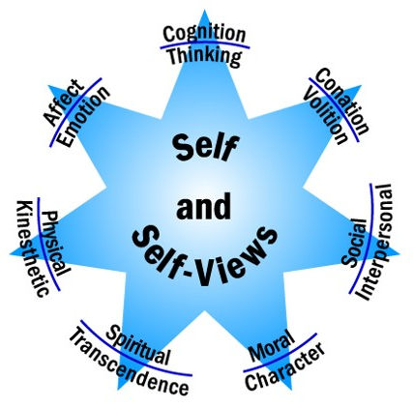
Of the spiritual prerequisites of success, which constitute the bedrock on which the security of all plans, projects, and schemes must ultimately rest, the following stand out as preeminent and vital….a high sense of moral rectitude in their social and administrative activities, absolute chastity in their individual lives, and complete freedom from prejudice in their dealings with peoples of a different race, class, creed, or colour.
Shoghi Effendi
Advent of Divine Justice, p. 19

Slide 14
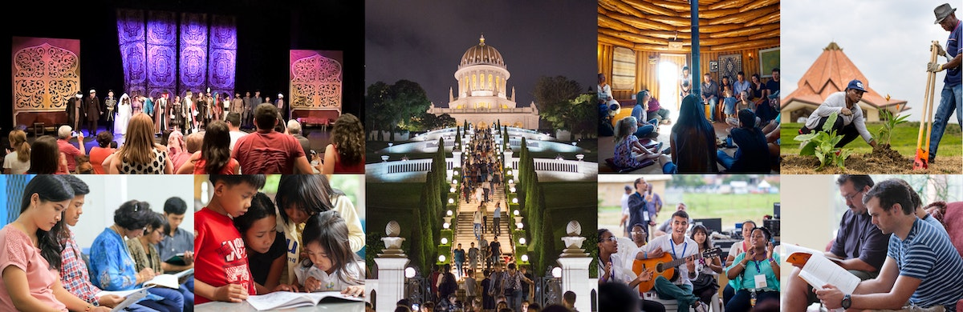
I beseech Thee by the suns of the heavens of Thy will and the pearls of the oceans of Thy knowledge and behest, to draw me nigh unto Thee, under all conditions, and to write down for me with Thy Most Exalted Pen such as Thou hast ordained for Thy loved ones and chosen ones, whom Thou hast aided to shatter the idols of vain fancies and prejudice in Thy power and sovereignty, and unto whom Thou hast shown Thy path.
Bahá’u’lláh
Supplications by Bahá’u’lláh, #280

Slide 15
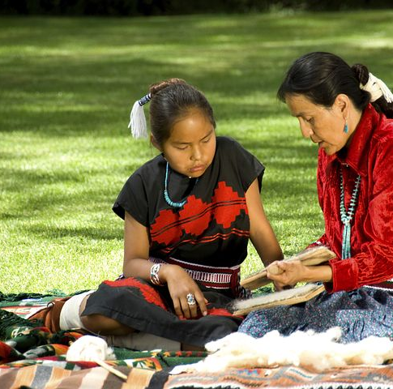
You who are the servants of God fight against oppression, hate and discord…. Only have faith, patience and courage--this is but the beginning, but surely you will succeed, for God is with you!
‘Abdu’l-Bahá
Paris Talks, p. 101

Slide 16
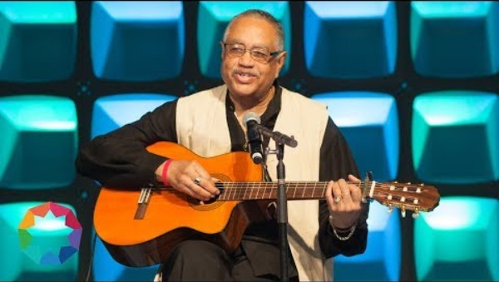
https://www.youtube.com/watch?v=3A21ItKOc1A

Slide 17

https://brilliantstar19.org/videos/bahai/bh-43-LeavesOfOneTree.mp4

