Slide 1
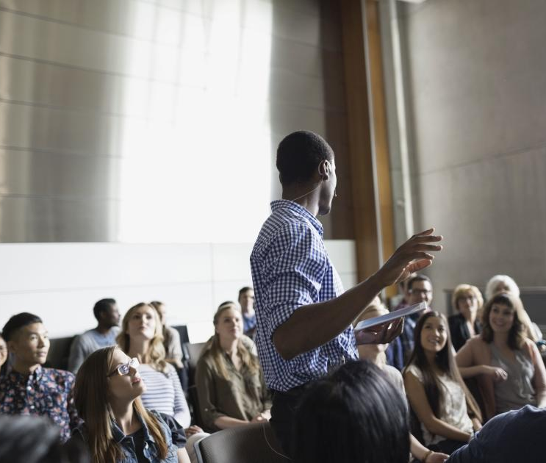
Words & Eloquent Speech
Tucker, GA

Slide 2

https://www.youtube.com/watch?v=JYDe7u6xqi8

Slide 3
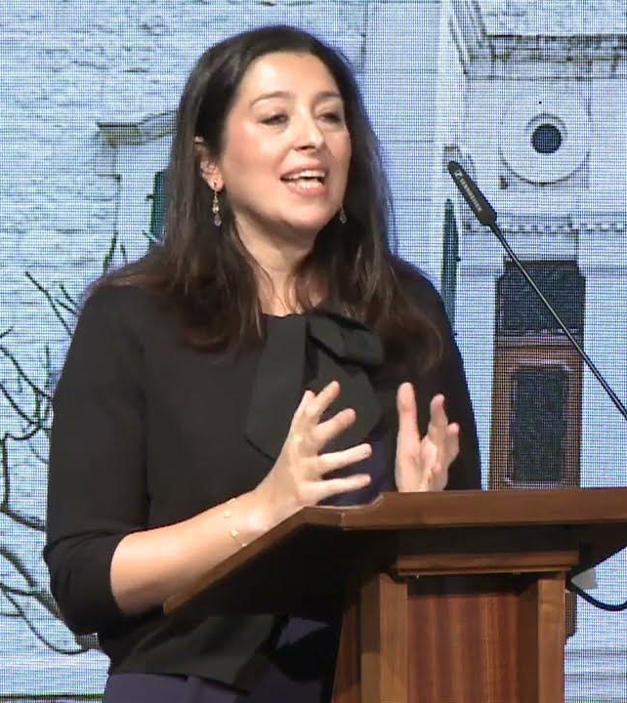
It is not desirable that a man be left without knowledge or skills, for he is then but a barren tree. Then, so much as capacity and capability allow, ye needs must deck the tree of being with fruits such as knowledge, wisdom, spiritual perception, and eloquent speech.
Bahá’u’lláh,
Bahá’í Sacred Writings, 355

Slide 4

Good speech and truthfulness are, in loftiness of position and rank, like unto the sun which hath risen from the horizon of the heaven of knowledge.
Bahá’u’lláh,
Tablets of Bahá’u’lláh, p. 12

Slide 5
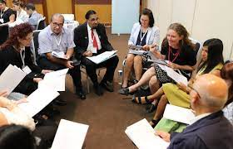
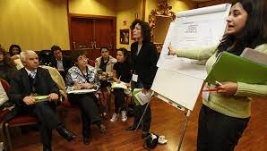
Verily I say, the tongue is for mentioning what is good, defile it not with unseemly talk. God hath forgiven what is past. Henceforward everyone should utter that which is meet and seemly, and should refrain from slander, abuse and whatever causeth sadness in men.
Bahá'u'lláh
Tablets of Bahá’u’lláh, pp. 219-220

Slide 6
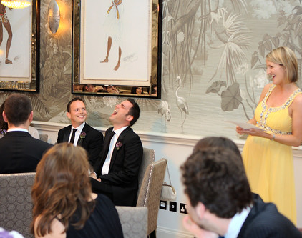
A kindly tongue is the lodestone of the hearts of men. It is the bread of the Spirit, it clotheth the words with meaning, it is the fountain of the light of wisdom and understanding.
Bahá'u'lláh
Epistle to the Son of the Wolf,
p. 15

Slide 7
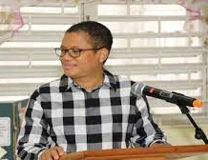
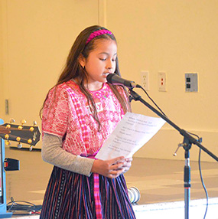
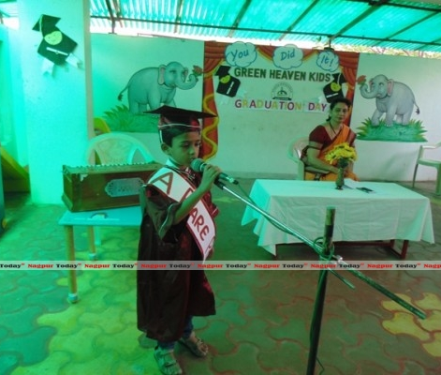
Encourage ye the school children, from their earliest years, to deliver speeches of high quality, so that in their leisure time they will engage in giving cogent and effective talks, expressing themselves with clarity and eloquence.
'Abdu'l-Bahá
Selections From the
Writings of ‘Abdu’l-Bahá, p. 134

Slide 8

Human utterance is an essence which aspireth to exert its influence and needeth moderation. As to its influence, this is conditional upon refinement which in turn is dependent upon hearts which are detached and pure. As to its moderation, this hath to be combined with tact and wisdom as prescribed in the Holy Scriptures and Tablets.
Bahá'u'lláh
Tablets of Bahá’u’lláh, p. 172

Slide 9

Unless he teacheth his own self, the words of his mouth will not influence the heart of the seeker.
Take heed, O people, lest ye be of them that give good counsel to others but forget to follow it themselves.
Bahá'u'lláh
Gleanings, p. 277

Slide 10
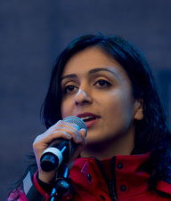
Moderation is indeed highly desirable. Every person who in some degree turneth towards the truth can himself later comprehend most of what he seeketh. However, if at the outset a word is uttered beyond his capacity, he will refuse to hear it and will arise in opposition.
Bahá'u'lláh
Guidelines for Teaching, p. 293

Slide 11
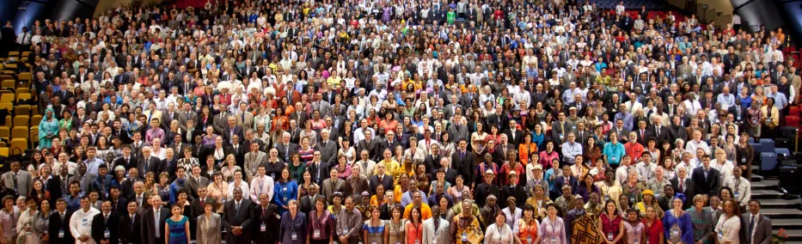
Baha'u'llah has proclaimed the adoption of a universal language. A language shall be agreed upon by which unity will be established in the world. Each person will require training in two languages: his native tongue and the universal auxiliary form of speech.
'Abdu'l-Bahá
Promulgation of Universal Peace, p. 300

Slide 12
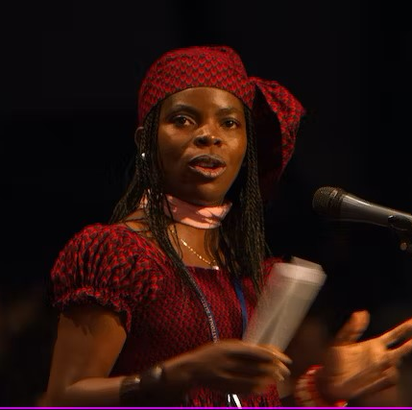
...We have ordained that complete victory should be achieved through speech and utterance, that Our servants throughout the earth may thereby become the recipients of divine good.
Bahá’u’lláh
Fountain of Wisdom, 13.9

Slide 13
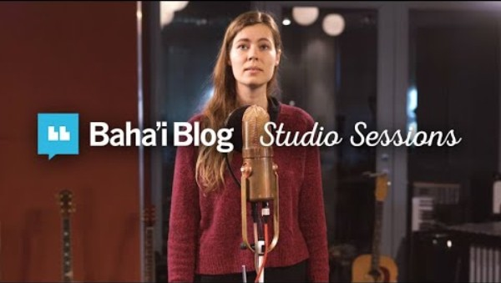
https://www.youtube.com/watch?v=gQ_d6zJejbw

Slide 14
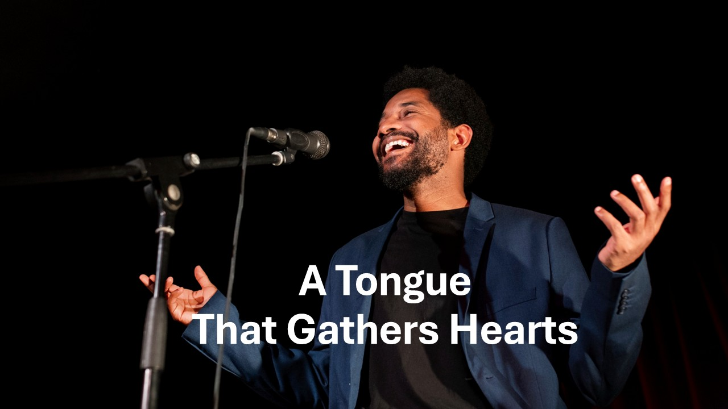
https://www.youtube.com/watch?v=8l2Bap_kv28

