Slide 1

Wisdom
Tucker, GA

Slide 2
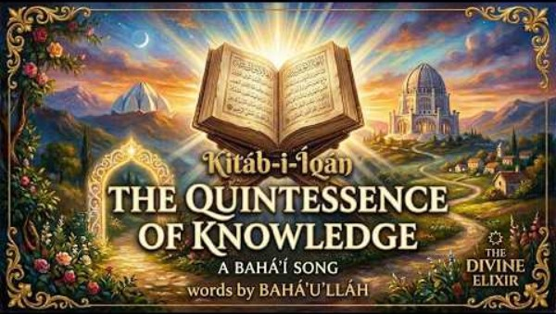
https://www.youtube.com/watch?v=L69BNAg3D9o

Slide 3
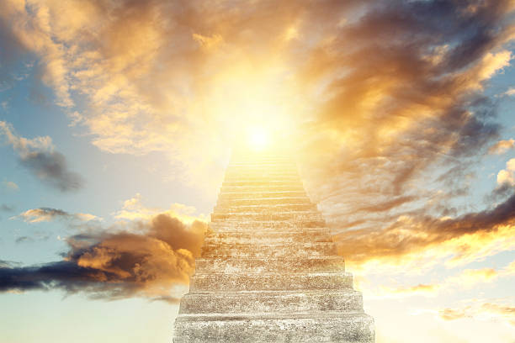
And it was this peerless Source of wisdom that at the beginning of the foundation of the world ascended the stair of inner meaning and when enthroned upon the pulpit of utterance, through the operation of the divine Will, proclaimed two words. The first heralded the promise of reward, while the second voiced the ominous warning of punishment. The promise gave rise to hope and the warning begat fear. Thus the basis of world order hath been firmly established upon these twin principles. Exalted is the Lord of Wisdom, the Possessor of Great Bounty.
Bahá'u'lláh
Tablets of Bahá’u’lláh, p. 66

Slide 4
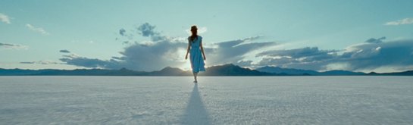
It behooveth whosoever hath set his face towards the Most Sublime Horizon to cleave tenaciously unto the cord of patience, and to put his reliance in God, the Help in Peril, the Unconstrained. O ye loved ones of God! Drink your fill from the well spring of wisdom, and soar ye in the atmosphere of wisdom, and speak forth with wisdom and eloquence. Thus biddeth you your Lord, the Almighty, the All Knowing.
Bahá’u’lláh
Epistle to the Son of the Wolf, p. 99

Slide 5

Above all else, the greatest gift and the most wondrous blessing hath ever been and will continue to be wisdom. It is man’s unfailing Protector. It aideth him and strengtheneth him. Wisdom is God’s Emissary and the Revealer of His Name the Omniscient. Through it the loftiness of man’s station is made manifest and evident.
Bahá’u’lláh,
Tablets of Bahá’u’lláh, p. 66

Slide 6

The essence of wisdom is the fear of God, the dread of His scourge and punishment, and the apprehension of His justice and decree.
Bahá’u’lláh,
Tablets of Bahá’u’lláh, p. 155

Slide 7
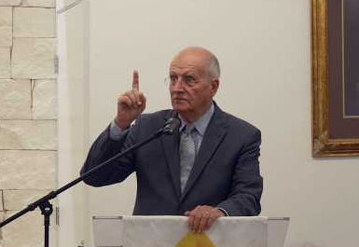

Knowledge is love. Study, listen to exhortations, think, try to understand the wisdom and greatness of God. The soil must be fertilized before the seed can be sown.
‘Abdu’l-Bahá
Compilation of Compilations
(The Importance of Deepening), p. 204

Slide 8
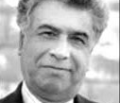
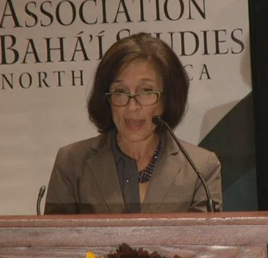
The Great Being saith: The man of consummate learning and the sage endowed with penetrating wisdom are the two eyes to the body of mankind. God willing, the earth shall never be deprived of these two greatest gifts. That which hath been set forth and will be revealed in the future is but a token of this Servant’s ardent desire to dedicate Himself to the service of all the kindreds of the earth.
Bahá’u’lláh
Tablets of Bahá’u’lláh, p. 171

Slide 9


The heaven of divine wisdom is illumined with the two luminaries of consultation and compassion and the canopy of world order is upraised upon the two pillars of reward and punishment.
Bahá’u’lláh
Tablets of Bahá’u’lláh, p.126

Slide 10
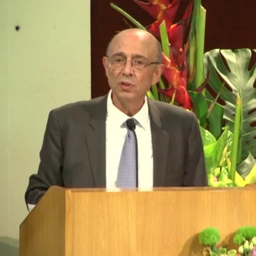
No man of wisdom can demonstrate his knowledge save by means of words. This showeth the significance of the Word as is affirmed in all the Scriptures, whether of former times or more recently. For it is through its potency and animating spirit that the people of the world have attained so eminent a position. Moreover words and utterances should be both impressive and penetrating. However, no word will be infused with these two qualities unless it be uttered wholly for the sake of God and with due regard unto the exigencies of the occasion and the people.
Bahá’u’lláh
Tablets of Bahá’u’lláh, p. 172

Slide 11
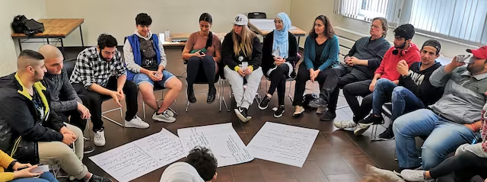
Human utterance is an essence which aspireth to exert its influence and needeth moderation. As to its influence, this is conditional upon refinement which in turn is dependent upon hearts which are detached and pure. As to its moderation, this hath to be combined with tact and wisdom as prescribed in the Holy Scriptures and Tablets.
Bahá’u’lláh
Tablets of Bahá’u’lláh, p. 172

Slide 12

It is incumbent upon thee to acquire the various branches of knowledge, and to turn thy face toward the beauty of the Manifest Beauty, that thou mayest be a sign of saving guidance amongst the peoples of the world, and a focal centre of understanding in this sphere from which the wise and their wisdom are shut out, except for those who set foot in the Kingdom of lights and become informed of the veiled and hidden mystery, the well-guarded secret.
‘Abdu’l-Bahá
Selections From the Writings of ‘Abdu’l-Bahá, p.110

Slide 13
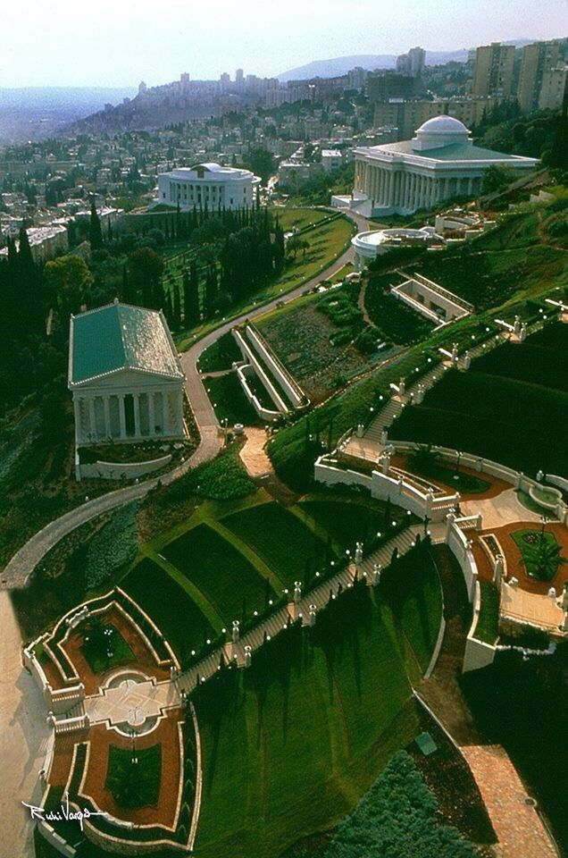
The Cause to which we belong stands on the threshold of an era of unprecedented expansion. Its problems are many, diverse and challenging. Our methods and ways of approach must likewise be characterized by unusual sagacity, consummate skill and wisdom.
Shoghi Effendi
Messages to America, p. 2

Slide 14

In this Day whatsoever serveth to reduce blindness and to increase vision is worthy of consideration. This vision acteth as the agent and guide for true knowledge. Indeed in the estimation of men of wisdom keenness of understanding is due to keenness of vision. The people of Bahá must under all circumstances observe that which is meet and seemly and exhort the people accordingly.
Bahá'u'lláh
Tablets of Bahá’u’lláh, p. 35

Slide 15

https://www.youtube.com/watch?v=nGOx2IITrPk

Slide 16

https://www.youtube.com/watch?v=ItYJUjbPxdk

