Slide 1

Cognitive Intelligence
Tucker, GA

Slide 2
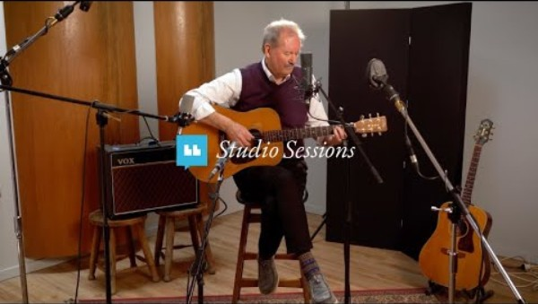
https://www.youtube.com/watch?v=AGx8f_2t2j4

Slide 3
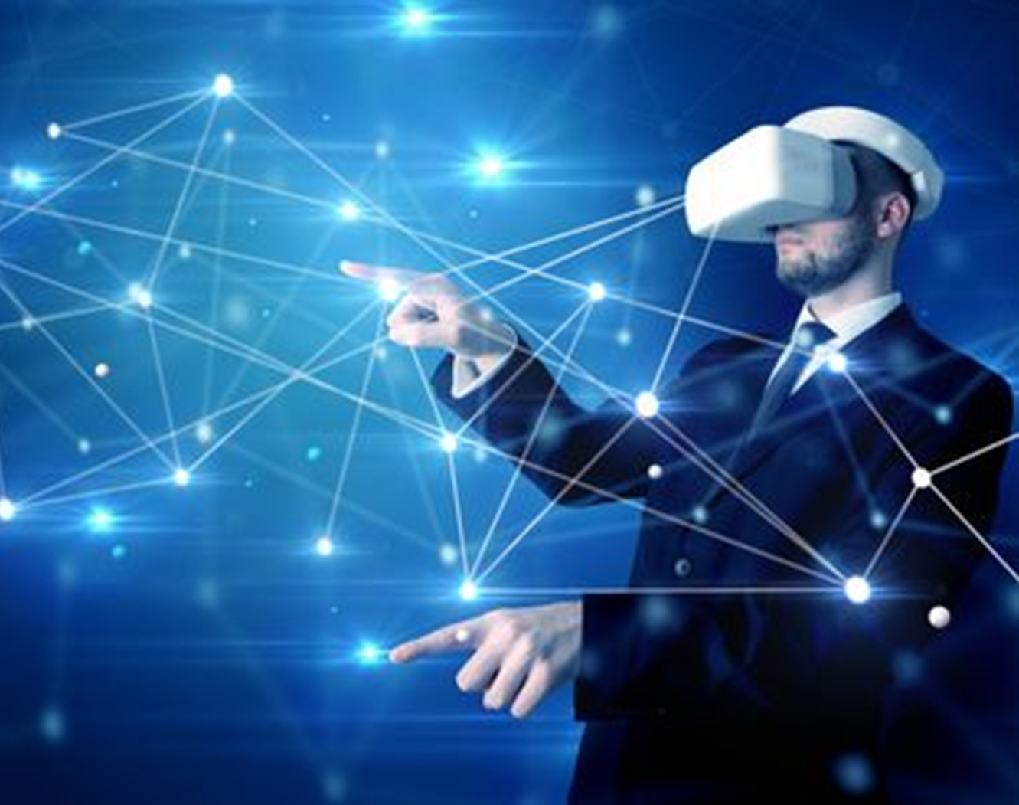
All blessings are divine in origin, but none can be compared with this power of intellectual investigation and research, which is an eternal gift producing fruits of unending delight. Man is ever partaking of these fruits. All other blessings are temporary; this is an everlasting possession.
‘Abdu’l-Bahá,
Promulgation of Universal Peace, p. 50

Slide 4

All created things have their degree or stage of maturity. The period of maturity in the life of a tree is the time of its fruit-bearing…. The animal attains a stage of full growth and completeness, and in the human kingdom man reaches his maturity when the light of his intelligence attains its greatest power and development.…
Abdu’l-Baha,
Foundations of World Unity, p. 9

Slide 5
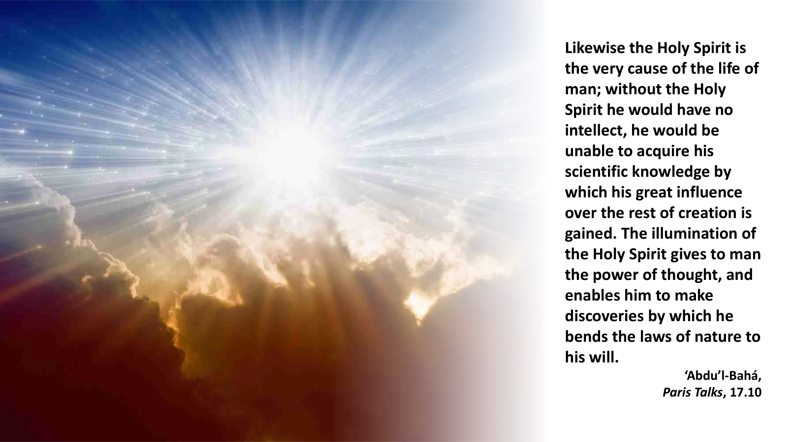

Slide 6
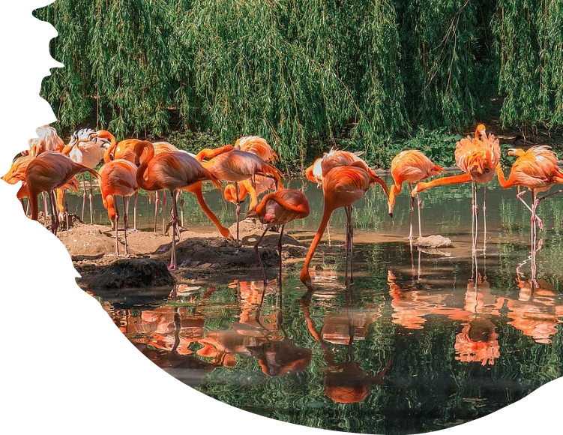

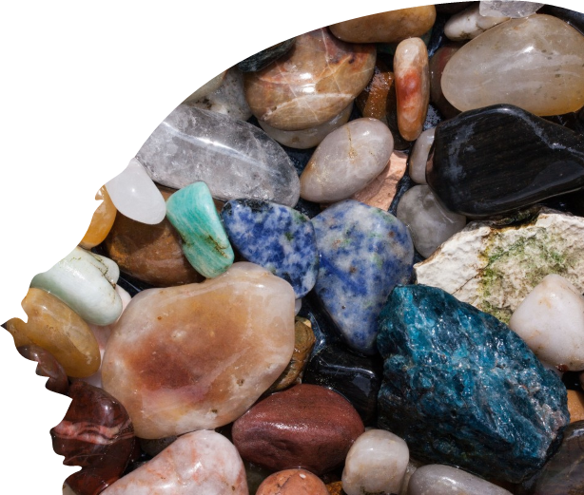
All created things are captives of nature and subject to its laws. They cannot transgress the control of these laws in one detail or particular. The infinite starry worlds and heavenly bodies are nature's obedient subjects. The earth and its myriad organisms, all minerals, plants and animals are thralls of its dominion. But man through the exercise of his scientific, intellectual power can rise out of this condition, can modify, change and control nature according to his own wishes and uses. Science, so to speak, is the breaker of the laws of nature.
‘Abdu’l-Bahá
Promulgation of Universal Peace, p. 30

Slide 7
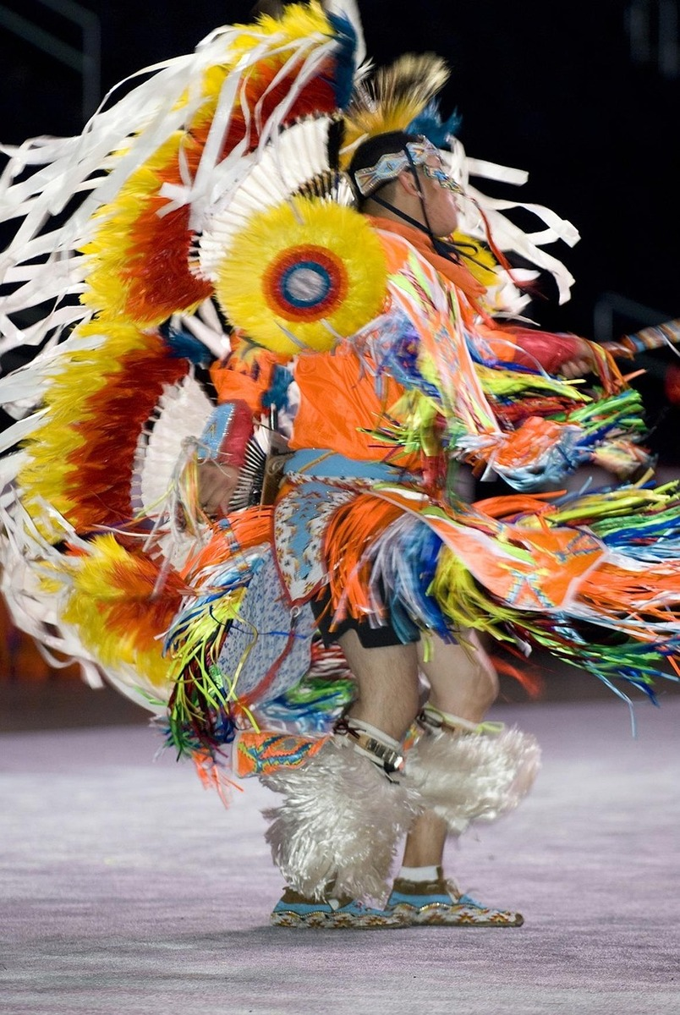
With regard to the innate character, although the divine creation is purely good, yet the varieties of natural qualities in man come from the difference of degree; all are excellent, but they are more or less so, according to the degree. So all mankind possess intelligence and capacities, but the intelligence, the capacity, and the worthiness of men differ. This is evident.
‘Abdu’l-Bahá,
Some Answered Questions, pp. 221-222

Slide 8
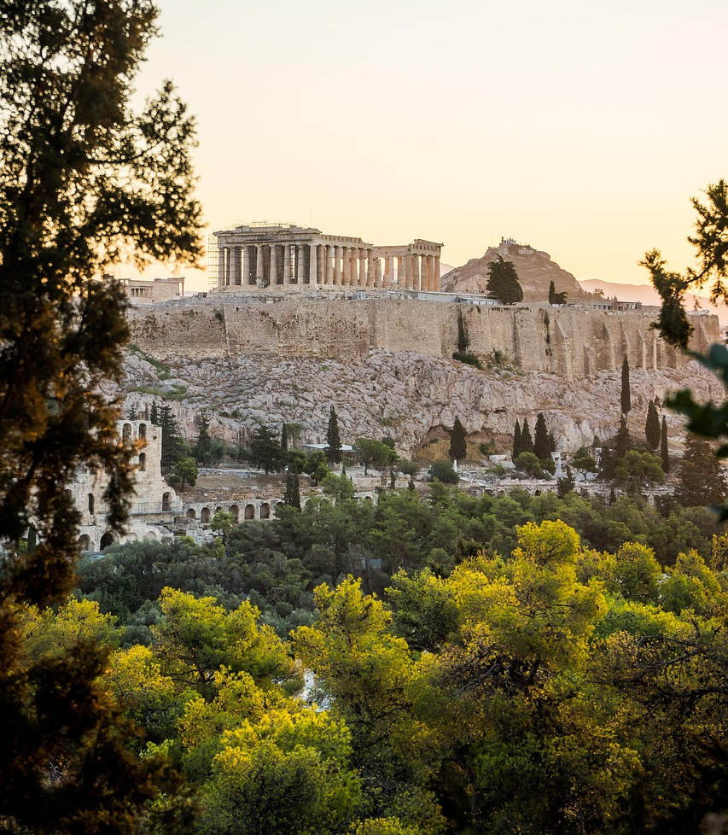
It is therefore evident that the criterion of reason is imperfect, as proven by the disagreements existing between the ancient philosophers as well as by their want of consistency and their propensity to change their own views. For if the criterion of intellect were perfect, all should have been united in their thoughts and agreed in their opinions.
‘Abdu’l-Bahá,
Some Answered Questions, p. 343

Slide 9

Former centuries were epochs of oppression. Now human intellects have developed, and human intelligence has increased. Each soul is investigating reality. This is not a time when we shall wage war and be hostile toward each other. We are living at a time when we should enjoy real friendship.
‘Abdu’l-Bahá,
The Promulgation of Universal Peace, pp. 222-223

Slide 10
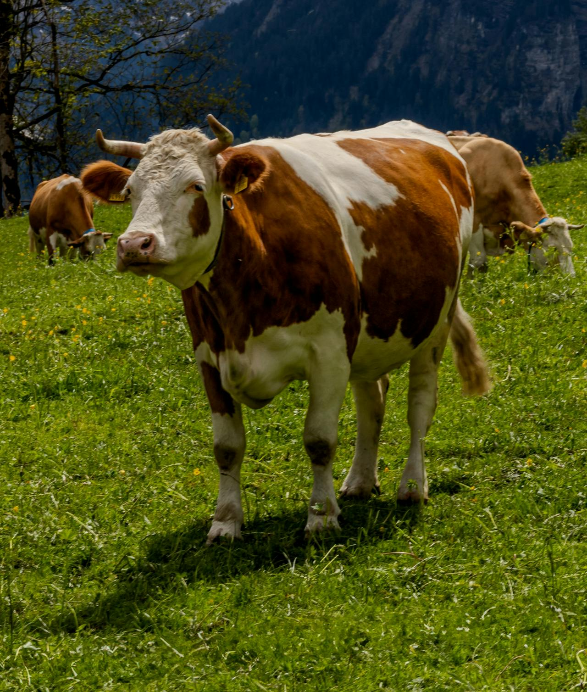
It is no proof of intelligence to reject everything which does not strike the senses. Nay, rather, such a one is brother to the animal. The cow has no idea of God; she does not know the soul. So the only difference between her highness the cow and a materialistic philosopher is that the latter takes a great deal of trouble! It is not a special or exclusive privilege to be the prisoner of one’s senses; the cow is the example of this theory.
‘Abdu’l-Bahá,
Divine Philosophy, 375

Slide 11
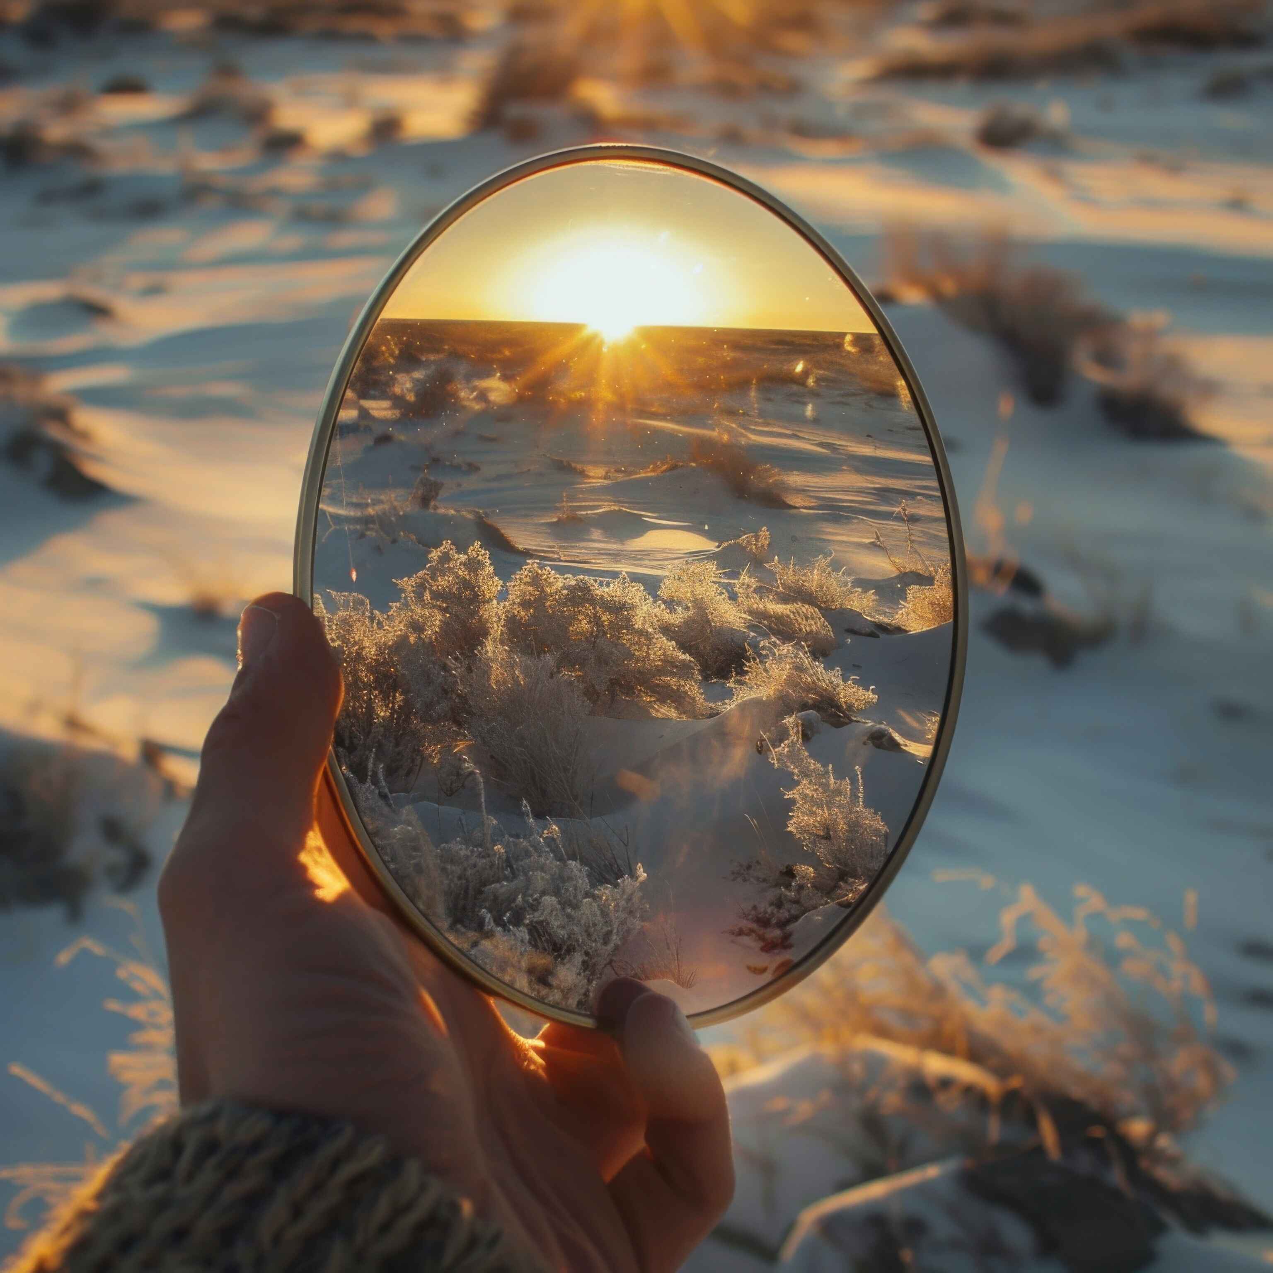
...knowledge, which is a form acquired by the mind, is an intelligible thing, and to speak of entering into the mind or exiting from it is absurd. Rather, it is a relationship of acquisition, even as images are reflected in a mirror.
‘Abdu’l-Bahá,
Some Answered Questions, 373

Slide 12

The rising of the sun at the equinox is the symbol of life and the human reality is revivified; our thoughts are transformed and our intelligence is quickened. The sun of truth bestows eternal life, just as the solar sun is the cause of terrestrial life.
‘Abdu’l-Bahá ,
Divine Philosophy, 296

Slide 13
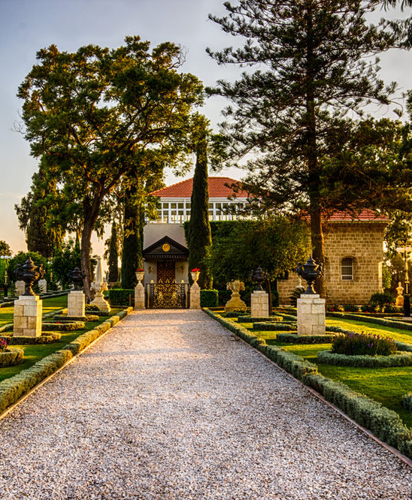
Now, we need an educator who can be at the same time a material, a human, and a spiritual educator, that his authority may have effect at every degree of existence. And should anyone say, “I am endowed with perfect reason and comprehension, and have no need for such an educator”, he would be denying the obvious. It is as though a child were to say, “I have no need of education, but will act and seek the perfections of existence according to my own thinking and intelligence”...
‘Abdu’l-Bahá,
Some Answered Questions, p. 10

Slide 14
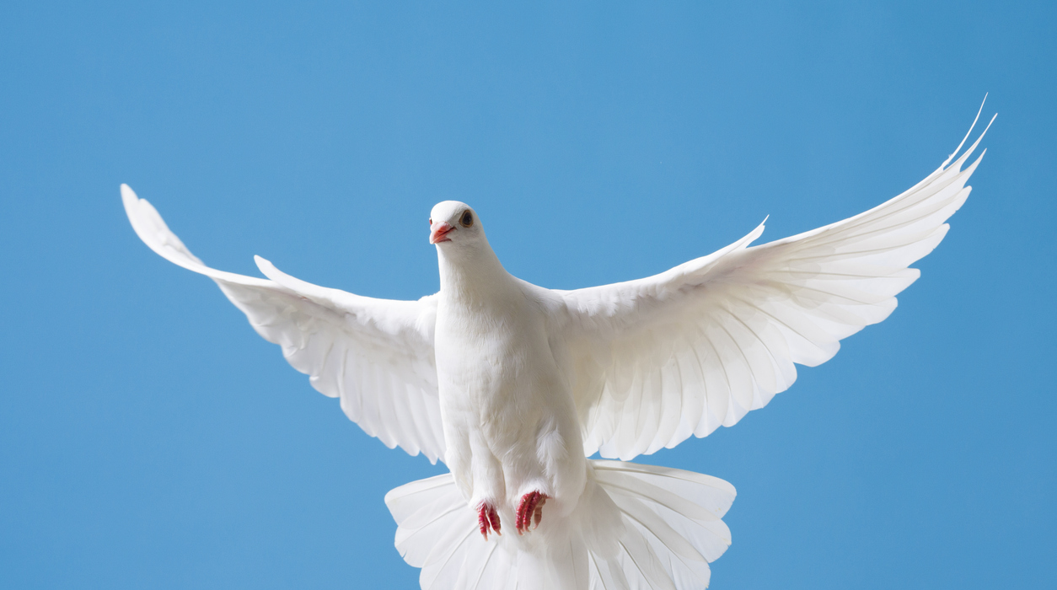
May the breezes of the Holy Spirit waft upon you, that your intelligence may progress and your souls rejoice in your lord. Thus will you become eternal beings shining in the divine kingdom.
‘Abdu’l-Bahá,
Divine Philosophy, p. 76

Slide 15
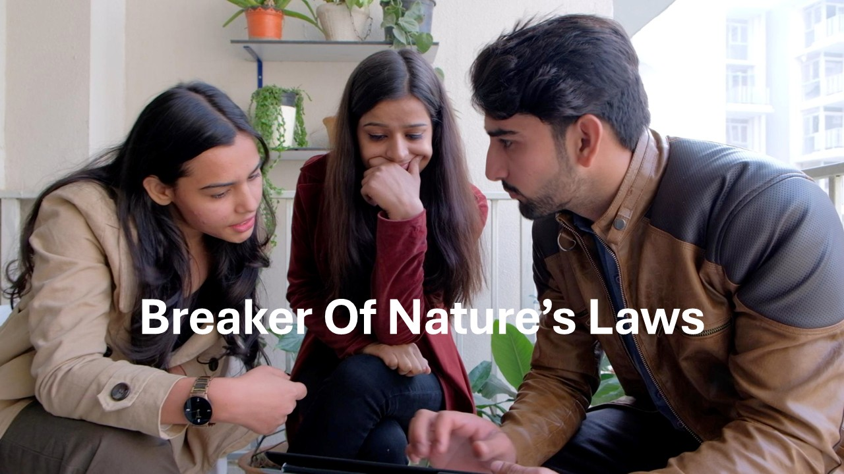
https://www.youtube.com/watch?v=RdDPXL4xCeU

