Slide 1
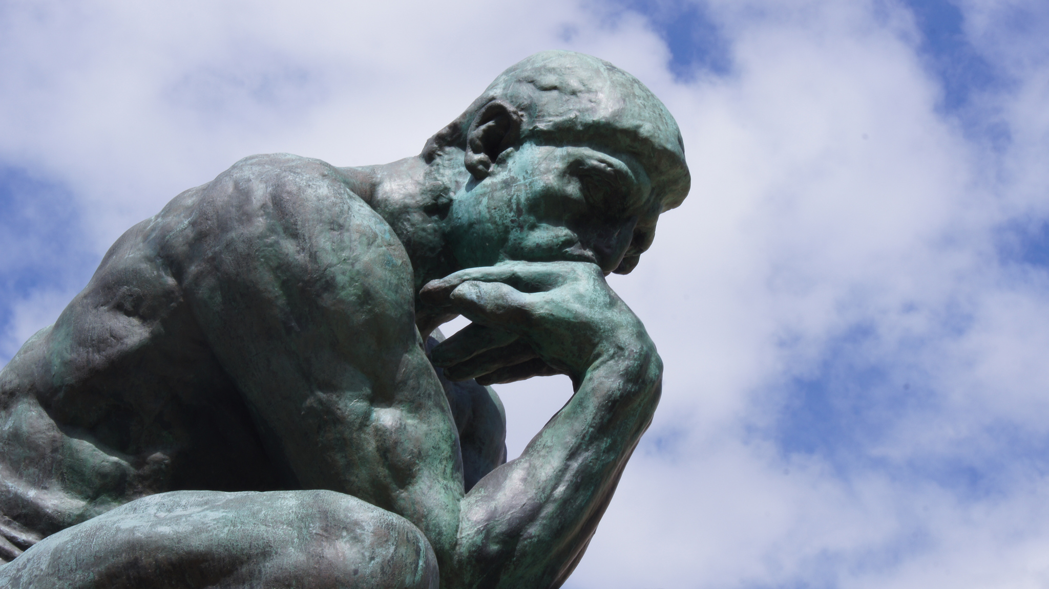
Thought & Thinking
Tucker, GA

Slide 2

https://www.youtube.com/watch?v=laelK7NBnyo

Slide 3

All blessings are divine in origin, but none can be compared with this power of intellectual investigation and research, which is an eternal gift producing fruits of unending delight. Man is ever partaking of these fruits. All other blessings are temporary; this is an everlasting possession.
‘Abdu’l-Bahá,
Promulgation of Universal Peace, p. 50

Slide 4
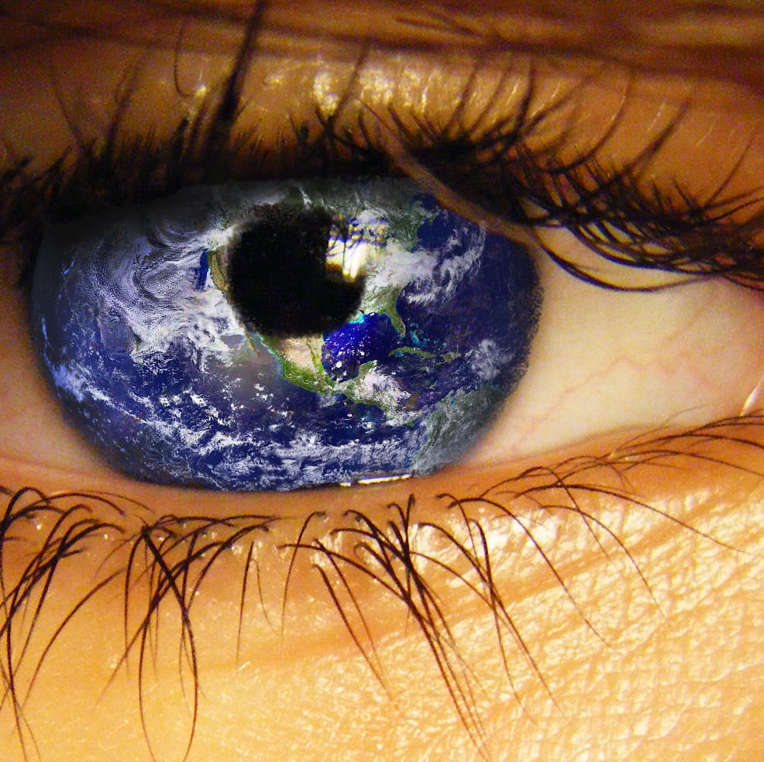
Let your vision be world-embracing, rather than confined to your own self.
Bahá’u’lláh,
Tablets of Bahá’u’lláh, p. 87

Slide 5
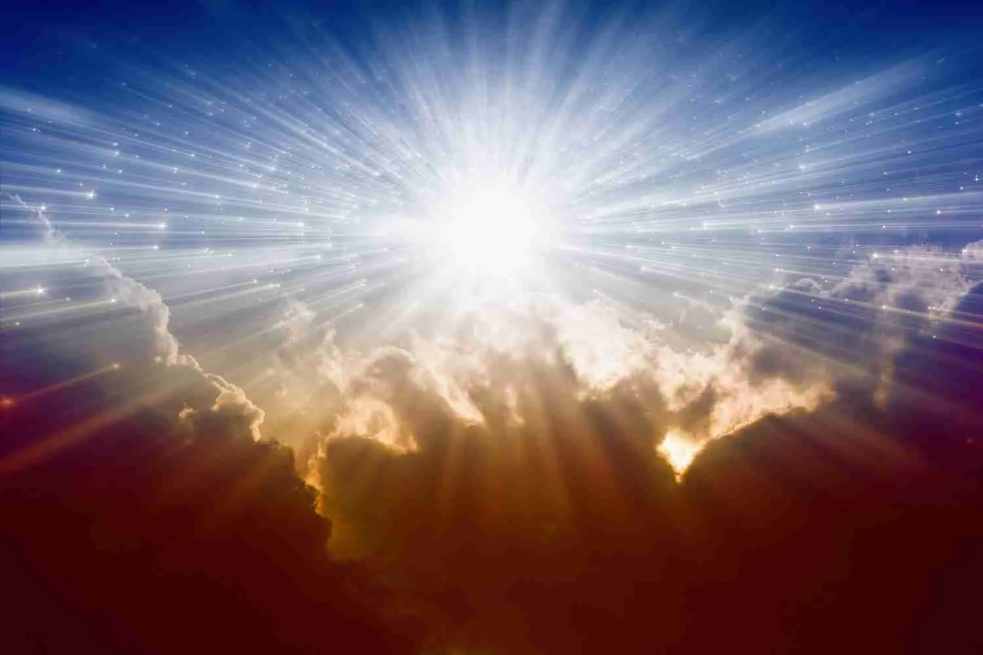
Likewise the Holy Spirit is the very cause of the life of man; without the Holy Spirit he would have no intellect, he would be unable to acquire his scientific knowledge by which his great influence over the rest of creation is gained. The illumination of the Holy Spirit gives to man the power of thought, and enables him to make discoveries by which he bends the laws of nature to his will.
‘Abdu’l-Bahá,
Paris Talks, 17.10

Slide 6



All created things are captives of nature and subject to its laws. They cannot transgress the control of these laws in one detail or particular. The infinite starry worlds and heavenly bodies are nature's obedient subjects. The earth and its myriad organisms, all minerals, plants and animals are thralls of its dominion. But man through the exercise of his scientific, intellectual power can rise out of this condition, can modify, change and control nature according to his own wishes and uses. Science, so to speak, is the breaker of the laws of nature.
‘Abdu’l-Bahá
Promulgation of Universal Peace, p. 30

Slide 7

The reality of man is his thought, not his material body. The thought force and the animal force are partners. Although man is part of the animal creation, he possesses a power of thought superior to all other created beings.
‘Abdu’l-Bahá
Paris Talks, 2.1

Slide 8
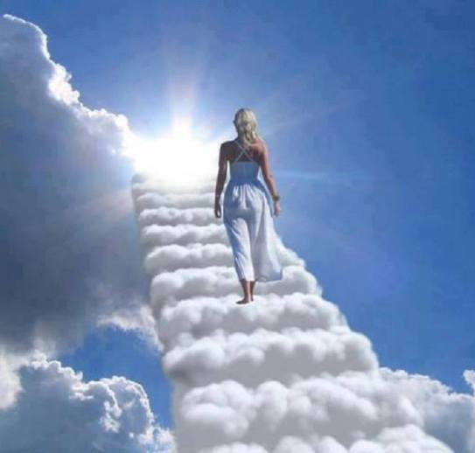
If a man’s thought is constantly aspiring towards heavenly subjects then does he become saintly; if on the other hand his thought does not soar, but is directed downwards to centre itself upon the things of this world, he grows more and more material until he arrives at a state little better than that of a mere animal.
‘Abdu’l-Bahá
Paris Talks, 2.2

Slide 9

Some men and women glory in their exalted thoughts, but if these thoughts never reach the plane of action they remain useless: the power of thought is dependent on its manifestation in deeds.
‘Abdu’l-Bahá
Paris Talks, 2.6

Slide 10

Do not allow difference of opinion, or diversity of thought to separate you from your fellow-men, or to be the cause of dispute, hatred and strife in your hearts.
‘Abdu’l-Bahá,
Paris Talks, 15.9

Slide 11

I hope that each one of you will become just, and direct your thoughts towards the unity of mankind; that you will never harm your neighbours nor speak ill of any one; that you will respect the rights of all men, and be more concerned for the interests of others than for your own.
'Abdu'l-Bahá
Paris Talks, p. 160

Slide 12

Especially to those whose thoughts are material and retrograde show the utmost love and patience, thereby winning them into the unity of fellowship by the radiance of your kindness.
'Abdu'l-Bahá,
Paris Talks, p. 27

Slide 13
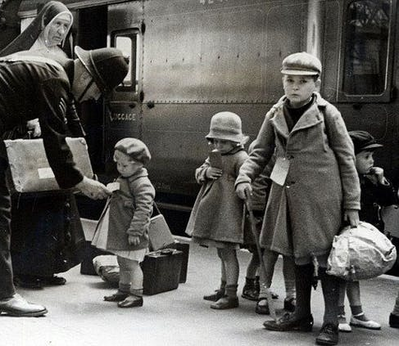
Every soul of the friends of God must concentrate his mind on this, that he may manifest the mercy of God and the bounty of the Forgiving One. He must do good to every soul whom he encounters, and render benefit to him, becoming the cause of improving the morals and correcting the thoughts so that the light of guidance may shine forth and the bounty of His Holiness the Merciful One may encompass. Love is light in whatsoever house it may shine and enmity is darkness in whatsoever abode it dwell.
Abdu’l-Bahá,
Baha'i World Faith, p. 217

Slide 14

Be united in counsel, be one in thought.
Bahá'u'lláh
Tablets of Bahá’u’lláh, p. 138

Slide 15

https://www.youtube.com/watch?v=4zo0XIvxKo8

Slide 16

https://www.youtube.com/watch?v=FNHZMeYQQYc

