Slide 1
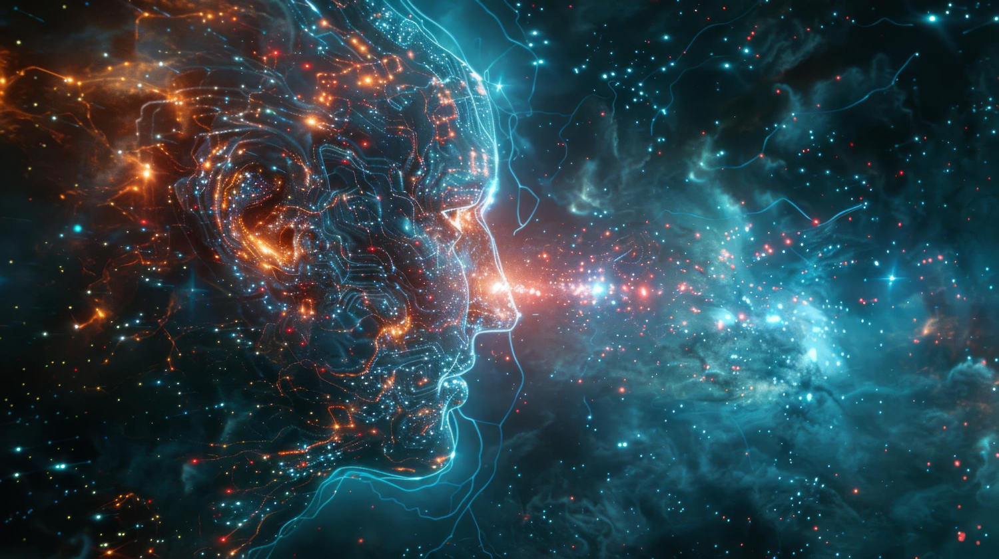
Comprehension & Understanding
Tucker, GA

Slide 2

https://www.youtube.com/watch?v=NZkgsmUEWKc

Slide 3

Man has also spiritual powers: imagination, which conceives things; thought, which reflects upon realities; comprehension, which comprehends realities; memory, which retains whatever man imagines, thinks and comprehends.
'Abdu'l-Bahá
Some Answered Questions, p. 210

Slide 4

Know thou that, according to what thy Lord, the Lord of all men, hath decreed in His Book, the favors vouchsafed by Him unto mankind have been, and will ever remain, limitless in their range. First and foremost among these favors, which the Almighty hath conferred upon man, is the gift of understanding. His purpose in conferring such a gift is none other except to enable His creature to know and recognize the one true God--exalted be His glory....
Bahá’u’lláh,
Gleanings, p. 194

Slide 5

In this Day whatsoever serveth to reduce blindness and to increase vision is worthy of consideration. This vision acteth as the agent and guide for true knowledge. Indeed in the estimation of men of wisdom keenness of understanding is due to keenness of vision. The people of Bahá must under all circumstances observe that which is meet and seemly and exhort the people accordingly.
Bahá’u’lláh
Tablets of Bahá’u’lláh, p. 35

Slide 6


...it is evident that movement is essential to all existence. All material things progress to a certain point, then begin to decline. This is the law which governs the whole physical creation....
My hope for you is that you will progress in the world of spirit, as well as in the world of matter; that your intelligence will develop, your knowledge will augment, and your understanding be widened.
You must ever press forward, never standing still; avoid stagnation, the first step to a backward movement, to decay.
'Abdu'l-Bahá
Paris Talks, pp. 89-90

Slide 7



Is it commendable that you should waste and fritter away in apathy the brilliance that is your birthright, your native competence, your inborn understanding?
‘Abdu’l-Bahá
Secret of Divine Civilization, p. 92

Slide 8

It is towards the inmost essence of these Prophets, therefore, that the eye of every man of discernment must be directed, inasmuch as their one and only purpose hath always been to guide the erring, and give peace to the afflicted....
Bahá’u’lláh
Gleanings, pp. 80-81

Slide 9
It is evident that the human understanding is a quality of the existence of man, and that man is a sign of God: how can the quality of the sign surround the creator of the sign?--that is to say, how can the understanding, which is a quality of the existence of man, comprehend God? Therefore, the Reality of the Divinity is hidden from all comprehension, and concealed from the minds of all men. It is absolutely impossible to ascend to that plane.
'Abdu'l-Bahá
Some Answered Questions, pp. 146-147

Slide 10

There are only four accepted methods of comprehension--that is to say, the realities of things are understood by these four methods. The first method is by the senses... The second is the method of reason... The third method of understanding is by tradition -- that is, through the text of the Holy Scriptures...But the bounty of the Holy Spirit gives the true method of comprehension which is infallible and indubitable.
'Abdu'l-Bahá
Some Answered Questions, pp. 146-147

Slide 11

All these sacred words show us that man is made in God’s image: yet the Essence of God is incomprehensible to the human mind, for the finite understanding cannot be applied to this infinite Mystery. God contains all: He cannot be contained.
'Abdu'l-Bahá
Paris Talks, p. 72

Slide 12

I hope that you will use your understanding to promote the unity and tranquility of mankind, to give enlightenment and civilization to the people, to produce love in all around you, and to bring about the universal peace.
'Abdu'l-Bahá
Paris Talks, p. 42

Slide 13

https://www.youtube.com/watch?v=PW4YotivxoM

