Slide 1

Faith
Tucker, GA

Slide 2
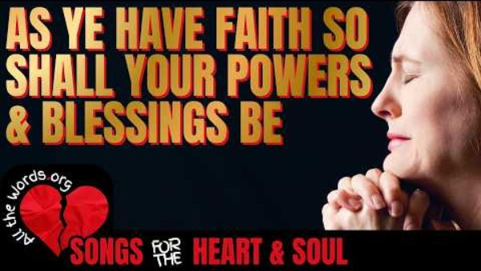
https://www.youtube.com/watch?v=qRp0j3cFgj8

Slide 3

This Day a door is open wider than both heaven and earth. The eye of the mercy of Him Who is the Desire of the worlds is turned towards all men. An act, however infinitesimal, is, when viewed in the mirror of the knowledge of God, mightier than a mountain. Every drop proffered in His path is as the sea in that mirror. For this is the Day which the one true God, glorified be He, hath announced in all His Books unto His Prophets and His Messengers.
Bahá’u’lláh,
quoted in The Advent of Divine Justice, p. 65-66

Slide 4
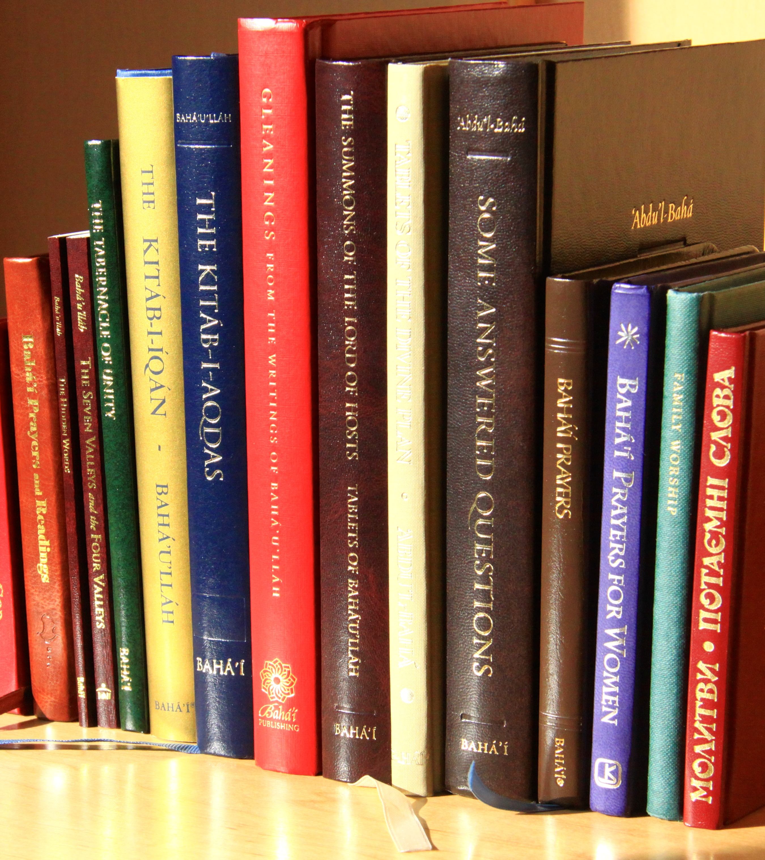
Know assuredly that just as thou firmly believest that the Word of God, exalted be His glory, endureth for ever, thou must, likewise, believe with undoubting faith that its meaning can never be exhausted.
Bahá'u'lláh
Gleanings, p. 175

Slide 5

The soul that hath remained faithful to the Cause of God, and stood unwaveringly firm in His Path shall, after his ascension, be possessed of such power that all the worlds which the Almighty hath created can benefit through him.
Bahá'u'lláh
Gleanings, p. 161

Slide 6

Lift up your hearts above the present and look with eyes of faith into the future! Today the seed is sown, the grain falls upon the earth, but behold the day will come when it shall rise a glorious tree and the branches thereof shall be laden with fruit. Rejoice and be glad that this day has dawned, try to realize its power, for it is indeed wonderful! God has crowned you with honour and in your hearts has He set a radiant star; verily the light thereof shall brighten the whole world!
‘Abdu’l-Bahá,
Paris Talks, p. 59

Slide 7

The lamp is lighted, but as it hath not a conscious knowledge of itself, no one hath become glad because of it. Moreover, a soul of excellent deeds and good manners will undoubtedly advance from whatever horizon he beholdeth the lights radiating. Herein lies the difference: By faith is meant, first, conscious knowledge, and second, the practice of good deeds.
'Abdu'l-Bahá
Bahá’í World Faith, p. 383

Slide 8
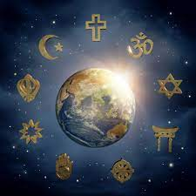
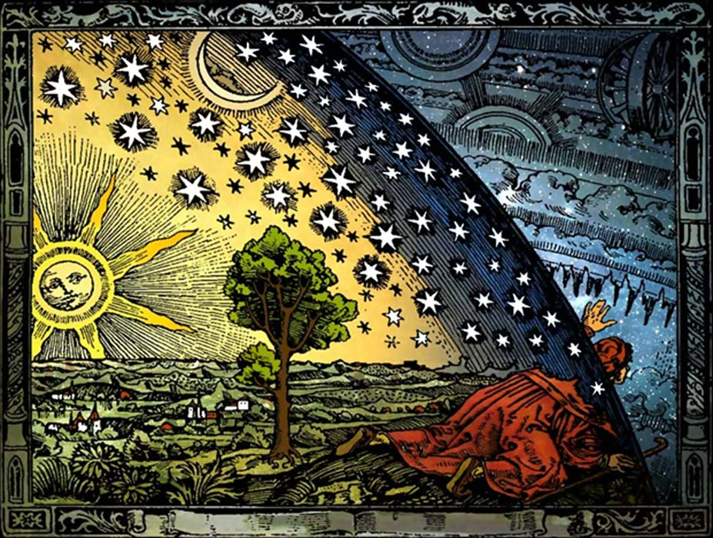
If religion is opposed to reason and science, faith is impossible; and when faith and confidence in the divine religion are not manifest in the heart, there can be no spiritual attainment.
'Abdu'l-Bahá
Promulgation of Universal Peace, p. 299

Slide 9


Know that faith is of two kinds. The first is objective faith that is expressed by the outer man, obedience of the limbs and senses. The other faith is subjective, and unconscious obedience to the will of God.
'Abdu'l-Bahá
Bahá’í World Faith, p. 364

Slide 10

It is from the bounty of God that man is selected for the highest degree; and the differences which exist between men in regard to spiritual progress and heavenly perfections are also due to the choice of the Compassionate One. For faith, which is life eternal, is the sign of bounty, and not the result of justice. The flame of the fire of love, in this world of earth and water, comes through the power of attraction and not by effort and striving.
'Abdu'l-Bahá
Some Answered Questions, p. 130

Slide 11

Sincerity is the foundation-stone of faith. That is, a religious individual must disregard his personal desires and seek in whatever way he can wholeheartedly to serve the public interest; and it is impossible for a human being to turn aside from his own selfish advantages and sacrifice his own good for the good of the community except through true religious faith.
‘Abdu’l-Bahá,
The Secret of Divine Civilization, p. 96

Slide 12

God Who has given the revelation to His Prophets will surely give of His abundance daily bread to all those who ask Him faithfully.
‘Abdu’l-Bahá,
Paris Talks, p. 57

Slide 13

Surely a day will come when all thy desires will be attained and God will answer all that which thou hast prayed for in thine heart, and I beg of Him to make all that which thou hast longed for long ago very attainable. Then thine heart will be overflowed with joy on account of such a great bounty.
‘Abdu’l-Bahá,
Tablets of ‘Abdu’l-Bahá v1, p. 122

Slide 14

Regard thou faith as a tree. Its fruits, leaves, boughs and branches are, and have ever been, trustworthiness, truthfulness, uprightness and forbearance.
Bahá’u’lláh
Compilation of Compilations, Vol II, p. 327

Slide 15


Slide 16

https://www.youtube.com/watch?v=V2DA646bL-E

