Slide 1

Hope
Tucker, GA

Slide 2

https://www.youtube.com/watch?v=RAuB-9K3MiI

Slide 3
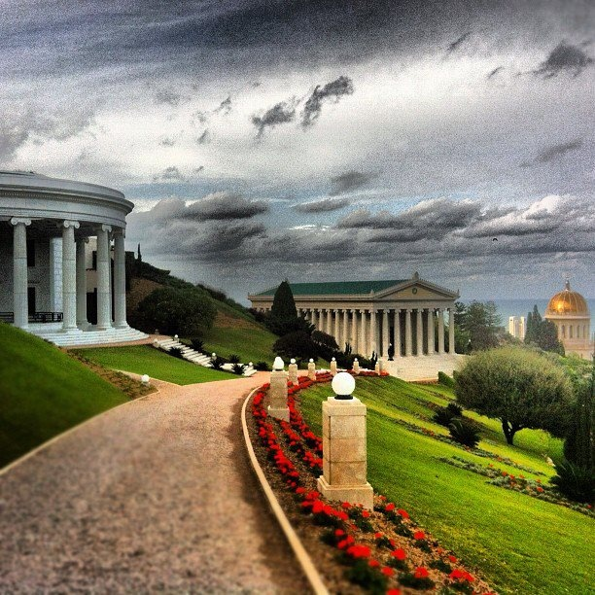
Set all thy hope in God, and cleave tenaciously to His unfailing mercy. Who else but Him can enrich the destitute, and deliver the fallen from his abasement?
Bahá'u'lláh
Gleanings, p. 323

Slide 4


Fire and paradise both bow down and prostrate themselves before God. That which is worthy of His Essence is to worship Him for His sake, without fear of fire, or hope of paradise.
The Báb
Selections from the Báb, p. 78

Slide 5
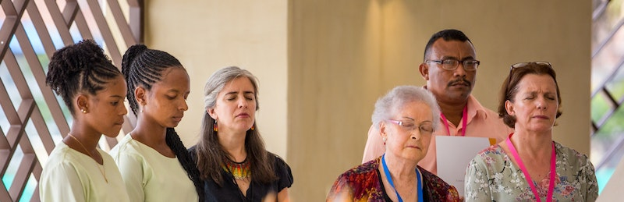
O MOVING FORM OF DUST!
I desire communion with thee, but thou wouldst put no trust in Me. The sword of thy rebellion hath felled the tree of thy hope. At all times I am near unto thee, but thou art ever far from Me. Imperishable glory I have chosen for thee, yet boundless shame thou hast chosen for thyself. While there is yet time, return, and lose not thy chance.
Bahá'u'lláh
Hidden Words, Persian #21

Slide 6

When you see a tree growing and developing, be hopeful of its outcome. It will blossom and bear fruit eventually. If you see dry wood or old trees, there is no hope whatever of fruitage.
'Abdu'l-Bahá
Promulgation of Universal Peace, p. 111

Slide 7
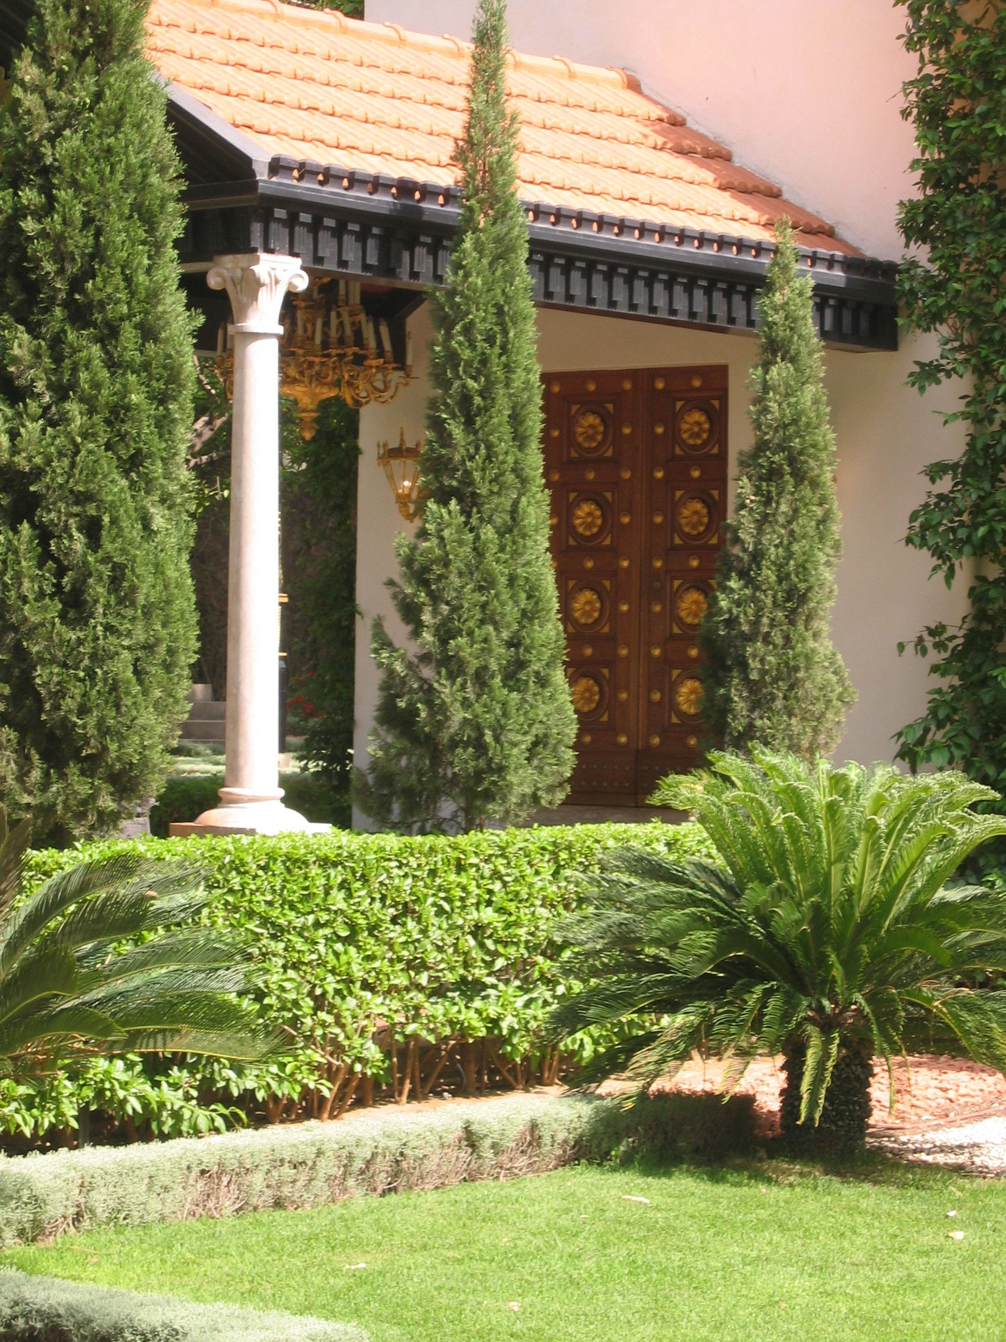
Be thou hopeful and be thou happy and rejoiced. For I have supplicated and beseeched before the Threshold of the Almighty that thy wish may be realized, so thou mayest overcome the self and perform charitable deeds and that human perfections may appear from thee; that thou mayest be endowed with lofty gifts; find thy way to divine wisdom and show forth the manners and conduct of those who are favored in the Threshold of the Almighty.
‘Abdu’l-Bahá,
Tablets of ‘Abdu’l-Bahá, v3, p. 545

Slide 8
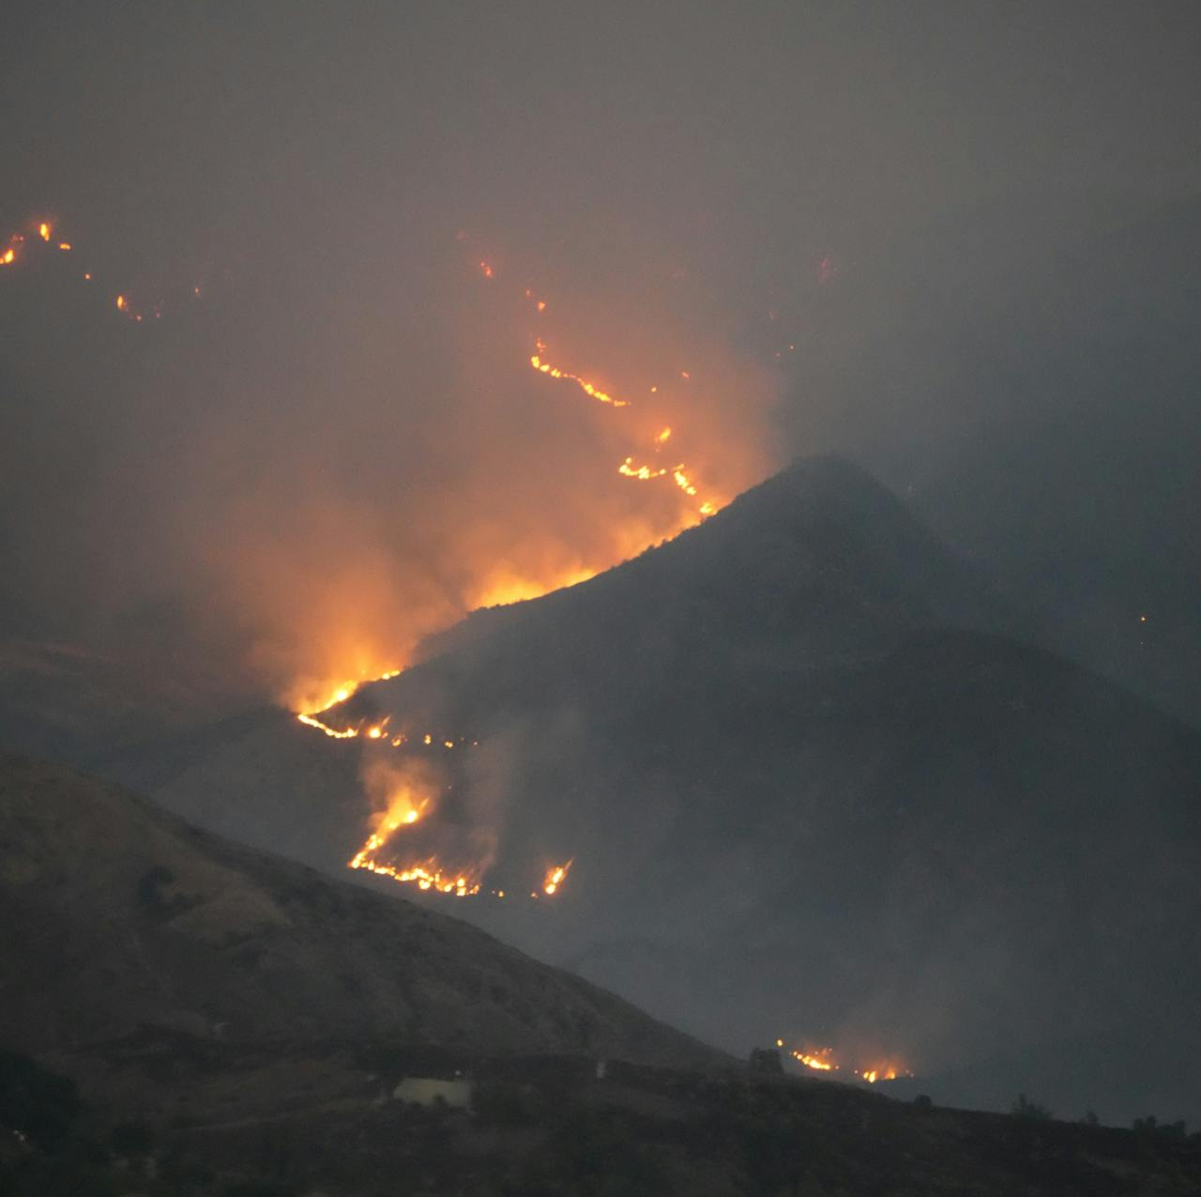
Do not wonder at the mercy and bounty of God. Consider thou how one spark sets on fire a great forest. Therefore, there is great hope, and the favor and grace of the Almighty is limitless.
‘Abdu’l-Bahá,
Tablets of ‘Abdu’l-Bahá, v3, p. 639

Slide 9
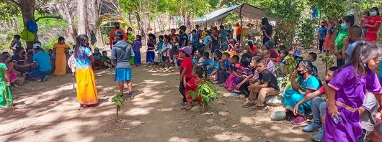
Let us pray to God that the breath of the Holy Spirit may again give hope and refreshment to the people, awakening in them a desire to do the Will of God. May heart and soul be vivified in every man: so will they all rejoice in a new birth.
‘Abdu’l-Bahá
Paris Talks, p. 34

Slide 10

In the darksome night of despair, my eye turneth expectant and full of hope to the morn of Thy boundless favor and at the hour of dawn my drooping soul is refreshed and strengthened in remembrance of Thy beauty and perfection.
‘Abdu’l-Bahá, Bahá’í Prayers, p. 30

Slide 11
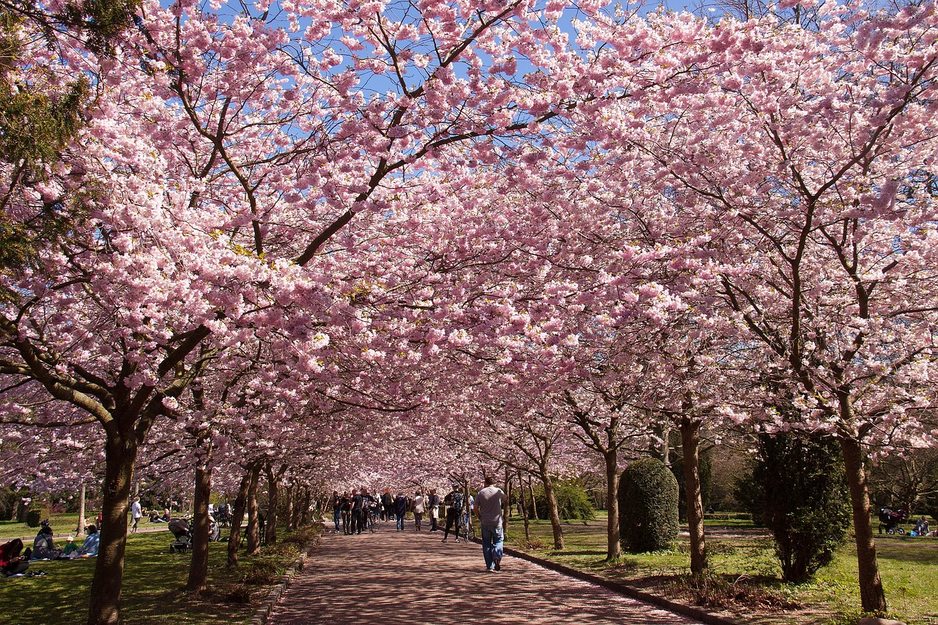
The bright day is coming. The nucleus of the new race is forming. The harbinger of the new ideals of international justice is appearing. The trees of hope will become verdant; the copper of scorn and derision will be transmuted into the gold of honour and praise...
‘Abdu’l-Bahá,
Star of the West, v5, p. 141

Slide 12


In the conduct of life, man is actuated by two main motives: 'The Hope for Reward' and 'The Fear of Punishment'.
‘Abdu’l-Bahá, Paris Talks, p. 157

Slide 13
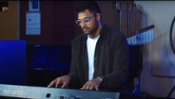
https://www.youtube.com/watch?v=tvHP6-k91Vg

Slide 14

https://www.youtube.com/watch?v=OWSpB4s7vWw

