Slide 1

Enlightened & Awakened
Tucker, GA

Slide 2


Slide 3

The lamp is lighted, but as it hath not a conscious knowledge of itself, no one hath become glad because of it. Moreover, a soul of excellent deeds and good manners will undoubtedly advance from whatever horizon he beholdeth the lights radiating. Herein lies the difference: By faith is meant, first, conscious knowledge, and second, the practice of good deeds.
‘Abdu’l-Bahá,
Bahá’í World Faith, p. 383

Slide 4

Rise up and struggle, seek education, seek enlightenment.
‘Abdu’l-Bahá,
Secret of
Divine Civilization, p. 91

Slide 5

Let your vision be world-embracing, rather than confined to your own self.
Bahá'u'lláh
Tablets of Bahá’u’lláh, p. 87

Slide 6

We must use our utmost endeavors in order that the Holy Spirit may influence minds and hearts toward peace, the bounties of God surround, the divine effulgences become successive, human souls advance, minds expand in wider vision, souls become more holy and the world of humanity be rid of its great menace.
'Abdu'l-Bahá
Promulgation of Universal Peace, p. 322

Slide 7
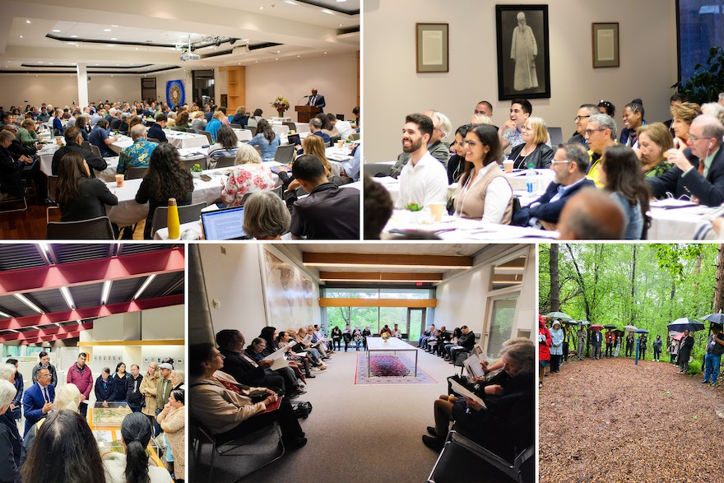
The honour of man is through the attainment of the knowledge of God; his happiness is from the love of God; his joy is in the glad-tidings of God; his greatness is dependent upon his servitude to God. The highest development of man is his entrance into the divine kingdom; and the outcome of this human existence is the nucleus and essence of eternal life.
'Abdu'l-Bahá
Promulgation of Universal Peace, p. 329

Slide 8

For every one of you his paramount duty is to choose for himself that on which no other may infringe and none usurp from him. Such a thing - and to this the Almighty is My witness - is the love of God, could ye but perceive it.
Bahá'u'lláh
Gleanings, p. 261

Slide 9
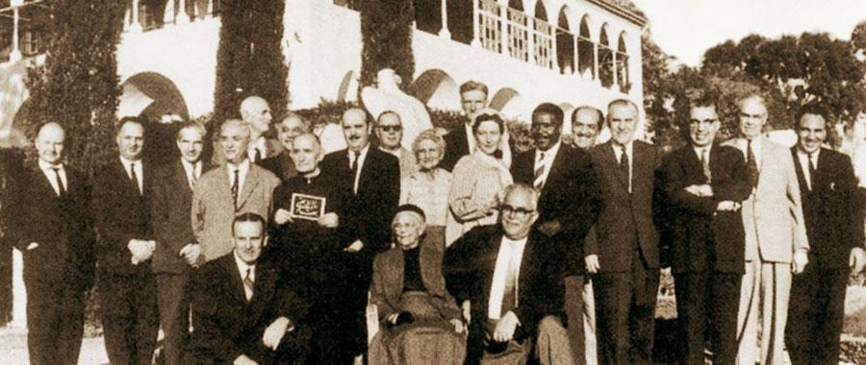
For every thing, however, God has created a sign and symbol, and established standards and tests by which it may be known. The spiritually learned must be characterized by both inward and outward perfections; they must possess a good character, an enlightened nature, a pure intent, as well as intellectual power, brilliance and discernment, intuition, discretion and foresight, temperance, reverence, and a heartfelt fear of God. For an unlit candle, however great in diameter and tall, is no better than a barren palm tree or a pile of dead wood.
‘Abdu'l-Bahá
Secret of Divine Civilization, pp. 33-34

Slide 10
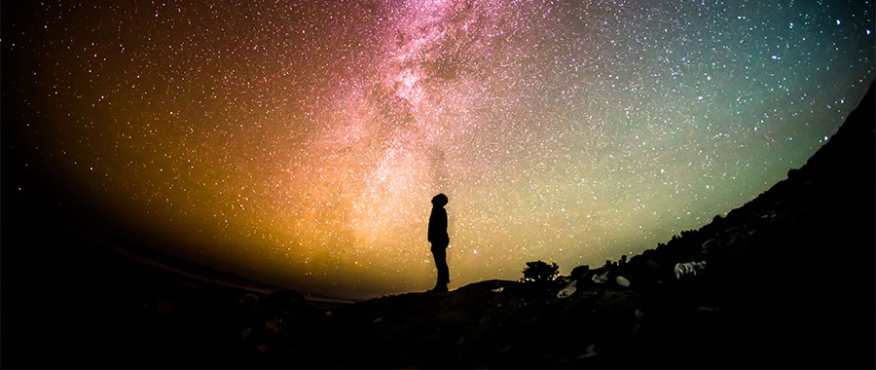
God has conferred upon and added to man a distinctive power--the faculty of intellectual investigation into the secrets of creation, the acquisition of higher knowledge--the greatest virtue of which is scientific enlightenment.
'Abdu'l-Bahá
Promulgation of Universal Peace, p. 31

Slide 11
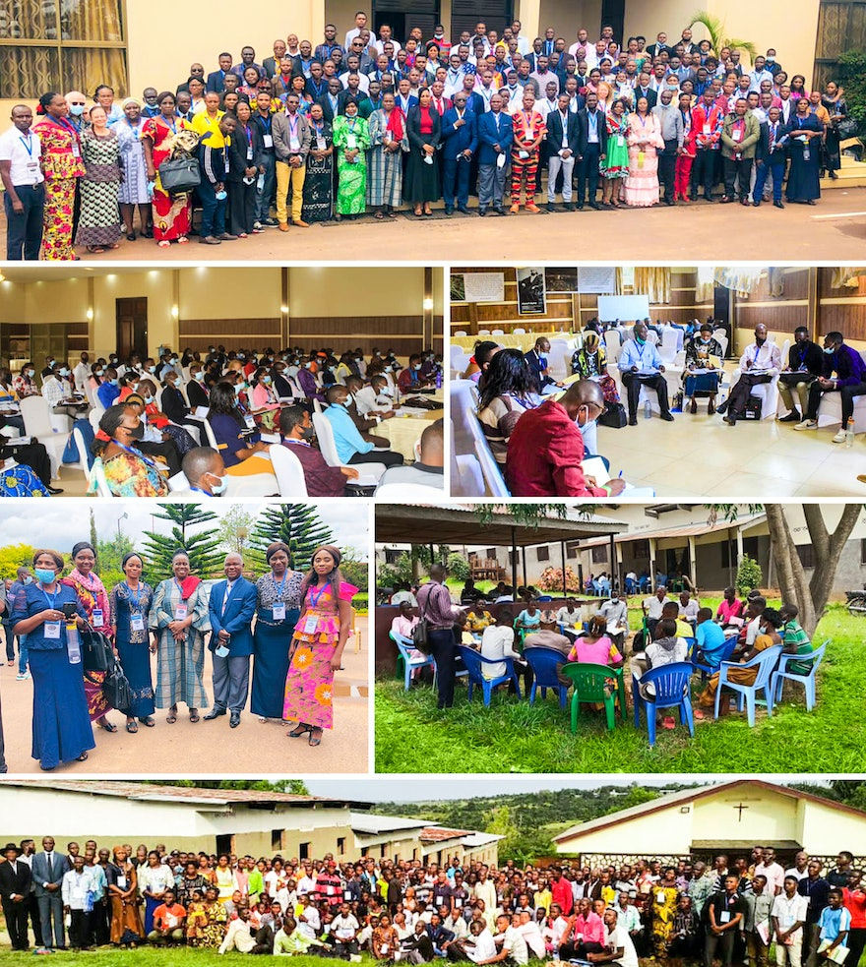
Let us pray to God that the breath of the Holy Spirit may again give hope and refreshment to the people, awakening in them a desire to do the Will of God. May heart and soul be vivified in every man: so will they all rejoice in a new birth.
'Abdu'l-Bahá
Paris Talks, p. 34

Slide 12

You were asleep; you are awakened. Your ears are attentive; your hearts are informed. You have acquired the love of God. You have attained to the knowledge of God. This is the most great bestowal of God. This is the breath of the Holy Spirit, and this consists of faith and assurance. This eternal life is the second birth; this is the baptism of the Holy Spirit.
‘Abdu’l-Bahá
The Promulgation of Universal Peace, 67.3

Slide 13


Slide 14
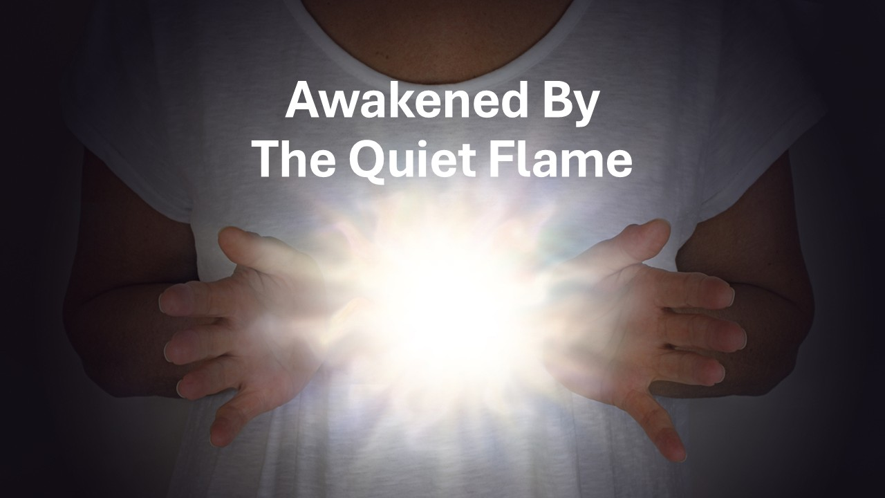
https://www.youtube.com/watch?v=HlOcvJNFQQI

