Slide 1

Accountable
Tucker, GA

Slide 2
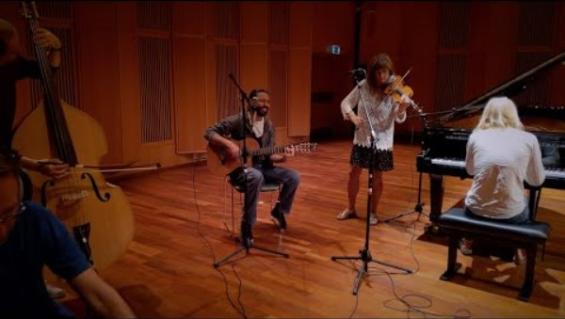
https://www.youtube.com/watch?v=FMBGv6En5jM

Slide 3

O Living Temple! Through Thee have We gathered together all created things, whether in the heavens or on the earth, and called them to account for that which We had covenanted with them before the foundation of the world.
Bahá’u’lláh
Summons of the Lord of Hosts, 1.19

Slide 4

All souls are under the shadow of the universal Manifestation, must submit to the authority of the religion of God, and are not to deviate so much as a hairsbreadth. Rather, they must conform their every act and deed to the religion of God, and should they deviate from it they will be reproved and held accountable before God.
Abdu’l-Bahá
Some Answered Questions, 45.9

Slide 5
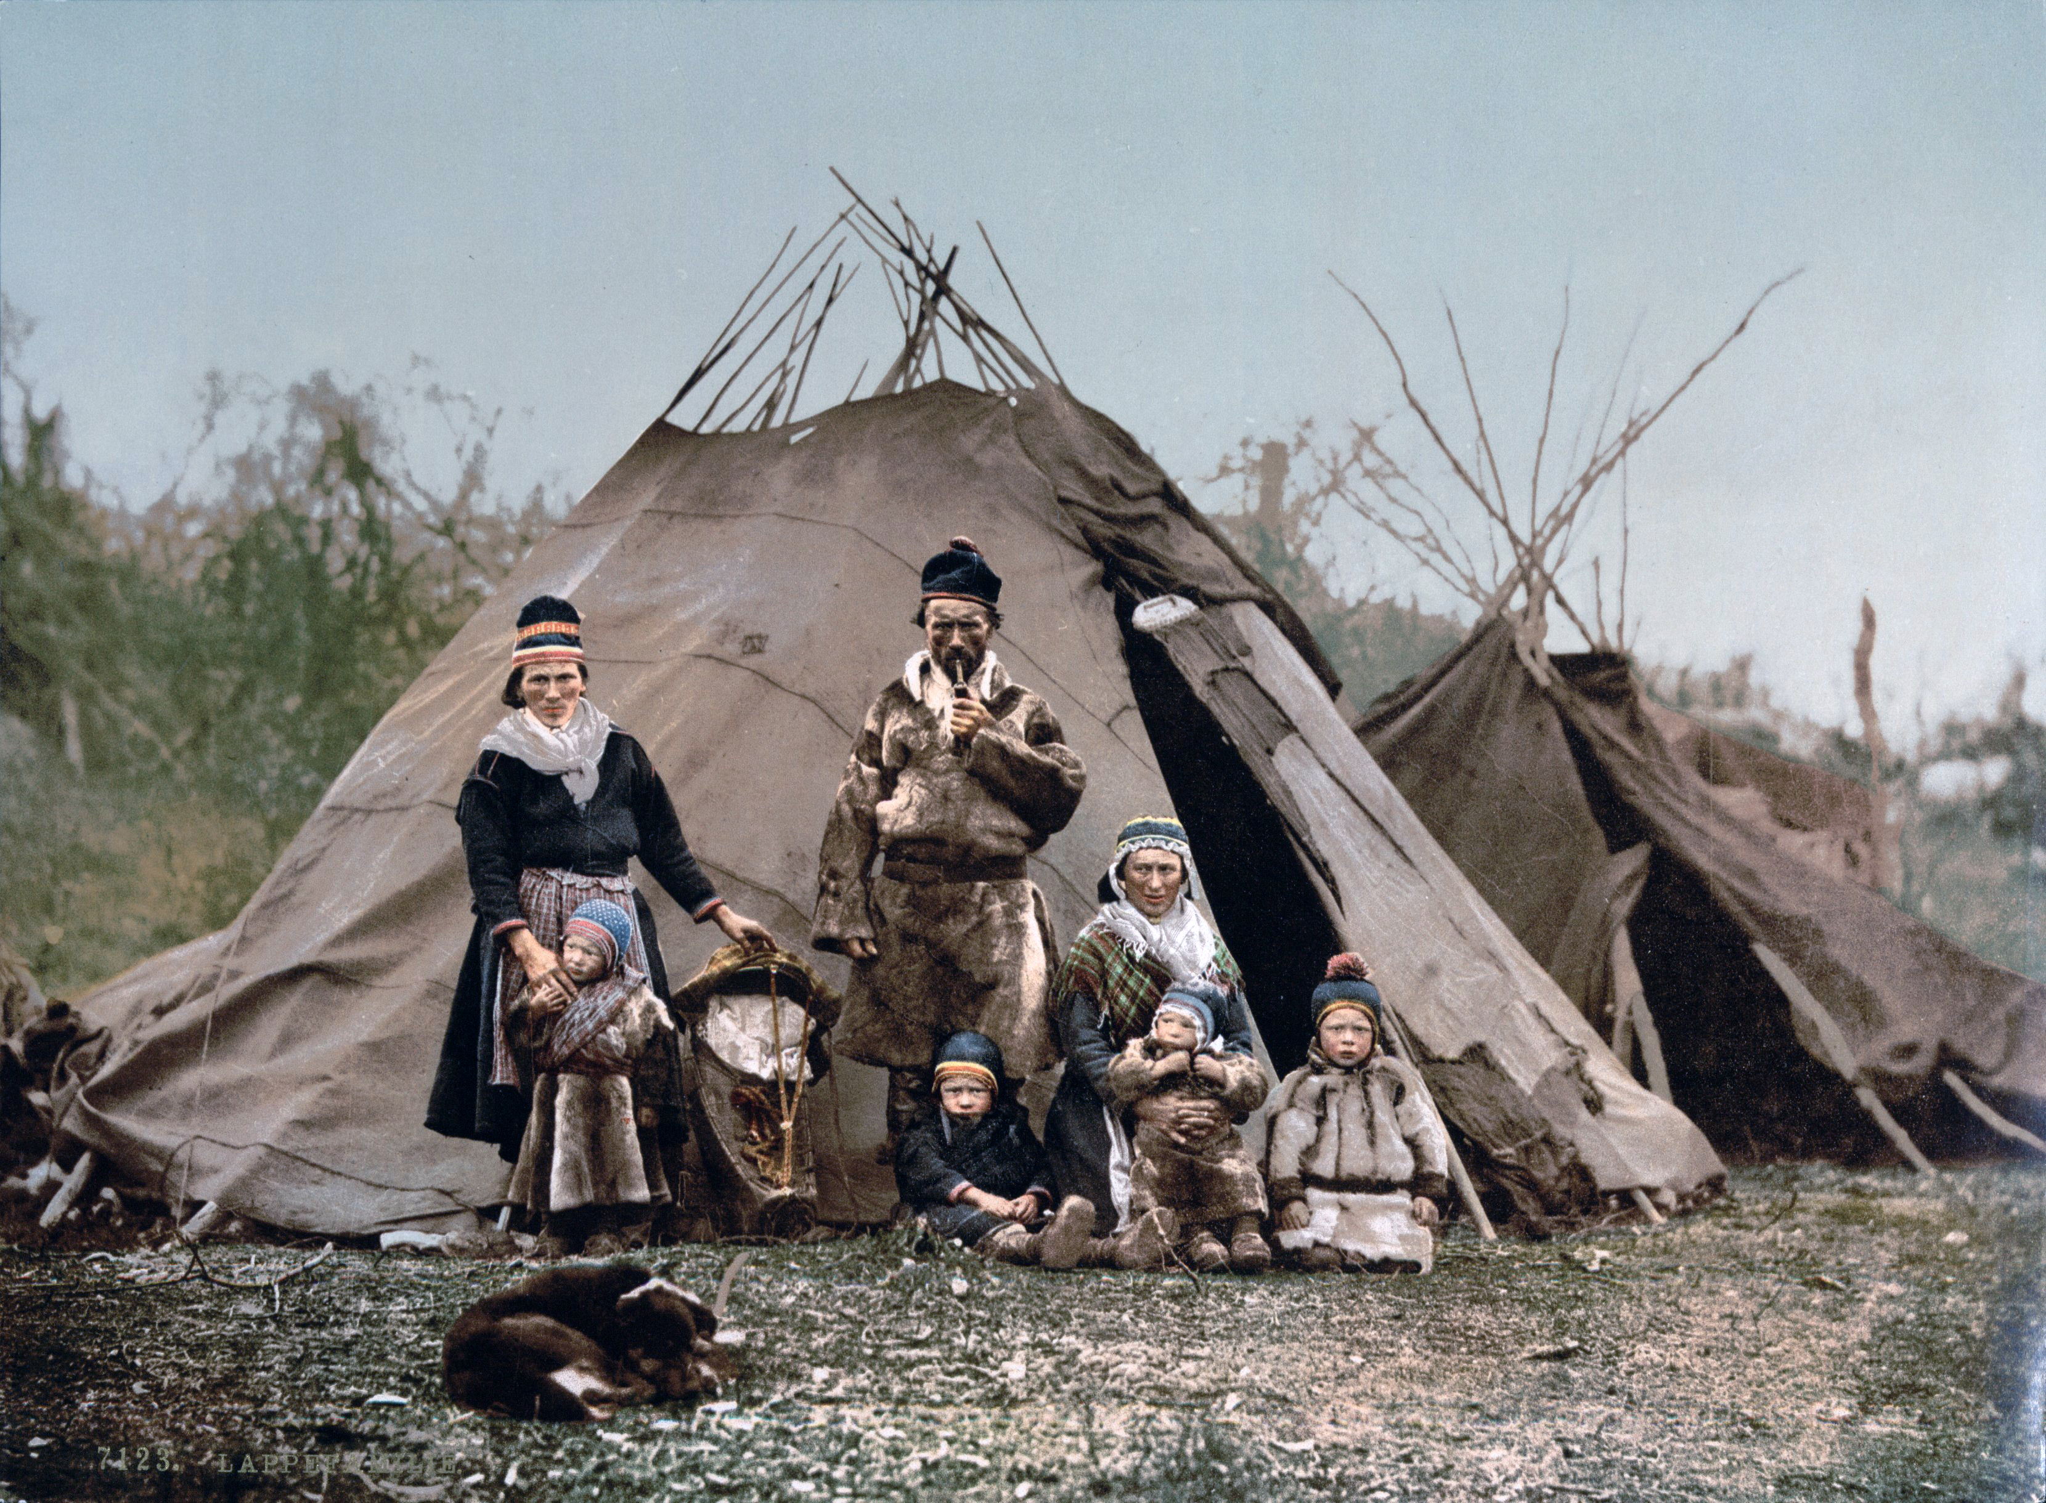
But if the prophetic injunctions have not reached a place and the people fail, as a result, to act in conformity with the divine teachings, then they are not held accountable according to the laws of religion.
‘Abdu’l-Bahá
Some Answered Questions, 76.4

Slide 6

...the divine philosophers hold that the excellence or baseness of things depends upon both reason and religious law. Thus, the prohibitions on murder, theft, treachery, falsehood, hypocrisy, and iniquity are based on reason: Every rational mind can grasp that these are all vile and reprehensible...And were he to commit such a crime, he would be held accountable for it whether the prophetic message had reached him or not, for reason itself grasps the reprehensible character of this deed.
‘Abdu’l-Bahá
Some Answered Questions, 76.3

Slide 7

No faith or religion hath ever held children responsible. The Pen of divine Command hath exempted them, yet the fire of thy tyranny and oppression encompasseth all. If thou bearest allegiance to any faith or religion, then thou shouldst know that, according to all the heavenly Books and all the divinely inspired and weighty Scriptures, children are not to be held accountable.
Bahá’u’lláh
Summons of the Lord of Hosts, 8.3

Slide 8
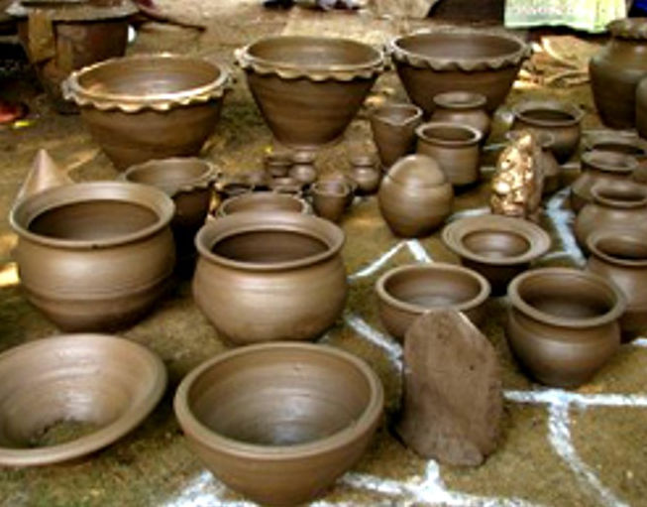
[E]very man hath been, and will continue to be, able of himself to appreciate the Beauty of God, the Glorified. Had he not been endowed with such a capacity, how could he be called to account for his failure?
Bahá’u’lláh,
Gleanings, p. 143

Slide 9
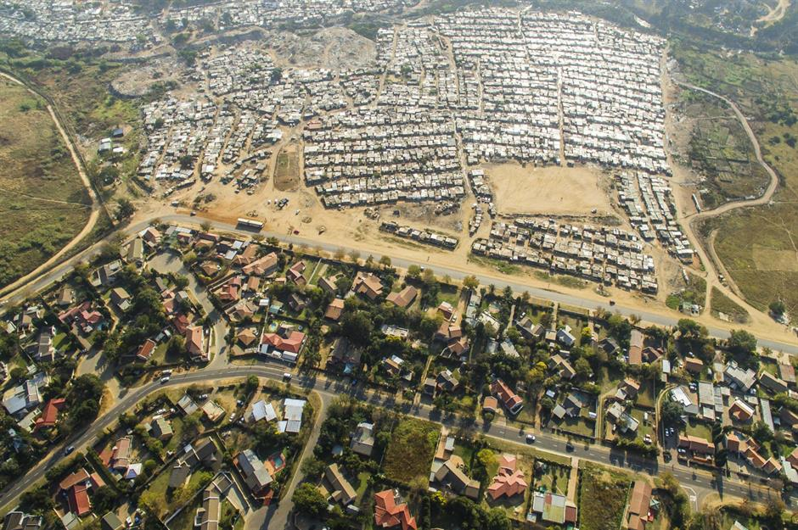
The differences among mankind are of two sorts: one is a difference of station, and this difference is not blameworthy. The other is a difference of faith and assurance; the loss of these is blameworthy, for then the soul is overwhelmed by his desires and passions, which deprive him of these blessings and prevent him from feeling the power of attraction of the love of God. Though that man is praiseworthy and acceptable in his station, yet as he is deprived of the perfections of that degree, he will become a source of imperfections, for which he is held responsible.
'Abdu'l-Bahá
Some Answered Questions, pp. 130-131

Slide 10
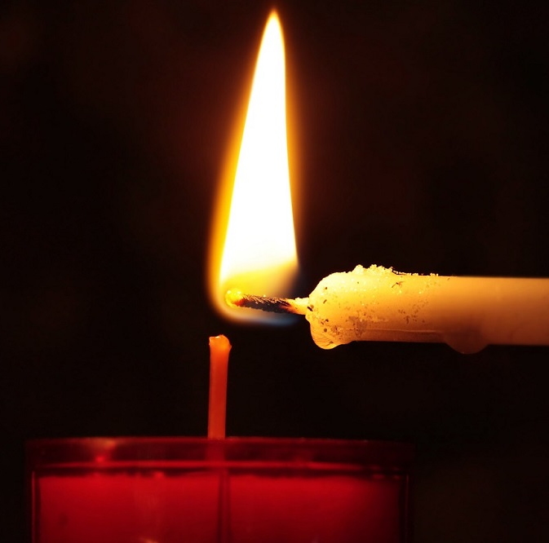
Certain matters are subject to the free will of man, such as acting with justice and fairness, or injustice and iniquity — in other words, the choice of good or evil actions... He can light the candle of his heart with the flame of the love of God and become a well-wisher of the world, or he can become an enemy of all mankind or set his affections on worldly things; he can choose to be just or iniquitous. All these deeds and actions are under his own control, and he is therefore accountable for them.
‘Abdu’l-Bahá
Some Answered Questions, 70.3-4

Slide 11

Ye shall, of a truth, be asked of your doings, shall be called to account for your failure in duty with regard to the Cause of God, and for having disdainfully rejected His loved ones who, with manifest sincerity, have come unto you.
Bahá’u’lláh, Gleanings, p. 124

Slide 12
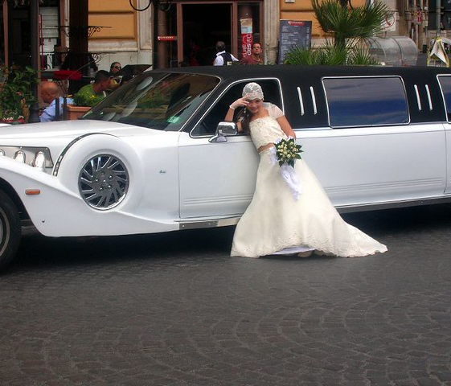
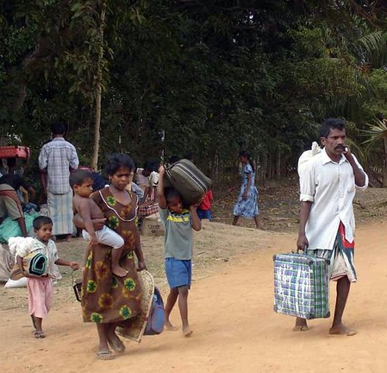
Ye, and all ye possess, shall pass away. Ye shall, most certainly, return to God, and shall be called to account for your doings in the presence of Him Who shall gather together the entire creation...
Bahá'u'lláh
Gleanings, p. 247

Slide 13

Let each morn be better than its eve and each morrow richer than its yesterday.
Bahá'u'lláh
Gleanings, p. 138

Slide 14
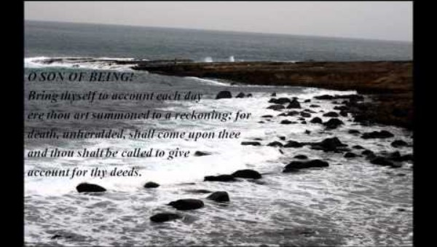
https://www.youtube.com/watch?v=c2P3P605Ddo

Slide 15

https://www.youtube.com/watch?v=c5COTfnunqo

