Slide 1

Moral Character
Tucker, GA

Slide 2
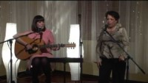
https://www.youtube.com/watch?v=sPxMJgYYYgo

Slide 3
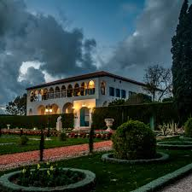
The purpose of the one true God in manifesting Himself is to summon all mankind to truthfulness and sincerity, to piety and trustworthiness, to resignation and submissiveness to the Will of God, to forbearance and kindliness, to uprightness and wisdom. His object is to array every man with the mantle of a saintly character, and to adorn him with the ornament of holy and goodly deeds.
Bahá'u'lláh
Gleanings, p. 299

Slide 4
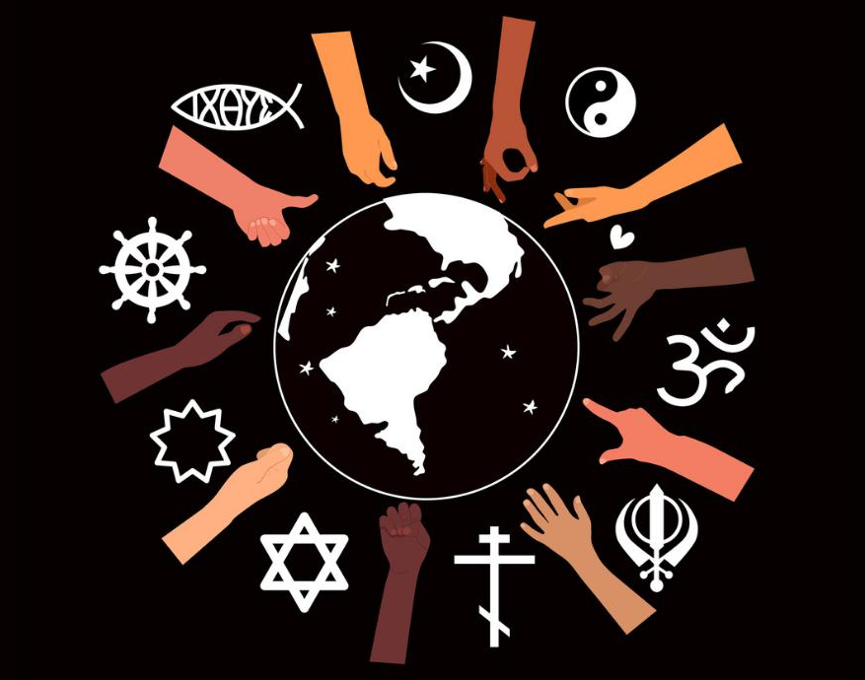
Each one of the divine religions has established two kinds of ordinances: the essential and the accidental. The essential ordinances rest upon the firm, unchanging, eternal foundations of the Word itself. They concern spiritualities, seek to stabilize morals, awaken intuitive susceptibilities, reveal the knowledge of God and inculcate the love of all mankind. The accidental laws concern the administration of outer human actions and relations, establishing rules and regulations requisite for the world of bodies and their control. These are ever subject to change and supersedure according to exigencies of time, place and condition.
‘Abdu'l-Bahá,
Promulgation of Universal Peace, pp. 338-339

Slide 5

The third Taraz concerneth good character. A good character is, verily, the best mantle for men from God. With it He adorneth the temples of His loved ones. By My life! The light of a good character surpasseth the light of the sun and the radiance thereof. Whoso attaineth unto it is accounted as a jewel among men. The glory and the upliftment of the world must needs depend upon it. A goodly character is a means whereby men are guided to the Straight Path and are led to the Great Announcement. Well is it with him who is adorned with the saintly attributes and character of the Concourse on High.
Bahá'u'lláh
Tablets of Bahá’u’lláh, p. 36

Slide 6
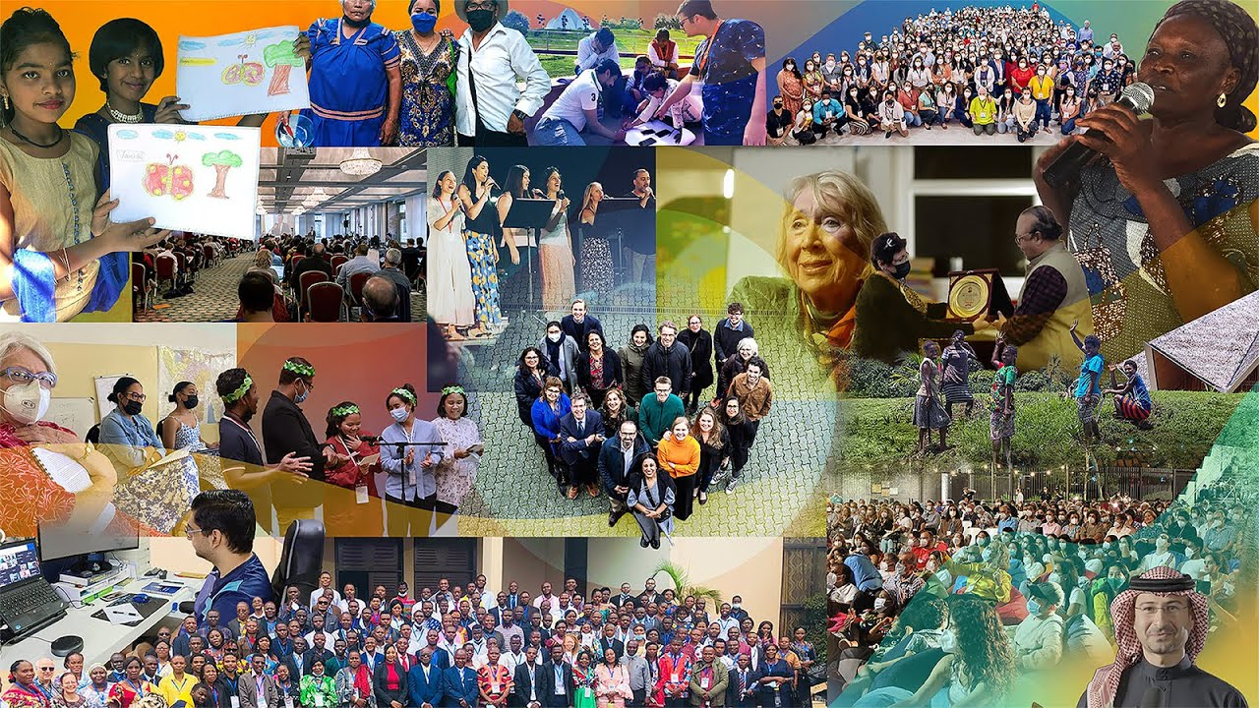
Good character is, verily, the best mantle for men on the part of God; by this God adorns the temples of His friends. By My life, the light of good character surpasses the light of the sun and its effulgence. He who attains thereto is accounted as the essence of men. Upon this the honour and glory of the world are based and are dependent. Good character is the means of guiding men to the right path and the great message.
Bahá'u'lláh
Tablets of Bahá’u’lláh, p. 7

Slide 7
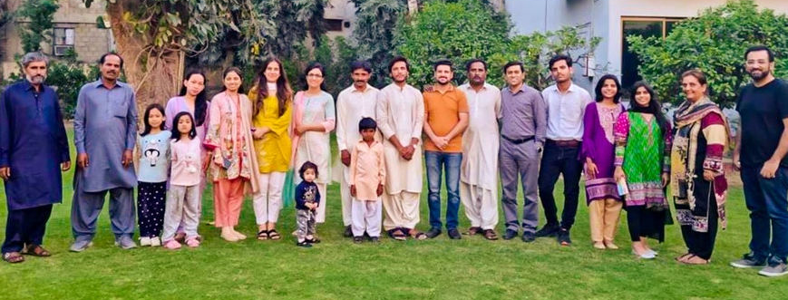
Of the spiritual prerequisites of success, which constitute the bedrock on which the security of all plans, projects, and schemes must ultimately rest, the following stand out as preeminent and vital. ..a high sense of moral rectitude in their social and administrative activities, absolute chastity in their individual lives, and complete freedom from prejudice in their dealings with peoples of a different race, class, creed, or colour.
Shoghi Effendi, Advent of Divine Justice, p. 19

Slide 8
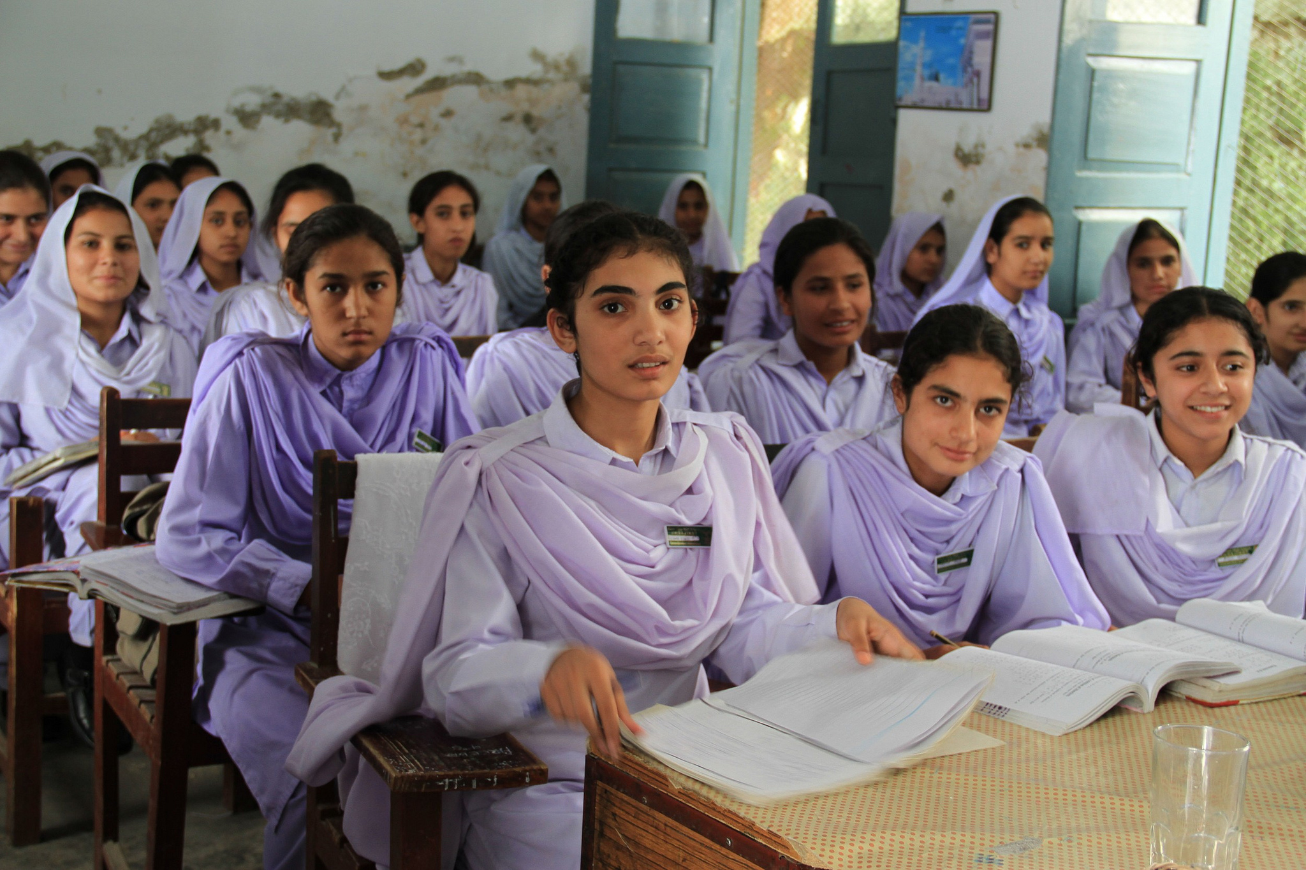
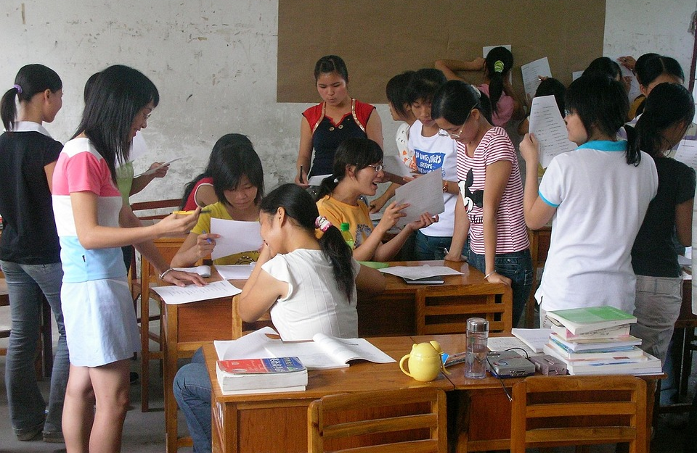
Work ye for the guidance of the women in that land, teach the young girls and the children, so that the mothers may educate their little ones from their earliest days, thoroughly train them, rear them to have a goodly character and good morals, guide them to all the virtues of humankind, prevent the development of any behaviour that would be worthy of blame, and foster them in the embrace of Bahá'í education...
'Abdu'l-Bahá,
Selections from the Writings
of ‘Abdu’l-Bahá, pp. 124-125

Slide 9
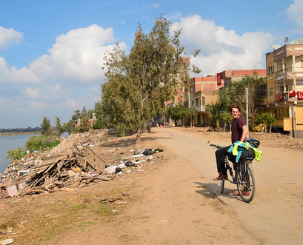
Should any one of you enter a city, he should become a centre of attraction by reason of his sincerity, his faithfulness and love, his honesty and fidelity, his truthfulness and loving-kindness towards all the peoples of the world, so that the people of that city may cry out and say: `This man is unquestionably a Bahá'í, for his manners, his behaviour, his conduct, his morals, his nature, and disposition reflect the attributes of the Bahá'ís.' Not until ye attain this station can ye be said to have been faithful to the Covenant and Testament of God.
‘Abdu'l-Bahá,
Selections from the
Writings of ‘Abdu’l-Bahá, p. 71

Slide 10
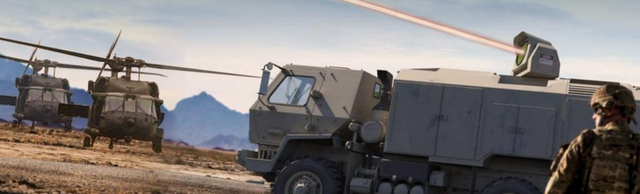
Instruments and means of human destruction have enormously multiplied in this era of material civilization. But if material civilization shall become organized in conjunction with divine civilization, if the man of moral integrity and intellectual acumen shall unite for human betterment and uplift with the man of spiritual capacity, the happiness and progress of the human race will be assured.
'Abdu'l-Bahá,
Promulgation of Universal Peace, p. 102

Slide 11
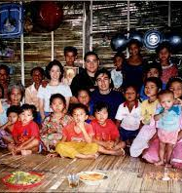
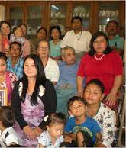
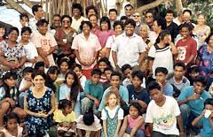

The companions of God are, in this day, the lump that must leaven the peoples of the world. They must show forth such trustworthiness, such truthfulness and perseverance, such deeds and character, that all mankind may profit by their example.
Bahá'u'lláh,
Advent of Divine Justice, p. 19

Slide 12
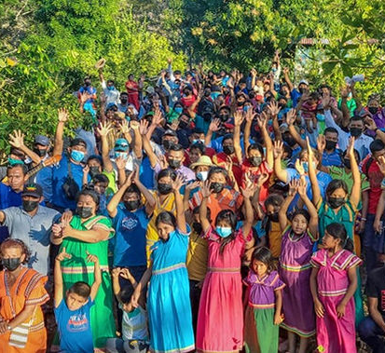
A Bahá'í is known by the attributes manifested by him, not by his name: he is recognized by his character, not by his person.
'Abdu'l-Bahá
Compilation of Compilations, Vol I
(Chaste and Holy Life), p. 60

Slide 13

For every thing...God has created a sign and symbol, and established standards and tests by which it may be known. The spiritually learned must be characterized by both inward and outward perfections; they must possess a good character, an enlightened nature, a pure intent, as well as intellectual power, brilliance and discernment, intuition, discretion and foresight, temperance, reverence, and a heartfelt fear of God. For an unlit candle, however great in diameter and tall, is no better than a barren palm tree or a pile of dead wood.
‘Abdu’l-Bahá,
Secret of Divine Civilization, p. 33-34

Slide 14
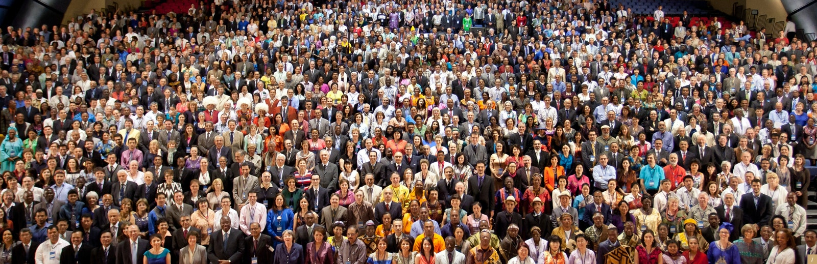
Then it is evident that excellence does not depend upon color. Character is the true criterion of humanity. Anyone who possesses a good character, who has faith in God and is firm, whose actions are good, whose speech is good--that one is accepted at the threshold of God no matter what color he may be.
‘Abdu’l-Bahá,
Promulgation of Universal Peace, pp. 427-428

Slide 15
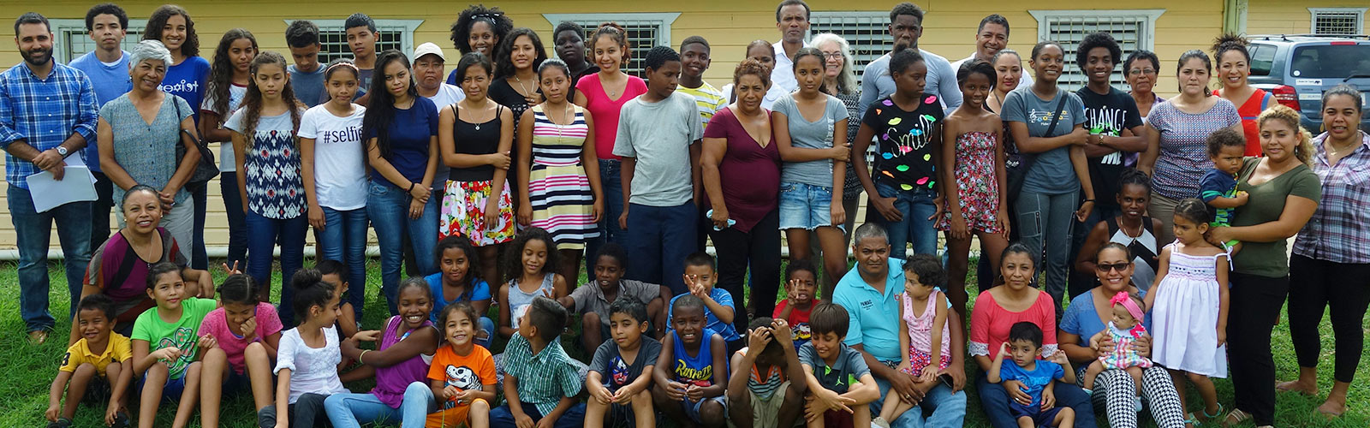
The sword of a virtuous character and upright conduct is sharper than blades of steel.
Bahá'u'lláh
Epistle to the Son of the Wolf, p. 29

Slide 16

The friends of God must so live and conduct themselves, and evince such excellence of character and conduct, as to make others astonished.
‘Abdu’l-Bahá,
Compilation of Compilations,
Vol I, p. 391

Slide 17
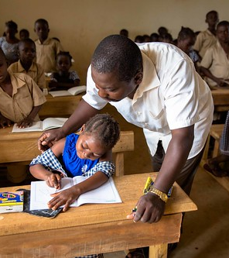
[T]he root of the exaltation of man is the good attributes and virtues which are the adornments of his reality. These are the divine appearances, the heavenly bounties, the sublime emotions, the love and knowledge of God; universal wisdom, intellectual perception, scientific discoveries, justice, equity, truthfulness, benevolence, natural courage and innate fortitude; the respect for rights and the keeping of agreements and covenants; rectitude in all circumstances; serving the truth under all conditions; the sacrifice of one's life for the good of all people; kindness and esteem for all nations; obedience to the teachings of God; service in the Divine Kingdom; the guidance of the people, and the education of the nations and races. This is the prosperity of the human world! This is the exaltation of man in the world! This is eternal life and heavenly honor!
'Abdu'l-Bahá
Some Answered Questions, pp. 79-80

Slide 18

Strive thou with heart and soul; see to it that the children are raised up to embody the highest perfections of humankind, to such a degree that every one of them will be trained in the use of the mind, in acquiring knowledge, in humility and lowliness, in dignity, in ardour and love.
'Abdu'l-Bahá
Compilation of Compilations, Vol I (Education), p. 272

Slide 19

https://www.youtube.com/watch?v=yGrFg5MqpCo

Slide 20

https://www.youtube.com/watch?v=f68snKOdOW8

