Slide 1

Developing Human Potential
Tucker, GA

Slide 2

https://www.youtube.com/watch?v=JVJcFxGZbqQ

Slide 3


Man has two powers; and his development, two aspects. One power is connected with the material world, and by it he is capable of material advancement. The other power is spiritual, and through its development his inner, potential nature is awakened. These powers are like two wings. Both must be developed, for flight is impossible with one wing.
‘Abdu’l-Bahá,
Promulgation of Universal Peace, p. 60

Slide 4
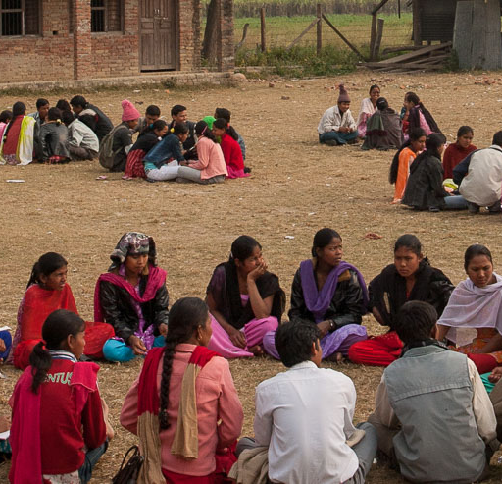
What a heavenly potentiality God has deposited within us! What a power God has given our spirits! He has endowed us with a power to penetrate the realities of things; but we must be self-abnegating, we must have pure spirits, pure intentions, and strive with heart and soul while in the human world to attain everlasting glory.
‘Abdu’l-Bahá
The Promulgation of Universal Peace, 66.6

Slide 5

God has created all earthly things under a law of progression in material degrees, but He has created man and endowed him with powers of advancement toward spiritual and transcendental kingdoms.
‘Abdu’l-Bahá
The Promulgation of Universal Peace, 99.1

Slide 6

It is from the bounty of God that man is selected for the highest degree; and the differences which exist between men in regard to spiritual progress and heavenly perfections are also due to the choice of the Compassionate One. For faith, which is life eternal, is the sign of bounty, and not the result of justice. The flame of the fire of love, in this world of earth and water, comes through the power of attraction and not by effort and striving. Nevertheless, by effort and perseverance, knowledge, science and other perfections can be acquired; but only the light of the Divine Beauty can transport and move the spirits through the force of attraction.
'Abdu'l-Bahá, Some Answered Questions, p. 130

Slide 7

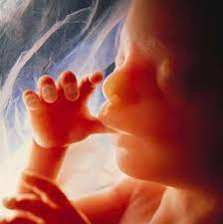
The spirit of man appears and is manifest in the embryonic condition, and also in that of childhood and of maturity, and it is resplendent and evident in the condition of perfection. The spirit is one, but in the embryonic condition the power of sight and of hearing is lacking. In the state of maturity and perfection it appears in the utmost splendor and brilliance.
'Abdu'l-Bahá
Some Answered Questions, p. 150

Slide 8

True distinction among mankind is through divine bestowals and receiving the intuitions of the Holy Spirit. If man does not become the recipient of the heavenly bestowals and spiritual bounties, he remains in the plane and kingdom of the animal. For the distinction between the animal and man is that man is endowed with the potentiality of divinity in his nature, whereas the animal is entirely bereft of that gift and attainment. Therefore, if a man is bereft of the intuitive breathings of the Holy Spirit, deprived of divine bestowals, out of touch with the heavenly world and negligent of the eternal truths, though in image and likeness he is human, in reality he is an animal...
'Abdu'l-Bahá
Promulgation of Universal Peace, pp. 316-317

Slide 9

The first aspect of the revealed religion of God is that which concerns the ethical development and spiritual progress of mankind, the awakening of potential human susceptibilities and the descent of divine bestowals.
‘Abdu’l-Bahá
The Promulgation of Universal Peace, 41.3

Slide 10
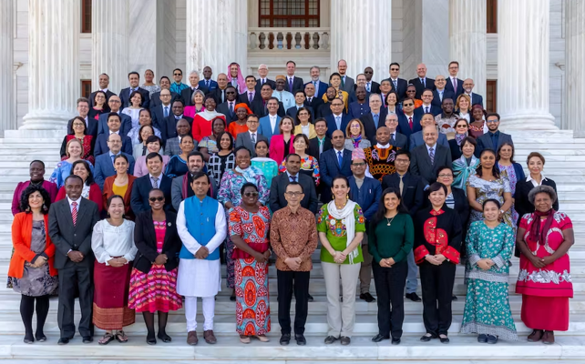
For every thing, however, God has created a sign and symbol, and established standards and tests by which it may be known. The spiritually learned must be characterized by both inward and outward perfections; they must possess a good character, an enlightened nature, a pure intent, as well as intellectual power, brilliance and discernment, intuition, discretion and foresight, temperance, reverence, and a heartfelt fear of God. For an unlit candle, however great in diameter and tall, is no better than a barren palm tree or a pile of dead wood.
'Abdu'l-Bahá, Secret of Divine Civilization, p. 33-34

Slide 11
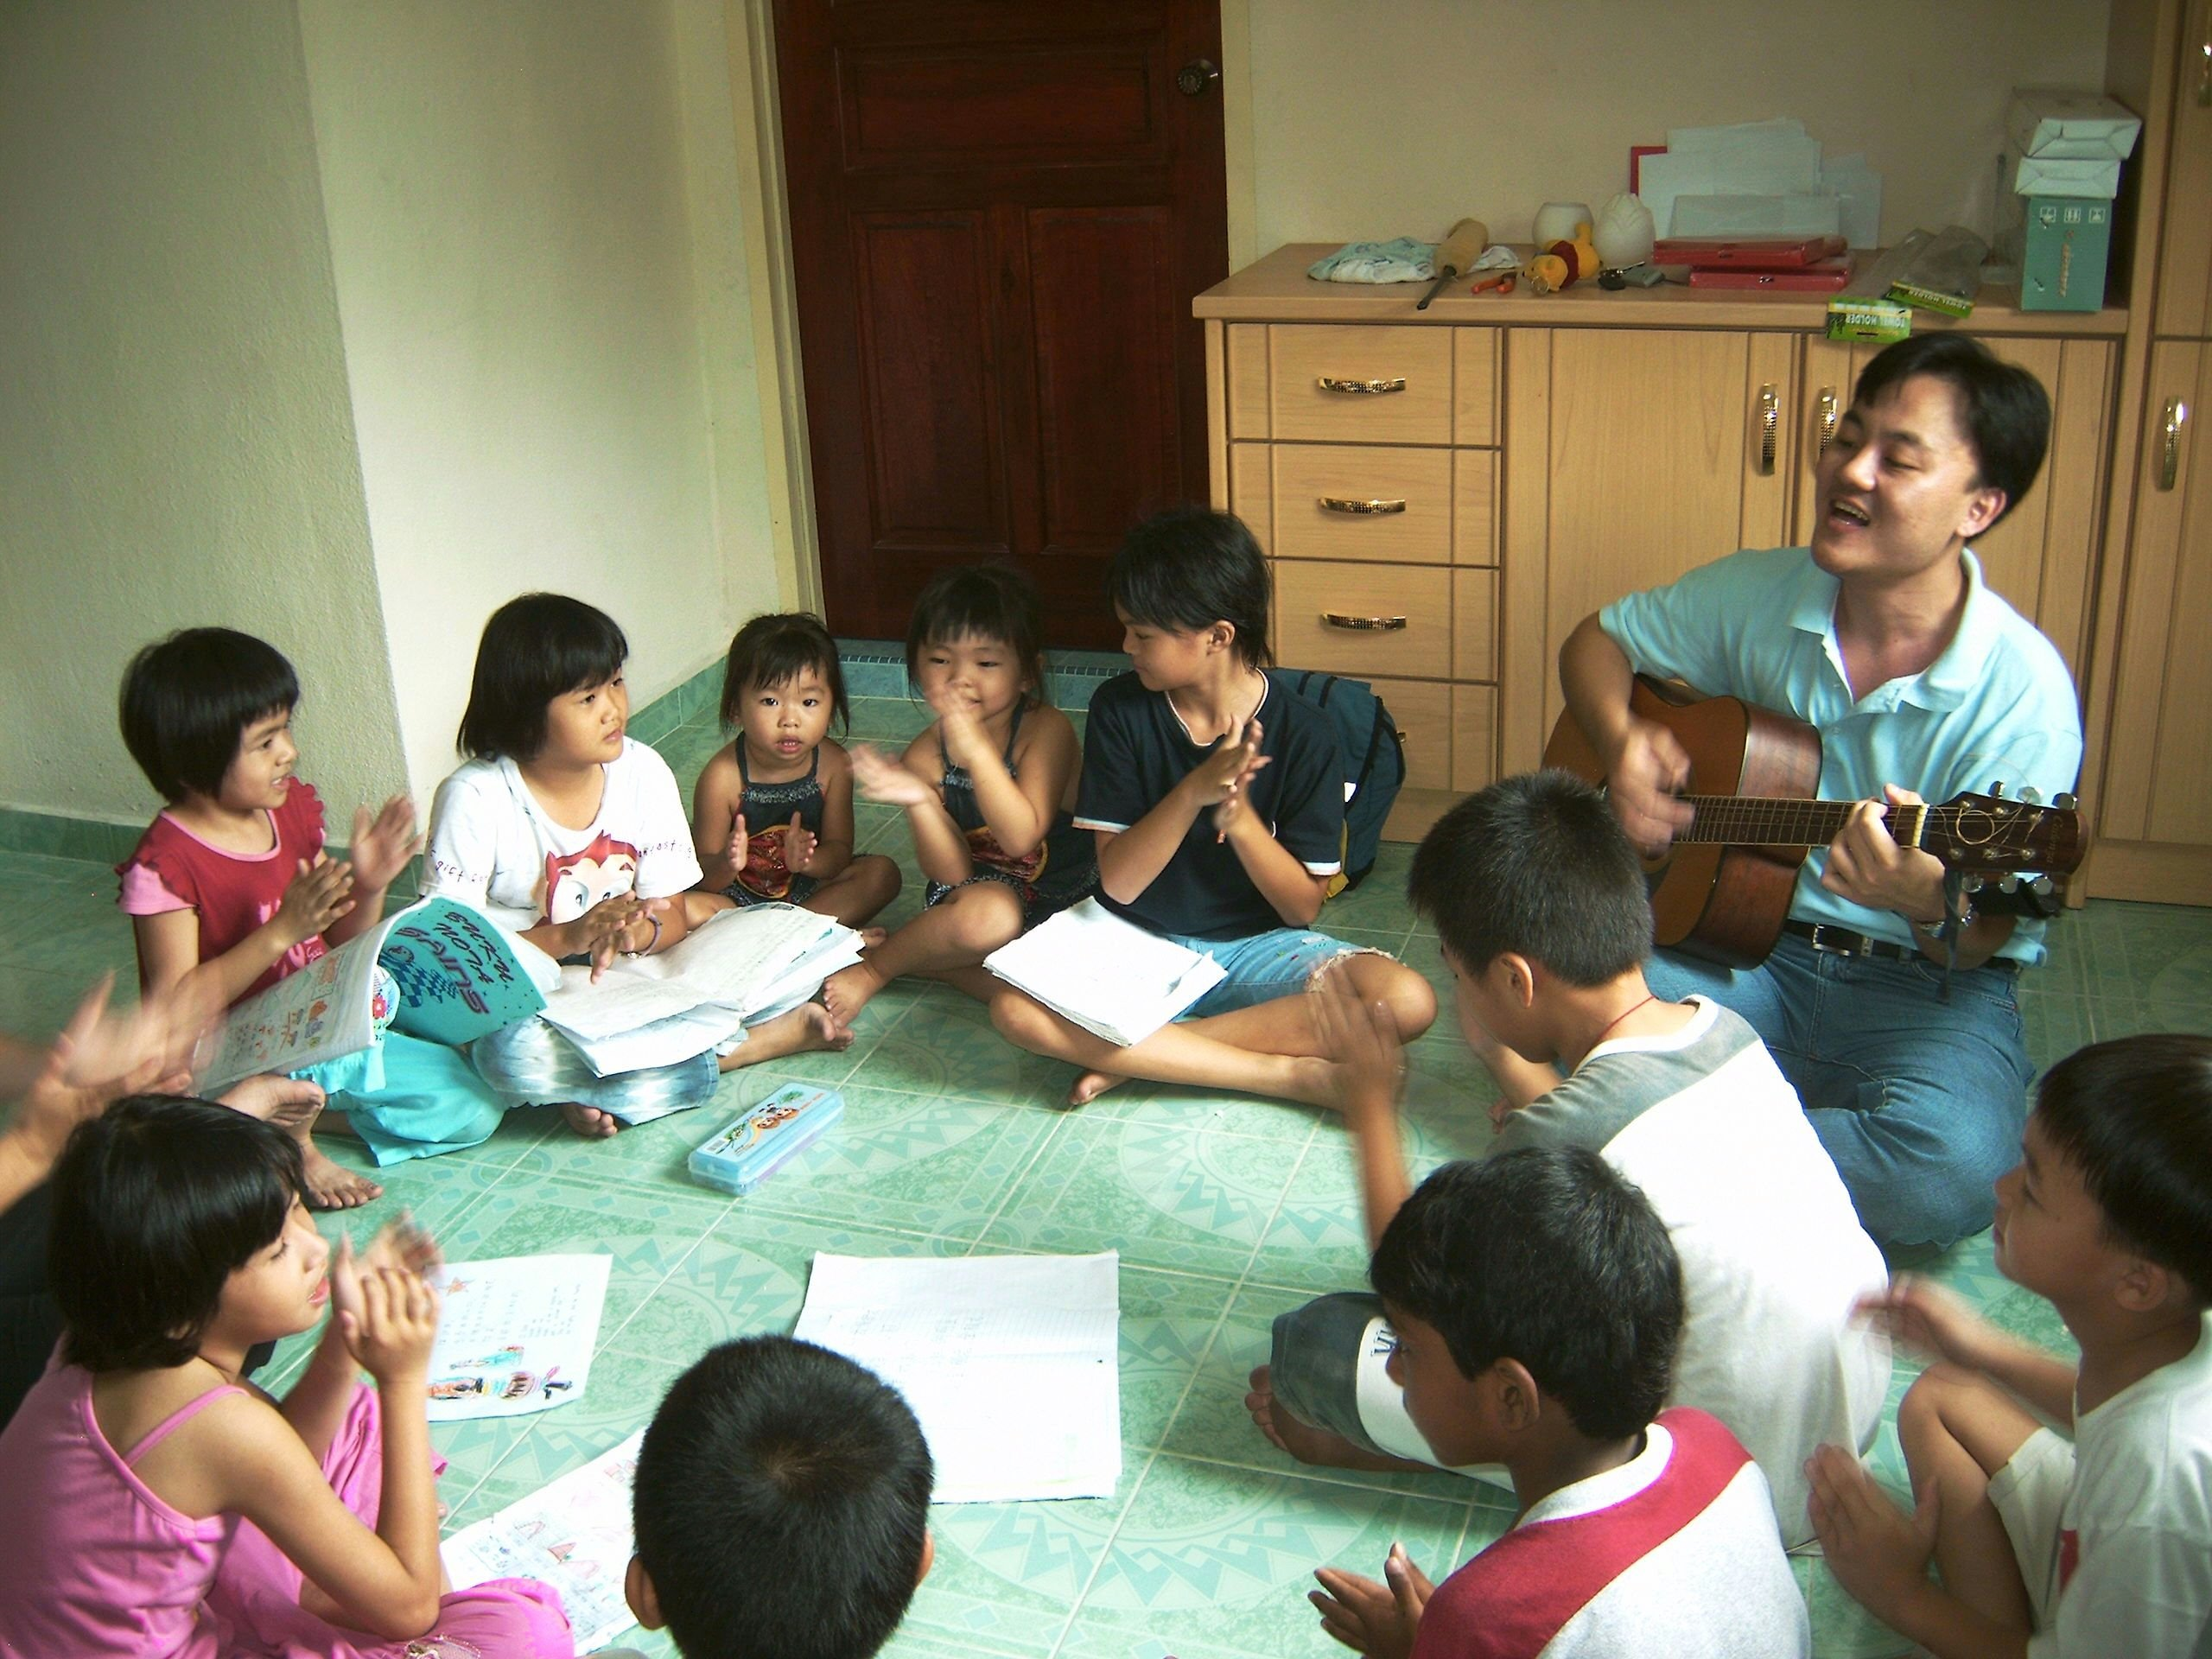
Strain every nerve to acquire both inner and outer perfections, for the fruit of the human tree hath ever been and will ever be perfections both within and without. It is not desirable that a man be left without knowledge or skills, for he is then but a barren tree. Then, so much as capacity and capability allow, ye needs must deck the tree of being with fruits such as knowledge, wisdom, spiritual perception and eloquent speech.
Bahá'u'lláh
Compilation of Compilations, Vol I
(Excellence in All Things), p. 368

Slide 12

...it is evident that movement is essential to all existence. All material things progress to a certain point, then begin to decline. This is the law which governs the whole physical creation....
My hope for you is that you will progress in the world of spirit, as well as in the world of matter; that your intelligence will develop, your knowledge will augment, and your understanding be widened.
You must ever press forward, never standing still; avoid stagnation, the first step to a backward movement, to decay.
'Abdu'l-Bahá, Paris Talks, pp. 89-90

Slide 13

Make every effort to acquire the advanced knowledge of the day, and strain every nerve to carry forward the divine civilization.
'Abdu'l-Bahá
Compilation of Compilations, Vol I (The Arts), p. 6

Slide 14

The fear of God hath ever been a sure defence and a safe stronghold for all the peoples of the world. It is the chief cause of the protection of mankind, and supreme instrument for its preservation. Indeed, there existeth in man a faculty which deterreth him from, and guardeth him against, whatever is unworthy and unseemly, and which is known as his sense of shame.
Bahá'u'lláh
Epistle to the Son of the Wolf, p. 27

Slide 15

Strive to be shining examples unto all mankind, and true reminders of the virtues of God amidst men.
Bahá'u'lláh
Tablets of Bahá’u’lláh,
p. 138

Slide 16

https://www.youtube.com/watch?v=L5NYWQv0zuA

Slide 17
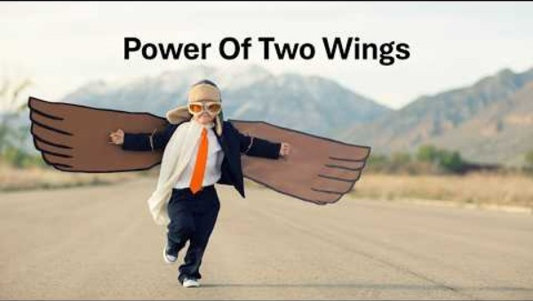
https://www.youtube.com/watch?v=8Vrg_Kfyaao

