Slide 1
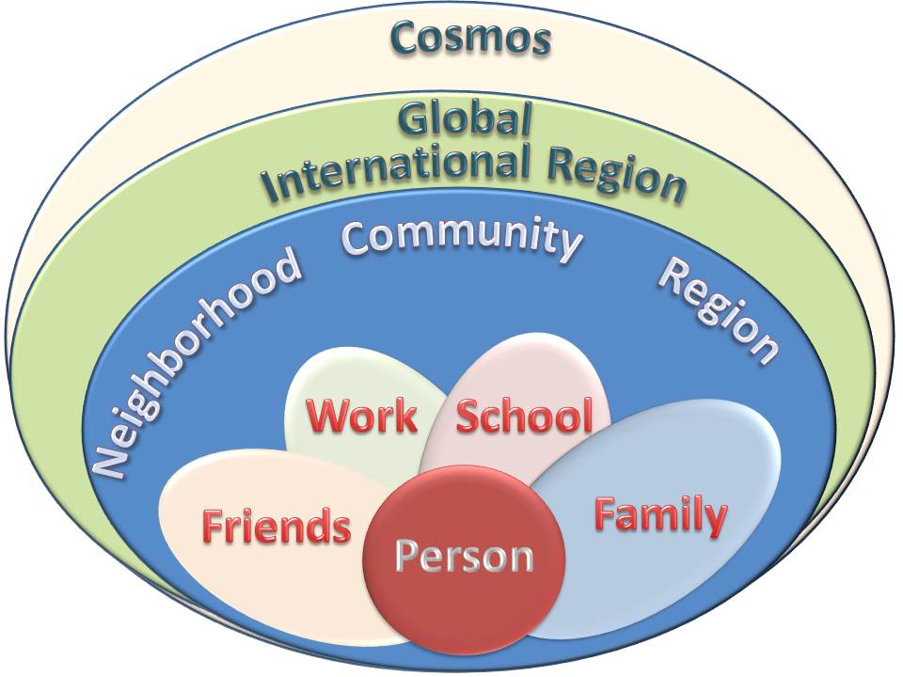
Ecology Of Human Development
Tucker, GA

Slide 2

https://www.youtube.com/watch?v=n2lpGOGADRs

Slide 3
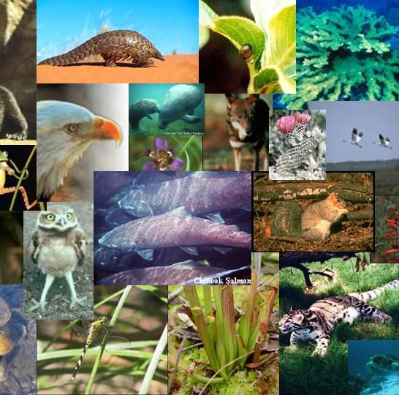
It is obvious that all created things are connected one to another by a linkage complete and perfect, even, for example, as are the members of the human body. Note how all the members and component parts of the human body are connected one to another. In the same way, all the members of this endless universe are linked one to another.
‘Abdu’l-Bahá
Selections from the
Writings of ‘Abdu’l-Bahá, 21.6

Slide 4
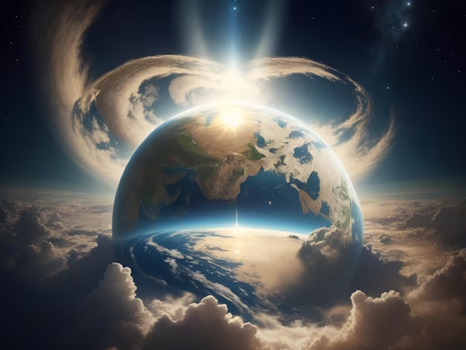
...whatever is in the heavens and whatever is on the earth is a direct evidence of the revelation within it of the attributes and names of God, inasmuch as within every atom are enshrined the signs that bear eloquent testimony to the revelation of that most great Light.
Bahá’u’lláh
The Kitáb-i-Íqán, 107

Slide 5

By nature is meant those inherent properties and necessary relations derived from the realities of things. And these realities of things, though in the utmost diversity, are yet intimately connected one with the other. For these diverse realities an all-unifying agency is needed that shall link them all one to the other.
‘Abdu’l-Bahá
Bahá’í World Faith
(‘Abdu’l-Bahá section), 37.13

Slide 6
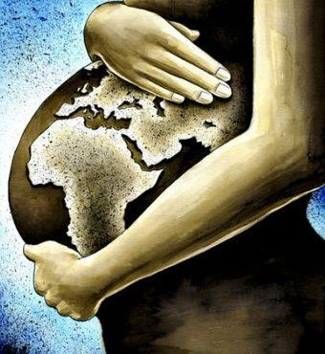
The whole earth is now in a state of pregnancy. The day is approaching when it will have yielded its noblest fruits, when from it will have sprung forth the loftiest trees, the most enchanting blossoms, the most heavenly blessings. Immeasurably exalted is the breeze that wafteth from the garment of thy Lord, the Glorified! For lo, it hath breathed its fragrance and made all things new!
Bahá’u’lláh
Quoted in Shoghi Effendi
The Promised Day is Come, 112

Slide 7

The world’s equilibrium hath been upset through the vibrating influence of this most great, this new World Order. Mankind’s ordered life hath been revolutionized through the agency of this unique, this wondrous System — the like of which mortal eyes have never witnessed.
Bahá’u’lláh
The Kitáb-i-Aqdas, 181

Slide 8

Far be it from us to despair at any time of the incalculable favors of God, for if it were His wish He could cause a mere atom to be transformed into a sun and a single drop into an ocean.
Bahá’u’lláh
Fountain of Wisdom, 11.42

Slide 9
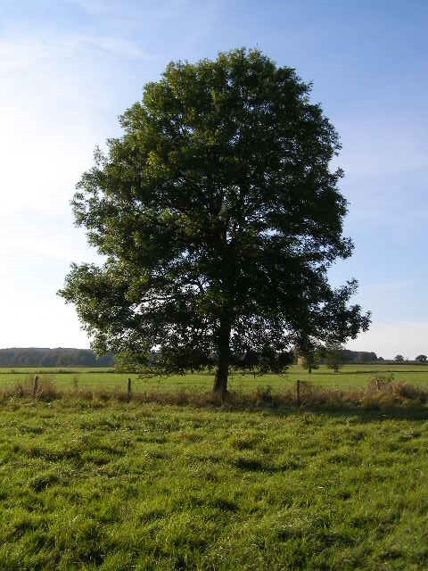
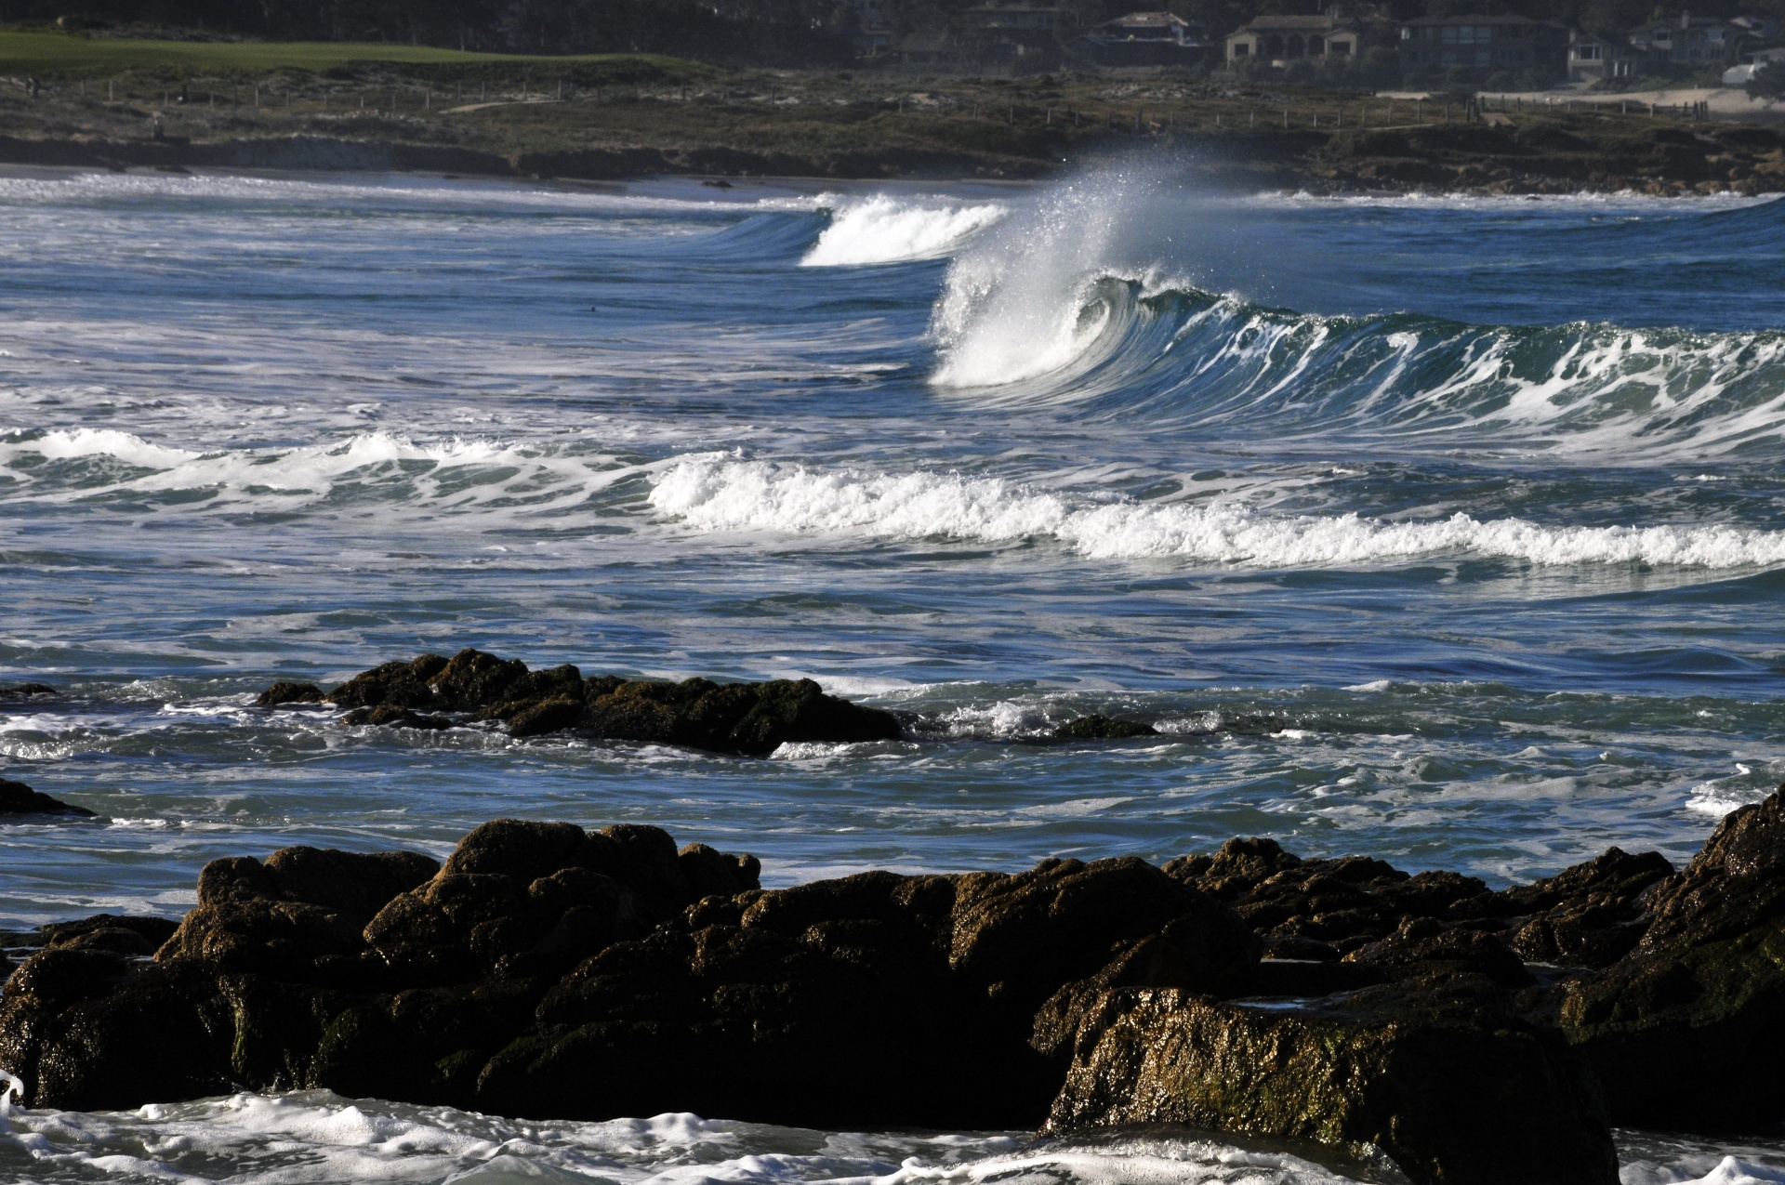
Ye are all the leaves of one tree and the drops of one ocean.
Bahá’u’lláh
Fountain of Wisdom, 3.24

Slide 10

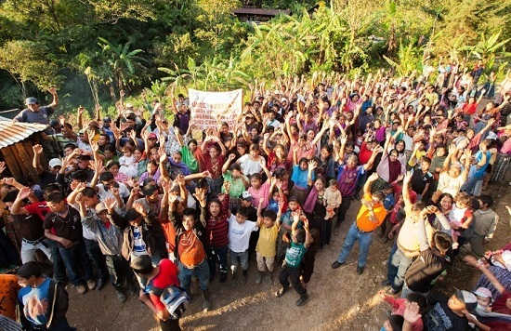
A family is a nation in miniature. Simply enlarge the circle of the household, and you have the nation. Enlarge the circle of nations, and you have all humanity. The conditions surrounding the family surround the nation. The happenings in the family are the happenings in the life of the nation.
‘Abdu’l-Bahá
The Promulgation of Universal Peace, 58.2

Slide 11
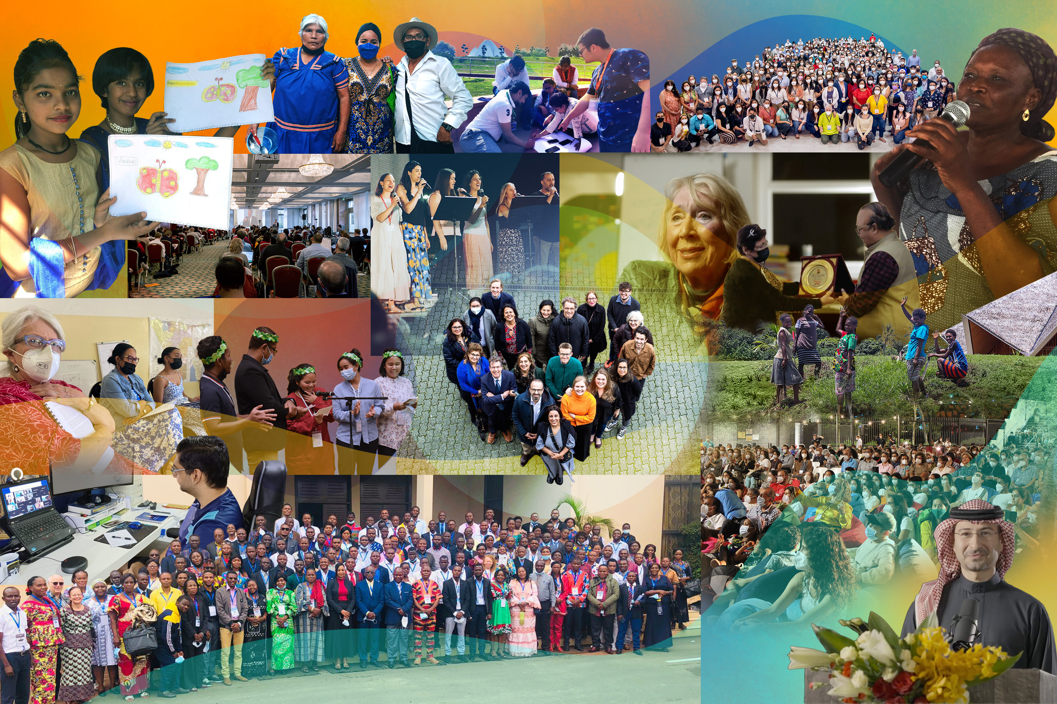
That the divers communions of the earth, and the manifold systems of religious belief, should never be allowed to foster the feelings of animosity among men, is, in this Day, of the essence of the Faith of God and His Religion. These principles and laws, these firmly-established and mighty systems, have proceeded from one Source, and are rays of one Light.
Bahá’u’lláh
Epistle to the Son of the Wolf, 17

Slide 12
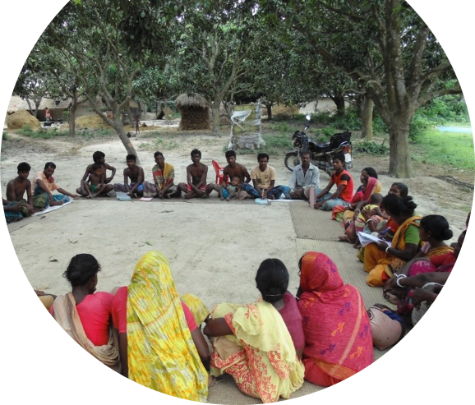
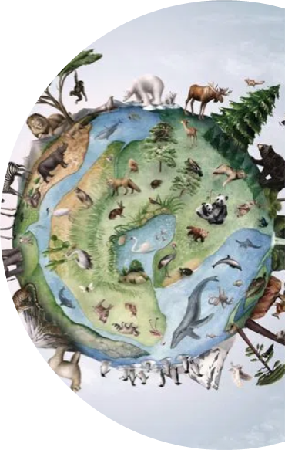

We cannot segregate the human heart from the environment outside us and say that once one of these is reformed everything will be improved. Man is organic with the world. His inner life moulds the environment and is itself also deeply affected by it. The one acts upon the other and every abiding change in the life of man is the result of these mutual reactions.
Letter written on behalf of
Shoghi Effendi,
To an individual believer,
17 February 1933

Slide 13
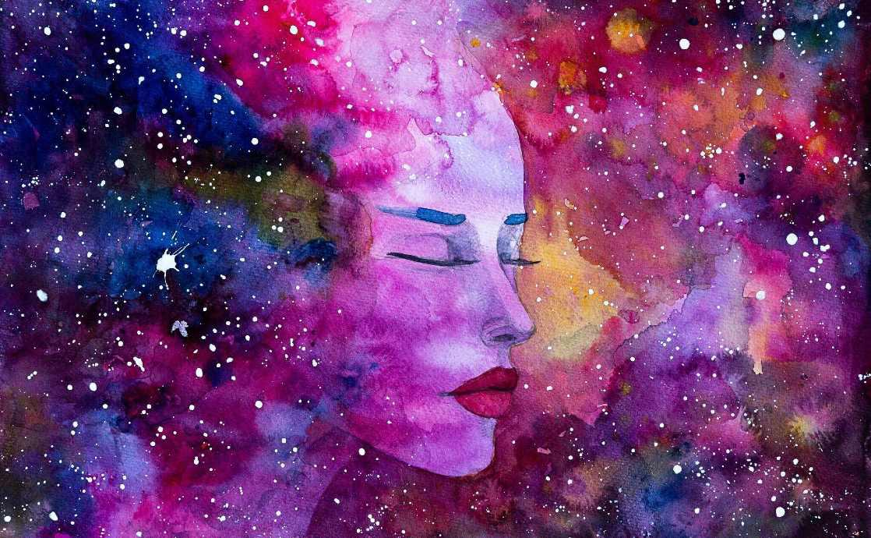
Consider the body of man, and let the part be an indication of the whole. Consider how these diverse parts and members of the human body are closely connected and harmoniously united one with the other. Every part is the essential requisite of all other parts and has a function by itself. It is the mind that is the all-unifying agency that so uniteth all the component parts one with the other that each dischargeth its specific function in perfect order, and thereby co-operation and reaction are made possible.
‘Abdu’l-Bahá
Tablet to August Forel, 24

Slide 14

https://www.youtube.com/watch?v=3rlR4e4VHnU

Slide 15
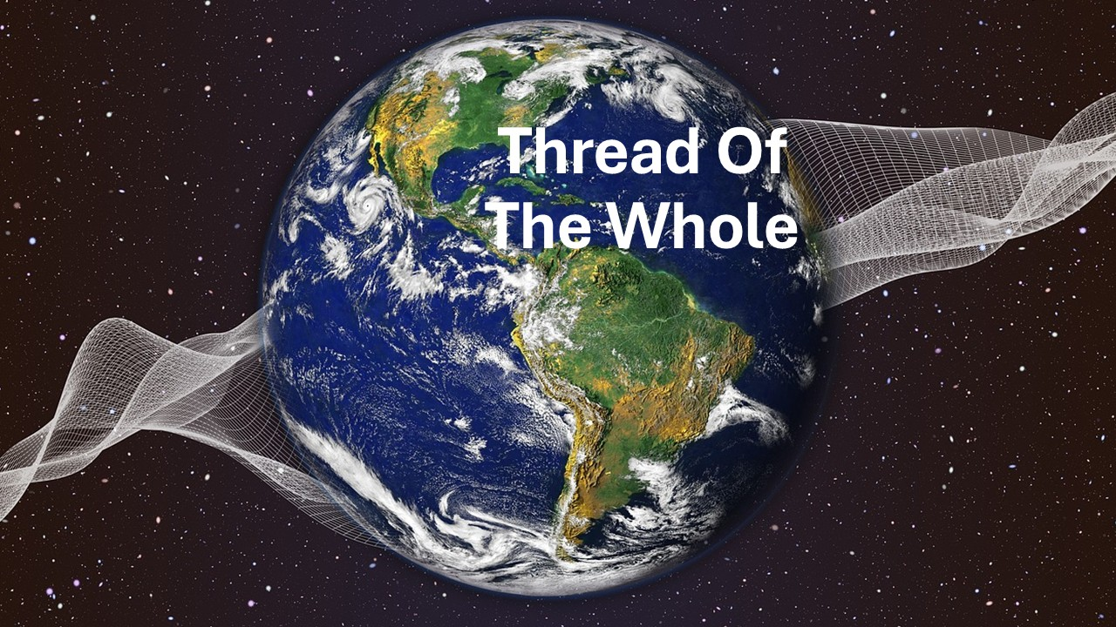
https://www.youtube.com/watch?v=jx-9nJNuo1U

