Slide 1


Science & Religion
Tucker, GA

Slide 2
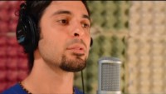
https://www.youtube.com/watch?v=zfPzUZ_25yw

Slide 3

If religion is opposed to reason and science, faith is impossible; and when faith and confidence in the divine religion are not manifest in the heart, there can be no spiritual attainment.
'Abdu'l-Bahá,
Promulgation of Universal Peace,
p. 299

Slide 4

At the outset of every endeavour, it is incumbent to look to the end of it. Of all the arts and sciences, set the children to studying those which will result in advantage to man, will ensure his progress and elevate his rank. Thus the noisome odours of lawlessness will be dispelled, and thus through the high endeavours of the nation's leaders, all will live cradled, secure and in peace.
Bahá'u'lláh,
Tablets of Bahá’u’lláh, pp. 168-169

Slide 5

The third Tajallí is concerning arts, crafts and sciences. Knowledge is as wings to man’s life, and a ladder for his ascent. Its acquisition is incumbent upon everyone. The knowledge of such sciences, however, should be acquired as can profit the peoples of the earth, and not those which begin with words and end with words. Great indeed is the claim of scientists and craftsmen on the peoples of the world.
Bahá’u’lláh,
Fountain of Wisdom, 5.13

Slide 6

God has conferred upon and added to man a distinctive power--the faculty of intellectual investigation into the secrets of creation, the acquisition of higher knowledge--the greatest virtue of which is scientific enlightenment.
‘Abdu’l-Bahá,
Promulgation of Universal Peace, p. 31

Slide 7



It is from the bounty of God that man is selected for the highest degree; and the differences which exist between men in regard to spiritual progress and heavenly perfections are also due to the choice of the Compassionate One. For faith, which is life eternal, is the sign of bounty, and not the result of justice. The flame of the fire of love, in this world of earth and water, comes through the power of attraction and not by effort and striving. Nevertheless, by effort and perseverance, knowledge, science and other perfections can be acquired; but only the light of the Divine Beauty can transport and move the spirits through the force of attraction.
'Abdu'l-Bahá,
Some Answered Questions, p. 130

Slide 8

A question or principle which is religious in its nature must be sanctioned by science. Science must declare it to be valid, and reason must confirm it in order that it may inspire confidence. If religious teaching, however, be at variance with science and reason, it is unquestionably superstition.
‘Abdu’l-Bahá,
Promulgation of Universal Peace, p. 394

Slide 9


Religion must agree with science, so that science shall sustain religion and religion explain science. The two must be brought together, indissolubly, in reality. Down to the present day it has been customary for man to accept blindly what was called religion, even though it were not in accord with human reason.
‘Abdu’l-Bahá,
Divine Philosophy, Sec b, Par. 14

Slide 10

O people of Bahá! The source of crafts, sciences and arts is the power of reflection. Make ye every effort that out of this ideal mine there may gleam forth such pearls of wisdom and utterance as will promote the well-being and harmony of all the kindreds of the earth.
Bahá'u'lláh,
Tablets of Bahá’u’lláh, p. 72

Slide 11
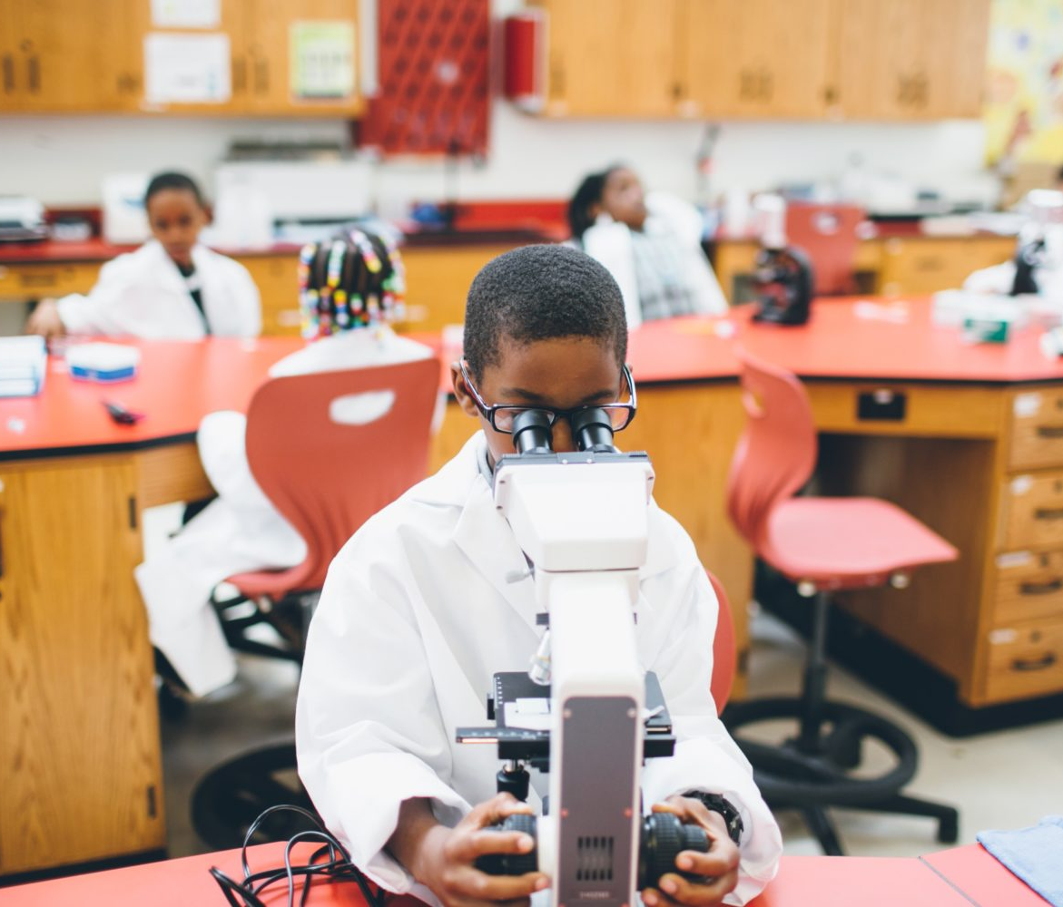


Make every effort to acquire the advanced knowledge of the day, and strain every nerve to carry forward the divine civilization. Establish schools that are well organized, and promote the fundamentals of instruction in the various branches of knowledge through teachers who are pure and sanctified, distinguished for their high standards of conduct and general excellence, and strong in faith; scholars and educators with a thorough knowledge of sciences and arts.
'Abdu'l-Bahá,
Compilation of Compilations,
Vol I (The Arts), p. 6

Slide 12
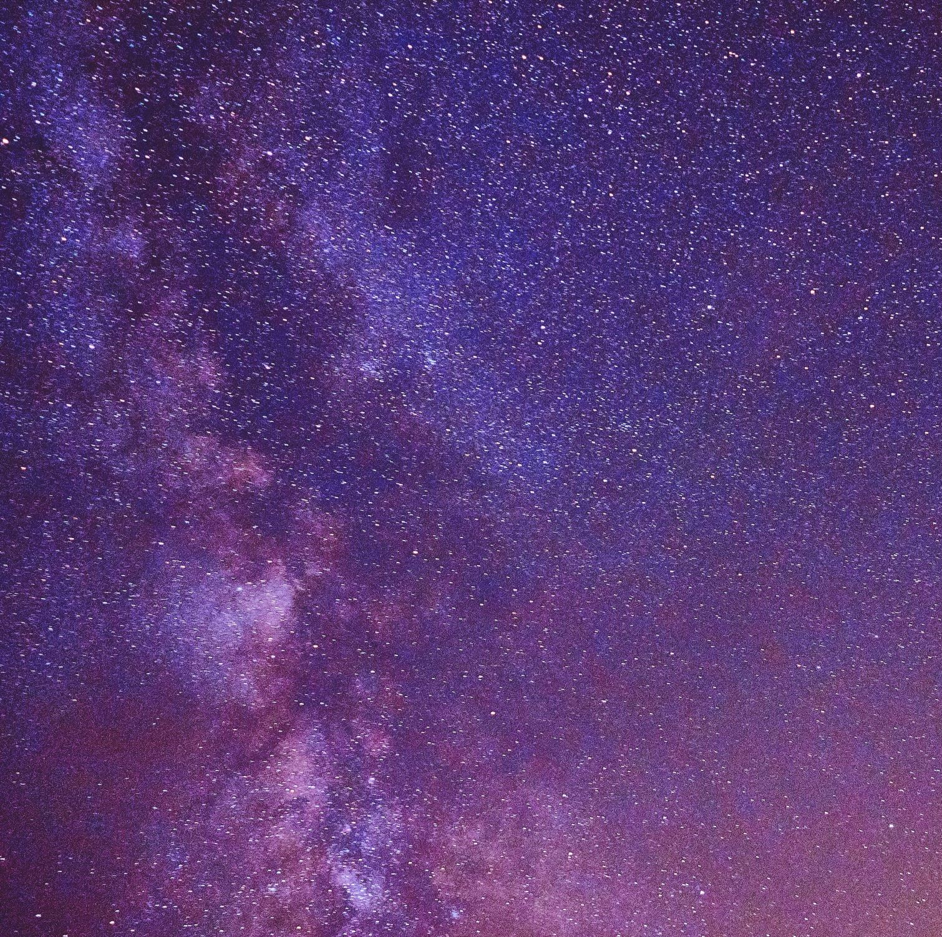
The Bible shows the way to go to heaven, not the way the heavens go.
Scientist, Galileo Galilei,
Letter to Dowager Grand Duchess, Christina

Slide 13
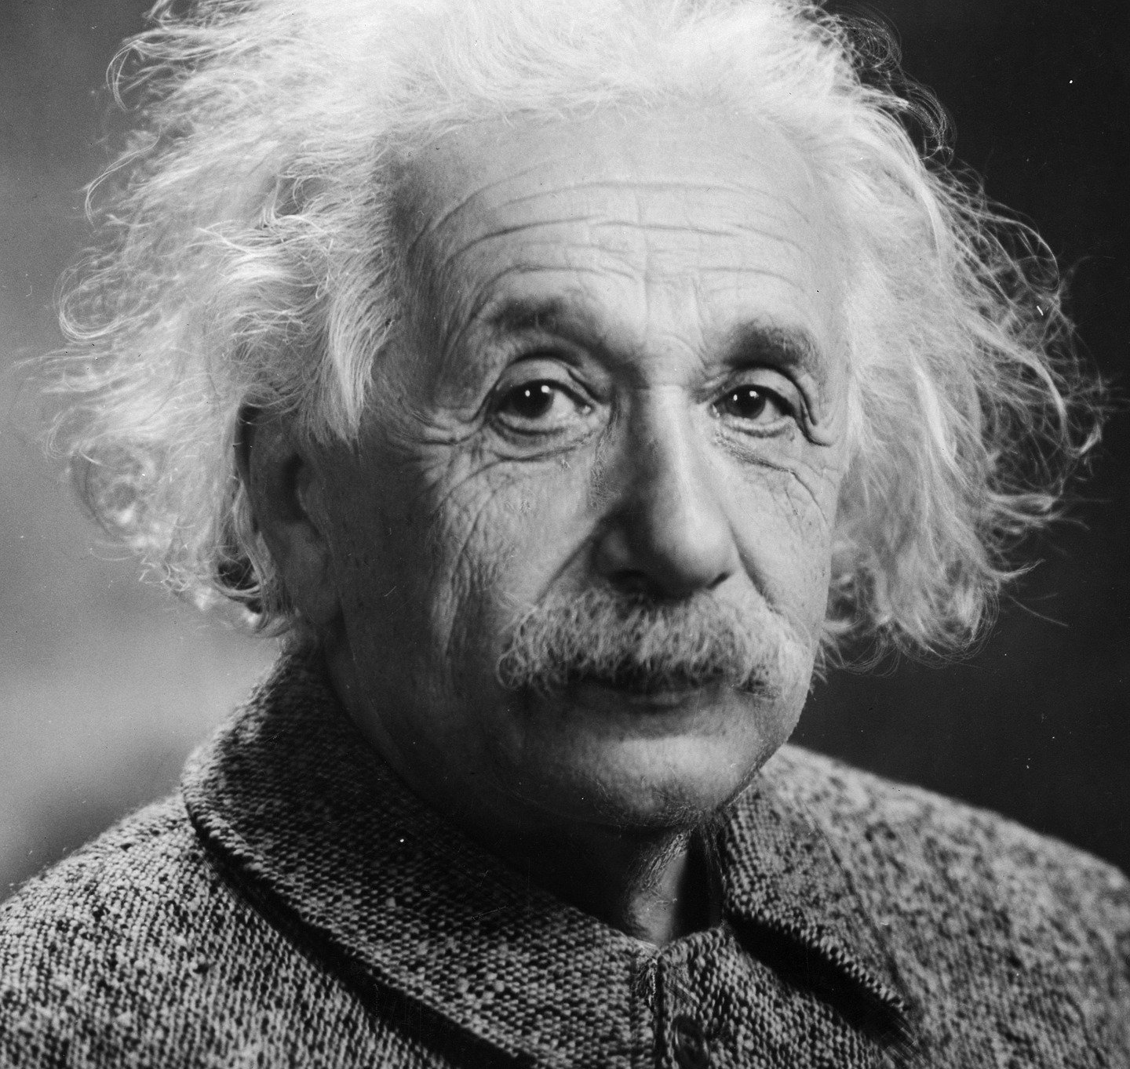
But science can only be created by those who are thoroughly imbued with the aspiration towards truth and understanding. This source of feeling, however, springs from the sphere of religion. To this there also belongs the faith in the possibility that the regulations valid for the world of existence are rational, that is, comprehensible to reason. I cannot conceive of a genuine scientist without that profound faith. The situation may be expressed by an image: Science without religion is lame, religion without science is blind.
Scientist, Albert Einstein,
Out of My Later Years, p. 26

Slide 14
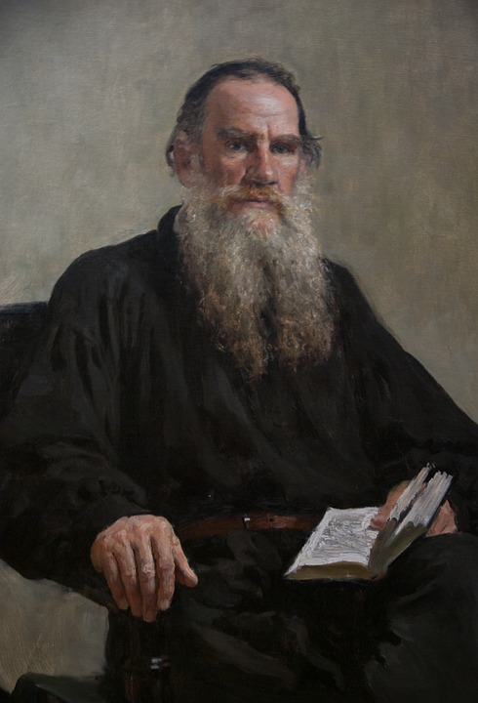
Religion reveals the meaning of life, and science only applies this meaning to the course of circumstances.
Leo Tolstoy, Russian Author

Slide 15

Science and religion find common ground in their search for universal truths. Universal truths cannot be compartmentalized. From this perspective, if a scientist genuinely searches for universal truths, he or she will be naturally led to religion, and correspondingly, a sincere member of a religious faith will be open to the results of scientific investigation.
Scientist, Anjam Khursheed,
The Spiritual Foundations
of Science, p. 20

Slide 16

https://www.youtube.com/watch?v=yMJkxKtMpbM

Slide 17

https://www.youtube.com/watch?v=yq_ynpblZdc

