Slide 1

Oneness of Humanity
Tucker, GA

Slide 2

https://www.youtube.com/watch?v=nS1RBSrOGng

Slide 3

O CHILDREN OF MEN! Know ye not why We created you all from the same dust? That no one should exalt himself over the other. Ponder at all times in your hearts how ye were created. Since We have created you all from one same substance it is incumbent on you to be even as one soul, to walk with the same feet, eat with the same mouth and dwell in the same land, that from your inmost being, by your deeds and actions, the signs of oneness and the essence of detachment may be made manifest. Such is My counsel to you, O concourse of light! Heed ye this counsel that ye may obtain the fruit of holiness from the tree of wondrous glory.
Bahá'u'lláh
Hidden Words, Arabic #68

Slide 4


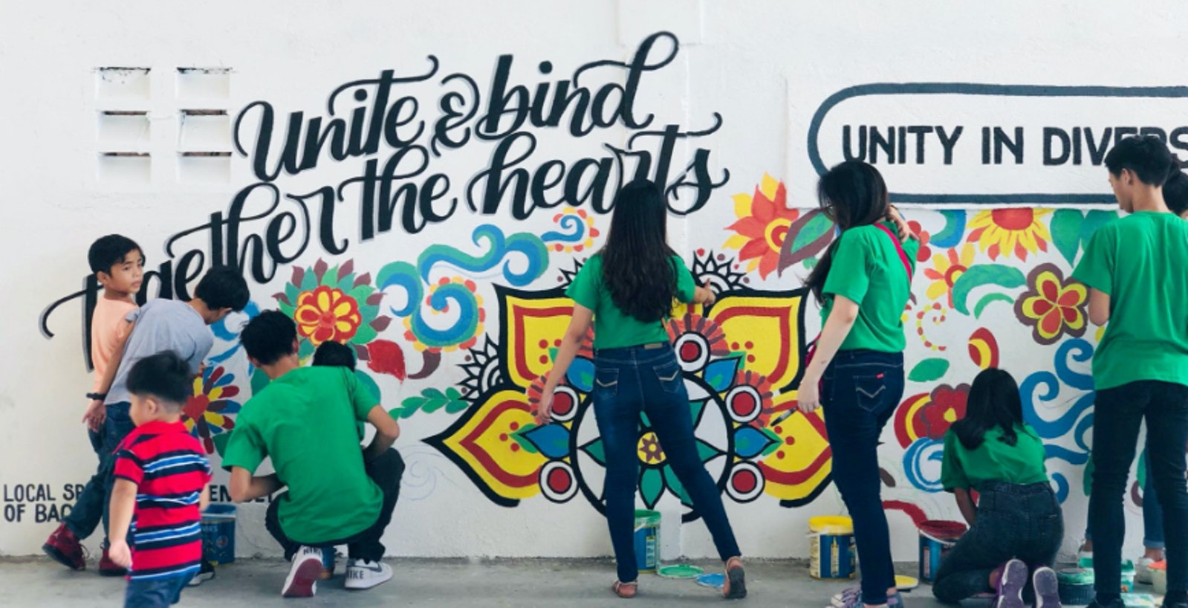
The first teaching of Bahá'u'lláh is the investigation of reality. Man must seek reality himself, forsaking imitations and adherence to mere hereditary forms. As the nations of the world are following imitations in lieu of truth and as imitations are many and various, differences of belief have been productive of strife and warfare. So long as these imitations remain, the oneness of the world of humanity is impossible.
'Abdu'l-Bahá
Promulgation of Universal Peace,
p. 180

Slide 5

The real bond of integrity is religious in character, for religion indicates the oneness of the world of humanity. Religion serves the world of morality. Religion purifies the hearts. Religion impels men to achieve praiseworthy deeds. Religion becomes the cause of love in human hearts, for religion is a divine foundation, the foundation ever conducive to life. The teachings of God are the source of illumination to the people of the world. Religion is ever constructive, not destructive.
'Abdu'l-Bahá
Promulgation of Universal Peace,
p. 344

Slide 6

The time has come when all mankind shall be united, when all races shall be loyal to one fatherland, all religions become one religion, and racial and religious bias pass away. It is a day in which the oneness of humankind shall uplift its standard and international peace, like the true morning, flood the world with its light.
‘Abdu'l-Bahá
Promulgation of Universal Peace, p. 153

Slide 7

The first principle of Bahá'u'lláh is independent investigation of truth, that is, all the nations of the world have to investigate after truth independently and turn their eyes from the moribund blind imitations of the past ages entirely. Truth is one when it is independently investigated, it does not accept division. Therefore the independent investigation of truth will lead to the oneness of the world of humanity.
'Abdu'l-Bahá
Japan Will Turn Ablaze, p. 35

Slide 8

Then it is evident that excellence does not depend upon color. Character is the true criterion of humanity. Anyone who possesses a good character, who has faith in God and is firm, whose actions are good, whose speech is good--that one is accepted at the threshold of God no matter what color he may be.
'Abdu'l-Bahá
Promulgation of Universal Peace, pp. 427-428

Slide 9

Ye are the fruits of one tree, and the leaves of one branch. Deal ye one with another with the utmost love and harmony, with friendliness and fellowship.
Bahá’u’lláh
Epistle to the
Son of the Wolf, p. 14

Slide 10


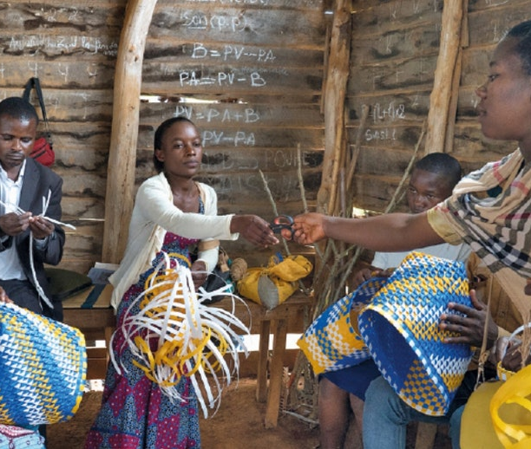
Therefore, we must exercise extreme patience, sympathy and love toward all mankind, considering no soul as rejected. If we look upon a soul as rejected, we have disobeyed the teachings of God. God is loving to all. Shall we be unjust or unkind to anyone? Is this allowable in the sight of God? God provides for all. Is it befitting for us to prevent the flow of His merciful provisions for mankind?
‘Abdu’l-Bahá
Promulgation of Universal Peace,
pp. 286-287

Slide 11
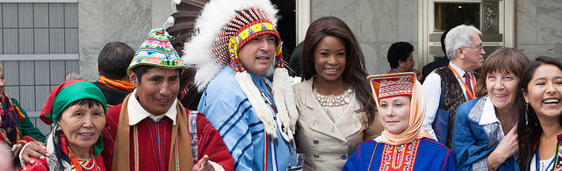
The holy Manifestations of God were sent down to make visible the oneness of humanity. For this did They endure unnumbered ills and tribulations, that a community from amongst mankind’s divergent peoples could gather within the shadow of the Word of God and live as one, and could, with delight and grace, demonstrate on earth the unity of humankind. Therefore must the desire of the friends be this, to bring together and unify all peoples, that all may receive a generous drink of this pure wine from this cup that is “tempered at the camphor fountain.” Let them make the differing populations to be as one and induce the hostile and murderous kindreds of the earth to love one another instead.
‘Abdu’l-Bahá
Selections from the Writings of ‘Abdu’l-Bahá, p. 221

Slide 12

…we must not make distinctions between individual members of the human family. We must not consider any soul as barren or deprived. Our duty lies in educating souls so that the Sun of the bestowals of God shall become resplendent in them, and this is possible through the power of the oneness of humanity. The more love is expressed among mankind and the stronger the power of unity, the greater will be this reflection and revelation, for the greatest bestowal of God is love. Love is the source of all the bestowals of God. Until love takes possession of the heart, no other divine bounty can be revealed in it.
‘Abdu’l-Bahá
The Promulgation of Universal Peace, p. 15

Slide 13

https://www.youtube.com/watch?v=VMl2m1M7nLg

Slide 14

https://www.youtube.com/watch?v=zSAj5A55fR8

