Slide 1

Physical/ Material Death
Tucker, GA

Slide 2

https://www.youtube.com/watch?v=Zv-nCJcMoow&t=3s

Slide 3
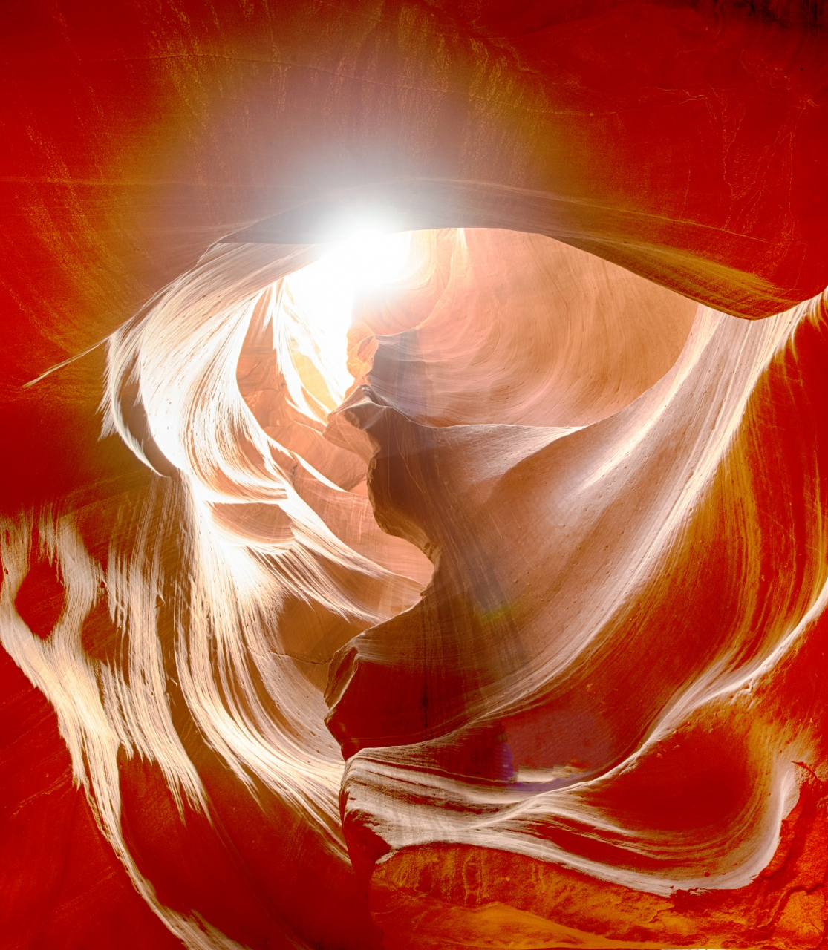
Man--the true man--is soul, not body; though physically man belongs to the animal kingdom, yet his soul lifts him above the rest of creation. Behold how the light of the sun illuminates the world of matter: even so doth the Divine Light shed its rays in the kingdom of the soul. The soul it is which makes the human creature a celestial entity!
‘Abdu’l-Bahá
Paris Talks, p. 85

Slide 4
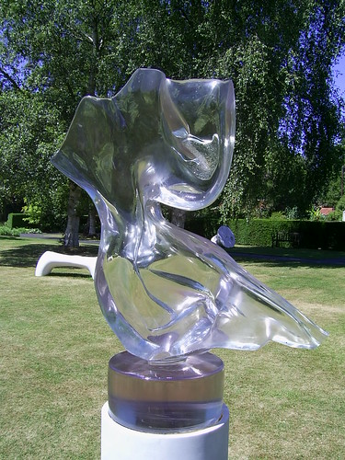
O SON OF THE SUPREME!
I have made death a messenger of joy to thee. Wherefore dost thou grieve? I made the light to shed on thee its splendor. Why dost thou veil thyself therefrom?
Bahá’u’lláh
Arabic Hidden Words, #32

Slide 5
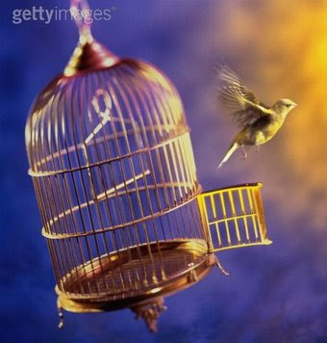
To consider that after the death of the body the spirit perishes is like imagining that a bird in a cage will be destroyed if the cage is broken, though the bird has nothing to fear from the destruction of the cage. Our body is like the cage, and the spirit is like the bird. We see that without the cage this bird flies in the world of sleep; therefore, if the cage becomes broken, the bird will continue and exist. Its feelings will be even more powerful, its perceptions greater, and its happiness increased.
‘Abdu’l-Bahá
Some Answered Questions, p. 228

Slide 6

https://www.youtube.com/watch?v=UYsQ4eS8pKg&t=4s

Slide 7

In the world of spirit there is no retrogression. The world of mortality is a world of contradictions, of opposites; motion being compulsory everything must either go forward or retreat. In the realm of spirit there is no retreat possible, all movement is bound to be towards a perfect state. `Progress' is the expression of spirit in the world of matter. The intelligence of man, his reasoning powers, his knowledge, his scientific achievements, all these being manifestations of the spirit, partake of the inevitable law of spiritual progress and are, therefore, of necessity, immortal.
‘Abdu’l-Bahá
Paris Talks, p. 90

Slide 8

O SON OF WORLDLINESS!
Pleasant is the realm of being, wert thou to attain thereto; glorious is the domain of eternity, shouldst thou pass beyond the world of mortality; sweet is the holy ecstasy if thou drinkest of the mystic chalice from the hands of the celestial Youth. Shouldst thou attain this station, thou wouldst be freed from destruction and death, from toil and sin.
Bahá’u’lláh
Persian Hidden Words, #70

Slide 9

As to the soul of man after death, it remains in the degree of purity to which it has evolved during life in the physical body, and after it is freed from the body it remains plunged in the ocean of God's Mercy.
From the moment the soul leaves the body and arrives in the Heavenly World, its evolution is spiritual, and that evolution is: The approaching unto God.
‘Abdu’l-Bahá
Paris Talks, p. 66

Slide 10

One of the distinguishing characteristics of this most great Dispensation is that the kin of such as have recognized and embraced the truth of this Revelation and have, in the glory of His name, the Sovereign Lord, quaffed the choice, sealed wine from the chalice of the love of the one true God, will, upon their death, if they are outwardly non- believers, be graciously invested with divine forgiveness and partake of the ocean of His Mercy.
Bahá’u’lláh
Family Life, p. 386

Slide 11

O God! Refresh and gladden my spirit. Purify my heart. Illumine my powers. I lay all my affairs in Thy hand. Thou art my Guide and my Refuge. I will no longer be sorrowful and grieved; I will be a happy and joyful being. O God! I will no longer be full of anxiety, nor will I let trouble harass me. I will not dwell on the unpleasant things of life.
O God! Thou art more friend to me than I am to myself. I dedicate myself to Thee, O Lord.
‘Abdu’l-Bahá
Baha'i Prayers
(US edition), p. 152

Slide 12
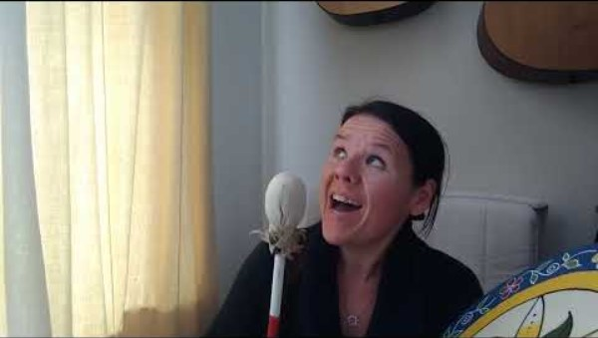
https://www.youtube.com/watch?v=lecIdK79WcE&t=1s

Slide 13

https://www.youtube.com/watch?v=yk85B9W3cQ0

