Slide 1
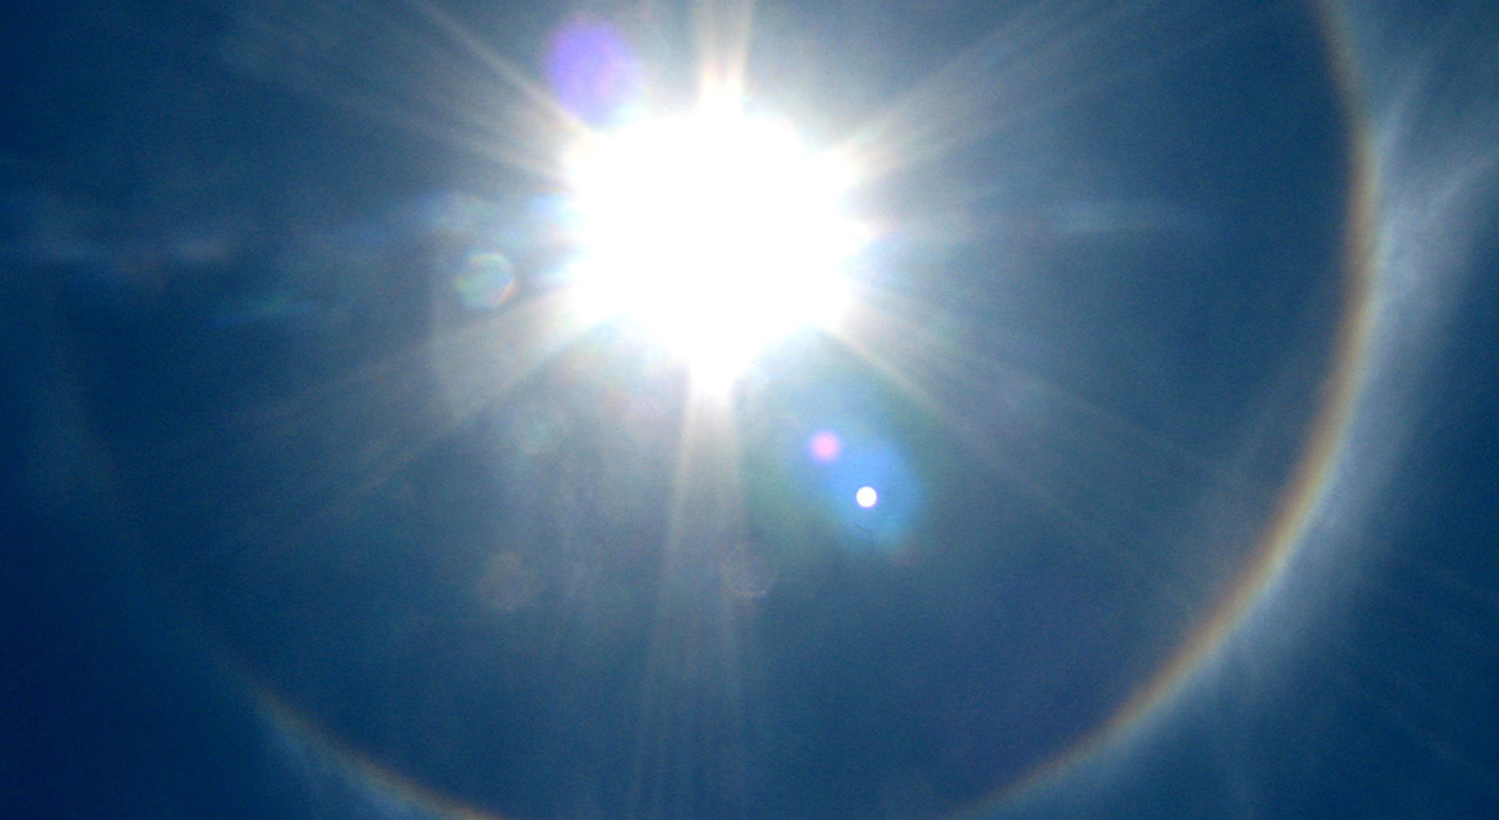
Spirituality
Tucker, GA

Slide 2


Slide 3

Say, this earthly life shall come to an end, and everyone shall expire and return unto my Lord God Who will reward with the choicest gifts the deeds of those who endure with patience. Verily thy God assigneth the measure of all created things as He willeth, by virtue of His behest; and those who conform to the good-pleasure of your Lord, they are indeed among the blissful.
The Báb
Selections from the Báb, p. 161

Slide 4

Know, verily, that the soul is a sign of God, a heavenly gem whose reality the most learned of men hath failed to grasp, and whose mystery no mind, however acute, can ever hope to unravel. It is the first among all created things to declare the excellence of its Creator, the first to recognize His glory, to cleave to His truth, and to bow down in adoration before Him. If it be faithful to God, it will reflect His light, and will, eventually, return unto Him. If it fail, however, in its allegiance to its Creator, it will become a victim to self and passion, and will, in the end, sink in their depths.
Baha’u’lláh,
Gleanings, p. 158

Slide 5

Spirit cannot be perceived by the material senses of the physical body, excepting as it is expressed in outward signs and works. The human body is visible, the soul is invisible. It is the soul nevertheless that directs a man's faculties, that governs his humanity.
‘Abdu’l-Bahá,
Paris Talks, p. 86

Slide 6

For every one of you his paramount duty is to choose for himself that on which no other may infringe and none usurp from him. Such a thing - and to this the Almighty is My witness - is the love of God, could ye but perceive it.
Bahá'u'lláh
Gleanings, p. 261

Slide 7

Man has two powers; and his development, two aspects. One power is connected with the material world, and by it he is capable of material advancement. The other power is spiritual, and through its development his inner, potential nature is awakened. These powers are like two wings. Both must be developed, for flight is impossible with one wing.
'Abdu'l-Bahá, Promulgation of Universal Peace, p. 60

Slide 8
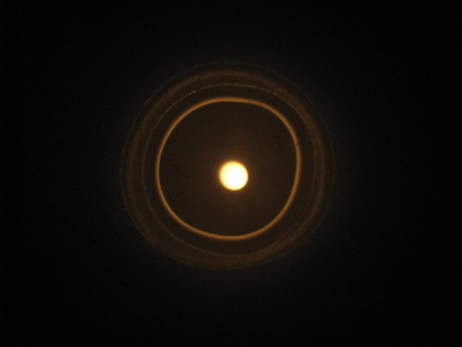
You see all round you proofs of the inadequacy of material things -- how joy, comfort, peace and consolation are not to be found in the transitory things of the world. Is it not then foolishness to refuse to seek these treasures where they may be found? The doors of the spiritual Kingdom are open to all, and without is absolute darkness.
‘Abdu’l-Bahá,
Paris Talks, p. 112

Slide 9

Just as the physical body of man is in need of its force of life, even so the human soul is in need of the divine animus and vivification emanating from the Holy Spirit. Without this vivification and sustenance, man would be an animal, nay, rather, dead.
‘Abdu’l-Bahá,
Promulgation of Universal Peace, p. 317

Slide 10
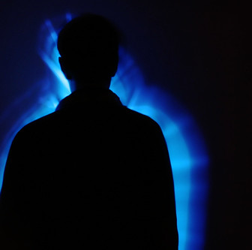
The world of humanity cannot advance through mere physical powers and intellectual attainments; nay, rather, the Holy Spirit is essential. The divine Father must assist the human world to attain maturity. The body of man is in need of physical and mental energy, but his spirit requires the life and fortification of the Holy Spirit.
'Abdu'l-Bahá
Promulgation of Universal Peace,
p. 182

Slide 11

The spirit of man appears and is manifest in the embryonic condition, and also in that of childhood and of maturity, and it is resplendent and evident in the condition of perfection. The spirit is one, but in the embryonic condition the power of sight and of hearing is lacking. In the state of maturity and perfection it appears in the utmost splendor and brilliance.
‘Abdu’l-Bahá
Some Answered Questions, p. 150

Slide 12

For every thing, however, God has created a sign and symbol, and established standards and tests by which it may be known. The spiritually learned must be characterized by both inward and outward perfections; they must possess a good character, an enlightened nature, a pure intent, as well as intellectual power, brilliance and discernment, intuition, discretion and foresight, temperance, reverence, and a heartfelt fear of God. For an unlit candle, however great in diameter and tall, is no better than a barren palm tree or a pile of dead wood.
‘Abdu’l-Bahá, Secret of Divine Civilization, pp. 33-34

Slide 13


Slide 14
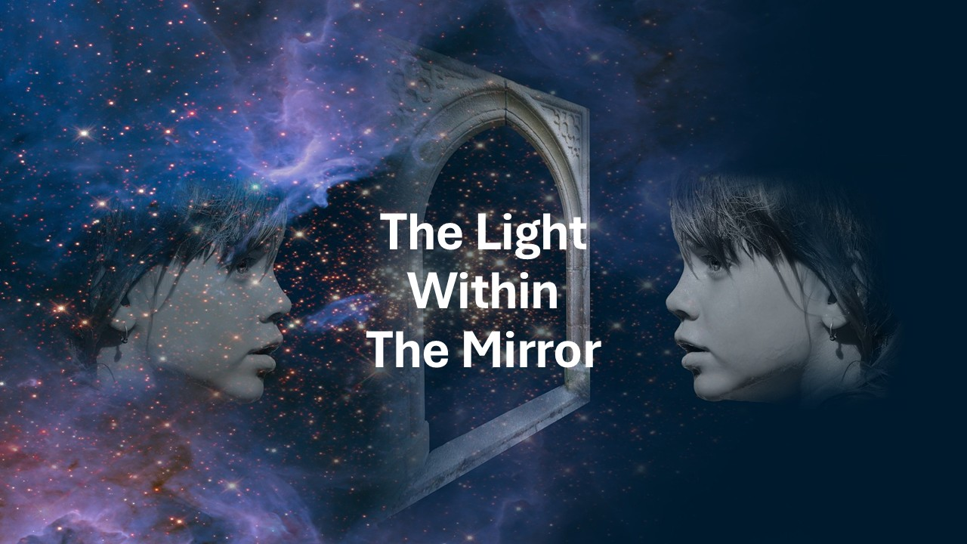
https://youtu.be/EcSisfEgeZo

