Slide 1

The Distinction of Humanity
Tucker, GA

Slide 2

https://www.youtube.com/watch?v=8YrU0-BFjKA

Slide 3
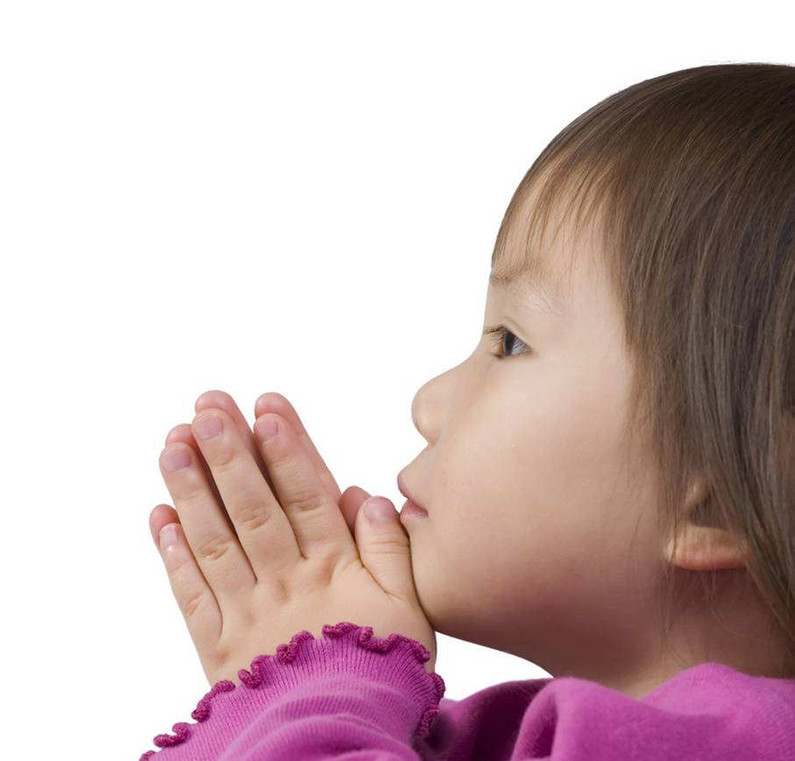
The supreme cause for creating the world and all that is therein is for man to know God.
Bahá’u’lláh
Tablets of Bahá’u’lláh, p. 268

Slide 4
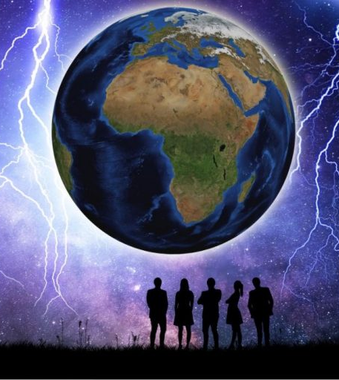
Having created the world and all that liveth and moveth therein, He, through the direct operation of His unconstrained and sovereign Will, chose to confer upon man the unique distinction and capacity to know Him and to love Him--a capacity that must needs be regarded as the generating impulse and the primary purpose underlying the whole of creation. Upon the inmost reality of each and every created thing He hath shed the light of one of His names, and made it a recipient of the glory of one of His attributes. Upon the reality of man, however, He hath focused the radiance of all of His names and attributes, and made it a mirror of His own Self. Alone of all created things man hath been singled out for so great a favor, so enduring a bounty.
Bahá’u’lláh
Gleanings, p. 65

Slide 5

And now, concerning thy question regarding the creation of man. Know thou that all men have been created in the nature made by God, the Guardian, the Self-Subsisting. Unto each one hath been prescribed a pre-ordained measure, as decreed in God’s mighty and guarded Tablets. All that which ye potentially possess can, however, be manifested only as a result of your own volition. Your own acts testify to this truth….
Bahá’u’lláh
Gleanings, pp. 149-150

Slide 6

Man alone can resist nature. Nature attracts bodies to the center of the earth; man through mechanical means goes far from it, and soars in the air. Nature prevents man from crossing the seas, man builds a ship, and he travels and voyages across the great ocean, and so on; the subject is endless. For example, man drives engines over the mountains and through the wildernesses, and gathers in one spot the news of the events of the East and West. All this is contrary to nature. The sea with its grandeur cannot deviate by an atom from the laws of nature; the sun in all its magnificence cannot deviate as much as a needle's point from the laws of nature, and can never comprehend the conditions, the state, the qualities, the movements, and the nature of man.
‘Abdu’l-Bahá
Baha’i World Faith, pp. 306-307

Slide 7

…the rays of the sun must shine upon the earth, and the solar heat develop the earthly beings; if the rays and heat of the sun did not shine upon the earth, the earth would be uninhabited, without meaning, and its development would be retarded. In the same way, if the perfections of the spirit did not appear in this world, this world would be unenlightened and absolutely brutal. By the appearance of the spirit in the physical form, this world is enlightened. As the spirit of man is the cause of the life of the body, so the world is in the condition of the body, and man is in the condition of the spirit. If there were no man, the perfections of the spirit would not appear, and the light of the mind would not be resplendent in this world. This world would be like a body without a soul.
‘Abdu’l-Bahá
Baha’i World Faith, p. 311

Slide 8

Man is even as steel, the essence of which is hidden: through admonition and explanation, good counsel and education, that essence will be brought to light. If, however, he be allowed to remain in his original condition, the corrosion of lusts and appetites will effectively destroy him.
Bahá’u’lláh
Compilation of Compilations,
Vol II (Bahá’í Education), p. 247

Slide 9
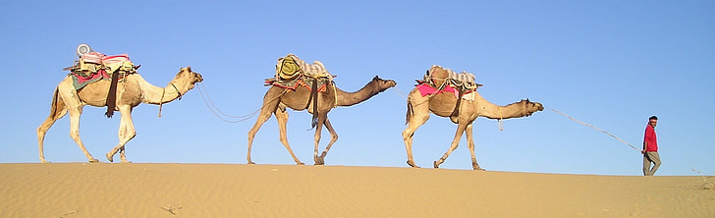
What a difference between the human world and the world of the animal; between the elevation of man and the abasement of the animal; between the perfection of man and the ignorance of the animal; between the light of man and the darkness of the animal; between the glory of man and the degradation of the animal! An Arab child of ten years can manage two or three hundred camels in the desert, and with his voice can lead them forward or turn them back. A weak Hindu can so control a huge elephant, that the elephant becomes the most obedient of servants...
‘Abdu’l-Bahá
The Promulgation of Universal Peace, p. 425

Slide 10
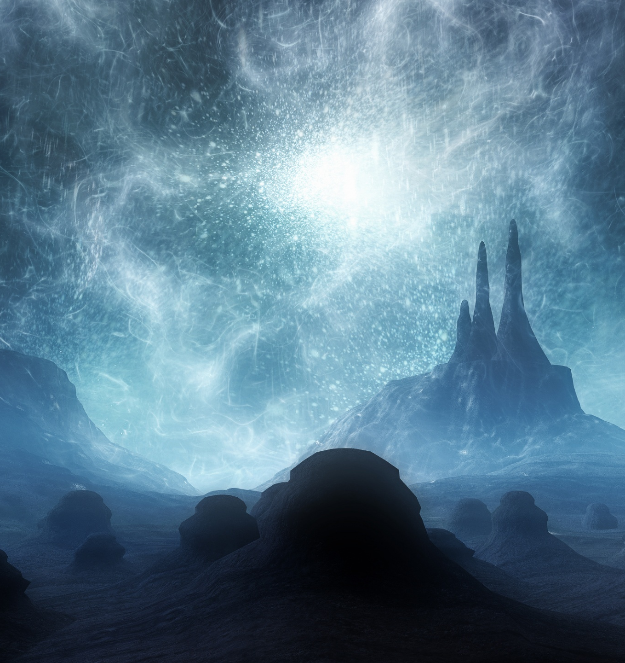
O SON OF MAN! Thou art My dominion and My dominion perisheth not, wherefore fearest thou thy perishing? Thou art My light and My light shall never be extinguished, why dost thou dread extinction? Thou art My glory and My glory fadeth not; thou art My robe and My robe shall never be outworn. Abide then in thy love for Me, that thou mayest find Me in the realm of glory.
Bahá’u’lláh
The Hidden Words, Arabic #14

Slide 11
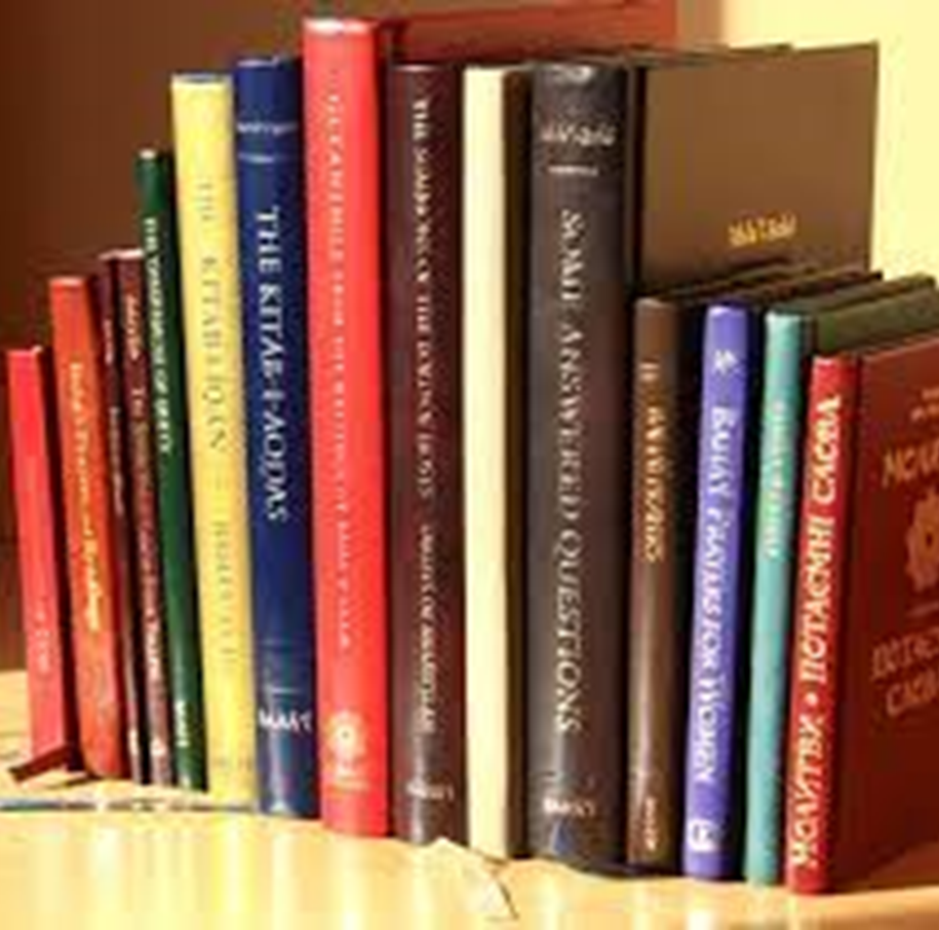
The source of all glory is acceptance of whatsoever the Lord hath bestowed, and contentment with that which God hath ordained.
Bahá’u’lláh
Tablets of Bahá’u’lláh,
p. 155

Slide 12
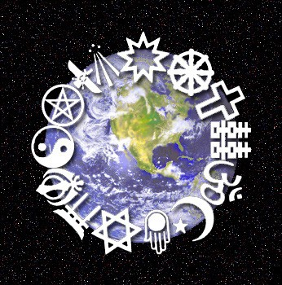
Now we need an educator who will be at the same time a material, human, and spiritual educator, and whose authority will be effective in all conditions. So if anyone should say, “I possess perfect comprehension and intelligence, and I have no need of such an educator”, he would be denying that which is clear and evident, as though a child should say, “I have no need of education; I will act according to my reason and intelligence, and so I shall attain the perfections of existence”; or as though the blind should say, “I am in no need of sight, because many other blind people exist without difficulty.”
Bahá’i, ‘Abdu’l-Bahá,
Some Answered Questions, p. 8

Slide 13
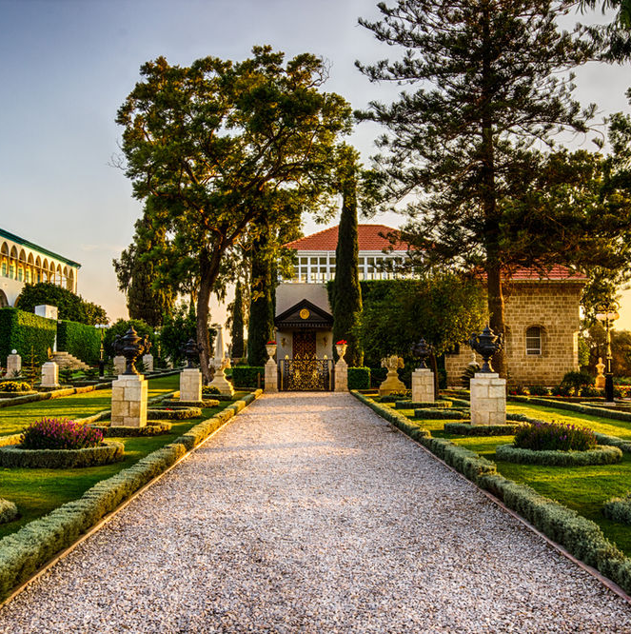
The source of all learning is the knowledge of God, exalted be His Glory, and this cannot be attained save through the knowledge of His Divine Manifestation.
Bahá’u’lláh
Tablets of Bahá’u’lláh, p. 156

Slide 14

This Wronged One testifieth that the purpose for which mortal men have, from utter nothingness, stepped into the realm of being, is that they may work for the betterment of the world and live together in concord and harmony. Dissension and strife have always been, and shall remain, rejected by God.
Bahá'u'lláh
Compilation of Compilations, Vol II (Trustworthiness), p. 332

Slide 15

If, however, an individual hath spiritual characteristics, and virtues that shine out, and his purpose in life be spiritual and his inclinations be directed toward God, and he also study other branches of knowledge--then we have light upon light: his outer being luminous, his private character radiant, his heart sound, his thought elevated, his understanding swift, his rank noble.
'Abdu'l-Bahá
Compilation of Compilations, Vol I (Education), p. 282

Slide 16

https://www.youtube.com/watch?v=-sUnMMFOZE4

Slide 17
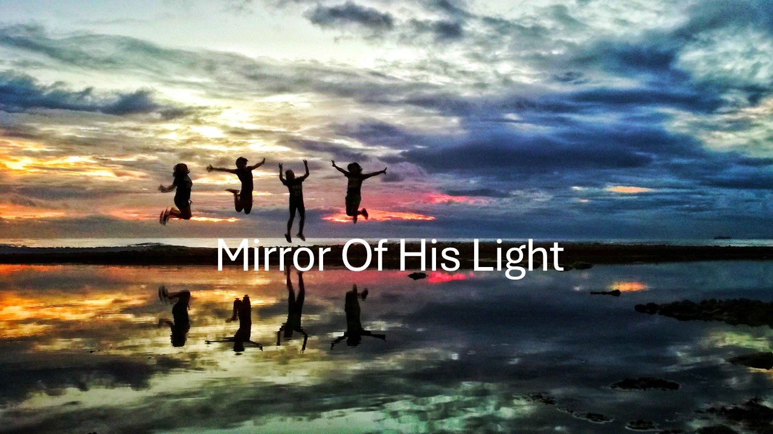
https://www.youtube.com/watch?v=OYN5NHZVNIg

