Slide 1
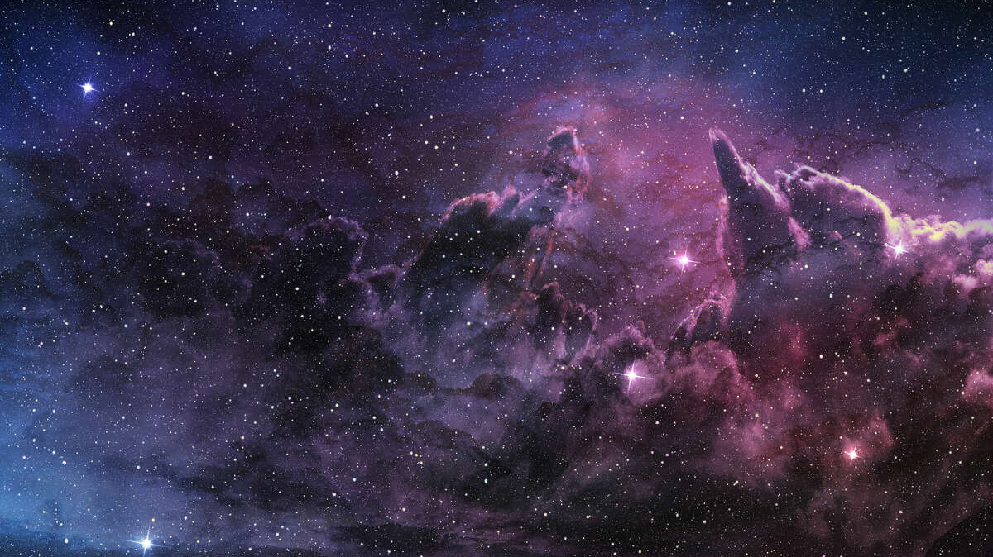
Existence of God
Tucker, GA

Slide 2
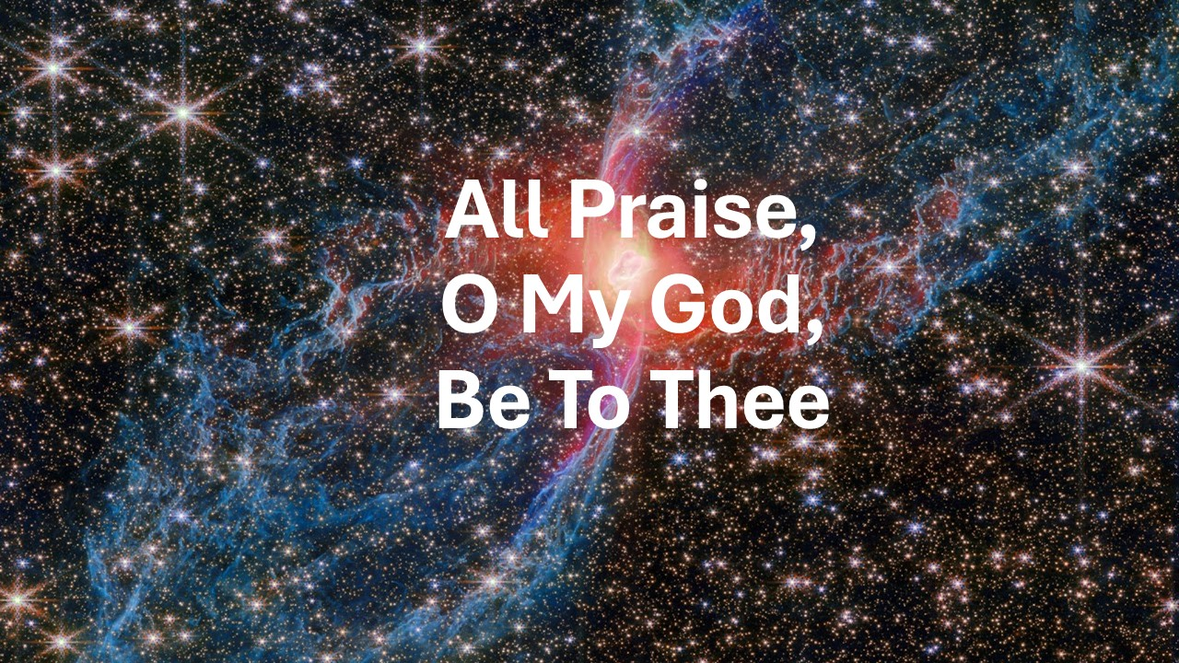
https://www.youtube.com/watch?v=Zu8wDejM-aw

Slide 3
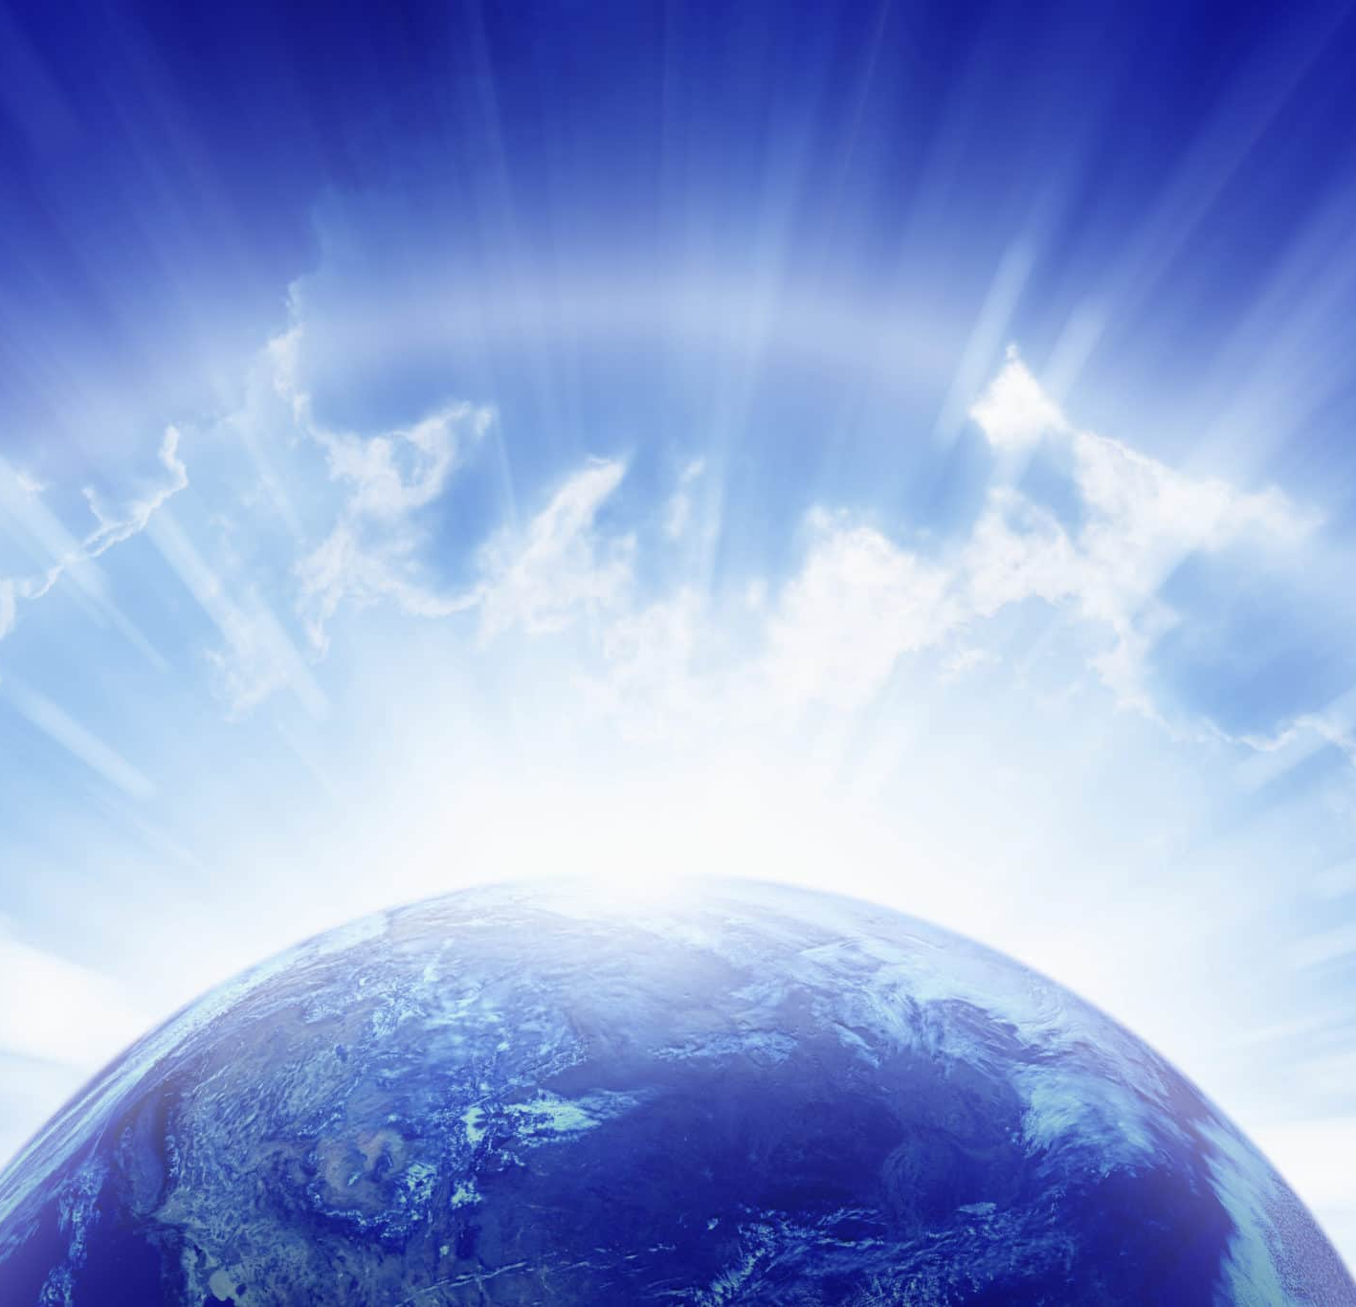
Praised be Thou, O Lord my God! I bear witness that from eternity Thou wert exalted in Thy transcendent majesty and might, and wilt to eternity abide in Thy surpassing power and glory. None in the kingdoms of earth and heaven can frustrate Thy purpose; none throughout the realms of revelation and of creation can prevail against Thee. At Thy command Thou doest what Thou willest, and by the power of Thy sovereignty Thou rulest as Thou pleasest.
Bahá’u’lláh
Prayers and Meditations, p. 32

Slide 4
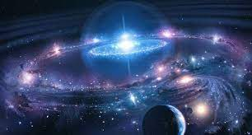
Thou art He Who from everlasting was, through the potency of His might, supreme over all things, and, through the operation of His will, was able to ordain all things. Nothing whatsoever, whether in Thy heaven or on Thy earth, can frustrate Thy purpose. Have mercy, then, upon me, O my Lord, through Thy gracious providence and generosity, and incline mine ear to the sweet melodies of the birds that warble their praise of Thee, amidst the branches of the tree of Thy oneness.
Bahá’u’lláh
Prayers and Meditations, pp. 4-5

Slide 5
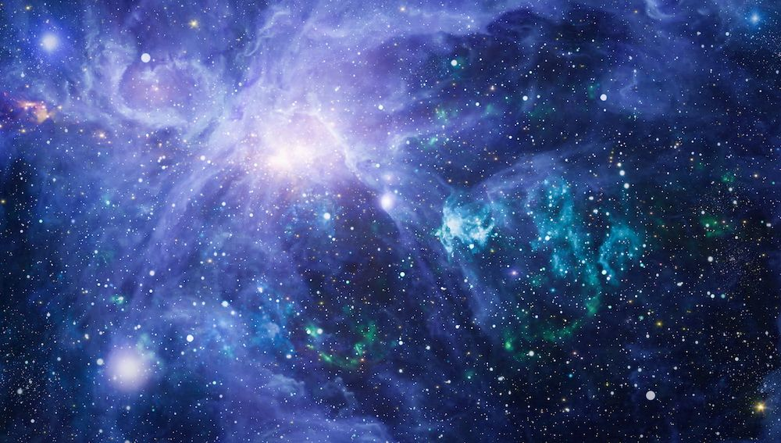
Regard thou the one true God as One Who is apart from, and immeasurably exalted above, all created things. The whole universe reflecteth His glory, while He is Himself independent of, and transcendeth His creatures. This is the true meaning of Divine unity. He Who is the Eternal Truth is the one Power Who exerciseth undisputed sovereignty over the world of being, Whose image is reflected in the mirror of the entire creation. All existence is dependent upon Him, and from Him is derived the source of the sustenance of all things. This is what is meant by Divine unity; this is its fundamental principle.
Bahá’u’lláh
Gleanings, p. 166

Slide 6
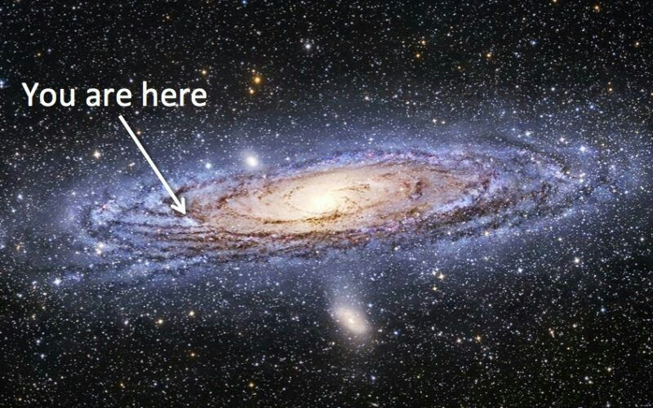
Sanctified be the Lord of all mankind, at the mention of Whose name all the atoms of the earth have been made to vibrate, and the Tongue of Grandeur hath been moved to disclose that which had been wrapt in His knowledge and lay concealed within the treasury of His might. He, verily, through the potency of His name, the Mighty, the All-Powerful, the Most High, is the ruler of all that is in the heavens and all that is on earth.
Bahá’u’lláh
Tablets of Bahá’u’lláh, p. 5

Slide 7

Thy might beareth me witness! Were it not to celebrate Thy praise, my tongue would be of no use to me, and were it not for the sake of rendering service to Thee, my existence would avail me not. But for the pleasure of beholding the splendours of Thy realm of glory, why should I cherish sight? And but for the joy of giving ear to Thy most sweet voice, of what use is hearing?
Bahá’u’lláh
Tablets of Bahá’u’lláh, p. 113

Slide 8
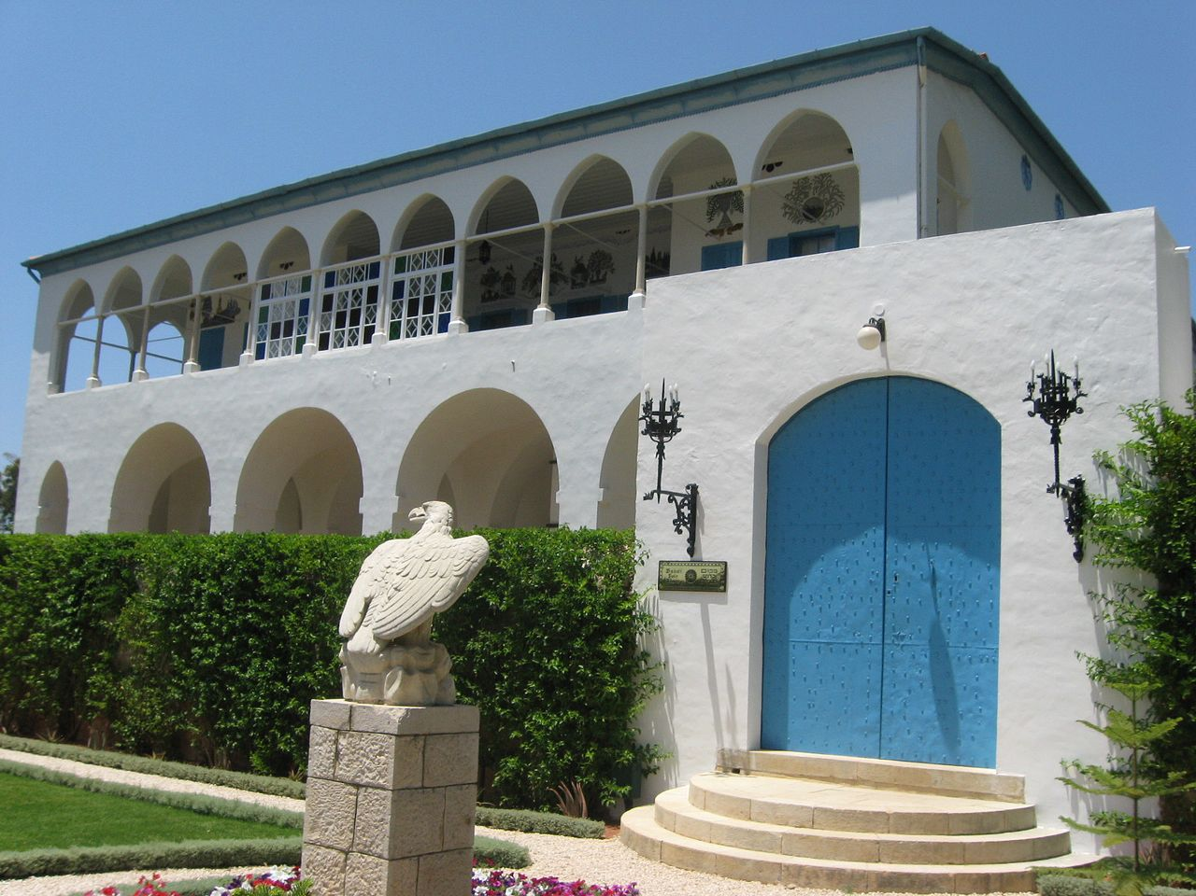
O Thou Whose face is the object of my adoration, Whose beauty is my sanctuary, Whose habitation is my goal, Whose praise is my hope, Whose providence is my companion, Whose love is the cause of my being, Whose mention is my solace, Whose nearness is my desire, Whose presence is my dearest wish and highest aspiration, I entreat Thee not to withhold from me the things Thou didst ordain for the chosen ones among Thy servants. Supply me, then, with the good of this world and of the next.
Bahá’u’lláh
Prayers and Meditations, p. 259

Slide 9
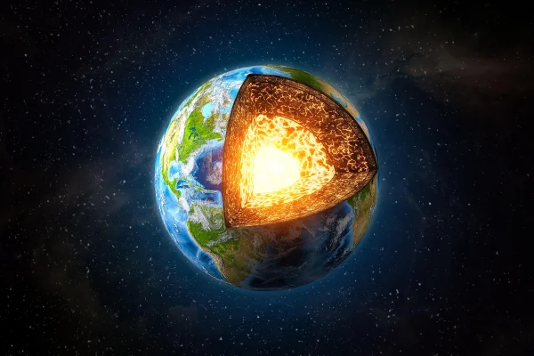
Lo, the All-Possessing is come. Earth and heaven, glory and dominion are God’s, the Lord of all men, and the Possessor of the Throne on high and of earth below!
Bahá’u’lláh,
Prayers and Meditations, 1186

Slide 10

Consider the mercy of God and His gifts. He enjoineth upon you that which shall profit you, though He Himself can well dispense with all creatures. Your evil doings can never harm Us, neither can your good works profit Us. We summon you wholly for the sake of God. To this every man of understanding and insight will testify.
Bahá’u’lláh
The Kitáb-i-Áqdás, K59

Slide 11
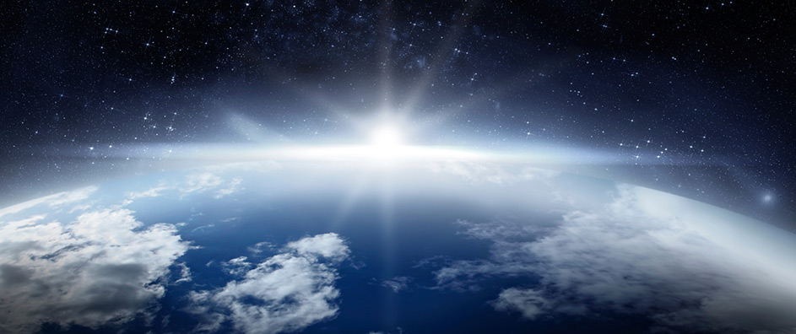
All praise be to God Who hath adorned the world with an ornament, and arrayed it with a vesture, of which it can be despoiled by no earthly power, however mighty its battalions, however vast its wealth, however profound its influence. Say: The essence of all power is God’s, the highest and the last End of all creation. The source of all majesty is God’s, the Object of the adoration of all that is in the heavens and all that is on the earth. Such forces as have their origin in this world of dust are, by their very nature, unworthy of consideration.
Bahá’u’lláh
Gleanings, p. 341

Slide 12
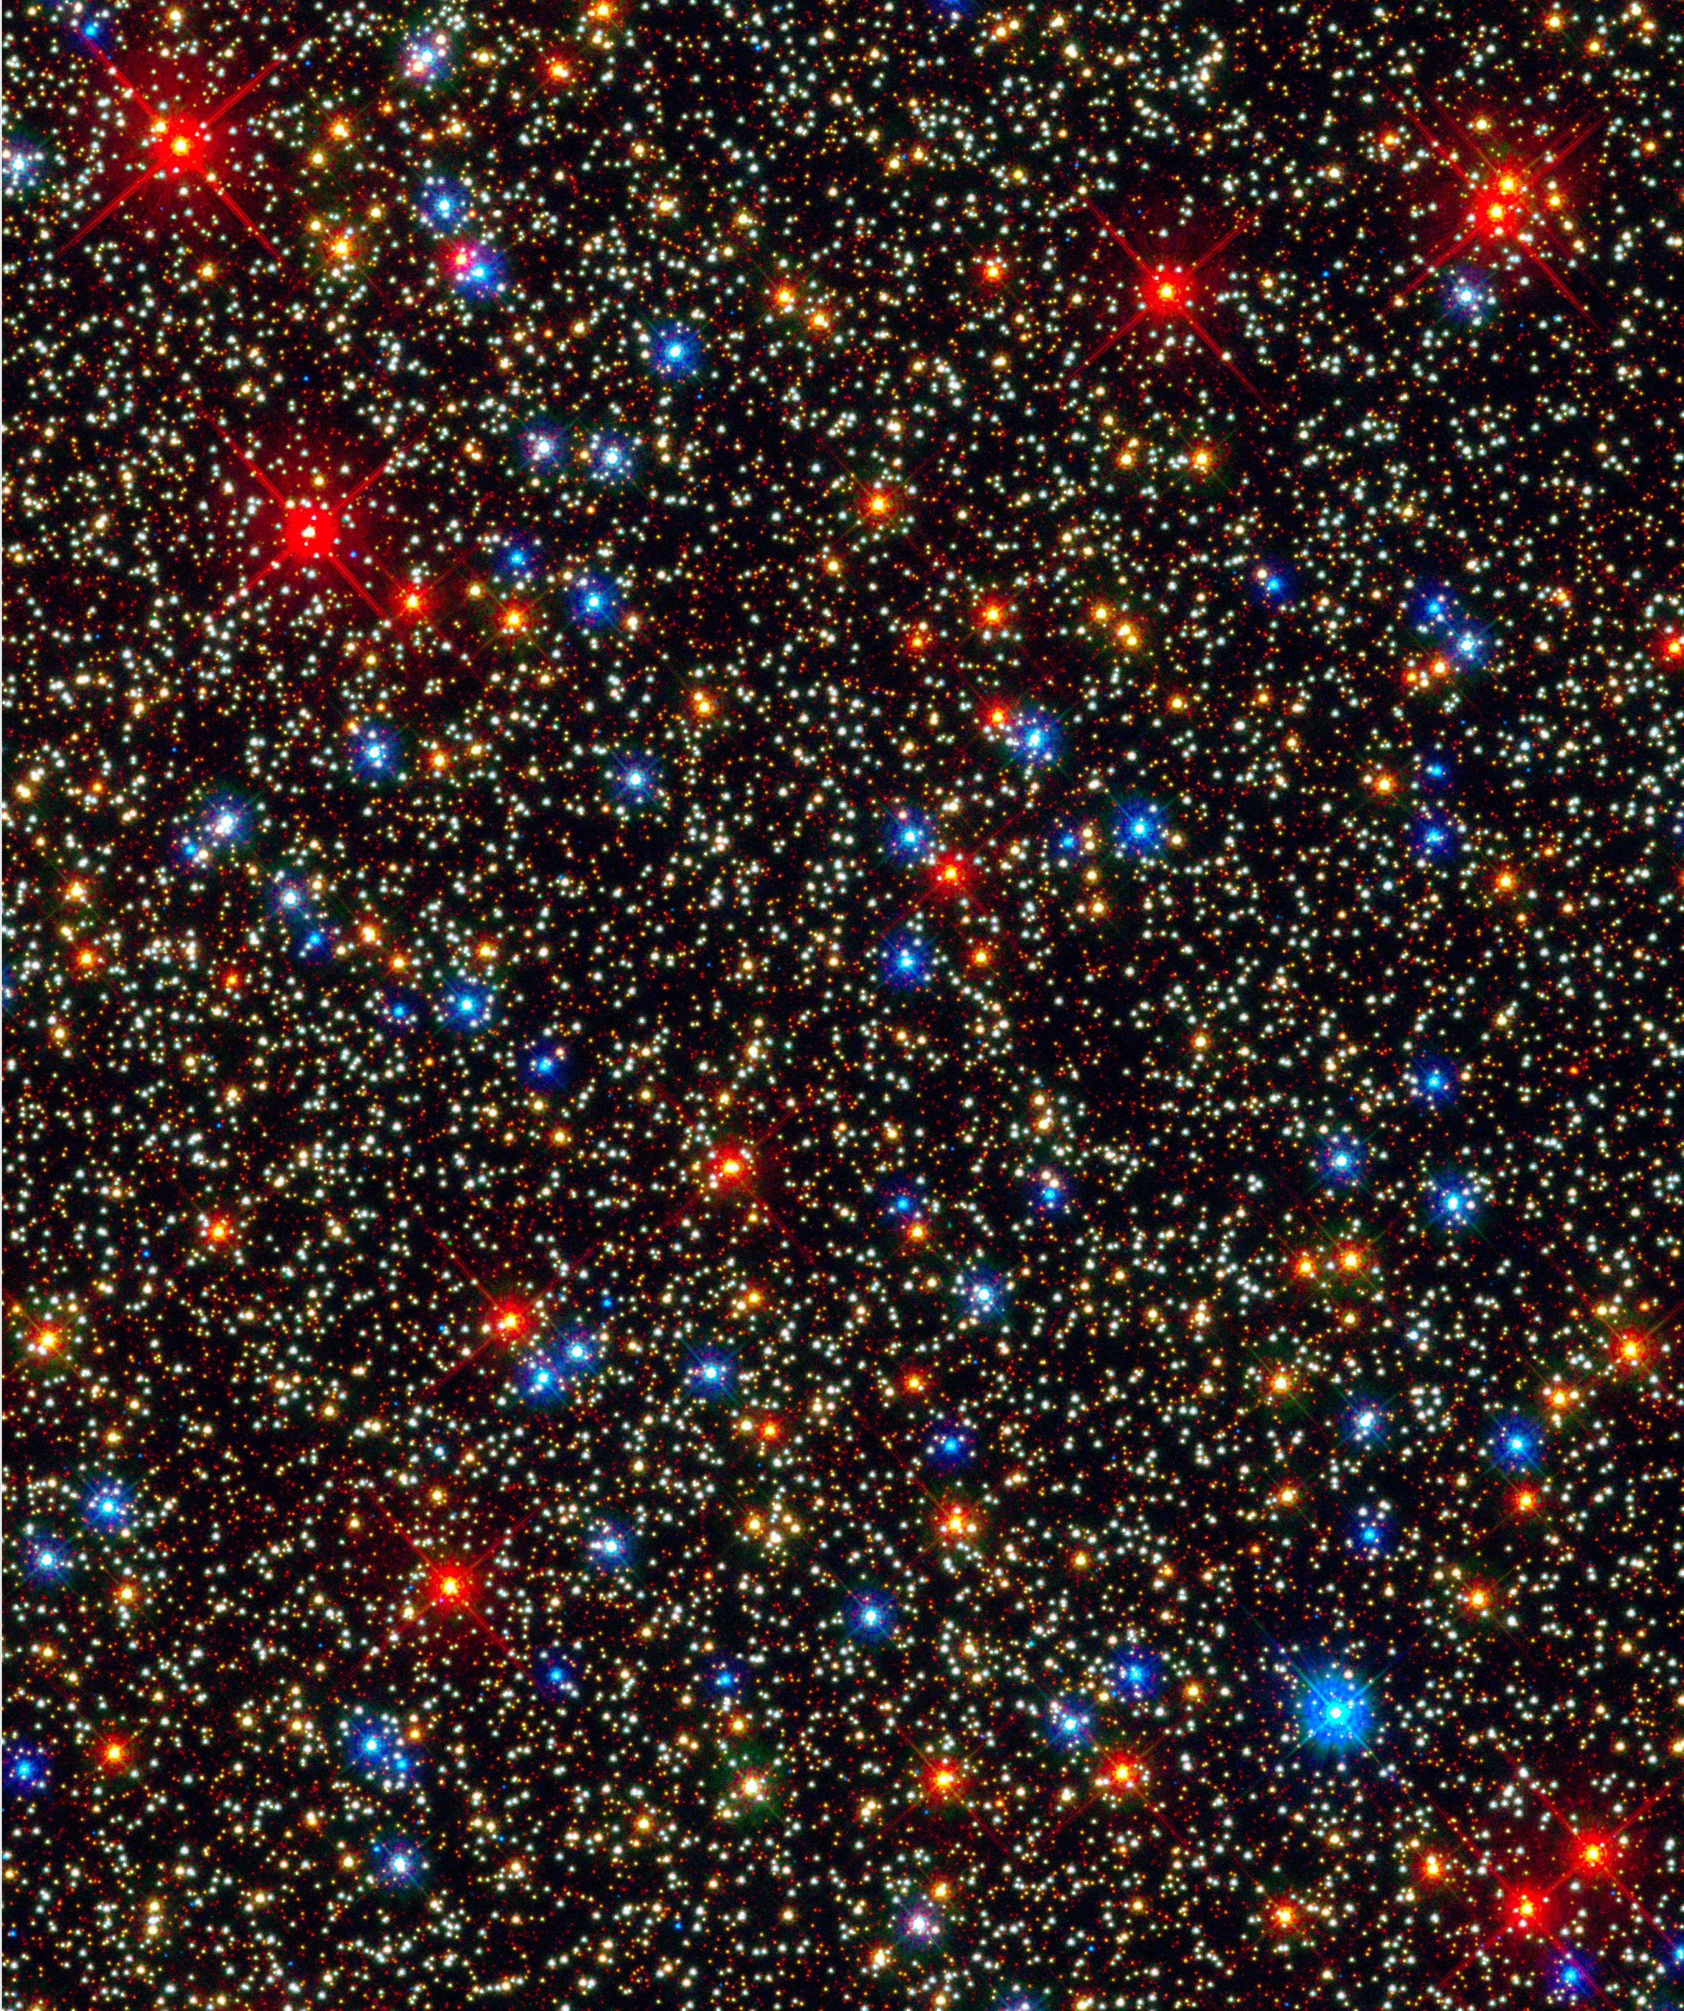
We testify, O my Lord, that Thou art God and that there is none other God besides Thee. From everlasting Thou wast enthroned on the inaccessible heights of Thy power, and wilt unto everlasting continue to exercise Thy transcendent and unrestrained dominion. The hosts of the world are powerless to frustrate Thy will, nor can all the dwellers of the earth and all the inmates of heaven annul Thy decree. Thou truly art the Almighty, the Most Exalted, the Most Great.
Bahá’u’lláh
Prayers and Meditations, p. 44

Slide 13
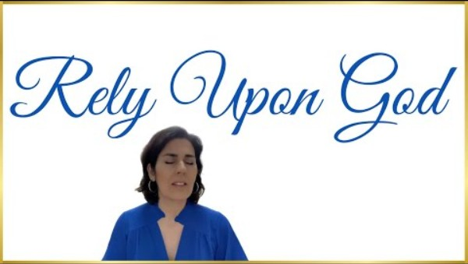
https://www.youtube.com/watch?v=lWWgRoQp9r8

Slide 14
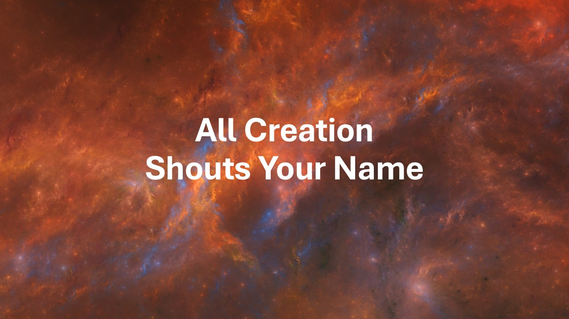
https://www.youtube.com/watch?v=3tGyzGIOYIQ

